Slide 2
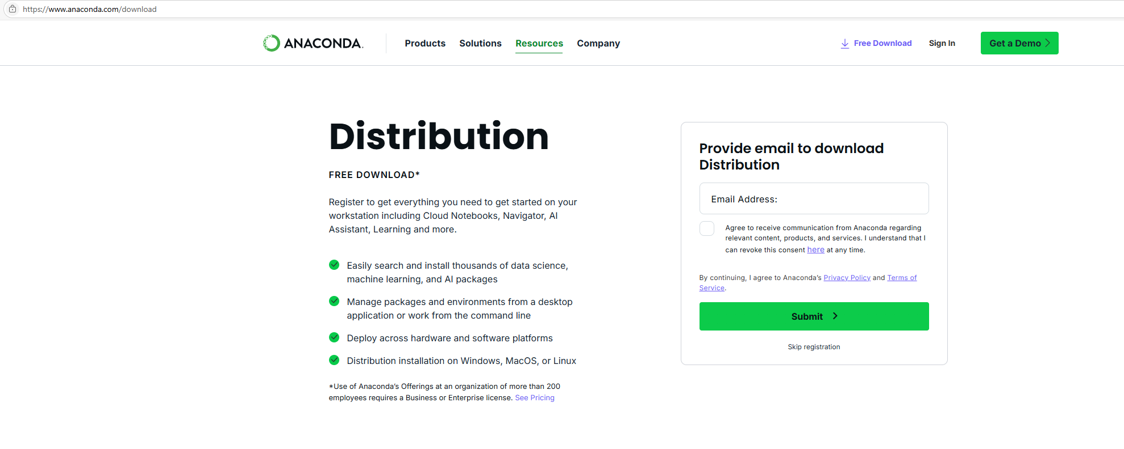
Go to https://www.anaconda.com/download
Register or click Skip registration

Slide 3


Download the Distribution installer for your OS
We tested on Windows and Mac (Apple Silicon)

Slide 4
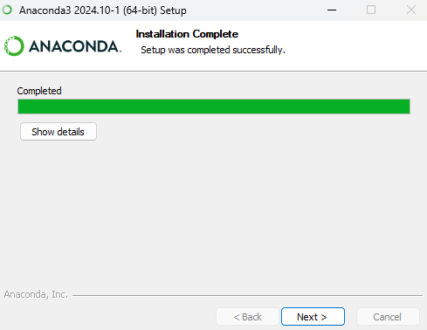
Go through the installation steps
Press continue, continue, agree, install (Mac) or next, agree, next, install (Windows)
You don’t need to change any option
Don’t start the navigator or knowledge base

Slide 5


Open the Anaconda Prompt

Slide 6
Execute this command in the Anaconda prompt by copying it from here and right clicking in the Anaconda prompt and pressing enter:
conda install -c anaconda git
Press enter when asked to proceed
Go in the prompt to the location where you want to store the conversion script
This is how you go to your Documents folder:
cd Documents
There you copy this command:
git clone https://github.com/ariken-research/convert_clinical_trial_gov_to_spss
Go in the prompt in the convert_clinical_trial_gov_to_spss that just has been created
cd convert_clinical_trial_gov_to_spss
(Tip: type ‘cd conv’ and press tab)

