Slide 1
Installation

Slide 2
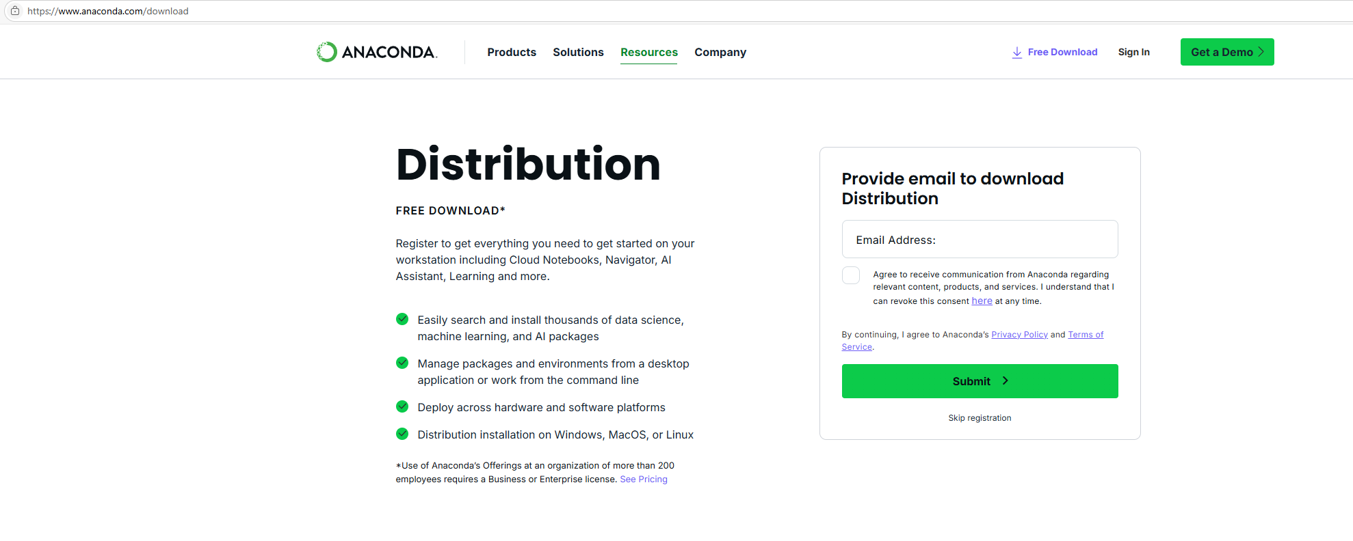
Go to https://www.anaconda.com/download
Register or click Skip registration

Slide 3
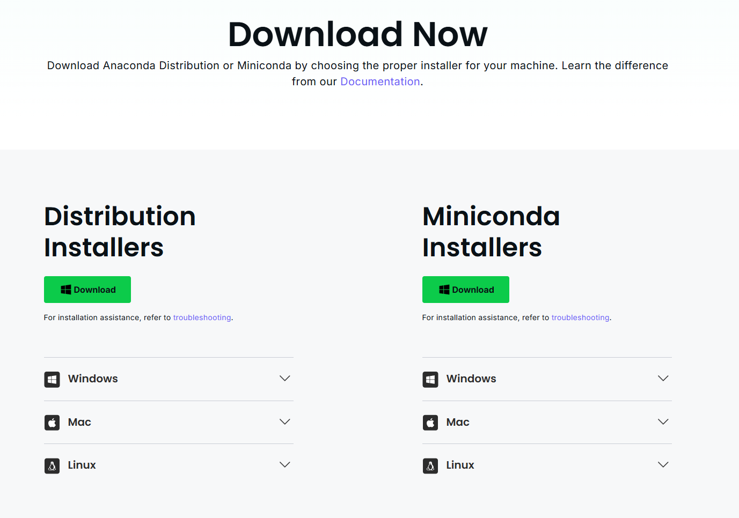
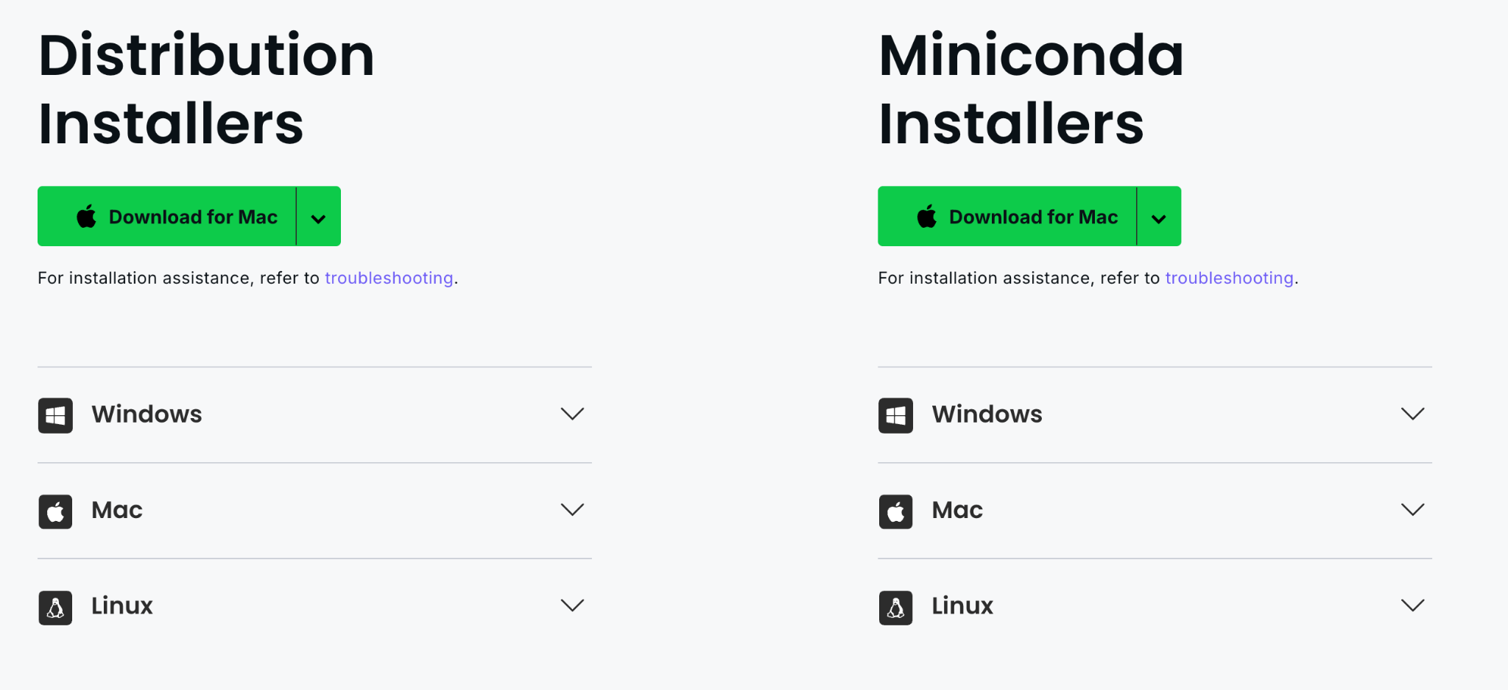
Download the Distribution installer for your OS
We tested on Windows and Mac (Apple Silicon)

Slide 4
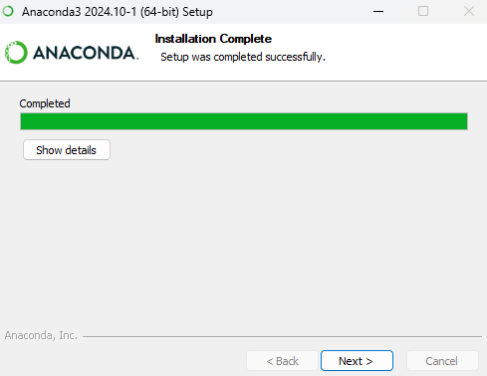
Go through the installation steps
Press continue, continue, agree, install (Mac) or next, agree, next, install (Windows)
You don’t need to change any option
Don’t start the navigator or knowledge base

Slide 5
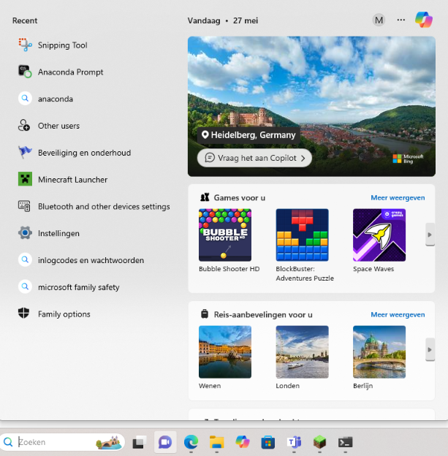

Open the Anaconda Prompt

Slide 6
Change your directory to the convert_clinical_trial_gov_to_spss directory in the Anaconda prompt
Tip:
Go in explorer to the parent directory of the convert_clinical_trial_gov_to_spss directory and right click on the convert_clinical_trial_gov_to_spss directory and use the “copy as path” option
Then go in the anaconda prompt and type “cd “, right click in the prompt and press enter
Configure and install the necessary conda environment with this command:
conda env create -f conda_env.yml

Slide 7
Usage

Slide 8
Change your directory to the convert_clinical_trial_gov_to_spss directory in the Anaconda prompt
Tip:
Go in explorer to the parent directory of the convert_clinical_trial_gov_to_spss directory and right click on the convert_clinical_trial_gov_to_spss directory and use the “copy as path” option
Then go in the anaconda prompt and type “cd “, right click in the prompt and press enter
Activate the necessary conda environment with this command:
conda activate ctg_to_spss
Ensure you have an ‘inputs’ sub-directory with the two following files:
ctg-studies.json
variables.json
Run the conversion script with this command:
python convert_excel_to_spss.py
You should now have two new sub-directories:
outputs
debug_outputs
The SPSS file can be found in the ‘outputs’ directory with the following name:
outputs/ctg-studies.sav

