Slide 1



Federal Air Marshal Misconduct
View in Power BI
Last data refresh:
4/30/2020 12:29:54 PM Central Standard Time
Downloaded at:
4/30/2020 1:55:03 PM Central Standard Time

Slide 2
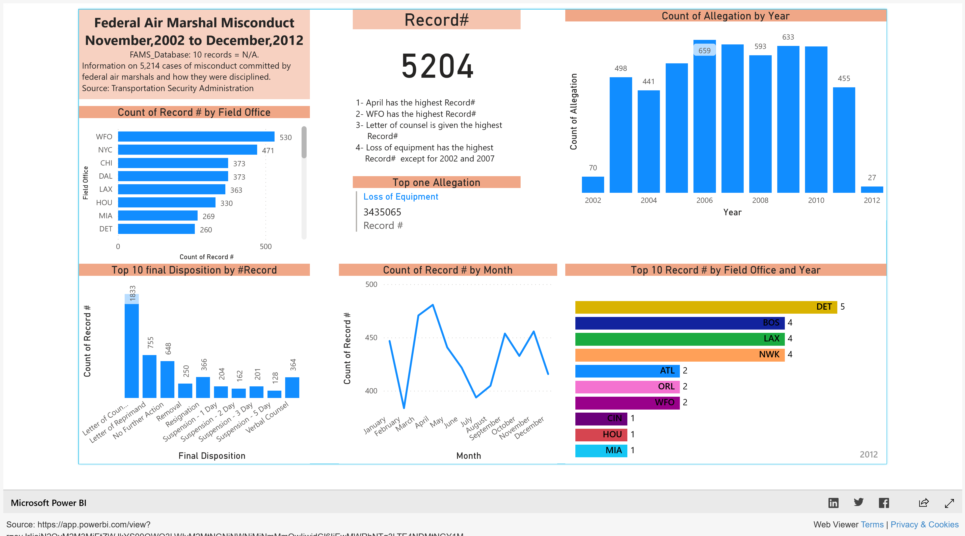

Slide 3


Questions

