Slide 1
BROWSER-X
Team Id:BR1125
Members:-
Arihant Jain
Bhavishya Mittal
Javesh Garg

Slide 2
Choice of browser
Why Google-Chrome?
This was a question that confused us a lot in the beginning(chrome vs firefox), but after a lot of infotainment we finally settled for chrome.
The main reason for discarding Firefox is that because after each new version, it tends to stutter at lesser number of opened tabs(800+ tabs in firefox 3.0 while just 90+ in firefox 4.0) .

Slide 3
About Tab Switchy….
Tab Switchy is a Google-Chrome extension developed by us .
This extension comes under the category of “Utilities” as per the marketing standards.
The extension caters to the needs of both ‘heavy as well as light users’ – the distinction based on the number of tabs opened and the length of a particular session.
The extension has various option as enumerated below:
It shows all the current tabs and helps user to navigate(switch) between the tabs.

Slide 4
About Tab Switchy….
It shows all the tabs closed in the current session and reopens them with just one click.
It also has the feature of bookmarking several tabs at a time and also clubbing them under a common name(super-tab).
This adds a new dimension in the browsing experience, giving the user the power to play with tabs.

Slide 5
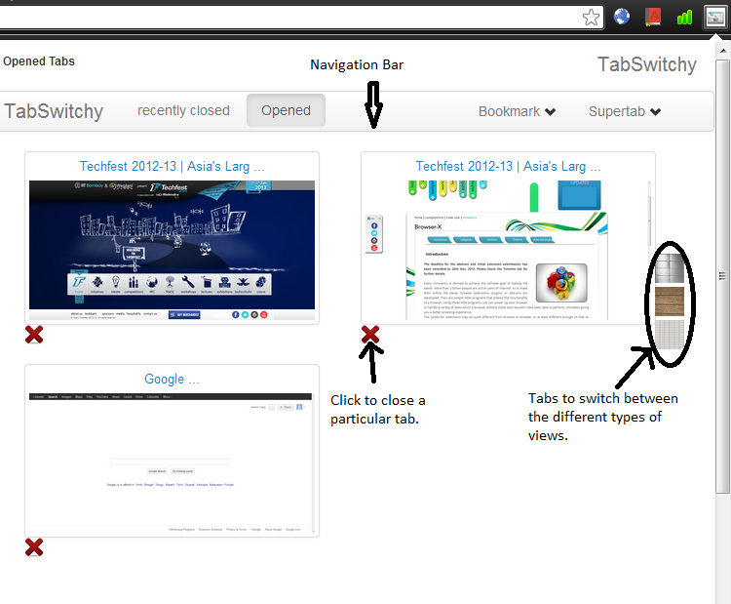

Slide 6
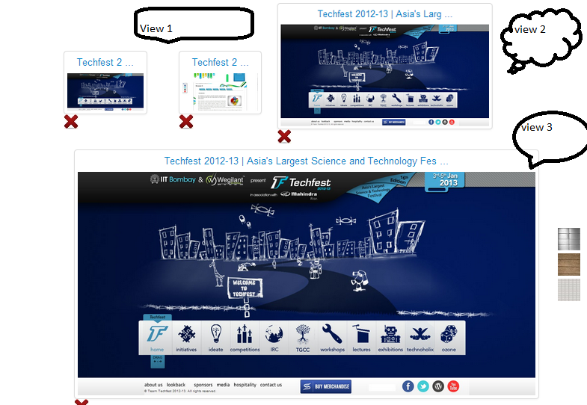

Slide 7
Why this??
The extension helps user to manage the currently opened tabs and navigate between the pages effectively.
The pictorial view and complete title of the page is displayed which helps to identify the correct tab one wants to switch to without fail(as against normal viewing when no information like title etc is available on tabs.).
The user has the freedom to choose any view of his choice to view the currently opened tabs viz. small view, tiling or horizontal placement.

Slide 8
Why this??(cont.)
The user can also close any tab from the extension also.
This helps reduce excess load on the CPU as unwanted tabs are closed as they come to the limelight due to the extension’s fine display.(otherwise user does not easily gets to notice that so many unwanted tabs are also opened.).

Slide 9
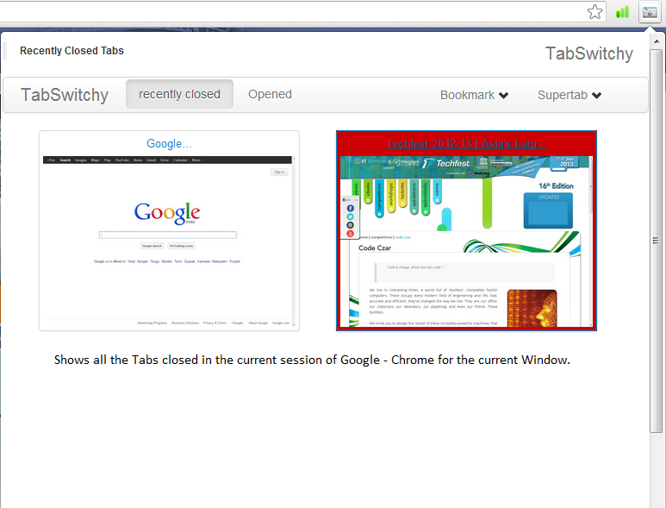

Slide 10
Why this?? (cont.)
Another important feature is that it shows all the closed tabs in the present browsing session , helping the user to easily identify whenever a tab needs to be reopened.
It diminishes the cognitive distinction between closed-preserved and open tabs. Therefore, there will be no substantial difference between closed or open tabs, and because of this, there will be no desire to keep them all open anymore!!!

Slide 11
Why this?? (cont.)
Actually, we are keeping tabs open most of the time not because we need them continuously, but because we want them to stay open to remind us about something unfinished, or about some thought related to them.
This saves us a lot of RAM and CPU resources also.
Another feature that increases the effectiveness of the browser as it helps user to bookmark more than one tab at a time!

Slide 12
Why this?? (cont.)
It also gives the facility to user to bookmark various tabs of their choice and also group them under a common folder name (if required).
The Bookmark feature also allows user to bookmark the tabs having the same Base URL ( Eg: various ‘facebook’ pages under one folder and Wikipedia searches of a particular topic into another.).

Slide 13
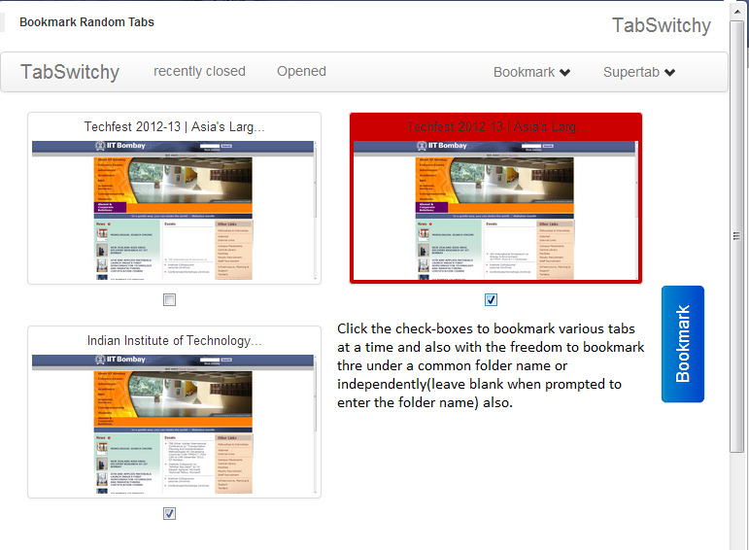

Slide 14
Why this?? (cont.)
Similarly , a new feature of a SUPER TAB has been included to give more powers to the user.
This allows the user to segregate different tabs on the basis of any condition as user decides such as priority of tabs, tabs related to some article or project etc.
Also, the URL’s having the same ‘baseurl’ are segregated under one ‘supertab’ automatically.(eg:- all ‘facebook’ pages are segregated under www.facebook.com name and all pages of the type google are segregated under a separate supertab named www.google.com .

Slide 15
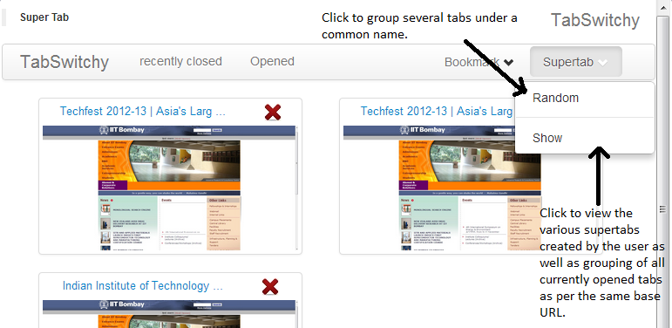

Slide 16
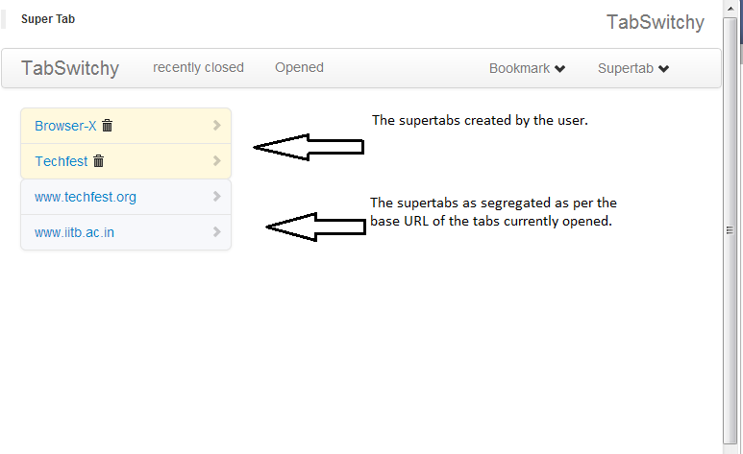

Slide 17
uniqueness
This is a first-of-a-kind extension for Google Chrome giving various features of tabs navigation , history tracking and bookmarking – all packed into a single extension.
The user has the freedom to choose which view of currently opened tabs to choose depending on the number of tabs opened or any other personal taste.
The idea of creating a “supertab” for segregating tabs is one of its kind.

