Slide 1
Target Acquisition/Image Processing
Arik Intenam Mir- Image Processing and Target Acquisition Engineer
4th Year, Bachelors of Engineering(Hons.)

Slide 2
Scope:
Using the Raspberry Pi camera module to capture imagery data
Transmitting imagery data from the Pi to the GCS
Implementing system for successful identification and detection of targets from the environment
Sending data of the detected targets to the Web Interface subsystem located at GCS.
System Requirements:
[REQ-M-03]: The UAVPayloadTAQ shall communicate with a ground station computer to transmit video, target detection and air quality data.
[REQ-M-04]: The target identification system shall be capable of alerting the GCS of a targets type.
[REQ-M-08]: Preliminary designs shall be completed by week 7.
[REQ-M-10]: Developed solution shall conform to the systems engineering approach.
[REQ-M-12]: The UAVPayloadTAQ shall process all imagery data on-board via the on-board computer.
[REQ-M-13]: The processing must be able to analyse all data from the flight path while the UAV moves at a maximum speed of 1m/s.
[REQ-M-14]: The processing must be able to analyse all data from the flight path while the UAV operates at an altitude of 2m.
Introduction
The target acquisition and image processing subsystem serves the purposes of capturing imagery data via the Raspberry Pi camera module and process data to identify targets and to finally transmit the output to the GCS.
Subsystems Work Package brunch
WP-TAIP-01: Develop Raspberry Pi code that correctly identifies and processes targets while alerting GCS of the target type(sourced from: HLO2 and Req 4, Req 12)
WP-TAIP-02: Connect and calibrate camera component ready for images to be taken whenever a target is identified(sourced from: HLO2 and Req 6)
WP-TAIP-03: Construct code that will send photos of target to GCS(sourced from: HLO2 and Req 6)
WP-TAIP-04: Test subsystem operates successfully for 10 minutes minimum(sourced from: HLO2 and Req 11)
WP-TAIP-05: Test subsystem operates successfully at a speed of 1m/s and altitude of 2m(sourced from: HLO2 and Req 14)

Slide 3
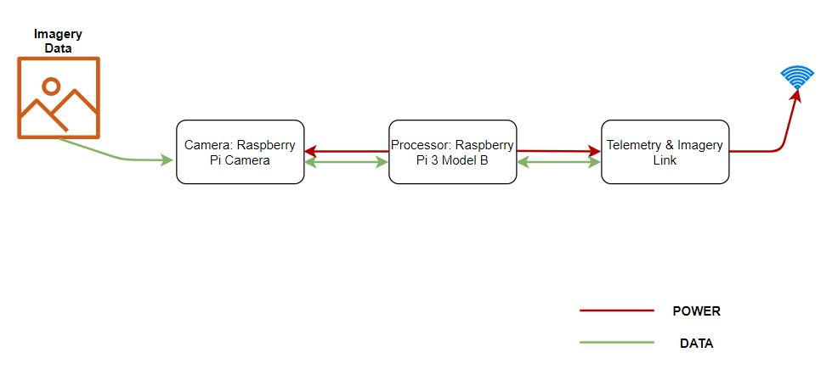
Subsystem Architecture

Slide 4
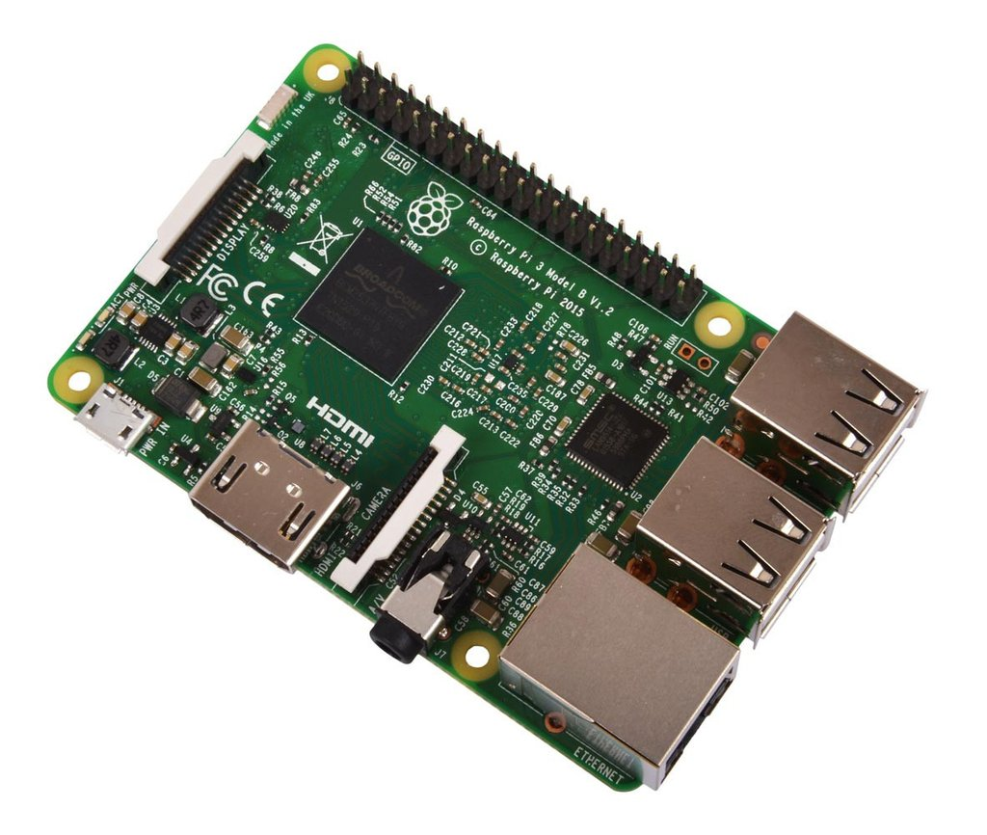
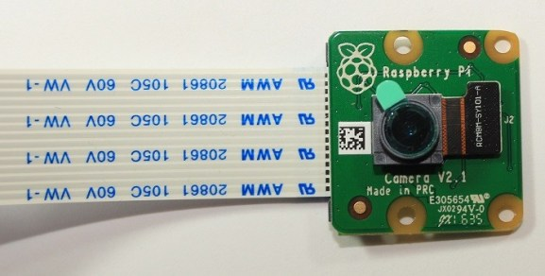
Subsystem Hardware
Fig: Raspberry Pi 3 Model B
Fig: Raspberry Pi Camera module
Very lightweight
Sensor Resolution: 3280 x 2464 pixels
Focal Length: 3.04mm
Video mode: 1080p30, 720p60 & 640x480p60/90
Physical connection type: CSI camera connector socket
Horizontal field of view: 62.2 degrees
Vertical field of view: 62.2 degrees
Lightweight
Reasonable in price
CPU: Quad Core 1.2GHz Broadcom BCM2837 64bit CPU
RAM: 1GB SDRAM
Storage: Micro SD
USB: 4 USB 2 ports
Instruction Set: ARMv8-A

Slide 5


Subsystem Software Components
OpenCV
Raspberry Pi OS (32-bit) Lite
Minimal lightweight OS for Raspberry Pi, doesn’t have the X-server window manager, and fewer modules.
Login via SSH over the local Wi-Fi network using IP address.
Supports command-line operations.
Open source computer vision machine learning software library.
Contains tools for Aruco marker detection.
Implementation of Cascade Classifier.
Programming language Python is used to operate.

Slide 6
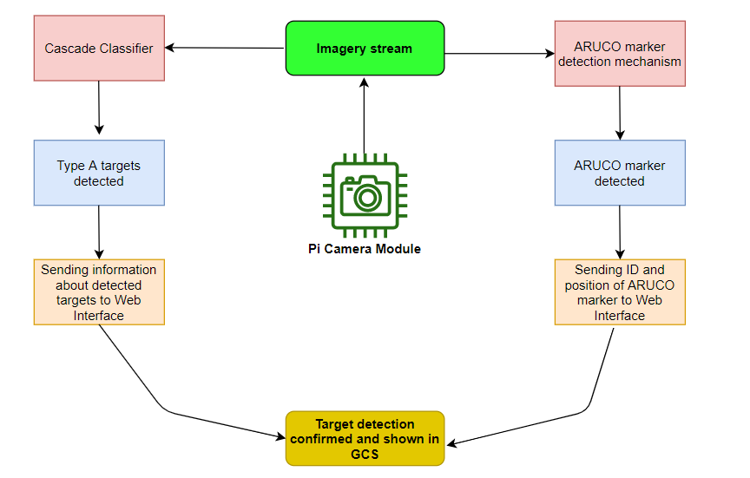
Target Acquisition Flow Chart
Fig: Flow Chart for Target Acquisition mechanism

Slide 7
Subsystem Tests
Component | Hardware Condition | Cable Connection Condition
Raspberry Pi 3 Model B | Good | Good
Raspberry Pi Camera Module V2.1 | Good | Good
USB to Serial Cable | Good | Good
Hardware Tests:
Visual inspection of hardware
Hardware and cable connection condition
Software Tests:
Raspberry Pi OS Lite flashed and installed
OpenCV installed
SSH and Camera module enabled
Added the extra packages for capturing and images.
Software /Modules Installed | Functionality
Raspberry Pi OS Lite | Yes
OpenCV | Yes
SSH and Camera Module | Yes
Target Detection mechanism | Yes (partially)

Slide 8
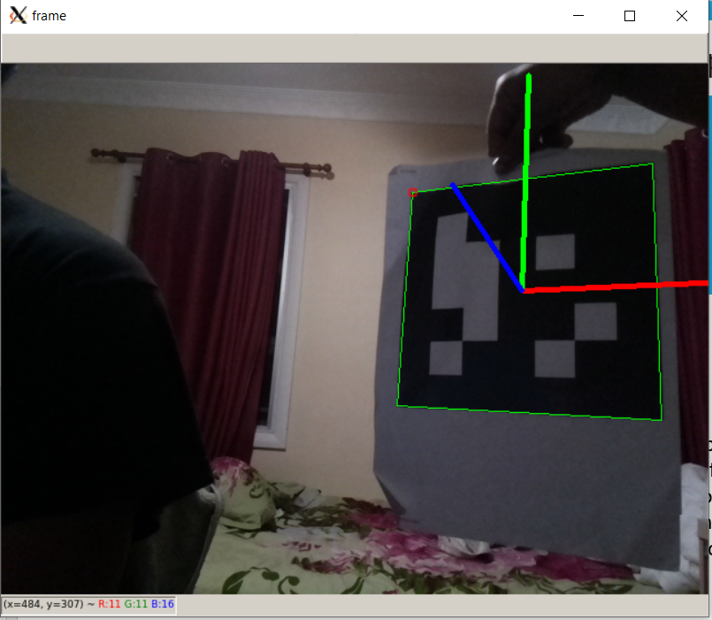
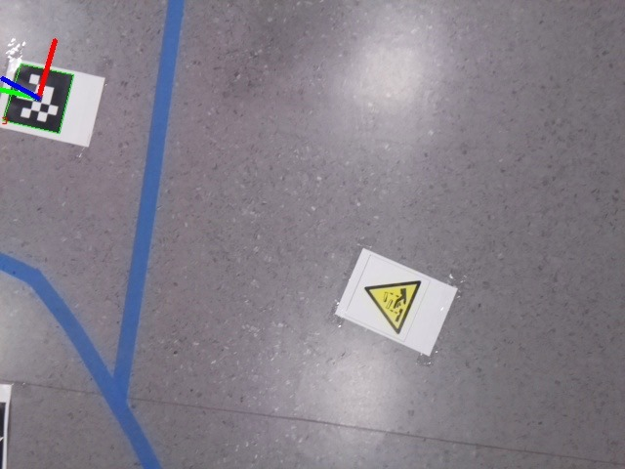
Results for Target Acquisition
Fig: ARUCO marker detected during demo
Fig: ARUCO marker detected

