Slide 1
Diagrams

Slide 2
Categories of diagrams
Conceptual / Logic / Physical
Structural / Behavioral

Slide 3
Conceptual diagram
Describes the real world domain
Describes the problem – NOT the solution
Based on entities

Slide 4
Logical diagrams
Describes what we want to build
Shows solutions
Based on entities AND requirements
Can have datatypes
May indicate a category of languages to be used, but preferably not a specific language

Slide 5
Physical
Shows the solution as it have been build or as it is about to be build
Is tailor-made to a specific language
Deals with constraint in the language
Should have 100% traceability to the code!

Slide 6
Structural diagrams
Static
Shows how the system is build (or will be build)
Typically broad scope and low on details
Example: Domain models

Slide 7
Behavioral diagrams
Dynamic
Shows what the system does
Typically narrow scope and high on details
Example: Sequence diagrams

Slide 8
Class diagrams
Domain model
Design class diagram (for design – before code)
Design class diagram (for documentation – after code)

Slide 9
Sequence diagrams
System Sequence Diagrams
(Design) Sequence Diagrams

Slide 10
Other artifacts
State diagrams (We use them to show navigation)
Requirements
Costumer vision
Sales rep. requirements specification
Project manager technical requirements specification

Slide 11
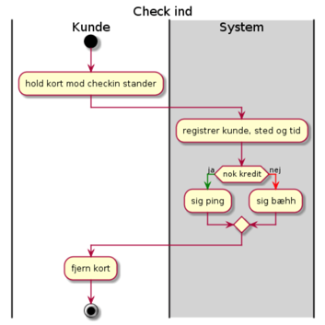
Navigation diagram
Use swimlanes in PlantUML

