Slide 1
Activity diagrams
Larman Chapter 28

Slide 2
Make a quick research:
How can we use them?
What is the most common usage of activity diagrams?

Slide 3
Drawing Activity Diagrams
Purpose:
– to model a business process
– to describe a function of a system represented by a use case
– to describe the logic of an operation
3

Slide 4
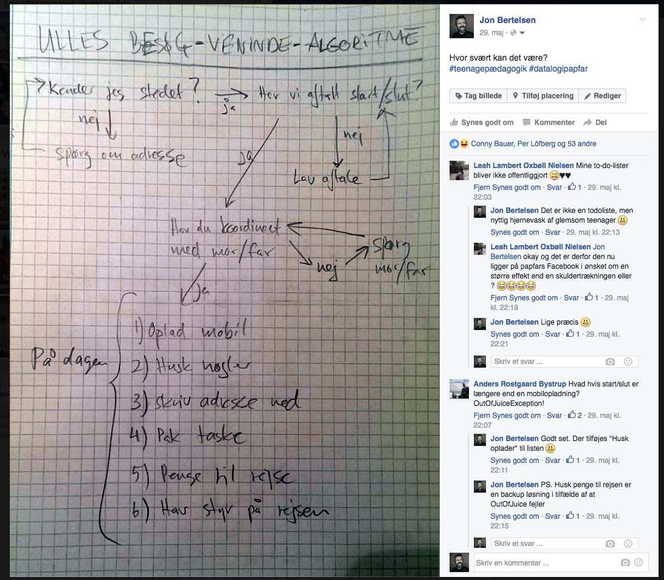

Slide 5
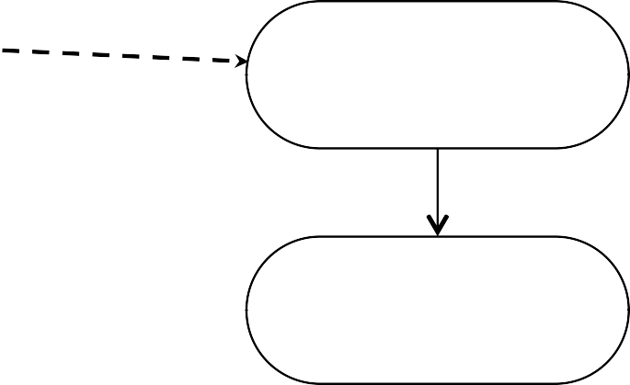
Notation of Activity Diagrams
• Activities
– rectangle with rounded ends
– meaningful name
• Transitions
– arrows with open arrowheads
Add a New Client
Assign Staﬀ Contact
4

Slide 6

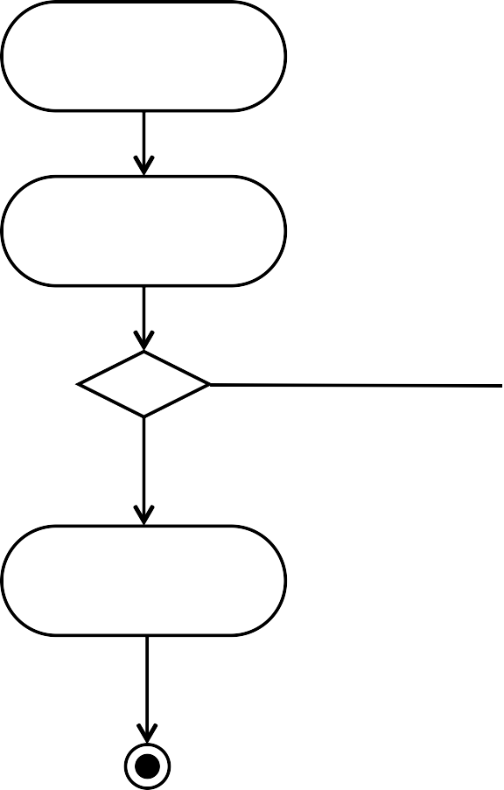
Notation of Activity Diagrams
• Start state
– black circle
• Decision points
– diamond
• Guard conditions
– in square brackets
• Final state
– black circle in white circle
Add a New Client
Assign Staﬀ Contact
[no campaign to add] [campaign to add]
Add New Campaign
5

Slide 7



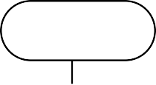


Notation of Activity Diagrams
• Swim lanes
– vertical columns
– labelled with the person, organisation or department responsible for the activities in that column
Campaign
Accountant
Client
Manager
Record Comple=on
of a campaign
Issue invoice
Pay invoice
Record client
payment
6

Slide 8
Drawing Activity Diagrams
• Are all the activities carried out by the same person, organisation or department?
• If not, then add swim lanes to show the responsibilities
• Name the swim lanes
• Show each activity in the appropriate swim lane
7

Slide 9


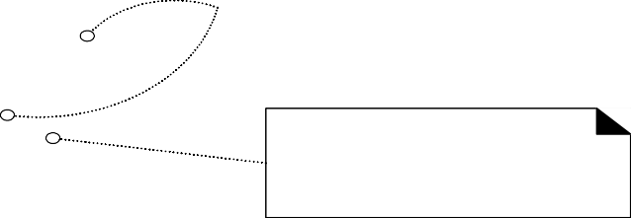
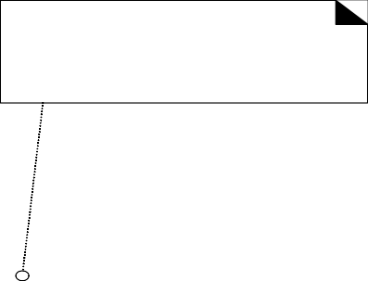



Activity diagrams with forks and
object Nodes
Fulfillment
Partitions. Show different parties involved in the process
start
Customer Service
Finance
Action. It does something. There is an automatic transition on its completion.
Object Node. An object produced or used by actions. This allows us to model data flows or object flows.
Receive Video Order
A transition supports modeling of control flow.
Fork. One incoming transition, and multiple outgoing parallel transitions and/or object flows.
Fill Order
Send Invoice
Invoice
Order
Deliver Order
Receive Payment
Join. Multiple incoming transitions and/or object flows; one outgoing transition.
The outgoing continuation does not happen until all the inputs arrive from all flows.
Close Order
end of activity

Slide 10
Sub-activity diagrams
Fill Order
the “rake” symbol (which represents a hierarchy) indicates this activity is expanded in a sub-activity diagram
Deliver Order

Slide 11
Sub-activity diagrams
Deliver Order
Decision: Any
branch happens. Mutual exclusion
[ else ]
[ rush ]
Deliver Regular
Deliver Rush
Merge: Any input leads to continuation. This is in contrast to a join, in which case all the inputs have to arrive before it continues.

Slide 12
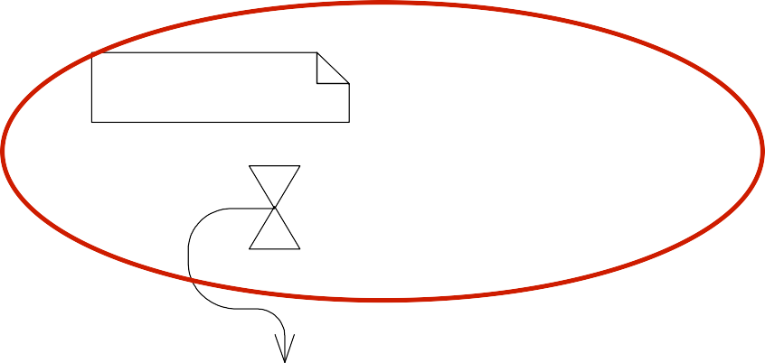
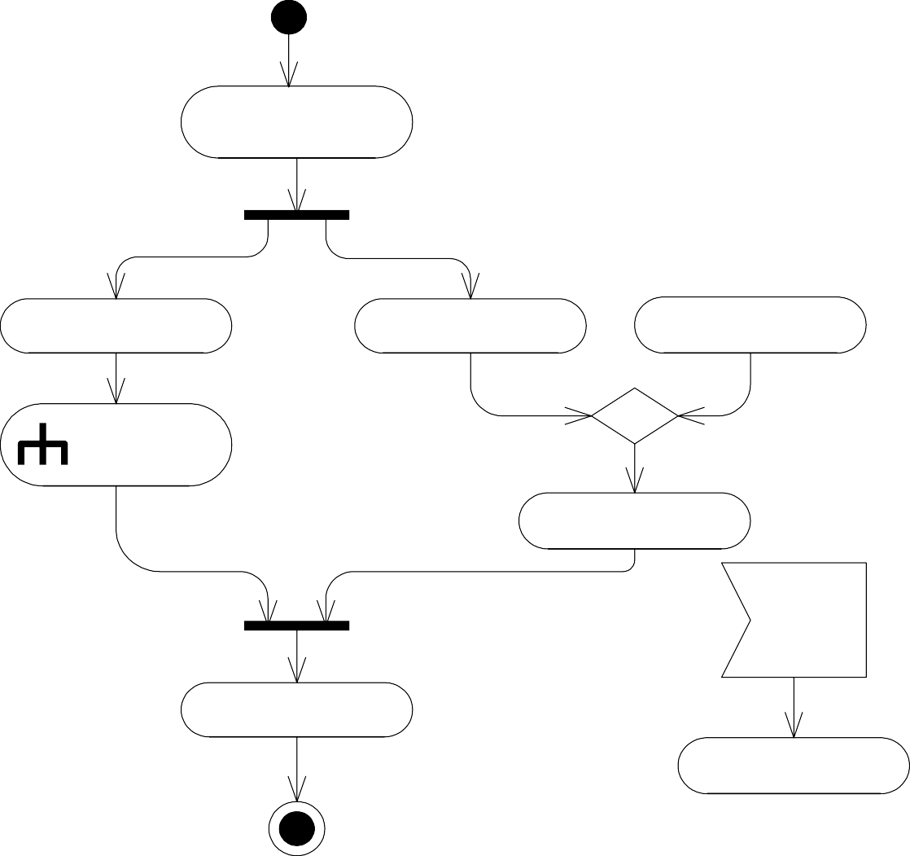
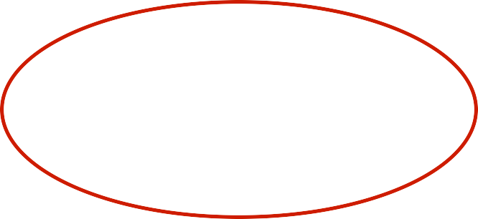
More UML Activity Diagram notation
A time signal
Receive Video Order
30 days since sent last invoice, and no payment received
Fill Order
Send Invoice
Resend Invoice
Deliver Order
Receive Payment
Cancel request
Accept a signal
Close Order
Cancel Order

Slide 13
Process sale use case
Customer
Cashier
NextGen POS
Authorization Service
Shop and Fill
Cart
Cart
Enter Cart Items
Calculate Taxes
and Discounts
[ cash payment ]
[ else ]
Submit Authorization
Request
Authorize Payment
Receipt
Create Receipt
Hand Over Items

