Slide 1


July 2023
TECHNOLOGY CATALOGUE

Slide 2
TECHNOLOGY TECHNOLOGYTECHNOLOGYTECHNOLOGYTECHNOLOGYTECHNOLOGYTECHNOLOGYTECHNOLOGYTECHNOLOGYTECHNOLOGYTECHNOLOGYTECHNOLOGYTECHNOLOGY
WELCOME!
TECHNOLOGY CATALOGUE
This catalog contains a list of technologies used by bank as a reference in developing solutions and operating bank services.

Slide 3
TECHNOLOGY TECHNOLOGYTECHNOLOGYTECHNOLOGYTECHNOLOGYTECHNOLOGYTECHNOLOGYTECHNOLOGYTECHNOLOGYTECHNOLOGYTECHNOLOGYTECHNOLOGYTECHNOLOGY
TABLE OF CONTENTS
Change Log
Infographic
Technology Adoption Criteria
IT Service Support Type
Technology domain
Technology List
Deprecated Technology List

Slide 4
TECHNOLOGY TECHNOLOGYTECHNOLOGYTECHNOLOGYTECHNOLOGYTECHNOLOGYTECHNOLOGYTECHNOLOGYTECHNOLOGYTECHNOLOGYTECHNOLOGYTECHNOLOGYTECHNOLOGY
CHANGE LOG
TECHNOLOGY CATALOGUE
Newly Added Technology:
This catalog contains a list of technologies used by bank as a reference in developing solutions and operating bank services.
TECH_ID | TECH_NAME | OWNER | VERSION_N
in-itg-soa-016 | Axway Policy Studio | COS INTEGRATION | 7.7

Slide 5
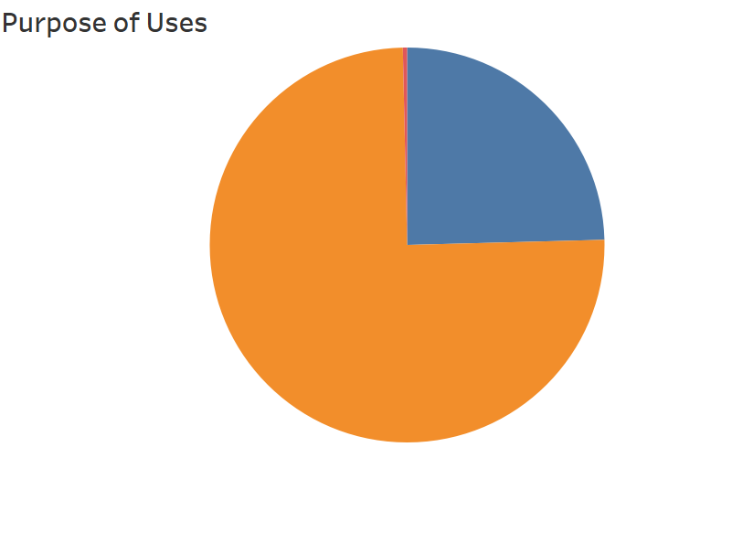
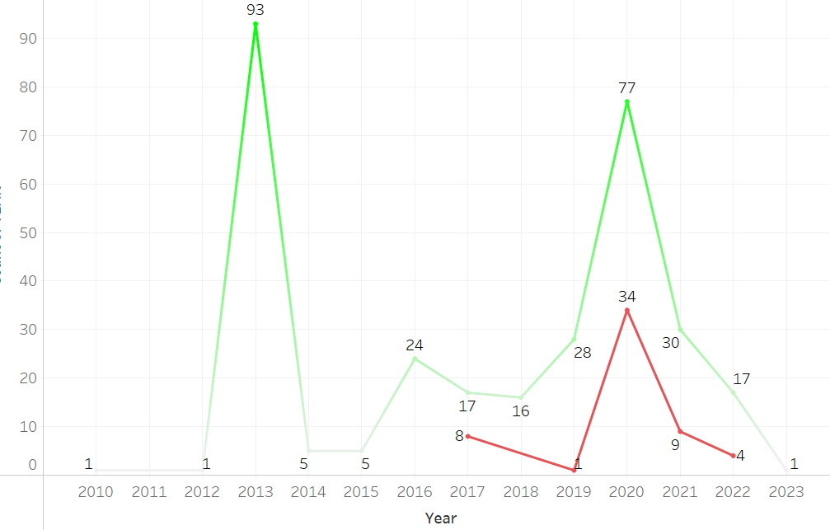
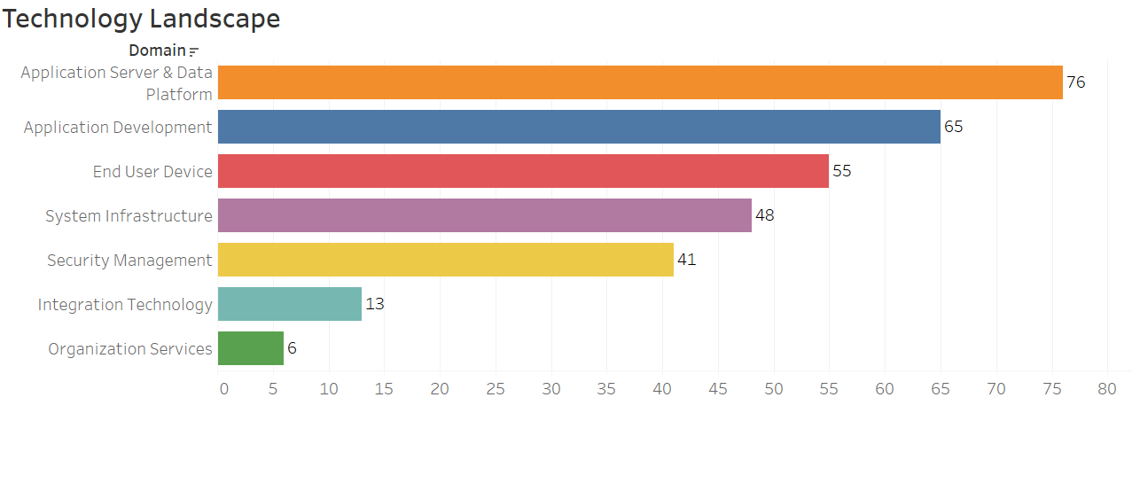
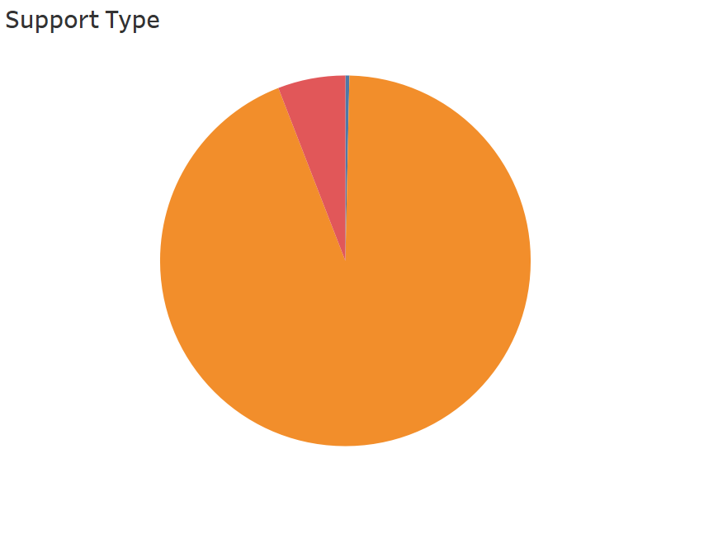
Testing
0,35%
Purpose of Uses
Development
25,26%
Total Active Tech
303 Technology
Total Deprecated Tech
62Technology
Most of the technology is used for the process of configuration and operation bank services
Non-Development
74,39%
The Most Active Tech Domain
Tech growth every year
On 2020 are the most adoption rate.
Annual review of Technology Standard perform every Q4
79
67
55
42
39
All Tech Support Type
XX
5,65%
DO
2,66%
14
Most of the technology used can be operated(installation, and configuration) by the IT team, but is not committed to having expertise to do development
Top 3 Technology Domain:
Application Server & Data Platform
Application Development
End Users Device
XO
91,69%

Slide 6
TECHNOLOGY TECHNOLOGYTECHNOLOGYTECHNOLOGYTECHNOLOGYTECHNOLOGYTECHNOLOGYTECHNOLOGYTECHNOLOGYTECHNOLOGYTECHNOLOGYTECHNOLOGYTECHNOLOGY
TECHNOLOGY ADOPTION CRITERIA
Criteria | Description
Technology Adoption Around the World | Asses the level of technology adoption around the world. How the technology used around the world to solve every cases
Organization Profile and Support | Asses the reputation of organization/foundation who being a backer or main sponsor.
Technical Quality & Performance | Asses the technical quality of the technology and its compliance to regulation and industry standards.
Cost & License Model | Evaluate license schema whether enterprise, community or Opensource. For Opensource: Asses whether technology use permissive (no copyleft), weak copyleft or strong copyleft license model.
Internal Acceptance | Perceived Usefulness (PU): The degree to which person (BTPN) believes that using a particular tech would enhace job performance. Perceived Ease of Use (PEOU): The degree to which a person (BTPN) believes that using a particular system would be free from effort

Slide 7
TECHNOLOGY TECHNOLOGYTECHNOLOGYTECHNOLOGYTECHNOLOGYTECHNOLOGYTECHNOLOGYTECHNOLOGYTECHNOLOGYTECHNOLOGYTECHNOLOGYTECHNOLOGYTECHNOLOGY
IT Service Support Type
Dev: Application development is creating new application, changing/modifying application functions/features, or bug fixing in applications.
Ops: Is the process of installing, configuring and operating technology services.
V: Internal BTPN have knowledge and expertise in using technology and are committed to maintaining the availability/capability of such expertise
X: Internal BTPN does not have or is not commited to having expertise in using a technology service
XO: Technology with XO support type has 3 levels internal support only for its operations while the development is supported by the third parties.
DO: Technology with the DO support type has the support from the internal team to do the dev, and has 3 levels. Also, operational activities are needed to run it.
XX: Technology with XX support type does not have internal support for both its development and its operations. Both require support from third parties.
Support Classification | Dev | Ops
DO | V | V
DX | V | X
XO | X | V
XX | X | X

Slide 8
TECHNOLOGY DOMAIN
Scope of Software Technology standards on IT services consist of:
Application Development Services
Organization Services
Application Server & Data Platform
Application Server & Data Platform
End User Device Services
End User Device Services
Integration Technology Services
Security Management Services
System Infrastructure Services

Slide 9
TECHNOLOGY LANDSCAPE
Scope of Software Technology standards on IT services consist of:
DOMAIN | CLUSTER | TECHNOLOGY_COUNT
 | Application Framework | 12
 | Design Tools | 6
 | Testing Framework | 17
 | Development Tools | 31
 | Utilities | 1
Application Server & Data Platform | Data Services | 29
 | Distributed Services | 4
 | Information Services | 16
 | Messaging Services | 5
 | Monitoring | 11
 | Transaction Services | 9
 | DevOps | 2
 | Document Collaboration | 2
 | CRM | 1
DOMAIN | CLUSTER | TECHNOLOGY_COUNT
 | Client Services | 42
 | End User Device Platform | 4
 | Endpoint & Mobile Security | 4
 | Information Service | 1
 | ITSM Platform | 1
 | Unified Endpoint Management | 3
 | Integration Services | 15
 | Collaboration Services | 3
 | HC System | 1
 | Software Asset | 2
Application Development
End User Device
Integration
Tech
Organization Services

Slide 10
TECHNOLOGY LANDSCAPE
Scope of Software Technology standards on IT services consist of:
DOMAIN | CLUSTER | TECHNOLOGY_COUNT
 | Application & Data Security | 9
 | Cloud Security | 4
 | DevSecOps | 1
 | Infrastructure Security | 15
 | Security Monitoring & Operation | 5
 | Security Services | 3
 | Threat & Vulnerability Management | 2
DOMAIN | CLUSTER | TECHNOLOGY_COUNT
 | Distributed Services | 6
 | Monitoring & Control | 14
 | Server Platform | 11
 | Server Virtualization | 2
 | Service Continuity | 2
 | Storage | 1
 | Unified Messaging | 1
 | Utilities | 2
 | Unified Communication | 2
Security Management
System Infrastructure

Slide 11
TECHNOLOGY TECHNOLOGYTECHNOLOGYTECHNOLOGYTECHNOLOGYTECHNOLOGYTECHNOLOGYTECHNOLOGYTECHNOLOGYTECHNOLOGYTECHNOLOGYTECHNOLOGYTECHNOLOGY
Technology List

Slide 12
APPLICATION DEVELOPMENT SERVICES
APPLICATION FRAMEWORK
SUB_CLUSTER | TECH_NAME | STATUS | VERSION_N | VERSION_N_1 | SUPPORT_TYPE
Application Framework | Node.js | A | 16.9.0 | 14.15.1 | XO
 | React Native | A | 16,6 | 0,6 | XO
 | Springboot | A | v2.x | v1.5.6 | XO
Application Framework | CodeIgniter | A | CodeIgniter 3.0.x |  | XO
 | Laravel | A | 6.x (LTS) | 5.x LTS | XO
 | vue.js | A | 2.x |  | XO
 | Apache Struts 2 | A | 2.x | NA | XO
PROTOTIPE LOGO 2
PROTOTIPE LOGO 2
PROTOTIPE LOGO 2

Slide 13
APPLICATION DEVELOPMENT SERVICES
APPLICATION FRAMEWORK
SUB_CLUSTER | TECH_NAME | STATUS | VERSION_N | VERSION_N_1 | SUPPORT_TYPE
Application Framework | OneCode | A | OneCode 3.0.x |  | XO
 | AngularJS | A | v7.10 | NA | XO
 | Express | A | NA | NA | XO
 | Quarkus | A | 2.7.2-FINAL | NA | XO
Web Content Development | HTML | A | HTML5 + JavaScript (ECMAScript 6) + CSS3 |  | XO
PROTOTIPE LOGO 2
PROTOTIPE LOGO 2
PROTOTIPE LOGO 2

Slide 14
APPLICATION DEVELOPMENT SERVICES
DESIGN TOOLS
SUB_CLUSTER | TECH_NAME | STATUS | VERSION_N | VERSION_N_1 | SUPPORT_TYPE
Design UI - UX | Zeplin | A | <GA version> | \N | XO
Design UI - UX | Figma | A | <GA version> | \N | XO
 | InVision | A | <GA version> | \N | XO
 | Marvel | A | <GA version> | \N | XO
Enterprise Architecture notation | Archi | A | Archi 4.x |  | XO
 | Archimate | A | Archimate 3.x |  | XO
PROTOTIPE LOGO 2
PROTOTIPE LOGO 2
PROTOTIPE LOGO 2

Slide 15
APPLICATION DEVELOPMENT SERVICES
DEVELOPMENT TOOLS
SUB_CLUSTER | TECH_NAME | STATUS | VERSION_N | VERSION_N_1 | SUPPORT_TYPE
Android Mobile Development | Java Android | A | <Android SDK sesuai OS> | <Android SDK sesuai OS> | XO
Development Tools | JavaScript | A | <sesuai web browser> | <sesuai web browser> | XO
 | IDE Webmethod | A | Webmethod Designer 10.3 |  | XO
Development Tools | Eclipse | A | <GA version> |  | XO
 | Outsystem Development Studio | A | Outsystem 11 Platform | Outsystem 10 Platform | XO
 | Dbeaver | A | 7.3.5 | 7.2.1 | XO
PROTOTIPE LOGO 2
PROTOTIPE LOGO 2
PROTOTIPE LOGO 2

Slide 16
APPLICATION DEVELOPMENT SERVICES
DEVELOPMENT TOOLS
SUB_CLUSTER | TECH_NAME | STATUS | VERSION_N | VERSION_N_1 | SUPPORT_TYPE
Development Tools | Intelij | A | Community 2018 |  | XO
 | Liquibase | A | 3.x | 2.x | XO
 | Notepad++ | A | 7.7.x |  | XO
 | Oracle SQL Developer | A | <GA version> |  | XO
Development Tools | Powercurve Strategy Design Studio | A | 2,7 | \N | XO
 | SQL Server Management Studio | A | <GA version> | 17.x | XO
 | Visual Studio Code | A | 1.62.2 | 1.49.1 | XO
 | Quartz Scheduler | A | v2.3 | NA | XO
 | Eclipse IDE | A | 4.21.0 | 4.12.0 | XO
PROTOTIPE LOGO 2
PROTOTIPE LOGO 2
PROTOTIPE LOGO 2

Slide 17
APPLICATION DEVELOPMENT SERVICES
DEVELOPMENT TOOLS
SUB_CLUSTER | TECH_NAME | STATUS | VERSION_N | VERSION_N_1 | SUPPORT_TYPE
Database/ SQL Programming | GraphQL | A | 19.2 |  | XO
 | jBasic | A | v5.1 | NA | XO
Database/ SQL Programming | PL/SQL | A | <Sesuai database> | <Sesuai database> | XO
 | PySpark | A | <Sesuai database> | <Sesuai database> | XO
 | Scala | A | <Sesuai database> | <Sesuai database> | XO
IOS Mobile Development | Swift | A | <Sesuai OS> | <Sesuai OS> | XO
 | Objective C | A | <Sesuai OS> | <Sesuai OS> | XO
Server Side Development | PHP (Linux) | A | PHP 7.3 | PHP 7.2 | XO
Server Side Development | .NET | A | .NET 4.8.x | .NET 4.7.x | XO
 | IBM RPG IV | A | <Sesuai OS> | <Sesuai OS> | XO
PROTOTIPE LOGO 2
PROTOTIPE LOGO 2
PROTOTIPE LOGO 2

Slide 18
APPLICATION DEVELOPMENT SERVICES
DEVELOPMENT TOOLS
SUB_CLUSTER | TECH_NAME | STATUS | VERSION_N | VERSION_N_1 | SUPPORT_TYPE
Server Side Development | Java Enterprise | A | Oracle Java EE 8 | Oracle Java EE 7 | XO
 | Java Standard Edition | A | Red Hat OpenJDK 11 | Red Hat OpenJDK 7 (1.7) | XO
Workflow Development | Flowlites | A | Flowlites V8.x |  | XO
UI Library | jQuery | A | <GA version> | \N | XO
 | React | A | <GA version> | NA | XO
Workflow Engine | Red Hat Process Automation Manager | A | RHPAM 7.x |  | DO
PROTOTIPE LOGO 2
PROTOTIPE LOGO 2
PROTOTIPE LOGO 2

Slide 19
APPLICATION DEVELOPMENT SERVICES
TESTING FRAMEWORK
SUB_CLUSTER | TECH_NAME | STATUS | VERSION_N | VERSION_N_1 | SUPPORT_TYPE
Software QA | Rational Performance Tester | A | 10.1.3 | 10.0.1 | XO
 | Apache Jmeter | A | 5.4.1 | 5.0.0 | XO
 | iTerm | A | 3.4.12 | 3.3.12 | XO
Software QA | Cucumber | A | 4.2.0 | 1.2.5 | XO
 | Automation Framework Catalyst | A | 1.0.0 | 1.0.0 | DO
 | Selenium | A | 4.0.0 | 3.14.0 | XO
 | Appium | A | 1.22.0 | 1.12.1 | XO
PROTOTIPE LOGO 2
PROTOTIPE LOGO 2
PROTOTIPE LOGO 2

Slide 20
APPLICATION DEVELOPMENT SERVICES
TESTING FRAMEWORK
SUB_CLUSTER | TECH_NAME | STATUS | VERSION_N | VERSION_N_1 | SUPPORT_TYPE
Software QA | Apache Maven | A | 3.8.3 | 3.6.0 | XO
 | Strapi | A | 3.6.8 | 3.0.5 | XO
 | Axios | A | 0.24.0 | 0.20.0 | XO
Software QA | Bootsrap | A | 5.1.3 | 4.5.2 | XO
 | Jest | A | 27.3.1 | 26.1.0 | XO
QA | testRail | A | Tesrail 6.x |  | XO
 | Surge | A | <GA version> | \N | XO
PROTOTIPE LOGO 2
PROTOTIPE LOGO 2
PROTOTIPE LOGO 2

Slide 21
APPLICATION DEVELOPMENT SERVICES
TESTING FRAMEWORK
SUB_CLUSTER | TECH_NAME | STATUS | VERSION_N | VERSION_N_1 | SUPPORT_TYPE
Code Quality Tools | Sonarqube | A | 8.9.9 | 7.9.0 | XO
 | Eslint | A | <GA version> | <GA version> | XO
 | NPM Audit | A | <GA version> | <GA version> | XO
UTILITIES
SUB_CLUSTER | TECH_NAME | STATUS | VERSION_N | VERSION_N_1 | SUPPORT_TYPE
Development Tools | Postman | A | 9.1.2 | 7,14 | XO
PROTOTIPE LOGO 2
PROTOTIPE LOGO 2
PROTOTIPE LOGO 2

Slide 22
APPLICATION SERVER & DATA PLATFORM
DATA SERVICES
SUB_CLUSTER | TECH_NAME | STATUS | VERSION_N | VERSION_N_1 | SUPPORT_TYPE
Content Management | Joomla! | A | Joomla! 3.9.x | Joomla! 3.8.x | XO
Data Lake | Hortonworks Data Platform | A | HDP 2.6.4 | 2.6.x | XO
Data Lake | Elastic Stack | A | Elastic Stack Pack 7.5 | Elastic Stack Pack 6.x | XO
 | Elastic Curator | A | v5 |  | XO
 | Cloudera Data Platform | A | CDP 7.1.5 |  | XO
Database (In Memory) | Redis | A | Redis 5.0 | Redis 4.x | XO
 | Memcached | A | 1.5.x | 1.4.x | XO
 | Red Hat Data Grid | A | <latest version> | \N | XO
PROTOTIPE LOGO 2
PROTOTIPE LOGO 2
PROTOTIPE LOGO 2

Slide 23
APPLICATION SERVER & DATA PLATFORM
DATA SERVICES
SUB_CLUSTER | TECH_NAME | STATUS | VERSION_N | VERSION_N_1 | SUPPORT_TYPE
Database (NoSQL) | MongoDB | A | MongoDB 4.2 | MongoDB 3.x | XO
 | Cassandra | A | Apache Cassandra 3.11 | Apache Cassandra 2.x | XO
Database (SQL) | IBM DB2 Database | A | <Sesuai Produk> | <Sesuai Produk> | XO
 | PostgreSQL | A | PostgreSQL 14.x | PostgreSQL 9.x | XO
Database (SQL) | DB 400 | A | <Sesuai Versi EQ> | <Sesuai Versi EQ> | XO
 | Apache Hbase | A | Hbase 1.1.2.2.6.4.0 | Hbase 1.1.x | XO
 | jBASE | A | v5.1 | NA | XO
Extract Transform Load | IBM InfoSphere DataStage | A | IBM InfoSphere DataStage 9.x |  | XO
 | Attunity Replicate Enterprise | A | Attunity Replicate 5.5.0.389 |  | XO
PROTOTIPE LOGO 2
PROTOTIPE LOGO 2
PROTOTIPE LOGO 2

Slide 24
APPLICATION SERVER & DATA PLATFORM
DATA SERVICES
SUB_CLUSTER | TECH_NAME | STATUS | VERSION_N | VERSION_N_1 | SUPPORT_TYPE
Extract Transform Load | JasperReports | A | 7.x | 6.x | XO
 | Apache Airflow | A | v2.0 | v1.10.9 | XO
 | Apache Flink | A | v1.10 | v1.8.1 | XO
MPP Engine | Pivotal Greenplum | A | Pivotal Greenplum 6.11 | Pivotal Greenplum 5.11.1 | XO
Object Storage | Minio | A | <GA version> | \N | XO
PROTOTIPE LOGO 2
PROTOTIPE LOGO 2
PROTOTIPE LOGO 2

Slide 25
APPLICATION SERVER & DATA PLATFORM
DATA SERVICES
SUB_CLUSTER | TECH_NAME | STATUS | VERSION_N | VERSION_N_1 | SUPPORT_TYPE
Data Catalog | Talend Data Catalog | A | v7.x | NA | XO
Development Tools | Talend Open Studio for Data integration | A | Open Studio for Big Data 6.4.1 |  | XO
PROTOTIPE LOGO 2
PROTOTIPE LOGO 2
PROTOTIPE LOGO 2

Slide 26
APPLICATION SERVER & DATA PLATFORM
DATA SERVICES
SUB_CLUSTER | TECH_NAME | STATUS | VERSION_N | VERSION_N_1 | SUPPORT_TYPE
Database (SQL) | Microsoft SQL Server | A | Microsoft SQL Sever 2016, 2017 | Microsoft SQL Server 2014, 2012 | XO
Database (SQL) | MySQL Community | A | MySQL Community Server 8.0 | MySQL Community Server 5.7 / 5.6 | XO
 | Oracle Database | A | Oracle 12c Release x | Oracle Database 11g Release 2 | XO
 | MySQL Enterprise | A | MySQL Enterprise 8.0 | MySQL Enterprise 5.7 | XO
Database (NoSQL) | etcd | A | 3.4.9 | 3.4.8 | XO
PROTOTIPE LOGO 2
PROTOTIPE LOGO 2
PROTOTIPE LOGO 2

Slide 27
APPLICATION SERVER & DATA PLATFORM
DEV OPS
SUB_CLUSTER | TECH_NAME | STATUS | VERSION_N | VERSION_N_1 | SUPPORT_TYPE
Code Repository | Bitbucket | A | <GA version> | \N | XO
 | Gitlab | A | v13.12.15-ee |  | XO
PROTOTIPE LOGO 2
PROTOTIPE LOGO 2
PROTOTIPE LOGO 2

Slide 28
APPLICATION SERVER & DATA PLATFORM
DISTRIBUTED SERVICES
SUB_CLUSTER | TECH_NAME | STATUS | VERSION_N | VERSION_N_1 | SUPPORT_TYPE
Application Server | Apache Tomcat (Linux) | A | Apache Tomcat 9.0.x | Apache Tomcat 8.5.x | XO
Application Server | JBoss Enterprise Application Platform (Linux) | A | JBoss Enterprise Application Platform 7.x | JBoss Enterprise Application Platform 6.x | XO
 | webOTX | A | WebOTX 9.x |  | XO
File / Print | AjaXplorer / Pydio | A | Pydio 6.x | AjaXplorer 4.x | XX
PROTOTIPE LOGO 2
PROTOTIPE LOGO 2
PROTOTIPE LOGO 2

Slide 29
APPLICATION SERVER & DATA PLATFORM
INFORMATION SERVICES
SUB_CLUSTER | TECH_NAME | STATUS | VERSION_N | VERSION_N_1 | SUPPORT_TYPE
Analytics | SAS Enterprise Miner / Analytics Pro Desktop | A | SAS EM 13.x | SAS EM 12.x | XO
 | SAS Office Analytics | A | SAS Office Analytics Server 7.4 | \N | XO
 | Appsflyer | A | 5.x | 4.x | XO
 | Google Analytics | A | SaaS |  | XX
Analytics | Powercurve Strategy Management Server | A | 1,13 | \N | XO
 | Customer Management Design Studio / PCCM | A | 1,13 | \N | XO
 | Powercurve Customer Management Server - Runtime | A | 2,13 | \N | XO
 | Powercurve Customer Management Server - Decision Agent | A | <GA version) | \N | XO
 | Powercurve Customer Management Server - Decsion Analytics | A | <GA version) | \N | XO
PROTOTIPE LOGO 2
PROTOTIPE LOGO 2
PROTOTIPE LOGO 2

Slide 30
APPLICATION SERVER & DATA PLATFORM
INFORMATION SERVICES
SUB_CLUSTER | TECH_NAME | STATUS | VERSION_N | VERSION_N_1 | SUPPORT_TYPE
Business Intelligence | Tableau Server | A | Tableau Server 2019.40 | Tableau Server 2019.40 | DO
Business Intelligence | Tableau Desktop | A | Tableau Desktop 2019.x | Tableau Desktop 10.x | XO
 | AtScale | A | AtScale Release 2020.2.3.1739 | AtScale Release 2020.2.3.1739 | DO
Master Data Management | Simian Master Data Management | A | v1.0.0 | NA | XO
Real-Time Financial Market Data | Refinitiv | A | Revinitiv Workspace |  | XO
 | Bloomberg | A | Bloomberg Anywhere GA Version |  | XO
PROTOTIPE LOGO 2
PROTOTIPE LOGO 2
PROTOTIPE LOGO 2

Slide 31
APPLICATION SERVER & DATA PLATFORM
INFORMATION SERVICES
SUB_CLUSTER | TECH_NAME | STATUS | VERSION_N | VERSION_N_1 | SUPPORT_TYPE
Enterprise Content Management | Springlake | A | V6 R4 |  | XO
PROTOTIPE LOGO 2
PROTOTIPE LOGO 2
PROTOTIPE LOGO 2

Slide 32
APPLICATION SERVER & DATA PLATFORM
MESSAGING SERVICES
SUB_CLUSTER | TECH_NAME | STATUS | VERSION_N | VERSION_N_1 | SUPPORT_TYPE
Unified Messaging | FCM (Firebase Cloud Messaging) | A | FCM SDK 20.0.x |  | XX
Unified Messaging | Mailchimp | A | SaaS |  | XX
 | NexMo | A | SaaS |  | XX
 | Urban Airship | A | SaaS |  | XX
Email, SMS, Chat | Twilio | A | PaaS | \N | XX
PROTOTIPE LOGO 2
PROTOTIPE LOGO 2
PROTOTIPE LOGO 2

Slide 33
APPLICATION SERVER & DATA PLATFORM
MONITORING
SUB_CLUSTER | TECH_NAME | STATUS | VERSION_N | VERSION_N_1 | SUPPORT_TYPE
CI/CD Engine | Fastlane | A | <GA version> | \N | XO
Integration Services | Fimi & Flora | A | Fimi 4.2.1.3 | Fimi 4.2.1.3 2 | XO
Log Monitoring | Filebeat | A | v7.11 | v6.6 | XO
PROTOTIPE LOGO 2
PROTOTIPE LOGO 2
PROTOTIPE LOGO 2

Slide 34
APPLICATION SERVER & DATA PLATFORM
MONITORING
SUB_CLUSTER | TECH_NAME | STATUS | VERSION_N | VERSION_N_1 | SUPPORT_TYPE
Monitoring & Control | New relic | A | <Cloud SaaS> | NA | XX
Monitoring & Control | Splunk | A | <GA version> | \N | XO
 | bugsnaq | A | <GA version> | \N | XO
 | Papertrail | A | <GA version> | \N | XO
Software QA | Dynatrace OneAgent | A | v1.2.04 | \N | XO
PROTOTIPE LOGO 2
PROTOTIPE LOGO 2
PROTOTIPE LOGO 2

Slide 35
APPLICATION SERVER & DATA PLATFORM
MONITORING
SUB_CLUSTER | TECH_NAME | STATUS | VERSION_N | VERSION_N_1 | SUPPORT_TYPE
Unified Monitoring | Dynatrace AppMon | A | 7,2 |  | XO
Unified Monitoring | Synthetic Monitoring | A | N | N | XO
 | Heimdall (Unified Monitoring) | A | N | N | XO
PROTOTIPE LOGO 2
PROTOTIPE LOGO 2
PROTOTIPE LOGO 2

Slide 36
APPLICATION SERVER & DATA PLATFORM
TRANSACTION SERVICES
SUB_CLUSTER | TECH_NAME | STATUS | VERSION_N | VERSION_N_1 | SUPPORT_TYPE
Core Banking | Misys Bank Fusion Equation | A | Misys Bank Fusion Equation 4.x |  | XO
Core Banking | Temenos T24 | A | Temenos T24 Transact 8.x |  | XO
 | IBM Websphere MQ for AS400 | A | v9.x | NA | XO
Debt Collection & Recovery | Exus Financial Suite | A | 6,1 |  | XO
Fraud Managament | Simility | A | 4,7 |  | XO
Mobile Banking | SAP Brand Mobiliser | A | 5.1.x |  | XO
 | SAP Money Mobiliser | A | 1.3.x |  | XO
PROTOTIPE LOGO 2
PROTOTIPE LOGO 2
PROTOTIPE LOGO 2

Slide 37
APPLICATION SERVER & DATA PLATFORM
TRANSACTION SERVICES
SUB_CLUSTER | TECH_NAME | STATUS | VERSION_N | VERSION_N_1 | SUPPORT_TYPE
Core Banking | CMS Card Zone | A | Cardzone CMS v3.4 |  | DO
Fraud Management | GBG Predator | A | Predator 5.3.0.x |  | XO
DOCUMENT COLLABORATION
SUB_CLUSTER | TECH_NAME | STATUS | VERSION_N | VERSION_N_1 | SUPPORT_TYPE
Productivity | Sharepoint | A | Sharepoint 2013 |  | XO
Utilities | Flexi Layout Studio | A | v11 | v11 | XO
PROTOTIPE LOGO 2
PROTOTIPE LOGO 2
PROTOTIPE LOGO 2

Slide 38
APPLICATION SERVER & DATA PLATFORM
DEV OPS
SUB_CLUSTER | TECH_NAME | STATUS | VERSION_N | VERSION_N_1 | SUPPORT_TYPE
Code Repository | Bitbucket | A | <GA version> | \N | XO
 | Gitlab | A | v10.8.7-ee |  | XO
CRM
SUB_CLUSTER | TECH_NAME | STATUS | VERSION_N | VERSION_N_1 | SUPPORT_TYPE
CRM | Dynamix CRM 365 | A | Microsoft Dynamics 365 |  | DO
PROTOTIPE LOGO 2
PROTOTIPE LOGO 2
PROTOTIPE LOGO 2

Slide 39
END USER DEVICE
CLIENT SERVICES
SUB_CLUSTER | TECH_NAME | STATUS | VERSION_N | VERSION_N_1 | SUPPORT_TYPE
Browser | Mozilla Firefox | A | <latest version> | Firefox ESR 45.x.x | XO
Browser | Safari | A | <latest version> | Safari 13.x | XO
 | Chrome | A | v77 | v104 | XO
 | Microsoft Edge | A | <sesuai OS> | <sesuai OS> | XO
Productivity | Microsoft Outlook | A | <sesuai versi MS Office> | <sesuai versi MS Office> | XO
 | Mozilla Thunderbird | A | <latest version> | Mozilla Thunderbird 68.2.x ESR | XO
Productivity | Microsoft Outlook for mac | A | <sesuai versi MS Office> | <sesuai versi MS Office> | XO
 | 7-Zip | A | 7-Zip 19.x | 7-Zip 16.x | XO
 | Adobe Acrobat Reader DC | A | v21x, v17x, v11x | v10.x | XO
 | Zoom Meetings | A |  |  | XO
PROTOTIPE LOGO 2
PROTOTIPE LOGO 2
PROTOTIPE LOGO 2

Slide 40
END USER DEVICE
CLIENT SERVICES
SUB_CLUSTER | TECH_NAME | STATUS | VERSION_N | VERSION_N_1 | SUPPORT_TYPE
Productivity | Microsoft Office | A | Microsoft Office 2019 | Microsoft Office 2013 | XO
 | Microsoft Project | A | Microsoft Project 2010 | Microsoft Project 2007 | XO
 | Microsoft Visio | A | Microsoft Visio 2010 | Microsoft Visio 2007 | XO
 | yEd Graph Editor | A | yEd Graph Editor 3.x |  | XO
Productivity | Open Office | A | OpenOffice 4.x | OpenOffice 3.x | XO
 | PrimoPDF | A | PrimoPDF 5.x | NA | XO
 | Xmind | A | Xmind 8.x | Xmind 7.x | XO
 | Microsoft Office for mac | A | Microsoft Office 2019 | Microsoft Office for mac 2016 | XO
 | Keka | A | v1.2.x | v1.1.x | XO
 | Libre Office | A | LibreOffice 7.x | NA | XO
PROTOTIPE LOGO 2
PROTOTIPE LOGO 2
PROTOTIPE LOGO 2

Slide 41
END USER DEVICE
CLIENT SERVICES
SUB_CLUSTER | TECH_NAME | STATUS | VERSION_N | VERSION_N_1 | SUPPORT_TYPE
Productivity | Adobe Acrobat Reader XI | A | v19.x | NA | XO
 | CutePDF Writter | A | v4.0.x | NA | XO
Productivity | Microsoft 365 | A | <sesuai versi cloud SaaS> | <sesuai versi cloud SaaS> | XO
 | Microsoft Teams | A | <sesuai versi cloud SaaS> | <sesuai versi cloud SaaS> | XO
 | Microsoft Access 365 | A | <sesuai versi cloud SaaS> | <sesuai versi cloud SaaS> | XO
 | OneDrive | A | <sesuai versi cloud SaaS> | <sesuai versi cloud SaaS> | XO
Unified Endpoint Management | Bigfix Agent | A | v9.5.x | NA | XO
PROTOTIPE LOGO 2
PROTOTIPE LOGO 2
PROTOTIPE LOGO 2

Slide 42
END USER DEVICE
CLIENT SERVICES
SUB_CLUSTER | TECH_NAME | STATUS | VERSION_N | VERSION_N_1 | SUPPORT_TYPE
Utilities | Adobe Flash Player | A | v32.x, v31.x | v15.x | XO
 | VLC Media Player | A | <latest version> | VLC Media Player 3.x | XO
 | Adobe Shockwave Player | A | v12.x | NA | XO
 | AirMedia | A | Creston AirMedia v3.6.x | Creston AirMedia 1.34.x | XO
 | MirrorOP | A | <stable version> | <stable version> | XO
 | FileZilla Client | A | Filezilla Client 3.x | NA | XO
Utilities | Microsoft Terminal Service Client | A | <Sesuai OS> |  | XO
 | PuTTY | A | PuTTY 0.76 | PuTTY 0.63 | XO
 | Dameware | A | v12.x | NA | XO
 | IBM System i Access | A | IBM i Access for Windows 7.x | IBM System i Access for Windows 6.x | XO
 | T24 Server File | A | v1.5 | N | XO
 | Java Runtime Environment (JRE) | A | v8 | v6.x | XO
 | Lagard | A | GA Version | 1.0.19 | XX
 | VMWare Horizon Client (VDI) | A | v5.4.x | V5.x.x | XO
 | Jetico | A | v5.02.x | v5.02.2 | XO
PROTOTIPE LOGO 2
PROTOTIPE LOGO 2
PROTOTIPE LOGO 2

Slide 43
END USER DEVICE
END USER DEVICE PLATFORM
SUB_CLUSTER | TECH_NAME | STATUS | VERSION_N | VERSION_N_1 | SUPPORT_TYPE
Client Operating System | Microsoft Windows Client | A | Microsoft Windows 11 Pro | Microsoft Windows 10 Pro | XO
 | Mac OS | A | Mac OS 13.1 (Ventura) | Mac OS 10.14.6 | XO
Mobile Device Operating System | Android | A | Android 13.x | Android 8.x | XO
 | IOS | A | IOS 16.x | IOS 12.x | XX
PROTOTIPE LOGO 2
PROTOTIPE LOGO 2
PROTOTIPE LOGO 2

Slide 44
END USER DEVICE
ENDPOINT & MOBILE SECURITY
SUB_CLUSTER | TECH_NAME | STATUS | VERSION_N | VERSION_N_1 | SUPPORT_TYPE
Anti Malware | Sophos Anti Virus | A | Sophos Anti Virus 10.x |  | XO
Endpoint & Mobile Security | Symantec Endpoint Protection for Server | A | Symantec Endpoint Protection 14.x | Symantec Endpoint Protection 12.x | XO
DLP | Forcepoint Endpoint DLP | A | 8,4 | NA | XO
Web Proxy Client | McAfee Proxy Client | A | v10.7.0 | NA | XO
VPN | Check Point VPN Client | A | Endpoint Security v84.x | NA | XO
Disk Encryption | Sophos Safeguards Disk Encryption | D | 8.30.x | 8.10.x | XO
PROTOTIPE LOGO 2
PROTOTIPE LOGO 2
PROTOTIPE LOGO 2

Slide 45
END USER DEVICE
ITSM PLATFORM
SUB_CLUSTER | TECH_NAME | STATUS | VERSION_N | VERSION_N_1 | SUPPORT_TYPE
ITSM Platform | Service Now | A | <New york> | <Kingston> | XX
PROTOTIPE LOGO 2
PROTOTIPE LOGO 2
PROTOTIPE LOGO 2

Slide 46
END USER DEVICE
UNIFIED ENDPOINT MANAGEMENT
SUB_CLUSTER | TECH_NAME | STATUS | VERSION_N | VERSION_N_1 | SUPPORT_TYPE
Configuration Management | IBM Endpoint Management (For Windows client) | A | IBM Endpoint Management 9.x |  | XO
Enterprise Mobility Management | Airwatch (BYOD) | A | Airwatch 19.x | Airwatch 21.x | XO
 | Workspace One Intelligent Hub | A | <Cloud SaaS> | <Cloud SaaS> | XO
PROTOTIPE LOGO 2
PROTOTIPE LOGO 2
PROTOTIPE LOGO 2

Slide 47
END USER DEVICE
INFORMATION SERVICES
SUB_CLUSTER | TECH_NAME | STATUS | VERSION_N | VERSION_N_1 | SUPPORT_TYPE
Analytics | ABBYY | A | Abby FlexyCapture Engine 11 |  | DO
PROTOTIPE LOGO 2
PROTOTIPE LOGO 2
PROTOTIPE LOGO 2

Slide 48
INTEGRATION TECHNOLOGY
INTEGRATION SERVICES
SUB_CLUSTER | TECH_NAME | STATUS | VERSION_N | VERSION_N_1 | SUPPORT_TYPE
SOA | Software AG webMethods | A | Software AG Webmethods 10.x (Application Integration) | Software AG Webmethods 9.x (Application Integration) | XO
 | Axway API Management | A | ver 7.7.x | ver 7.6.x | XO
 | IBM Websphere MQ | A | MQ V10.x | MQ V9.0.X | XO
 | Apache Kafka | A | Kafka 2.x | Kafka 1.x | XO
 | Manage file transfer (MFT) | A | IBM Sterling B2B 6.0.2.0 | IBM Sterling B2B 5.2.6.3 | XO
 | Konfluent Kafka | A | Confluent Kafka 5.3.1 |  | XO
SOA | Tranzware Online (TWO) | A | Tranzware Online (TWO) 5.3.15.3.F9 | Tranzware Online (TWO) 5.3.30.3.F17 137 | XO
 | Tranzware Card Management System (TWCMS) | A | Tranzware Card Management System (TWCMS) 4.15.30.4.7 | Tranzware Card Management System (TWCMS) 4.15.30.4.7 | XO
 | Tranzware Interchange (TWI) | A | Tranzware Interchange (TWI) 2.5.30.4.F3 | Tranzware Interchange (TWI) 2.5.60.5.F2 | XO
 | Tranzware Card Factory (TWCF) | A | Tranzware Card Factory (TWCF) 2.1.1.3.F1 | Tranzware Card Factory (TWCF) | XO
 | Tranzware Retail Batch Processor (TWRBP) | A | Tranzware Retail Batch Processor (TWRBP) 1.2.25.2 | Tranzware Retail Batch Processor (TWRBP) 1.2.25.2 | XO
 | Tranzware License server | A | Tranzware License server 1.3.4.4.2 | nzware License server 1.3.4.4.2 12 | XO
 | RabbitMQ | A | v3.8.9 | v3.7.23 | XO
PROTOTIPE LOGO 2
PROTOTIPE LOGO 2
PROTOTIPE LOGO 2

Slide 49
INTEGRATION TECHNOLOGY
INTEGRATION SERVICES
SUB_CLUSTER | TECH_NAME | STATUS | VERSION_N | VERSION_N_1 | SUPPORT_TYPE
RPA | Kofax | A | Kofax RPA 11.x |  | DO
SOA | Axway Policy Studio | A | 7.7 |  | XO
PROTOTIPE LOGO 2
PROTOTIPE LOGO 2
PROTOTIPE LOGO 2

Slide 50
ORGANIZATION SERVICES
COLLABORATION SERVICES
SUB_CLUSTER | TECH_NAME | STATUS | VERSION_N | VERSION_N_1 | SUPPORT_TYPE
Learning | Moodle | A | Moodle 3.5.x | Moodle 3.7.x | XO
Project Management | Atlassian Confluence | A | SaaS | \N | XX
 | Atlassian Jira | A | SaaS |  | XX
PROTOTIPE LOGO 2
PROTOTIPE LOGO 2
PROTOTIPE LOGO 2

Slide 51
ORGANIZATION SERVICES
SOFTWARE ASSET
SUB_CLUSTER | TECH_NAME | STATUS | VERSION_N | VERSION_N_1 | SUPPORT_TYPE
Software Asset Management | Snow Software | A | v.9.x | v.8.x | XO
 | Activo | A | <GA version> |  | XO
HC SYSTEM
SUB_CLUSTER | TECH_NAME | STATUS | VERSION_N | VERSION_N_1 | SUPPORT_TYPE
Human Capital | Success Factor | A | SaaS |  | XX
PROTOTIPE LOGO 2
PROTOTIPE LOGO 2
PROTOTIPE LOGO 2

Slide 52
SECURITY MANAGEMENT
APPLICATION & DATA SECURITY
SUB_CLUSTER | TECH_NAME | STATUS | VERSION_N | VERSION_N_1 | SUPPORT_TYPE
Application & Data Security | Transport Layer Security (TLS) | A | TLS 1.3 | TLS 1.2 | XX
 | Safenet Mobile Pass+ | A | \N | \N | XO
 | Forcepoint DLP Security Manager | A | 8,9 | NA | XO
 | Forcepoint DLP Logging | A | 8,9 | NA | XO
Application & Data Security | Forcepoint DLP Analytic | A | 8,9 | NA | XO
 | Forcepoint DLP Discovery & OCR | A | 8,5 | NA | XO
 | Forcepoint v1000 Appliance | A | <Software Appliance> | NA | XO
 | Sophos Enterprise Console | A | NA | 5.3 10.x | XO
 | Sophos Safeguards Disk Encryption Server | A | 8.3 |  | XO
PROTOTIPE LOGO 2
PROTOTIPE LOGO 2
PROTOTIPE LOGO 2

Slide 53
SECURITY MANAGEMENT
CLOUD SECURITY
SUB_CLUSTER | TECH_NAME | STATUS | VERSION_N | VERSION_N_1 | SUPPORT_TYPE
Cloud Security | Forcepoint Cloud Access Security Broker | A | <cloud SaaS> | NA | XO
Cloud Security | Fireye Threat Intelligence | A | <cloud SaaS> | NA | XX
 | RSA Fraudaction 360 | A | <cloud SaaS> | NA | XX
 | Knowbe4 Phishing Campaign Platform | A | <cloud SaaS> | NA | XO
PROTOTIPE LOGO 2
PROTOTIPE LOGO 2
PROTOTIPE LOGO 2

Slide 54
SECURITY MANAGEMENT
DEVSECOPS
SUB_CLUSTER | TECH_NAME | STATUS | VERSION_N | VERSION_N_1 | SUPPORT_TYPE
DevSecOps | Falco | A | v0.30 | v0.26 | XO
PROTOTIPE LOGO 2
PROTOTIPE LOGO 2
PROTOTIPE LOGO 2

Slide 55
SECURITY MANAGEMENT
INFRASTRUCTURE SECURITY
SUB_CLUSTER | TECH_NAME | STATUS | VERSION_N | VERSION_N_1 | SUPPORT_TYPE
Infrastructure Security | Check Point Firewall | A | R81.10 | R80 | XO
 | Palo Alto Firewal | A | 8.1.22 | 7.0.x | XO
 | Trendmicro Tipping Point | A | 5.5.3 |  | XO
Infrastructure Security | Cisco Sourcefire | A | 6.x | 5.x | XO
 | Cisco IronPort | A | 12.5.1 |  | XO
 | McAfee Web Gateway | A | 10.2 | 7.7.x | XO
 | F5 BIG IP LTM | A | TMOS v14.x | TMOS v14.x | XO
 | F5 ASM | A | TMOS v14.x | TMOS v14.x | XO
PROTOTIPE LOGO 2
PROTOTIPE LOGO 2
PROTOTIPE LOGO 2

Slide 56
SECURITY MANAGEMENT
INFRASTRUCTURE SECURITY
SUB_CLUSTER | TECH_NAME | STATUS | VERSION_N | VERSION_N_1 | SUPPORT_TYPE
Infrastructure Security | ManageEngine ADManager Plus (32Bit) | A | ADManager Plus 6.6 | ADManager Plus 6.1 | XO
 | Microsoft Certificate Service | A | <sesuai versi OS> | <sesuai versi OS> | XO
 | Fortigate 200D | A | V6.0.13 |  | XO
Infrastructure Security | BeyondTrust Virtual Appliances | A | V7.1.0 |  | XO
 | ManageEngine ADAudit(Upgrade to 64bit) | A | ADAudit 5.1 |  | XO
 | Check Point VPN Gateway | A | R81.10 | R80 | XO
 | HashiCorp Vault | A | v1.3 | NA | XO
PROTOTIPE LOGO 2
PROTOTIPE LOGO 2
PROTOTIPE LOGO 2

Slide 57
SECURITY MANAGEMENT
SECURITY MONITORING & OPERATION
SUB_CLUSTER | TECH_NAME | STATUS | VERSION_N | VERSION_N_1 | SUPPORT_TYPE
Security Monitoring & Operation | Enforcive CPA | A | v.8.3.3.0 |  | XO
 | Enforcive BSAFE | A | v.8.3.1.x |  | XO
NG SIEM | Splunk Enterprise Security (NG-SIEM) | A | v8.x | \N | XO
UBA | Splunk User Behavior Analytic (UBA) | A | v5.x | \N | XO
SOAR | Splunk Phantom (SOAR) | A | v4.x | \N | XO
PROTOTIPE LOGO 2
PROTOTIPE LOGO 2
PROTOTIPE LOGO 2

Slide 58
SECURITY MANAGEMENT
THREAT & VULNERABILITY MANAGEMENT
SUB_CLUSTER | TECH_NAME | STATUS | VERSION_N | VERSION_N_1 | SUPPORT_TYPE
Threat & Vulnerability Management | Check Point Sandblast | A | R81.10 | R77.30 | XO
 | Nessus Vulnerability Scanner | A | 8.11.x | \N | XO
PROTOTIPE LOGO 2
PROTOTIPE LOGO 2
PROTOTIPE LOGO 2

Slide 59
SECURITY MANAGEMENT
SECURITY SERVICES
SUB_CLUSTER | TECH_NAME | STATUS | VERSION_N | VERSION_N_1 | SUPPORT_TYPE
Identity & Access Management | Forgerock Identity Management | A | 6,5 | 5.x | XO
Identity & Access Management | Forgerock Access Management | A | 6,5 | 5.x | XO
 | Forgerock OpenDJ | A | 6,5 | 5.x | XO
PROTOTIPE LOGO 2
PROTOTIPE LOGO 2
PROTOTIPE LOGO 2

Slide 60
SYSTEM INFRASTRUCTURE
DISTRIBUTED SERVICES
SUB_CLUSTER | TECH_NAME | STATUS | VERSION_N | VERSION_N_1 | SUPPORT_TYPE
Directory | Microsoft Active Directory | A | <Sesuai OS> | <Sesuai OS> | XO
DNS | Microsoft Domain Name System | A | <Sesuai OS> | <Sesuai OS> | XO
 | Bind | A | Bind 16.x | Bind 9.x | XO
File / Print | Microsoft Sharing Folder | A | <Sesuai OS> | <Sesuai OS> | XO
HTTP Services | Apache HTTP Server (Linux) | A | Apache HTTP Server 2.4.x |  | XO
 | Microsoft Internet Information Services (IIS) | A | <Sesuai OS> | <Sesuai OS> | XO
PROTOTIPE LOGO 2
PROTOTIPE LOGO 2
PROTOTIPE LOGO 2

Slide 61
SYSTEM INFRASTRUCTURE
MONITORING & CONTROL
SUB_CLUSTER | TECH_NAME | STATUS | VERSION_N | VERSION_N_1 | SUPPORT_TYPE
Network Services | Infoblox Trinzic | A | Trinzic v1415 | Trinzic v1415 | XO
Unified Monitoring | Fluke Network Netflow Tracker | A | Fluke NetFlow version: 9.5.104 | Fluke NetFlow version: 9.5.104 | XO
 | Smart OTU | A | v6.54 | v6.54 | XO
 | Solarwind Server & Application Monitor | A | v2020.2.6 | v2020.2 | XO
Unified Monitoring | Grafana | A | 9.0.1 | 7.11 | XO
 | Elastic Cloud Enterprise (Platinum) | A | 7.14 | 7.12 | XO
 | Elastic Community | A | V7.16.1 | V7.15 | XO
 | Building Monitoring System | A | <GA version> | NA | XO
 | Control-M | A | <GA version> | NA | XO
PROTOTIPE LOGO 2
PROTOTIPE LOGO 2
PROTOTIPE LOGO 2

Slide 62
SYSTEM INFRASTRUCTURE
MONITORING & CONTROL
SUB_CLUSTER | TECH_NAME | STATUS | VERSION_N | VERSION_N_1 | SUPPORT_TYPE
Artifact Repository | Sonartype Nexus Repository Manager | A | V3.41.0 | V3.27.0 | XO
 | Sonartype Nexus Firewall | A | Release 127 | Release 119 | XO
Release & Configuration Management | Arcad | A | ARCAD 9.x | ARCAD 8.x | XO
CI/CD Engine | Ansible | A | Ansible 4.x | Ansible 2.6.x | XO
 | Cloudbees Core Operation Center | A | 2.176.3.3 | 2.176.3.3 | XO
PROTOTIPE LOGO 2
PROTOTIPE LOGO 2
PROTOTIPE LOGO 2

Slide 63
SYSTEM INFRASTRUCTURE
SERVER PLATFORM
SUB_CLUSTER | TECH_NAME | STATUS | VERSION_N | VERSION_N_1 | SUPPORT_TYPE
Identity & Access Management | Okta Access Management | A | v3.4.x |  | XO
Server Operating System | IBM iSeries | A | IBM iSeries 7.x | IBM iSeries 6.x | XO
 | Microsoft Windows Server | A | Microsoft Windows Server 2019 | Microsoft Windows Server 2012 R2 | XO
Server Operating System | Red Hat Enterprise Linux | A | Red Hat Enterprise Linux 7.x | Red Hat Enterprise Linux 6.x | XO
 | CentOS | A | CentOS 7.x | CentOS 6.x | XX
 | Red Hat Enterprise Linux CoreOS | A | RHCOS v4.10 | RHCOS v4.9 | XO
PROTOTIPE LOGO 2
PROTOTIPE LOGO 2
PROTOTIPE LOGO 2

Slide 64
SYSTEM INFRASTRUCTURE
SERVER PLATFORM
SUB_CLUSTER | TECH_NAME | STATUS | VERSION_N | VERSION_N_1 | SUPPORT_TYPE
Container Management | Openshift Container Platform | A | OpenShift v4.10 | OpenShift v4.9 | XO
 | Kubernetes | A | v1.23 | v1.20.x | XO
Container Management | Openshift Logging & Monitoring | A | 5.5.3 | 4.6.0 | XO
 | Openshift Service Mesh (OSSM) | A | OSSM_2.2.3 | OSSM_2.2.3 | XO
 | CRI-O | A | v1.23 | v1.20.4-4 | XO
Server Operating System | Windows Server 2019 | A | Windows Server 2019 Standard, Windows Server 2019 Datacenter |  | XO
PROTOTIPE LOGO 2
PROTOTIPE LOGO 2
PROTOTIPE LOGO 2

Slide 65
SYSTEM INFRASTRUCTURE
SERVER VIRTUALIZATION
SUB_CLUSTER | TECH_NAME | STATUS | VERSION_N | VERSION_N_1 | SUPPORT_TYPE
Hypervisor | Vmware ESXi | A | VMware ESXi 6.7 | VMware ESXi 6.5 | XO
Hypervisor Manager | Vmware vCenter | A | Vmware vCenter 6.7 | Vmware vCenter 6.5 | XO
PROTOTIPE LOGO 2
PROTOTIPE LOGO 2
PROTOTIPE LOGO 2

Slide 66
SYSTEM INFRASTRUCTURE
SERVICE CONTINUITY
SUB_CLUSTER | TECH_NAME | STATUS | VERSION_N | VERSION_N_1 | SUPPORT_TYPE
Patch Management | Microsoft Windows Server Update Services | A | <Sesuai OS> | <Sesuai OS> | XO
Server Management | IBM Endpoint Management (For Linux server) | A | IBM Endpoint Management 9.x |  | XO
PROTOTIPE LOGO 2
PROTOTIPE LOGO 2
PROTOTIPE LOGO 2

Slide 67
SYSTEM INFRASTRUCTURE
STORAGE
SUB_CLUSTER | TECH_NAME | STATUS | VERSION_N | VERSION_N_1 | SUPPORT_TYPE
Storage | IBM Tivoli Storage Manager | A | IBM Tivoli Storage Manager 7.x | IBM Tivoli Storage Manager 6.x | XO
PROTOTIPE LOGO 2
PROTOTIPE LOGO 2
PROTOTIPE LOGO 2

Slide 68
SYSTEM INFRASTRUCTURE
UNIFIED MESSAGING
SUB_CLUSTER | TECH_NAME | STATUS | VERSION_N | VERSION_N_1 | SUPPORT_TYPE
Internal & External Mail | Microsoft Exchange | A | Microsoft Exchange Server 2013 |  | XO
UTILITIES
SUB_CLUSTER​ | TECH_NAME​ | STATUS​ | VERSION_N​ | VERSION_N_1​ | SUPPORT_TYPE​
Extract Transform Load​ | Fluentd​ | A​ | 0,0507291666666667​ | 0,0465740740740741​ | XO​
OLAP​ | Microsoft SQL Server Analysis Services​ | A​ | <Sesuai versi Microsoft SQL Server>​ | <Sesuai versi Microsoft SQL Server>​ | XO​
PROTOTIPE LOGO 2
PROTOTIPE LOGO 2
PROTOTIPE LOGO 2

Slide 69
SYSTEM INFRASTRUCTURE
UNIFIED COMMUNICATION
SUB_CLUSTER | TECH_NAME | STATUS | VERSION_N | VERSION_N_1 | SUPPORT_TYPE
IP PBX | Avaya | A | Ver 18.01.0.890.0 |  | XO
Recording | Nice Recording | A | Ver 6.12 |  | XO
PROTOTIPE LOGO 2
PROTOTIPE LOGO 2
PROTOTIPE LOGO 2

Slide 70
TECHNOLOGY TECHNOLOGYTECHNOLOGYTECHNOLOGYTECHNOLOGYTECHNOLOGYTECHNOLOGYTECHNOLOGYTECHNOLOGYTECHNOLOGYTECHNOLOGYTECHNOLOGYTECHNOLOGY
TECHNOLOGY TECHNOLOGYTECHNOLOGYTECHNOLOGYTECHNOLOGYTECHNOLOGYTECHNOLOGYTECHNOLOGYTECHNOLOGYTECHNOLOGYTECHNOLOGYTECHNOLOGYTECHNOLOGY
Deprecated Technology List

Slide 71
Deprecated Tech
*Deprecated Tech does not have Domain, Cluster, Sub-Cluster, and Owner.
TECH_ID | TECH_NAME | VERSION_N
ap-inf-bi-001 | Oracle Business Intelligence | Oracle Business Intelligence 11.x
ap-inf-mdm-001 | IBM Infosphere MDM | Advanced Edition 11.x
ap-trx-fin-001 | FinArch Financial Studio (Wolters Kluwer) | FinArch Financial Studio 4.x
in-clt-bwr-004 | Internet Explorer | 10.x
in-clt-mcl-003 | Zimbra Desktop Client | Zimbra Desktop 7.x
in-clt-prd-008 | Project Libre | ProjectLibre 1.9.x
TECH_ID | TECH_NAME | VERSION_N
in-clt-prd-009 | PDFTools | PDFTools 1.x
in-clt-prd-020 | Bluejeans Desktop Agent | v2.19.x
in-clt-prd-022 | Serena Open Project | v1.4
in-dat-arc-001 | IBM Big Insight | 4.x
in-dist-aps-002 | GlassFish (Linux) | GlassFish 5.x
in-dist-dir-002 | Red Hat Enterprise IPA | <Sesuai OS>
TECH_ID | TECH_NAME | VERSION_N
in-itg-soa-002 | SAP Mobile Platform | SAP Mobile Platform 3
in-msg-mai-002 | Zimbra | Zimbra 8.x
in-net-dc-001 | Network Virtualization | VLAN, VPC, VDC
in-net-ha-001 | HSRP, VRRP, PortChannel | HSRP, VRRP, PortChannel
in-net-ip-001 | TCP/IPv4 | IPv4
in-net-lan-001 | Dual Band WiFi | 2.4Ghz 802.11 b/g/n & 5Ghz 802.11 a/n/ac
PROTOTIPE LOGO 2
PROTOTIPE LOGO 2
PROTOTIPE LOGO 2

Slide 72
Deprecated Tech
*Deprecated Tech does not have Domain, Cluster, Sub-Cluster, and Owner.
TECH_ID | TECH_NAME | VERSION_N
in-net-lan-002 | Microsoft Dynamic Host Configuration Protocol | <Sesuai OS>
in-net-pbx-001 | PBX | SIP, IP PBX
in-sec-ep-002 | Sophos Safeguards Disk Encryption | 8.30.x
in-net-rp-001 | OSPF, BGP | OSPFv2 , BGPv4
in-sec-ads-003 | Safenet Authentication (SecureID) | Safenet Authentication Service v3.5.x
in-sec-if-001 | Micro Focus Arcsight Express | v6.11.x
in-sec-if-012 | Juniper MAG 6610 | Junos Pulse 7.1R1
TECH_ID | TECH_NAME | VERSION_N
in-sec-if-017 | Micro Focus Arcsight Logger | v6.7
in-sec-if-018 | Micro Focus Arcsight Connector | v2.9.x
in-sec-os-004 | OSX Server | Server 5.x
in-sec-soc-002 | HP Webinspect | <Software Appliance>
in-sec-va-001 | HP Fortify | <Software Appliance>
in-sec-va-002 | Ncircle Tripwire Vulnerability Manager (Infrastructure) | Ncricle Tripwire Vulnerability Manager 7.x
TECH_ID | TECH_NAME | VERSION_N
in-svr-con-002 | Docker | Docker 1.13.1
op-mon-net-002 | StableNet | StableNet 7.6.5
op-mon-net-004 | WUG (WhatsUp Gold) 2018 | WhatsUp Gold 18.3.1
op-sys-svr-001 | Quest Foglight | Quest Foglight 5.x
or-clb-pm-001 | IBM Rational Focal Point | IBM Rational Focal Point v6.6.1
or-clb-pm-002 | IBM Rational Requirement Composer | IBM Rational Requirement Composer v4.0.6
PROTOTIPE LOGO 2
PROTOTIPE LOGO 2
PROTOTIPE LOGO 2

Slide 73
Deprecated Tech
*Deprecated Tech does not have Domain, Cluster, Sub-Cluster, and Owner.
TECH_ID | TECH_NAME | VERSION_N
or-clb-pm-003 | Project.net | Project.net 9.x
or-clb-pm-004 | Redmine | Redmine 2.x
or-idv-apf-001 | Grails | Grails 2.x
or-idv-db-003 | Apache Ignite
or-idv-dev-002 | Groovy/Grails Tool Suite | GGTS 3.x
or-idv-dev-005 | IBM Rational Developer for i RPG & Cobol | IBM Rational Developer for i RPG & Cobol v8.x
in-msg-um-001 | Microsoft Lync Front End Server | Microsoft Lync Server 2010
in-msg-um-002 | Microsoft Lync Server Application Server | Microsoft Lync Server 2010
in-msg-um-003 | Microsoft Lync Server Mediation | Microsoft Lync Server 2010
in-msg-um-004 | Microsoft Lync Server replica Replicator Agent | Microsoft Lync Server 2010
TECH_ID | TECH_NAME | VERSION_N
or-idv-ea-001 | Rational System Architect | Rational System Architect 11.x
or-idv-svr-002 | Groovy (Linux) | Groovy 2.x
or-sdv-con-001 | BMC Atrium Configuration Management Database | BMC Atrium Configuration Management Database 8.x
or-sdv-qa-001 | IBM Rational Quality Manager | IBM Rational Quality Manager v6.x
or-sdv-qa-003 | IBM Rational Functional Tester | IBM Rational Functional Tester v8.6.1
or-sdv-qa-004 | IBM Rational Integration Tester | IBM Rational Integration Tester 9.0.x
in-sec-soc-003 | Tripwire Enterprise 8.1 | Enterprise 8.6
TECH_ID | TECH_NAME | VERSION_N
or-sdv-qa-005 | IBM Rational Test Workbench Web UI Tester | IBM Rational Test Workbench Web UI Tester 9.x
or-sdv-qa-007 | Katalon | 7.x
or-sdv-rm-002 | Serena Dimensions CM | Serena Dimensions CM 14.x
or-sdv-rm-003 | IBM Rational Team Concert | IBM Rational Team Concert v6.x
in-dat-mpp-001 | Pivotal HAWQ | HAWQ ver 2.3.0
in-sec-if-022 | Skybox Security | v11.x
ap-trx-cc-001 | Microsoft Dynamics CRM | 2016
PROTOTIPE LOGO 2
PROTOTIPE LOGO 2
PROTOTIPE LOGO 2

Slide 74
TECHNOLOGY TECHNOLOGYTECHNOLOGYTECHNOLOGYTECHNOLOGYTECHNOLOGYTECHNOLOGYTECHNOLOGYTECHNOLOGYTECHNOLOGYTECHNOLOGYTECHNOLOGYTECHNOLOGY
Thank You!

