Slide 1
Framework for distributed computing in UPC++
Implementing a new programming model and data flow

Slide 2
UPC++
Library for C++
Based on Unified Parallel C, a C extension
Single Instruction Multiple Data
Partitioned Global Address Space
Can distribute across cores on a single node, or across nodes within a cluster (through Ethernet, Infiniband, ...)

Slide 3
UPC++ PGAS memory layout
Node 0
Node 1
Node 2
Node 3
UPC++ Partition
UPC++ Partition
UPC++ Partition
UPC++ Partition
Private memory
segment
Private memory
segment
Private memory
segment
Private memory
segment
Abstract Shared memory segment

Slide 4
Communicate through Global memory
Node 0
Node 1
Node 2
Node 3
UPC++ Partition
UPC++ Partition
UPC++ Partition
UPC++ Partition
Private memory
segment
Private memory
segment
Private memory
segment
Private memory
segment
Abstract Shared memory segment
// Allocate a global pointer
upcxx::global_ptr<int> gptr = nullptr;
if(upcxx::rank_me() == 0) {
gptr = upcxx::new_<int>( 123 );
}
gptr = upcxx::broadcast(gptr, 0).wait();

Slide 5
Communicate through RPC
Node 0
Node 1
Node 2
Node 3
UPC++ Partition
UPC++ Partition
UPC++ Partition
UPC++ Partition
Private memory
segment
Private memory
segment
Private memory
segment
Private memory
segment
Abstract Shared memory segment
//Send an RPC from rank 0 to rank 1
if(upcxx::rank_me() == 0) {
upcxx::rpc_ff(1, [](123) {
//this is a lambda function executed at partition 1
//remote_int is a parameter with value 123
}, remote_int);
}

Slide 6
Communicate with Distributed Objects
Node 0
Node 1
Node 2
Node 3
UPC++ Partition
UPC++ Partition
UPC++ Partition
UPC++ Partition
Private memory
segment
Private memory
segment
Private memory
segment
Private memory
segment
Abstract Shared memory segment
vector<int> some_vector;
auto dist_vector = upcxx::dist_object<vector<int>>(some_vector);
upcxx::barrier();
if(upcxx::rank_me == 0) {
upcxx::rpc_ff(1, [](upcxx::dist_object<vector<int>> &vec) {
vec->push_back(123)
}, dist_vector);
}

Slide 7
Advantages from message passing model: Can send RPC to a singular node: avoid overhead of distributing to all memories if not necessary
Advantages from shared memory model: Distributed Objects can be referenced on every node, which makes for easier programming.
Contents of objects must be explicitly set on every partition where it is relevant.

Slide 8
Our goals
A framework that distributes data across available partitions
Perform computation at the partition in which the data is stored
Communicate data through RPC rather than abstract shared memory to reduce/control data movement
Object oriented: Distributed objects containing both data and computation methods
Use C++ templates and inheritance for general-purpose distributed problems/algorithms

Slide 9
Programming model
Worker
Item: Object that contains data and methods. Extended per-application to suit a particular purpose
Table: Contains references to a set of Items, stored in a hash map. A Table contains Items of the same class.
Worker: Contains references to tables. Items within Tables within the same Worker can reference each other through communication.
A Worker and its Tables are distributed objects, available on all partitions. An Item can only exist on one partition.
Table 1
Table 2
ItemKey1
ItemKey2
ItemKey3
ItemKey4
ItemKey5
Item1
Item2
Item3
Item4
Item5
ItemKey1
ItemKey2
ItemKey3
ItemKey4
ItemKey5
Item1
Item2
Item3
Item4
Item5

Slide 10
Push-Pull-Work dataflow
Communication between objects allow for push and pull. Items define their own push and pull methods.
Between communication, each item can perform work
Iterative data flow: An application explicitly calls a cycle for pushes/pulls/work to be done.

Slide 11

Example: PageRank
template<class Tk, class Ok, class Mt>
class SiteItem : public Item<Tk, Ok, Mt> {
float page_rank = 1;
float new_page_rank = 0;
std::vector<int> links;
void add_link(int new_link) {
this->links.push_back(new_link);
}
void do_work() override {
for(auto it : this->links) {
Item<Tk, Ok, Mt>::push(0, it, page_rank / ((float)links.size()));
}
}
void foreign_push(Mt val) override {
new_page_rank += val;
}
void finishing_work() override {
page_rank = new_page_rank;
new_page_rank = 0;
}
};
PR(u) = Page rank of u
B_{u} = all sites linking to u
L(v) = count of outgoing links from v
* Each item represents a Web Page
* Each item contains a vector of links (represented as ints)
* Each iteration, every Web Page pushes a part of its page rank to every other Web Page that it links to
* When a Web Page receives a push, it sums the incoming data
* At the end of the iteration, the page rank is set to the sum of all the incoming data

Slide 12
Example: TF-IDF
Table
Not global
Table
Global
Table
Not global
DocumentItem
Counts number of words
in a document
TermItem
Counts how many unique
documents contain
a specific term
TermDocItem
Counts how many
times a specific term
occurs in a specific
Document
File input – For each rank: In collection of documents, hash document title and open it if it matches current rank
For each document, create a DocumentItem in the DocumentItem table
For each word in the document, increment word counter in current documents DocumentItem by 1. Add a TermDocItem matching current document and term. If it already exists, increment count by 1
When a new TermDocItem is created, push 1 to the TermItem matching the Term that is being read. This table entry may be on another partition
When file reading is finished, in each TermDocObject, pull Doc count → calculate term frequency. Pull Term count → calculate inverse document frequency

Slide 13
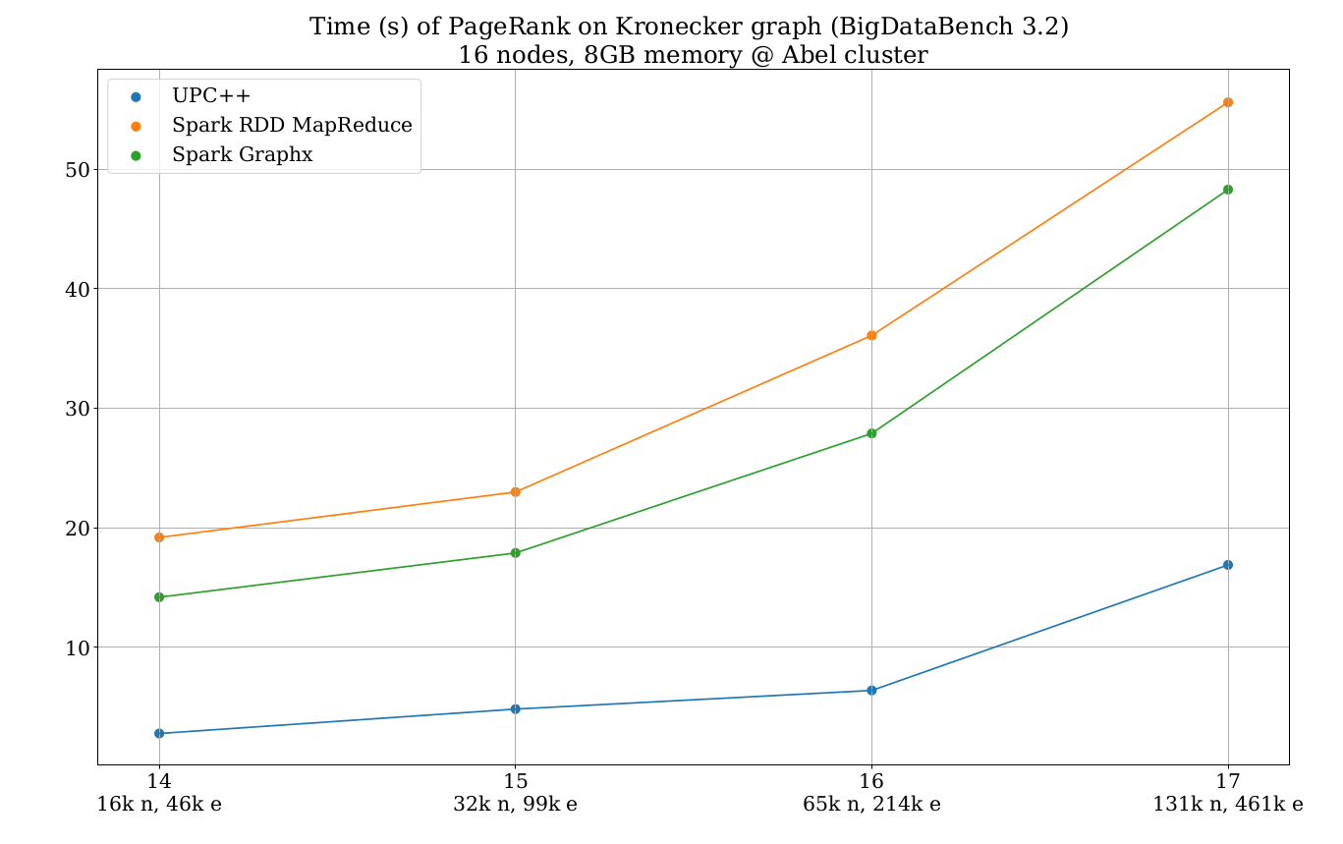

Slide 14
