Slide 1



2026 GitHub presentation template instructions 1
Turn any idea into a Hands-on GitHub Exercise
GitHub Copilot app/CLI and the gh-skills-builder-plugin
Ari LiVigni
Sr. Learning Advocate and Agentic AI Engineer
GitHub
Notes:
0:00–0:01 · Slide 1 of 14 · Welcome
SAY: Welcome! I'm Ari LiVigni, Sr. Learning Advocate and Agentic AI Engineer at GitHub. In the next 60 minutes we'll turn one small idea into a self-paced, hands-on GitHub Skills exercise, using the GitHub Copilot app and the gh-skills-builder plugin.
SAY: The exercise's working title is Copilot app Cleared for Takeoff: a 15–20-minute Copilot quick-start inside Tailspin Toys, with three graded steps. Most of this session is live. The slides set the stage, then we build it in the Copilot app and see all four builder phases: outline, bootstrap, review, and publish.
DO: Before you start talking, have the Copilot app open with a new quick chat ready (Interactive, Auto → Intelligence) and the rehearsal project already added as a fallback.
CLOCK: Move to slide 2 within the first minute.

Slide 2
00-06
Get oriented
Plugins, installation, and the quick-start scenario
06-16
Outline + hand-off
Three learner steps, a name, and a private repo
16-27
Bootstrap
Our 60-minute
flight plan
From outline to files, plus one fail-to-pass check
27-35
Review
Report findings, approve one fix, review again
35-41
Publish readiness
Mostly live.
Checkpoints protect the demo.
Evidence and a launch plan, without publishing
41-60
Recap + Q&A
Takeaways by 0:45, then a buffer and Q&A by 0:50
2
Notes:
0:00–0:01 · Slide 2 of 14 · Our 60-minute flight plan
SAY: Here's our flight plan. Six minutes to get oriented. Then we outline the exercise and hand it off to a private repo, bootstrap it into real files, review it, and get it ready to publish. We recap by 0:45, and Q&A starts by 0:50.
SAY: It's mostly live, so I saved a checkpoint for every phase. If something runs slow, I'll switch to the checkpoint and tell you. You'll still see every step.
DO: Nothing to paste. Point at each row as you name it; don't read the times aloud.
CLOCK: Budget: orientation 0:00–0:06, outline 0:06–0:12, hand-off 0:12–0:16, bootstrap 0:16–0:27, review 0:27–0:35, publish readiness 0:35–0:41, recap 0:41–0:45, flex buffer 0:45–0:50, protected Q&A 0:50–1:00.
CLOCK: Hard stops: saved outline at 0:12, rehearsal 00-idea at 0:16, 02-bootstrapped at 0:19, saved review at 0:30, no more fix rounds at 0:35, saved readiness at 0:38. If the buffer isn't needed, open Q&A at 0:45.

Slide 3
What is a plugin?
An installable toolkit that adds reusable capabilities to GitHub Copilot.
+
A
S
gh-skills-builder
One agent
Five skills
Install once.
Reuse the workflow.
Coordinates the work and asks for your approval.
Reusable workflows and capabilities the agent loads.
A plugin packages customizations. It is not a separate AI model.
3
Notes:
0:01–0:03 · Slide 3 of 14 · What is a plugin?
SAY: A plugin is an installable toolkit that adds reusable capabilities to GitHub Copilot. Instead of copying prompts and customization files from repo to repo, you install a bundle once and reuse it.
SAY: gh-skills-builder bundles one agent and five skills. The agent, @github-skills-orchestrator, coordinates the work and asks for your approval. The skills are reusable workflows the agent loads for each job: outline, bootstrap, review, publish, and one that runs the whole loop.
SAY: Two things a plugin is not. It's not a separate AI model; it customizes the Copilot you already use. And skills guide the agent's behavior; they don't guarantee correctness or replace your approvals.
DO: Nothing to paste. Point at the agent, then at the skills.
CLOCK: Slides 3 and 4 together end by 0:03.

Slide 4

Add the toolkit. Start building.
gh-skills-builder is available in the Awesome Copilot marketplace.
1
Find it
Open Plugins in the Copilot app.
Find gh-skills-builder.
2
Review + install
Review the source and capabilities.
Install and enable for your session.
3
Use it
Choose the orchestrator agent.
Ask it to run the exercise lifecycle.
gh.io/gh-skills-builder
CLI: copilot plugin install gh-skills-builder@awesome-copilot
4
Notes:
0:01–0:03 · Slide 4 of 14 · Add the toolkit. Start building.
SAY: gh-skills-builder is in the Awesome Copilot marketplace. Find it, review it, install it, and use it. The QR opens the plugin's listing; it doesn't install anything by itself.
SAY: Always review an external plugin's source before you install it.
DO: Optional: 60 seconds at most, or skip it and leave the QR up. In the Copilot app, open Plugins, find gh-skills-builder, review it, then install and enable it for this session. Or use the CLI:
copilot plugin install gh-skills-builder@awesome-copilot
DO: If the CLI says the marketplace is unknown, register it once, then rerun the install:
copilot plugin marketplace add github/awesome-copilot
DO: Confirm the install:
copilot plugin list
CLOCK: Leave slide 4 by 0:03. Help attendees with installation after the session, not during it.

Slide 5
Today's scenario: Tailspin Toys
Build a 15–20-minute Copilot quick-start inside Tailspin Toys.
1
2
Start with a real app
>
Teach three habits
Tailspin Toys as MIT starter code. Learners customize Copilot, not app features.
Repository instructions.
Consistent quality reports.
A report-only QA agent.
Working Title: Copilot app Cleared for Takeoff
5
Notes:
0:03–0:04 · Slide 5 of 14 · Today's scenario: Tailspin Toys
SAY: Here's what we'll build: Copilot app Cleared for Takeoff, a 15–20-minute Copilot quick-start inside Tailspin Toys. Tailspin is a real, MIT-licensed sample app. Here it's starter code, not a feature to build.
SAY: The learner practices three habits, one graded step each. First, add a TSDoc convention to the repository instructions. Second, give the existing quality-checks skill a consistent, evidence-based report format. Third, create a report-only QA agent.
SAY: We're building the learning journey, not coding a Tailspin feature. No filtering, no npm install, no database, no browser tooling.
SAY: Working title: Copilot app Cleared for Takeoff. That's the title I rehearsed. In a minute the agent proposes a title and three repository names, and you get to vote on the exercise's identity. If we can't decide in 30 seconds, we keep this one.
DO: Nothing to paste. Point at the three habits, then at the working title line.
CLOCK: Move on by 0:04.

Slide 6
From builder to architect
The agent does the heavy lifting. You own the learning experience.
A
H
Let the agent build
Keep the human decisions
Draft step content.
Scaffold repository files.
Wire validation and feedback.
Set learner outcomes.
Approve the outline and fixes.
Authorize publication.
Same pattern for educators, maintainers, event organizers, DevRel, startups, and enterprises.
6
Notes:
0:04–0:05 · Slide 6 of 14 · From builder to architect
SAY: Quick show of hands: who teaches, onboards contributors, runs events, or trains teams? Keep it to 10 seconds, and skip it if you're behind.
SAY: Whichever you are, the pattern is the same. The agent does the heavy lifting: it drafts the step content, scaffolds the repository files, and wires up validation and feedback. You keep the human decisions: you set the learner outcomes, approve the outline and the fixes, and authorize publication.
SAY: Your role shifts from builder to architect and reviewer, but you're still responsible for the result. Today's learner is a new Tailspin teammate, learning the team's Copilot conventions.
DO: Nothing to paste. Raise your own hand to prompt the room.
CLOCK: Move on by 0:05.

Slide 7
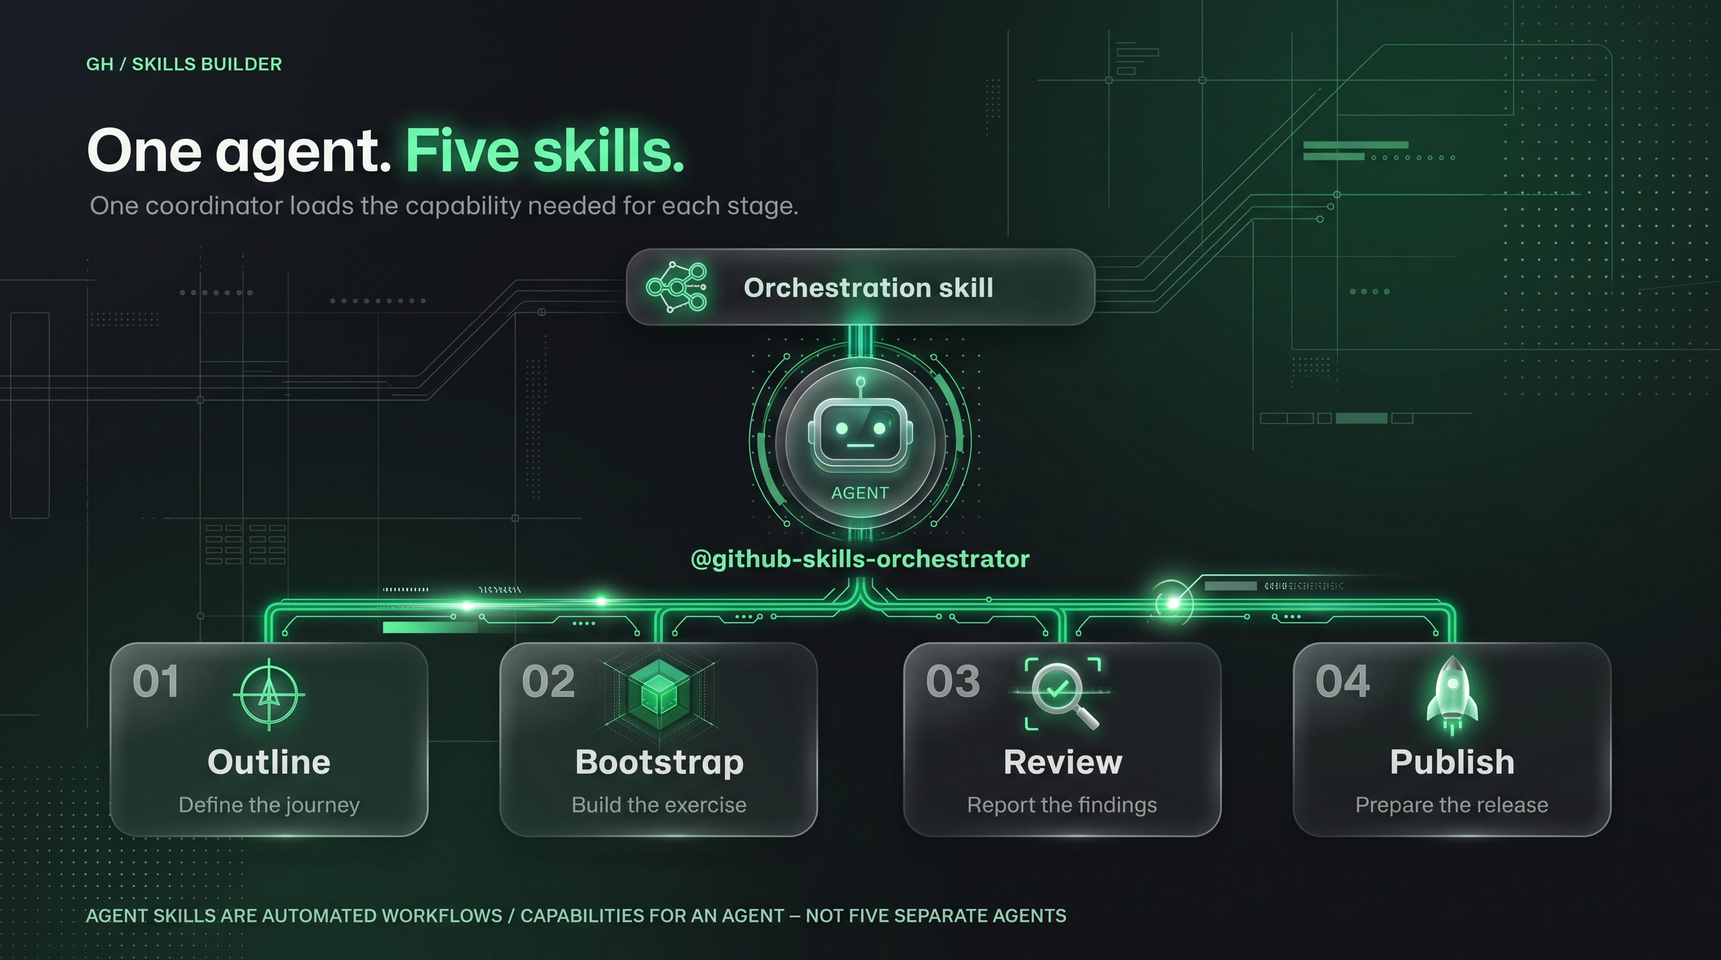
7
Notes:
0:05–0:06 · Slide 7 of 14 · One agent. Five skills.
SAY: One agent, five skills. Four of the skills each own one phase: outline, bootstrap, review, and publish. The fifth, orchestrate, runs those four in order and stops at every approval.
SAY: Skills are workflows the agent loads, not five more agents. You choose @github-skills-orchestrator, then either call one phase skill with its slash command, or let the orchestrate skill run the whole loop.
SAY: Today I'll call the four phase skills one at a time, so you can see each phase. At the end I'll show the orchestrate prompt without running it.
DO: Nothing to paste. Point at the agent, then the four phase skills, then orchestrate.
CLOCK: Slides 7 and 8 together end by 0:06.

Slide 8
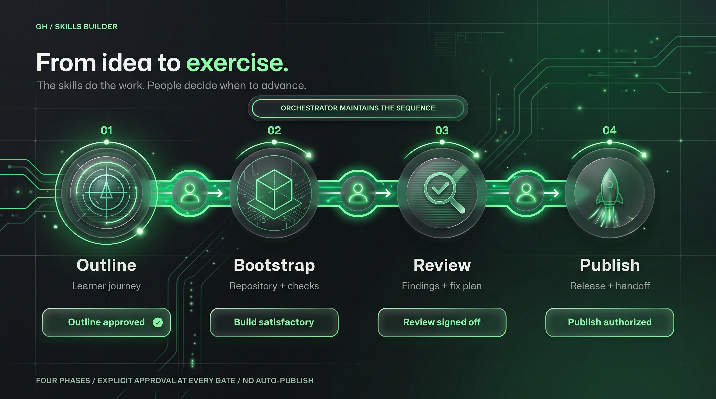
8
Notes:
0:05–0:06 · Slide 8 of 14 · From idea to exercise.
SAY: Four phases, each ending at a human gate. Gate 1: approve the outline before anything is generated. Gate 2: accept the build before it's reviewed. Gate 3: after the review, choose fixes or sign off. And actually publishing needs its own, separate authorization.
SAY: These gates are instructions the agent follows, not a permission system. That's why I'll say every approval out loud and check what the agent did.
DO: Nothing to paste. Advance to slide 9. We start with only an idea, in a quick chat: no repo yet.
CLOCK: It's minute 6. Start Prompt 1 by 0:06.

Slide 9
Outline: decide what success looks like
Input: a Tailspin idea. Output: an approved three-step journey.
1
2
3
Outcome
Identity
Validation
Three small Copilot customizations, done in 15–20 minutes.
Choose an exercise title and an eye-catching repository name.
For every graded step: what can a workflow actually check?
/create-github-skills-outline
9
Notes:
0:06–0:12 · Slide 9 of 14 · Outline: decide what success looks like
SAY: Phase I is the outline. We start with only an idea and decide three things: the outcome, the exercise's identity, meaning its title and repository name, and, for every graded step, what a workflow can actually check.
DO: SCREEN → Copilot app. New quick chat: Interactive, Auto → Intelligence. Paste Prompt 1:
@github-skills-orchestrator Use /create-github-skills-outline to design a
15–20-minute GitHub Skills exercise for a new Tailspin Toys teammate.
Keep exactly three graded learner steps:
1. Add a clearly delimited workshop section to .github/copilot-instructions.md
requiring TSDoc for new or changed exported TypeScript functions. Preserve
existing instructions.
2. Customize .github/skills/quality-checks/SKILL.md so reports include
command, passed/failed/blocked status, evidence, and reasons for failed or
blocked checks. Preserve frontmatter. Never invent command results.
3. Create .github/agents/qa.agent.md with name and description frontmatter. It
reports requirements with evidence, asks before implementation changes, and
never commits or opens PRs.
For each step include a short Theory block, one Activity, success criteria, a
repository-observable validation signal, and useful failure feedback. Validate
the content of learner artifacts, not just file existence. Do not claim
Actions can prove which local app mode or agent was used.
This is a small slice of the Dev Days Copilot app scenario, not a conversion
of the full lab. Do not add filtering, application changes, dependency
installation, database setup, browser tests, feature PR/merge requirements, or
extra graded steps. Mention Agent Merge, MCP, and canvases only as optional
next steps.
Propose a title and three lowercase-hyphenated repository names containing
copilot-app, without a skills- prefix. Recommend one.
We are in a quick chat with no repository. After I approve the identity and
outline, return the complete standalone exercise-outline.md content in one
Markdown code block. Start with # <approved title>, then Repository name:
<approved name>, then Learner copy: skills-<approved name>. Do not claim a
file has been saved.
SAY: While it generates: every step gets a short Theory block, one Activity, success criteria, a validation signal the repository can observe, and useful feedback for when the learner gets it wrong.
SAY: Ask the room: what would prove the learner changed the reporting contract, rather than merely created a file? A file-exists check isn't evidence. The check has to read what the learner wrote.
SAY: And be honest about the limits. Actions can check what the learner wrote. It can't see which app mode or agent they used, and it can't prove how the model will behave later.
DO: Read the proposed title and three repository-name candidates aloud and take a vote: 30 seconds at most. If the room can't decide, keep the rehearsed default. Send Gate 1 once. If the room chose a different title or name, edit both in the message first:
Approved. Use "Copilot app Cleared for Takeoff" and repository name
copilot-app-cleared-for-takeoff. Keep exactly the three approved learner
steps. Return the complete outline artifact in one Markdown code block,
including the title, Repository name, and Learner copy header. Do not create a
repository or claim to have saved a file.
SAY: Gate 1 approves the idea and the name. It creates nothing: no repo, no files.
DO: Check that the returned block starts with the approved title, then Repository name:, then Learner copy:. Copy the whole block. It isn't saved anywhere yet; you'll paste it into the project session.
CLOCK: Hard stop 0:12. If the outline isn't finished, open the saved fallback/exercise-outline.md, say it's from rehearsal, and match its identity header to the target repo. Don't spend the workshop waiting for the outline.
0:12–0:16 · Still slide 9 · Hand-off Authorization
SAY: Gate 1 approved the idea and created nothing. Now I give a separate approval, the Hand-off Authorization. It lets the agent run one existing script, once, to create one private authoring repo. Publishing a public template is a different gate, much later.
DO: STAY on slide 9; the screen stays on the Copilot app. In the same quick chat, replace <workshop-repo> with the absolute path of your clone of this workshop repo (a quick chat has no working directory), <you> with the demo owner, and the repository name if the room chose another. Then send:
Hand-off Authorization: I authorize running this existing workshop script once
to create my private authoring repository, import the Tailspin starter code,
commit, and push. This is not permission to publish a public template or run
the exercise lifecycle.
<workshop-repo>/handoff.sh <you> copilot-app-cleared-for-takeoff
Show the output and local folder path. Do not create other repositories or
files beyond the script's work.
DO: Inspect the command permission request, then approve it out loud. Not every configuration shows one.
SAY: handoff.sh creates the private repo and imports Tailspin Toys as one MIT starter commit. It keeps the license and supporting files, and drops the upstream issue sources, the issue-seeding and triage workflows, and CODEOWNERS. So when a learner starts, Step 0 opens just one issue: the exercise instructions.
DO: If the chat can't run commands, run the same authorized command in a terminal, with the same replacements:
<workshop-repo>/handoff.sh <you> copilot-app-cleared-for-takeoff
DO: If a run started, or you're not sure how it ended, check its output, the remote repo, and the local folder before you retry. Never run the script twice at once, never blindly repeat repo creation, and don't delete a partial repo.
DO: In the Copilot app, choose Add project and pick the folder the script printed. Start a New session on main: Interactive, Auto → Balance.
SAY: This new session can't see the quick chat, so I'll paste the whole outline into it.
CLOCK: Hard stop 0:16. If the hand-off isn't done, switch to the pre-added rehearsal project at 00-idea, say it's a rehearsal fallback, and match the outline identity to that repo.

Slide 10
Bootstrap: make the outline runnable
Generate exercise files in the current repository, not a new GitHub remote.
README.md
.github/steps/
1-step.md ... x-review.md
.github/workflows/
0-start-exercise.yml
1-step.yml ... 3-last-step.yml
The learner gets
A clear entry point.
Issue-driven practice.
Checks and useful feedback.
/bootstrap-github-skills-exercise
10
Notes:
0:16–0:27 · Slide 10 of 14 · Bootstrap: make the outline runnable
SAY: Phase II, bootstrap, turns the approved outline into a runnable exercise, right here in the private authoring repo. The learner gets a clear entry point with a Copy Exercise badge, issue-driven steps, and checks with useful feedback. Bootstrap doesn't create anything new on GitHub.
DO: SCREEN → Copilot app, the new project session. Paste Prompt 2, replacing only <paste the approved outline artifact> with the whole outline block you copied:
@github-skills-orchestrator Phase I is approved. Use
/bootstrap-github-skills-exercise with this outline artifact:
<paste the approved outline artifact>
First save that artifact verbatim to .github/exercise-outline.md. Use its
identity header for the README and Copy Exercise badge. Stop and ask if its
repository name differs from this repo.
Build exactly three graded steps plus the standard completion/review material.
Preserve Tailspin's MIT LICENSE and credit github-samples/tailspin-toys in the
README.
Do not complete the learner tasks: leave the new TSDoc workshop section, the
quality-reporting contract, and qa.agent.md for the learner to add. Inspect
the existing starter files first so validation requires a meaningful learner
change instead of passing the baseline.
Step 0 opens the normal exercise instructions issue only; do not seed any
other issues. Keep existing Tailspin workflows intact, but do not depend on
their checks for exercise progression.
Use lightweight artifact checks for all three steps. Do not run or require npm
ci, app builds, database setup, Playwright, or application tests. Check
frontmatter and required reporting/behavioral instructions with helpful
failure feedback, not file-exists or arbitrary whole-file text matching alone.
Follow the GitHub Skills workflow contract, use scoped permissions, and
inspect workflow event/path interactions. Report what was actually validated
and what remains untested. Do not publish or create another repository.
DO: When .github/exercise-outline.md appears, show it: the agent's first action saves the outline word for word. Then show the README and Copy Exercise badge, the three step files, the completion material, and how the workflows chain.
SAY: Notice the learner's work stays unsolved. If the agent did the learner's work, every check would pass before anyone started. The Tailspin MIT license and credit stay in place.
CLOCK: Wait three minutes at most. Hard stop 0:19: if the build isn't ready to inspect, switch to the rehearsal project's 02-bootstrapped state and say: "This is the same small scope, built during rehearsal."
DO: Show one fail-to-pass example for step 1, in a separate, disposable learner copy, never the authoring repo. First, the untouched starter fails with a message that says what to fix. Next, add the TSDoc workshop section. Then the check passes and the next step opens.
SAY: That check reads what the learner wrote, which is much stronger than checking that a file exists. But it can't prove how Copilot will behave later.
DO: If Actions is slow, use the rehearsed learner copy, the saved evidence in fallback/learner-validation.md, or a short clip, and say it's saved. Don't run the whole learner journey or install app dependencies live.
DO: Gate 2, by 0:27. Accept the build only if its evidence supports acceptance:
I accept this build round. Do not make more changes. I will send the
report-only review request next.
DO: If the build has unresolved failures, don't accept it or move it toward publication. Name the remaining problems and switch to the known-good rehearsal build.
CLOCK: Send Gate 2 by 0:27, then go to slide 11.

Slide 11
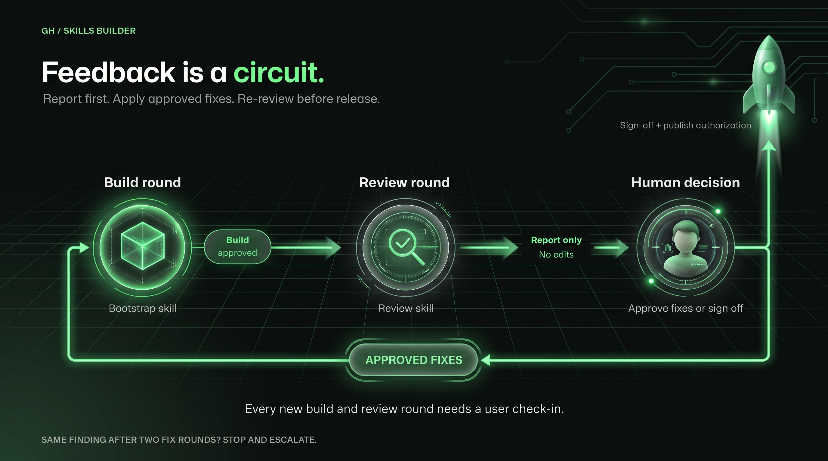
11
Notes:
0:27–0:35 · Slide 11 of 14 · Feedback is a circuit.
SAY: Phase III is review, and it's a loop: review, fix, review again. The review only reports; it changes nothing. Fixes happen only when I approve them, one at a time.
SAY: Three questions matter. Does the untouched starter fail? Does correct learner work pass? And is the feedback clear and safe?
DO: SCREEN → Copilot app, same project session, same settings. Paste Prompt 3:
@github-skills-orchestrator Use /review-github-skills-exercise. Report
findings without editing files.
Check the approved three-step scope, learner clarity and accessibility,
workflow safety, and validation reliability. In particular:
- The untouched starter must not already pass the three learner checks.
- Each correct learner artifact should pass; an incomplete or incorrect
artifact should fail with useful feedback. Inspect and, where feasible,
exercise those cases.
- Step 0 must open only the exercise instructions issue and create no other
issues.
- No grade should depend on npm, an app build, browser tooling, or proof that
the learner used a local Copilot mode.
- Repository-observable checks of written policies must not be described as
proof of model behavior.
Prioritize actual release blockers and include evidence and untested risks. If
no findings are supported, say so; do not invent a finding for the demo.
CLOCK: Hard stop 0:30. If the live review isn't finished, use the saved review in fallback/review-findings.md.
DO: Prompt 3a is an optional visual pass within the same review time box. It previews the exercise content, not the Tailspin app, and does not replace workflow checks or fresh-copy testing. Skip it if time is tight:
Show the current exercise README.md and all .github/steps/*.md files in a
browser canvas for a read-only learner-experience review.
Render the full Markdown, not summaries or source code. Put the README first,
then every numbered step in numeric order, then x-review.md. Include any
other step Markdown files in the navigation. Label each page with its source
path and provide a table of contents plus previous/next navigation. Preserve
headings, ordered lists, code blocks, links, images, details blocks, and
GitHub-style callouts so we can inspect readability and the learner journey.
Clearly label unresolved template variables as an unrendered preview; do not
invent their values or claim this is the live issue experience.
Keep all exercise files unchanged. If a local preview needs generated files,
use a temporary directory outside the repository and bind any server to
loopback only. Do not upload private content to an external renderer.
Do not run workflows, click Copy Exercise, create repositories, or publish.
If a source file or browser canvas is unavailable, report it explicitly.
DO: Check the README, each of the three steps, and the completion page in the canvas. Treat visual issues as findings, not permission to edit. If the preview cannot open promptly, inspect the source Markdown and continue within the existing hard stops.
DO: Pick one real, supported finding, such as a weak check, a workflow collision, or a learner accessibility issue. Don't invent a defect for the demo. Point out that the review hasn't changed any files.
DO: Prompt 3b approves a fix for that one finding. Replace <finding-id> with the finding you chose:
I approve a bootstrap fix round for <finding-id> only. Make the targeted fix
and run its relevant checks. Stop for my build approval before running the
review again.
DO: Inspect the change and its check results. Then accept the fix round and ask for a fresh review:
I accept the fix round. Re-run the report-only review with the same criteria.
DO: If the live review found nothing to fix, show the labeled rehearsal finding and its before and after from fallback/fix-and-rereview.md instead. It must come from this small exercise, not the old filtering scenario.
SAY: This is the agent reviewing its own work, which isn't the same as an independent review. And report-only is an instruction; it doesn't take away the agent's edit permissions. If the same finding survives two rounds, stop and escalate to a person.
CLOCK: Hard stop 0:35: start no more fix rounds. If needed, show the 03-reviewed checkpoint and say what remains.
DO: Gate 3, only if no known release blockers remain:
No known release blockers remain in the reviewed build. Prepare
release-readiness materials only; do not publish.
DO: If blockers remain, name them honestly and use the reviewed rehearsal build for Phase IV.

Slide 12
Publish: prepare first. Authorize separately.
Release-ready content is not permission to publish it.
P
H
Prepare the handoff
Pause for authorization
Validation evidence.
PR copy and release notes.
Launch checklist and known risks.
Confirm the exact owner/repo.
Confirm visibility.
Then create, push, or transfer.
/publish-github-skills-exercise
12
Notes:
0:35–0:41 · Slide 12 of 14 · Publish: prepare first. Authorize separately.
SAY: Phase IV, publish, has two halves. First, prepare the handoff: validation evidence, PR copy and release notes, a launch checklist, and known risks. Second, pause for authorization: confirm the exact owner, repository, and visibility before anything is created, pushed, or transferred.
SAY: Release-ready content isn't permission to publish it. Today we stop at that line.
DO: SCREEN → Copilot app, same project session. Stay in Interactive; never Autopilot here, because the authorization gate has to stop for you. Paste Prompt 4, or show the saved 04-publish-ready materials:
@github-skills-orchestrator Use /publish-github-skills-exercise for the
approved three-step exercise. Read its identity from
.github/exercise-outline.md.
Prepare a short readiness report: validation evidence, untested risks, a PR
description, brief release notes, and a launch checklist. Clearly separate
completed checks from required fresh-copy testing.
Do not create or transfer repositories, change visibility, push, or publish.
Stop at the authorization boundary.
DO: Keep the output short: observed validation evidence, untested risks, PR description, release notes, and launch checklist. If you have the rehearsal's fresh learner-copy result, show it.
SAY: Local checks alone don't prove the exercise works in a fresh copy on GitHub. That test is on the launch checklist.
DO: Prompt 4b shows the publication plan. Replace <demo-owner>/<approved-name> with a real demo owner and the approved name, for example <demo-owner>/copilot-app-cleared-for-takeoff. Send it, show the plan, and do not authorize it:
Use /publish-github-skills-exercise to show, without executing, a plan for
publishing this exercise to <demo-owner>/<approved-name> as a public template.
Show the exact target, visibility, changes, commands, and readiness blockers.
Wait for separate explicit authorization. This message is not authorization to
create, push, transfer, change settings, or publish.
SAY: Creating the private repo earlier wasn't permission to publish, transfer, change visibility, push, or create a public template. Publish can create a GitHub repository, but only with an explicit yes for the exact owner, repository, and visibility. Before that, make sure the README badge points at the approved target.
SAY: The private authoring repo and the public learner template have different jobs. We end with readiness evidence and a proposed publication plan, not a claim that the live build has been released.
CLOCK: Hard stop 0:38: if generation isn't finished, show the saved readiness report in fallback/publish-readiness.md and its planned commands. End this phase by 0:41.

Slide 13
One workflow. Many learning experiences.
Start with expertise. Ship practice, validation, and useful feedback.
1
2
3
4
Repeatable
Observable
Inclusive
Human-led
Reuse the same authoring loop across audiences.
Check what learners wrote, not file presence.
Review clarity, navigation, and accessibility.
Approve the decisions and the final release.
Outline and review generalize to other tutorials. Bootstrap targets the GitHub Skills contract.
13
Notes:
0:41–0:45 · Slide 13 of 14 · One workflow. Many learning experiences.
SAY: That's all five skills and the one agent. The fifth skill, orchestrate, runs the same lifecycle with the same gates from one prompt. It's not a second agent. I won't run it; we just did every step by hand.
DO: SCREEN → Copilot app. Show this prompt without sending it:
@github-skills-orchestrator Use /orchestrate-github-skills-exercise to
coordinate the same three-step Tailspin quick-start. Read the approved outline
from .github/exercise-outline.md. Stop after each build for approval; review
without edits; request separate approval for fixes and any publication. Do not
expand the scope or publish without explicit authorization.
DO: SCREEN → back to slide 13.
SAY: Four takeaways. Repeatable: reuse the same authoring loop for any audience. Observable: check what learners wrote, not whether a file exists. Inclusive: review clarity, navigation, and accessibility. Human-led: people approve the decisions and the final release.
SAY: Same lifecycle, different content. An educator could teach a classroom coding convention; an enterprise could onboard teammates to a team policy. The outline and review skills work for other tutorials too; bootstrap targets the GitHub Skills format.
SAY: A longer exercise could add filtering with tests, Plan and Autopilot practice, PRs and Agent Merge, MCP, or canvases. We won't demo those today.
SAY: Keep the learner task small. Make success observable. Let the agent draft; keep humans at the decisions.
CLOCK: Content ends at 0:45. The 0:45–0:50 buffer only absorbs overruns. If you don't need it, go to slide 14 and open Q&A.

Slide 14
Your next exercise starts here.
Bring an idea.
Build a hands-on experience.
gh.io/gh-skills-builder
Available in Awesome Copilot.
One orchestrator. Five Agent Skills.
Scan to explore the plugin
Q&A / What could you turn into an exercise?
14
Notes:
0:50–1:00 · Slide 14 of 14 · Your next exercise starts here.
SAY: Your next exercise starts here. Bring an idea, and build a hands-on experience. Scan the QR or go to gh.io/gh-skills-builder: it opens the plugin's Awesome Copilot page, with one orchestrator and five Agent Skills.
SAY: So: what could you turn into an exercise?
DO: Leave this slide and its QR up through Q&A. If someone asks for the install command, paste it in the chat:
copilot plugin install gh-skills-builder@awesome-copilot
DO: If the room is quiet, seed a question. What can Actions observe? Why is review report-only? What authorization does publishing need? What would your audience practice?
CLOCK: Q&A starts by 0:50, or at 0:45 if the buffer wasn't used. Don't troubleshoot individual installations or start another workflow. End at 1:00.

Slide 15
LIVE WORKSHOP / 60 MINUTES
Turn any idea into a hands-on GitHub exercise
Build with gh-skills-builder.
Live in the GitHub Copilot app.
Ari LiVigni
Notes:
Hidden backup slide · not presented
This is the original title slide, kept as a backup. If slide 1 can't be used, unhide this slide in PowerPoint, move it to the front, and present it with the slide 1 notes.

