Slide 1

SurveyApe
Team Member | Student ID
Arijit Mandal | 012458823
Rutvik Pensionwar | 012415988
Sannisth Soni | 012460565
Varun Shah | 010823657

Slide 2
Introduction
SurveyApe :
A Web-based application that allows users to create, edit and take surveys.
MVC Architecture
REST API
Front - End:
React -Redux (Client)
Back - End
Spring Boot (Server)
Dependency Injection
AOP
ORM
JPA
Hibernate
AWS RDS (MySQL)

Slide 3
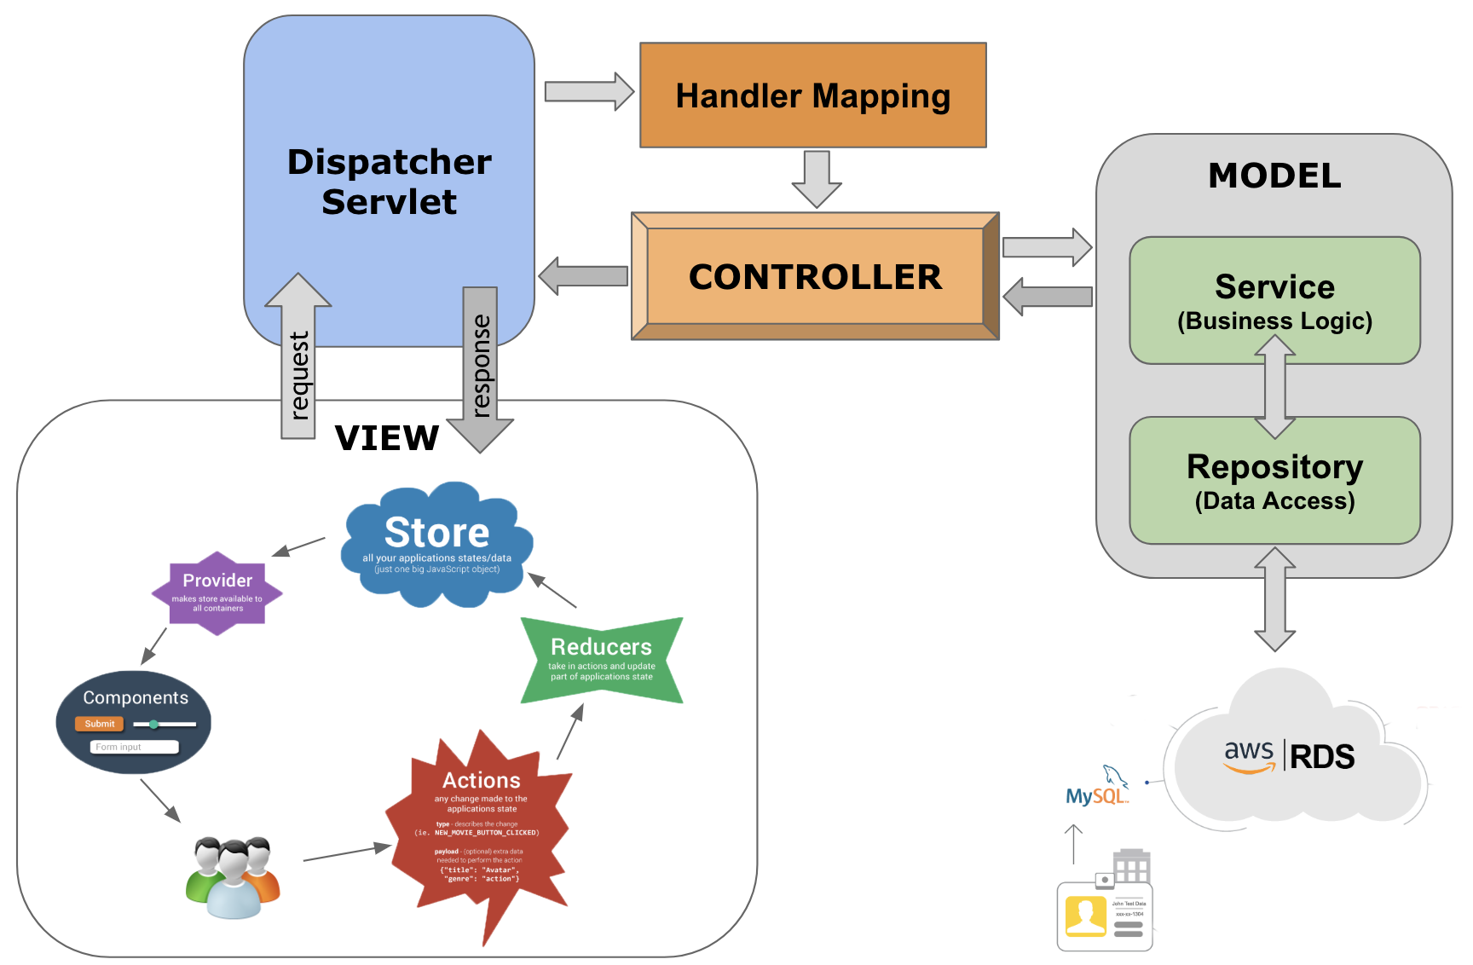
High Level Architecture

Slide 4
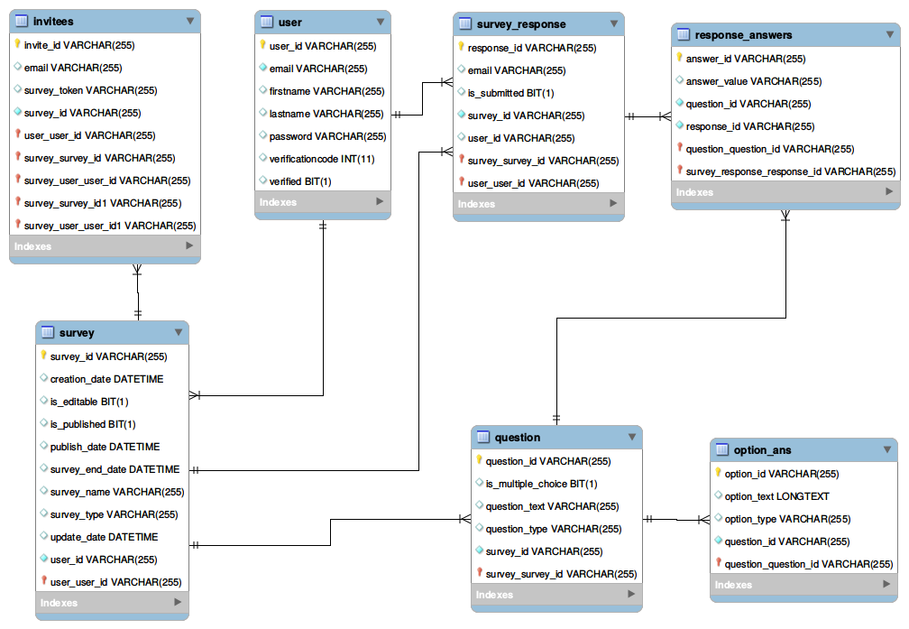
DB Design

Slide 5
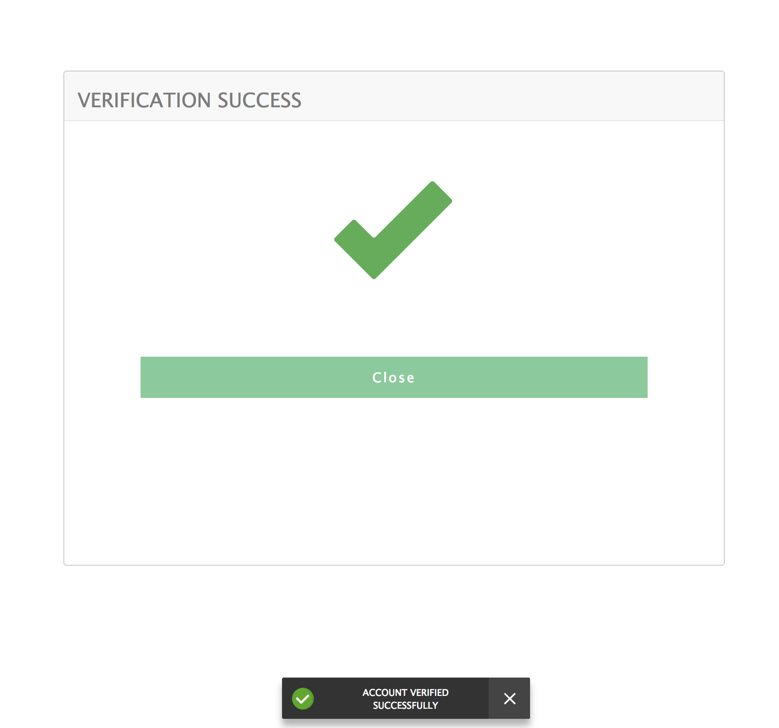
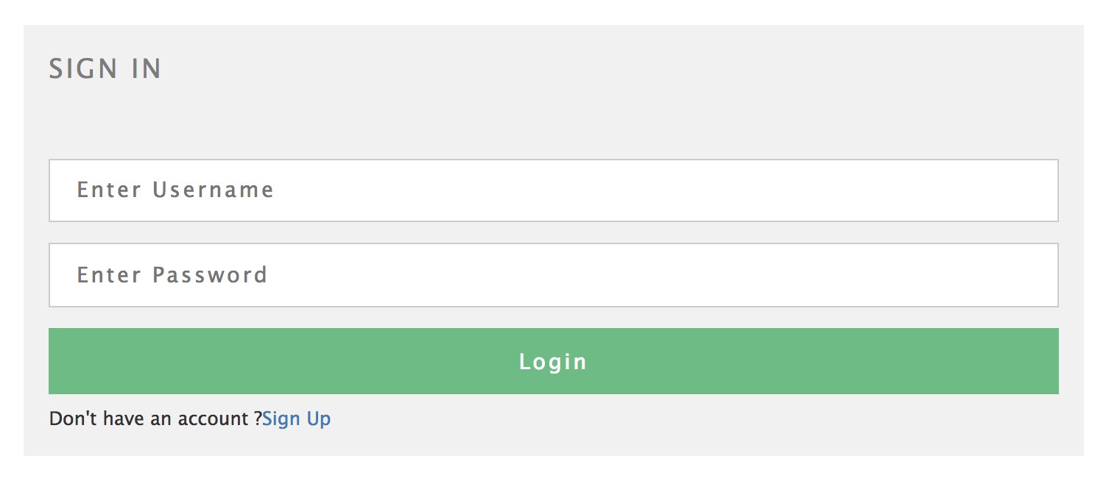
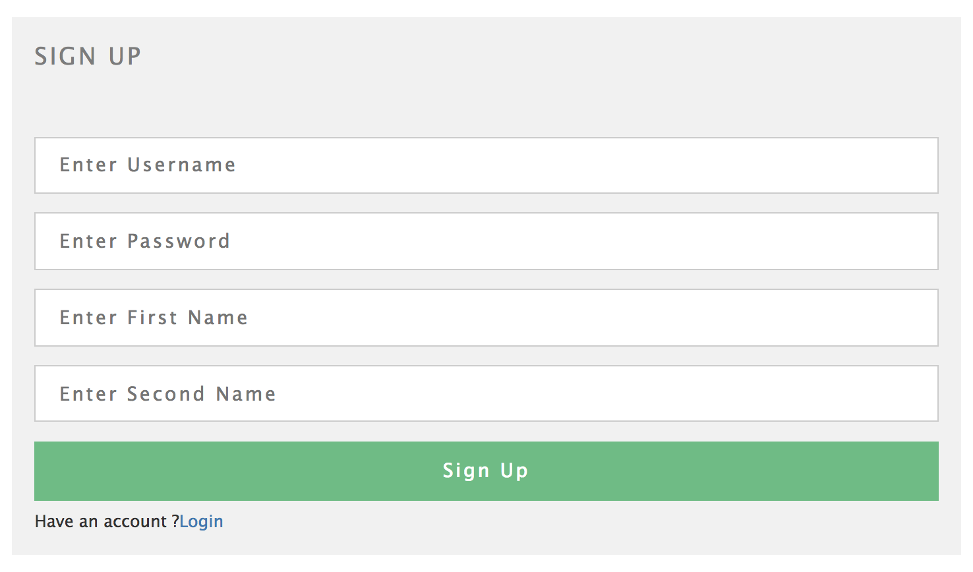
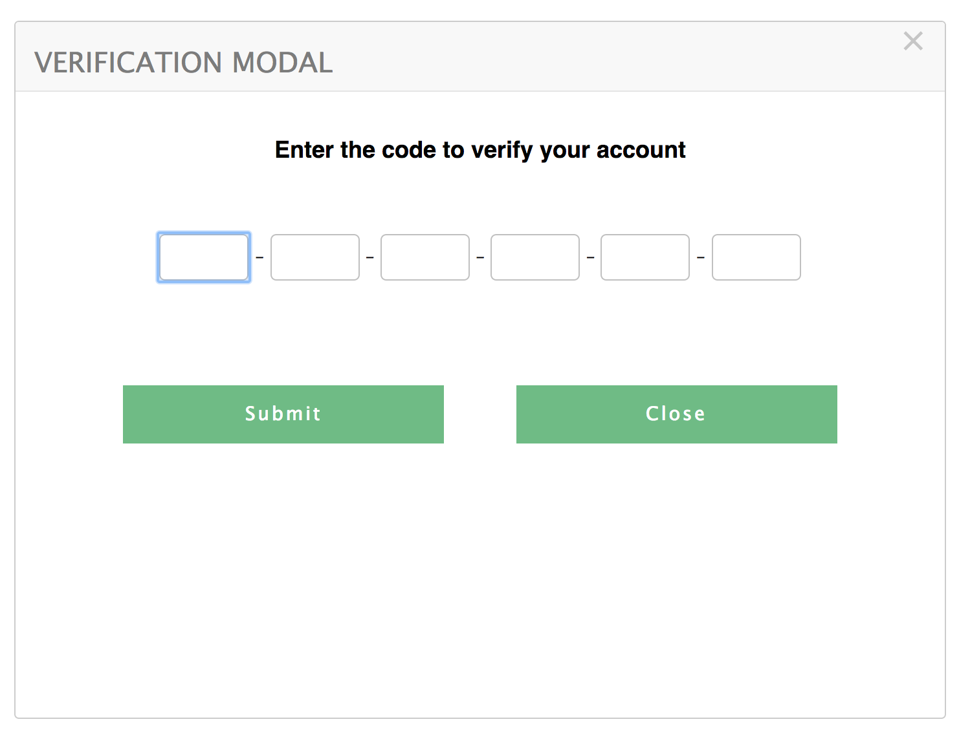
Feature : Login/SignUp/Account Verification

Slide 6
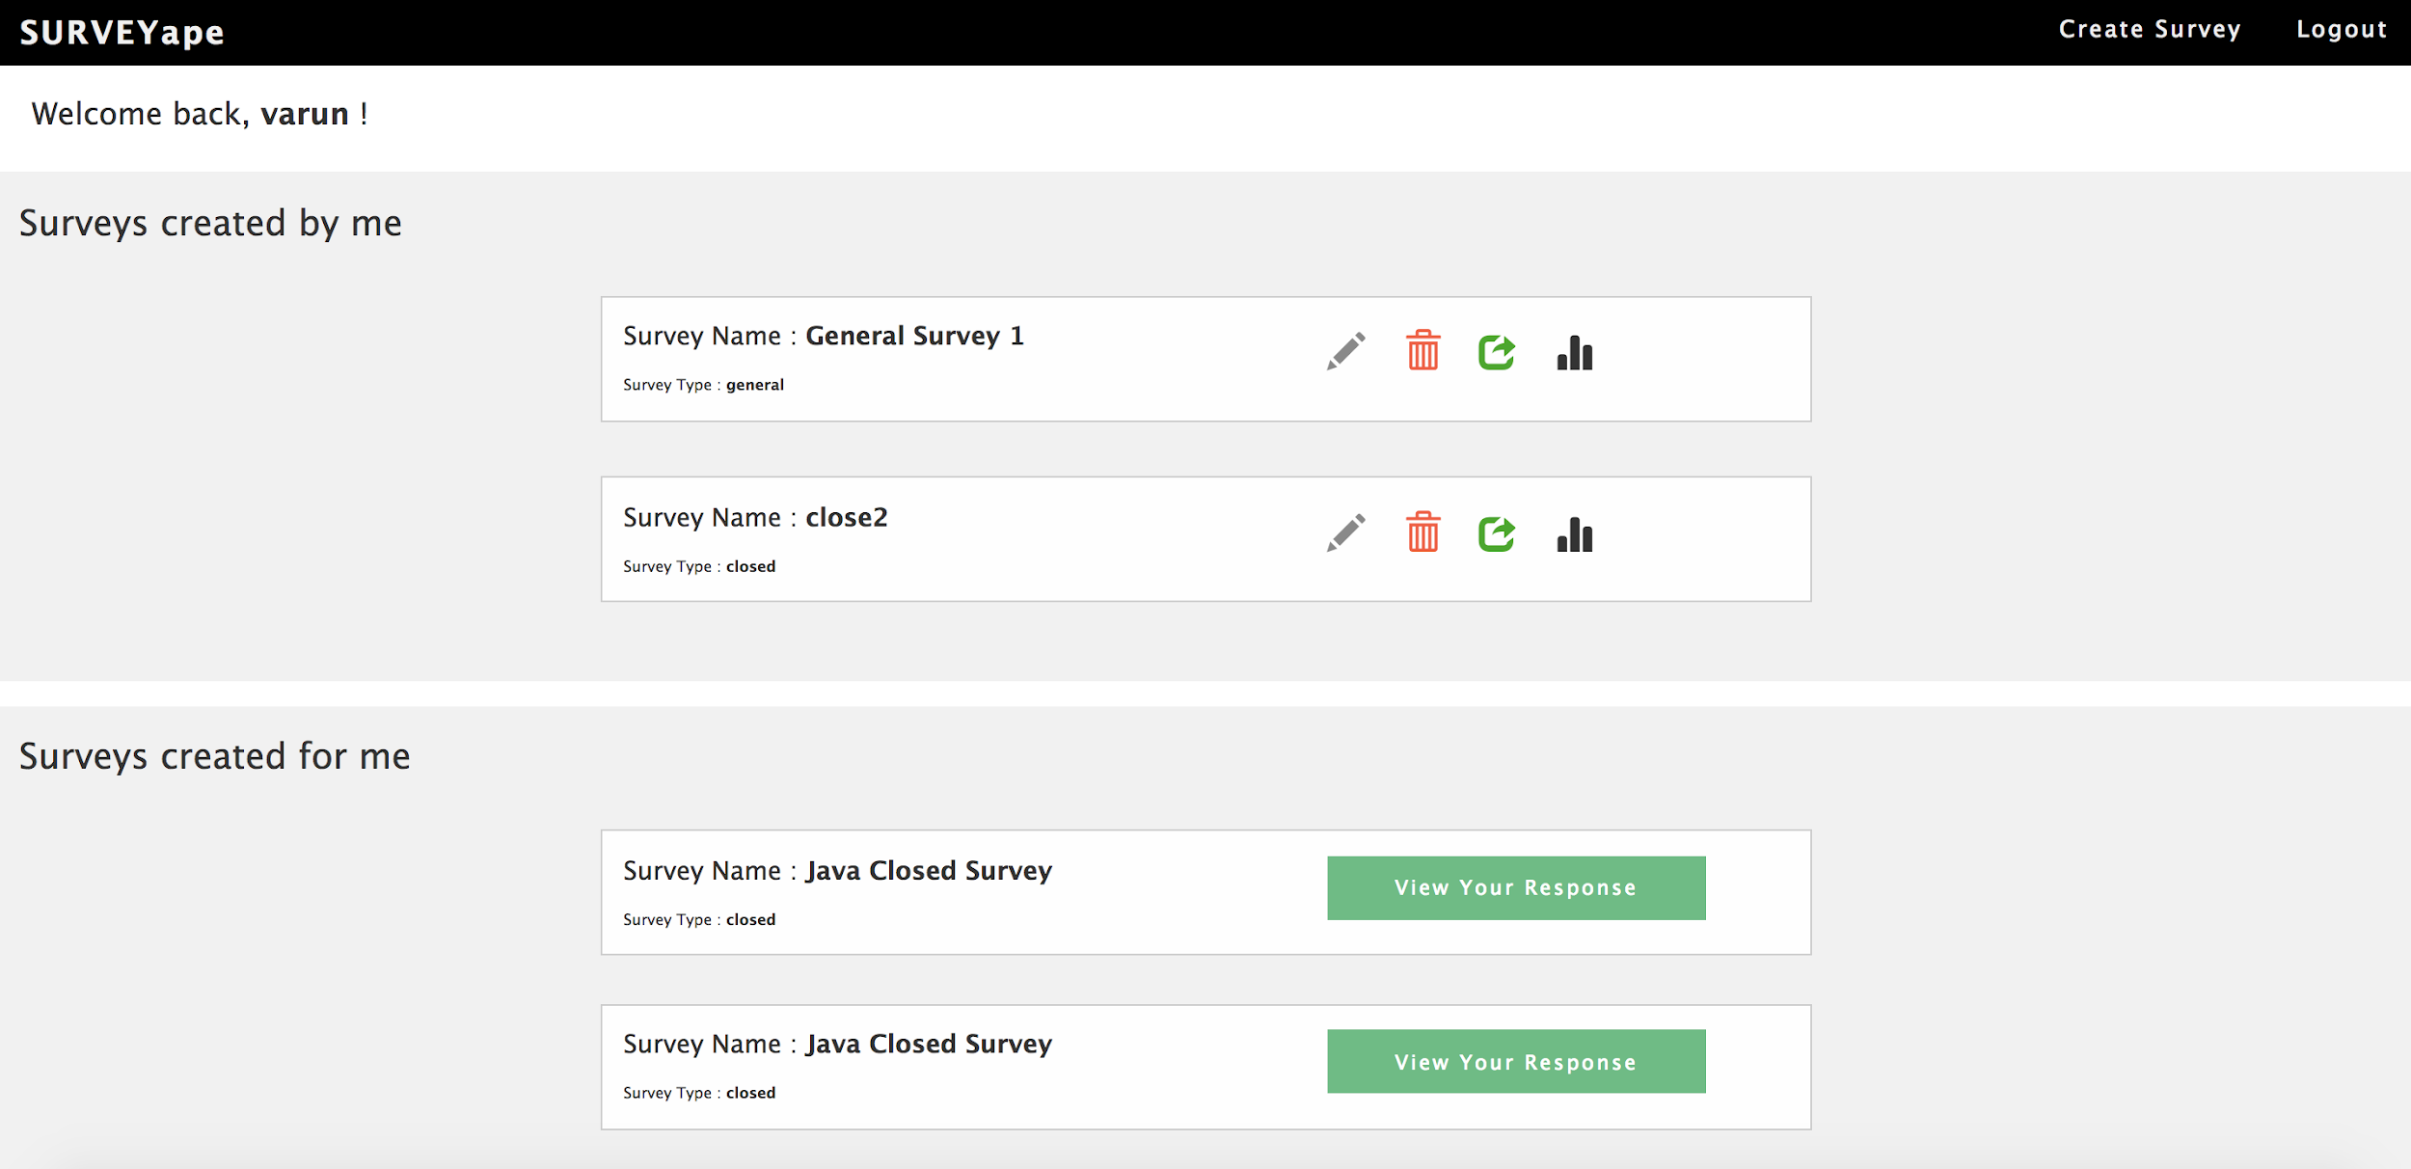
Feature 2 : User Dashboard

Slide 7
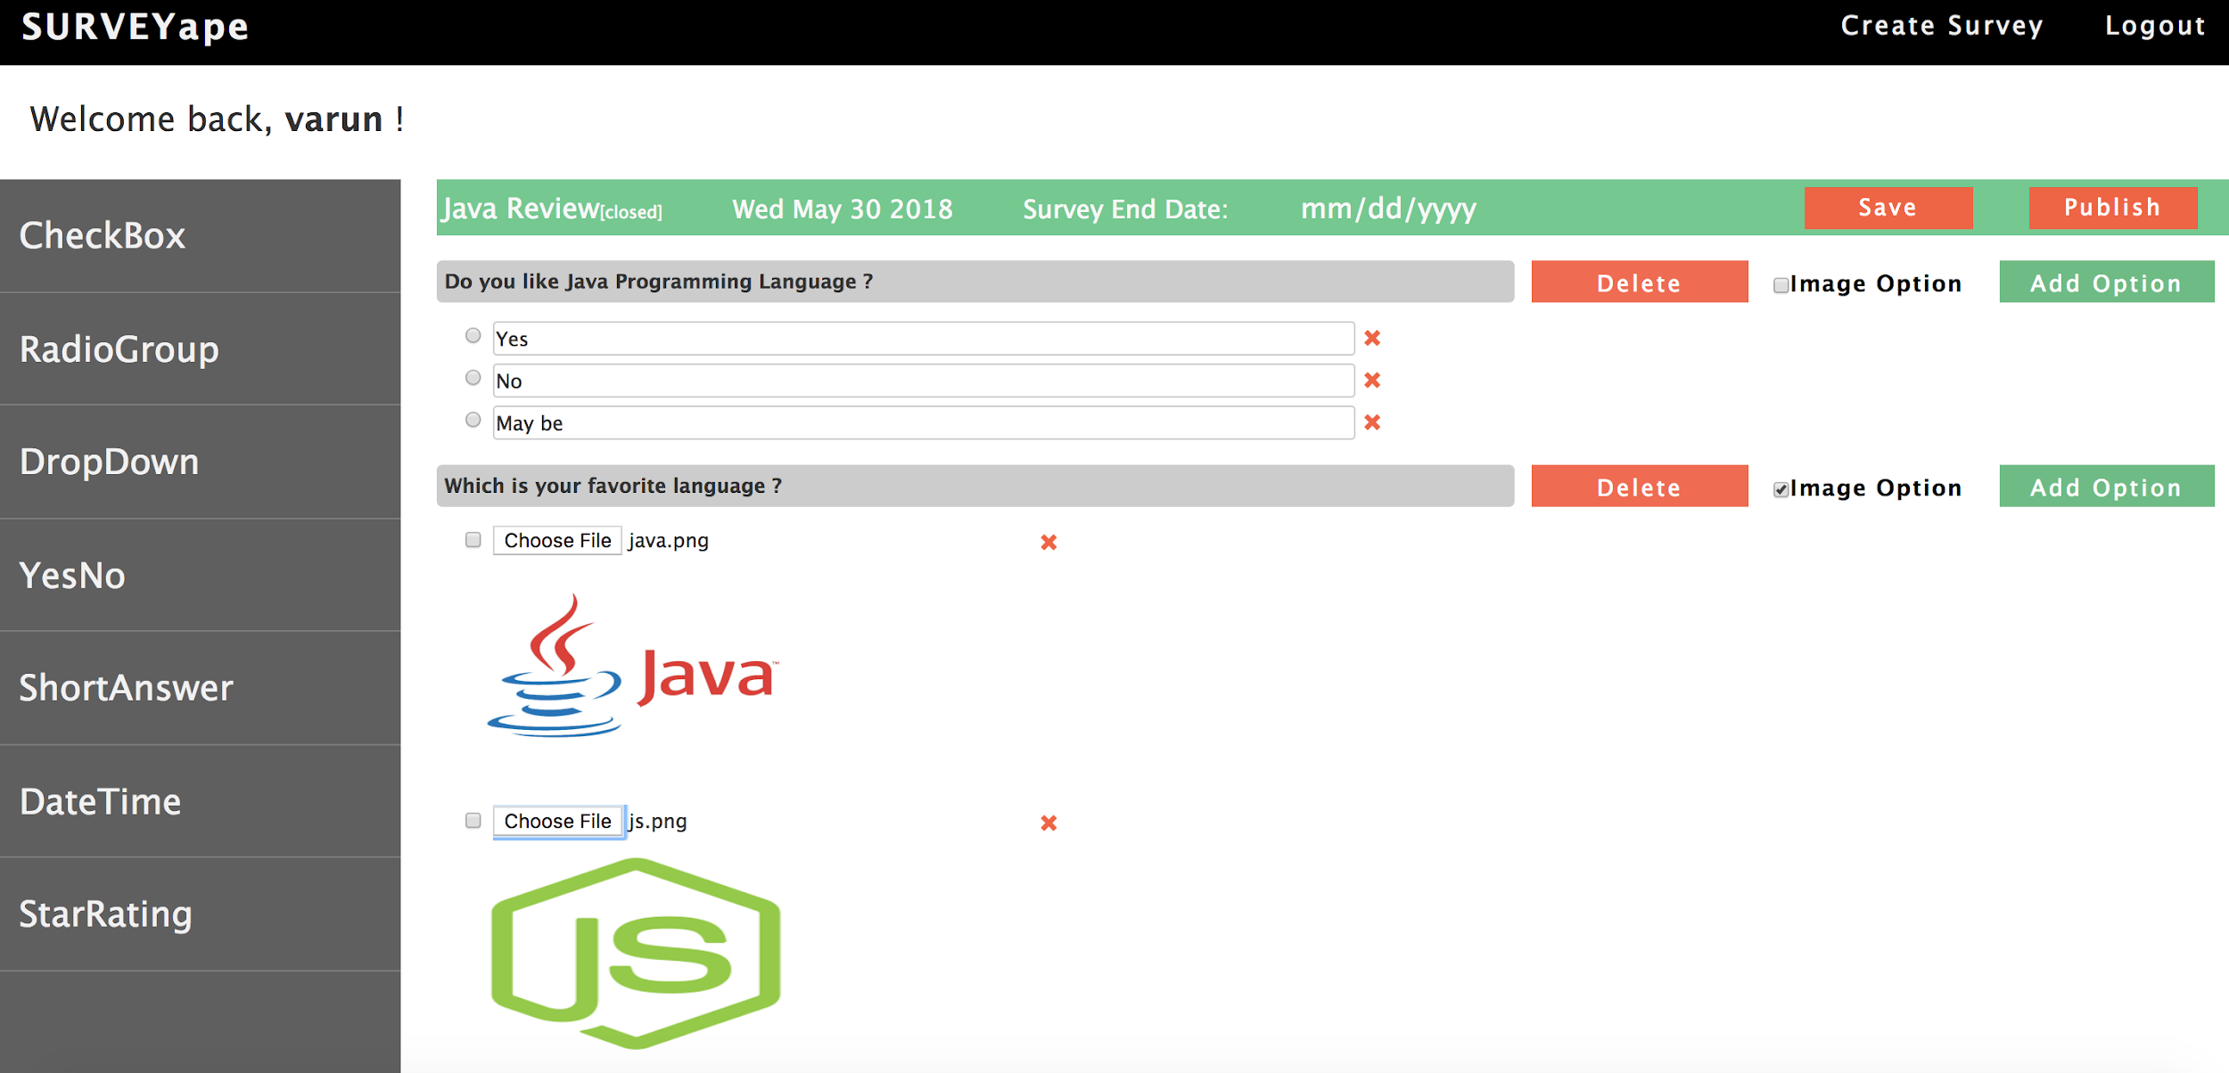
Feature 3 : Survey Builder

Slide 8
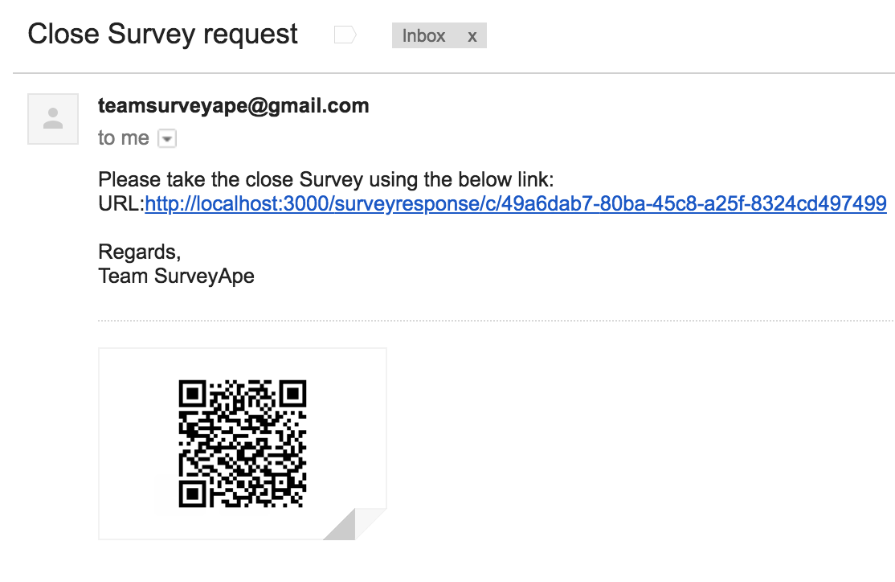
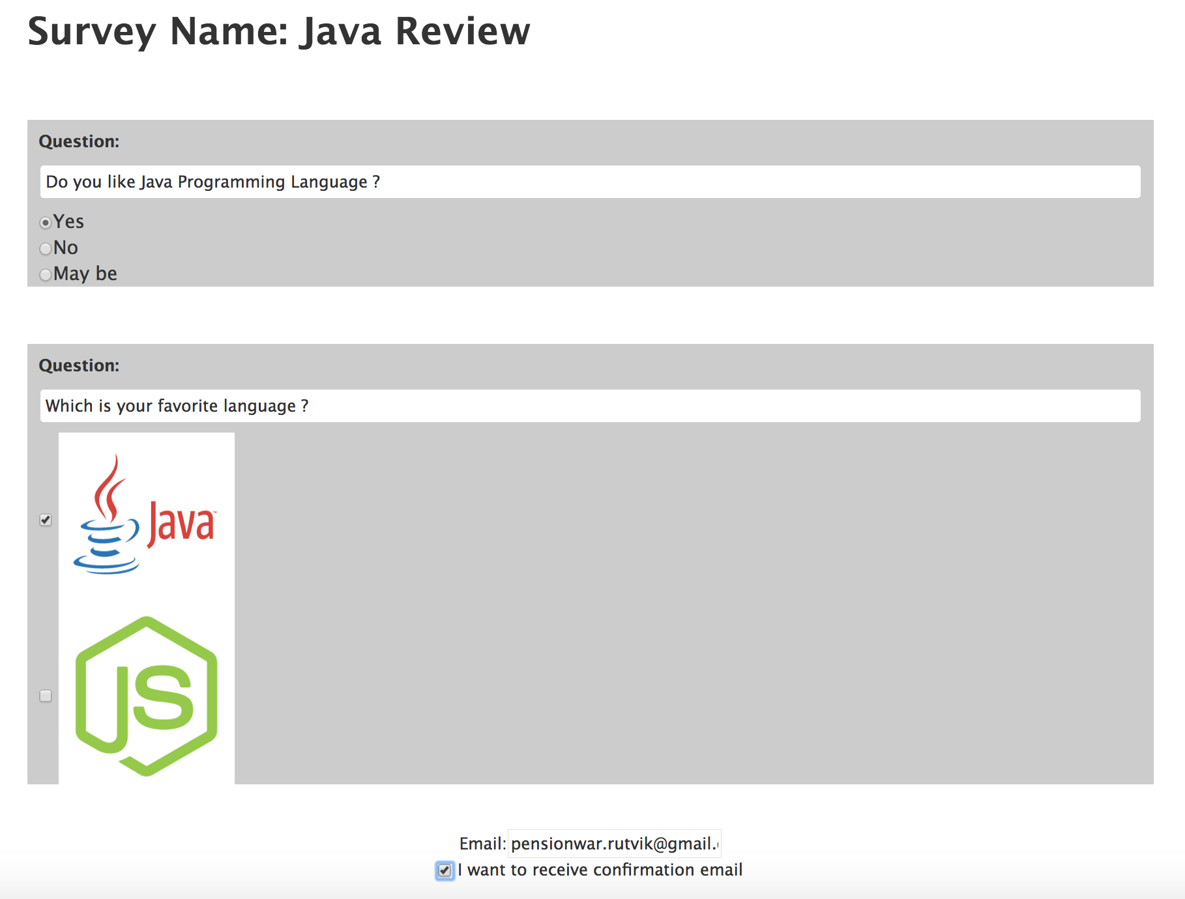
Feature 4 : Surveyee Actions

Slide 9
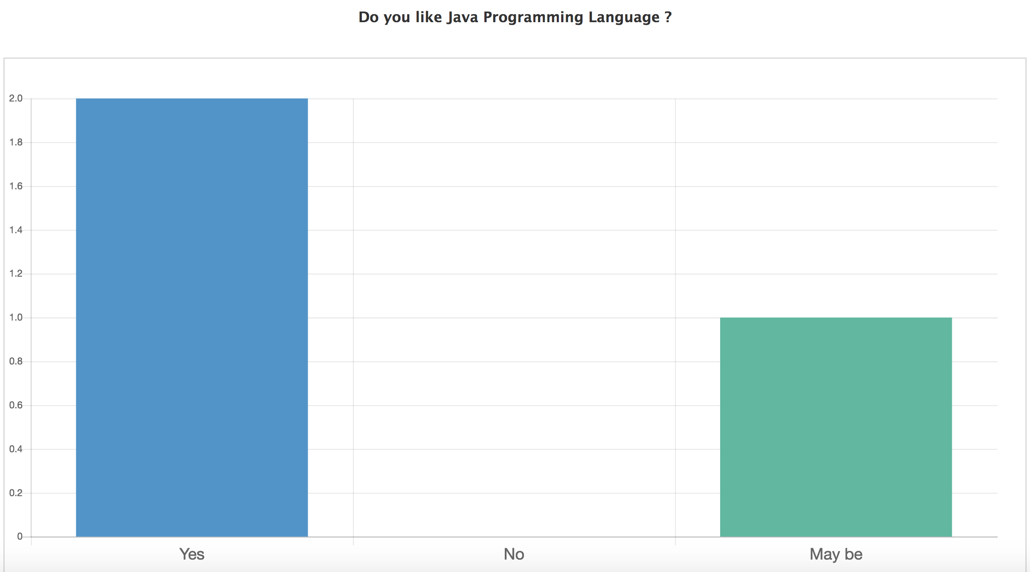
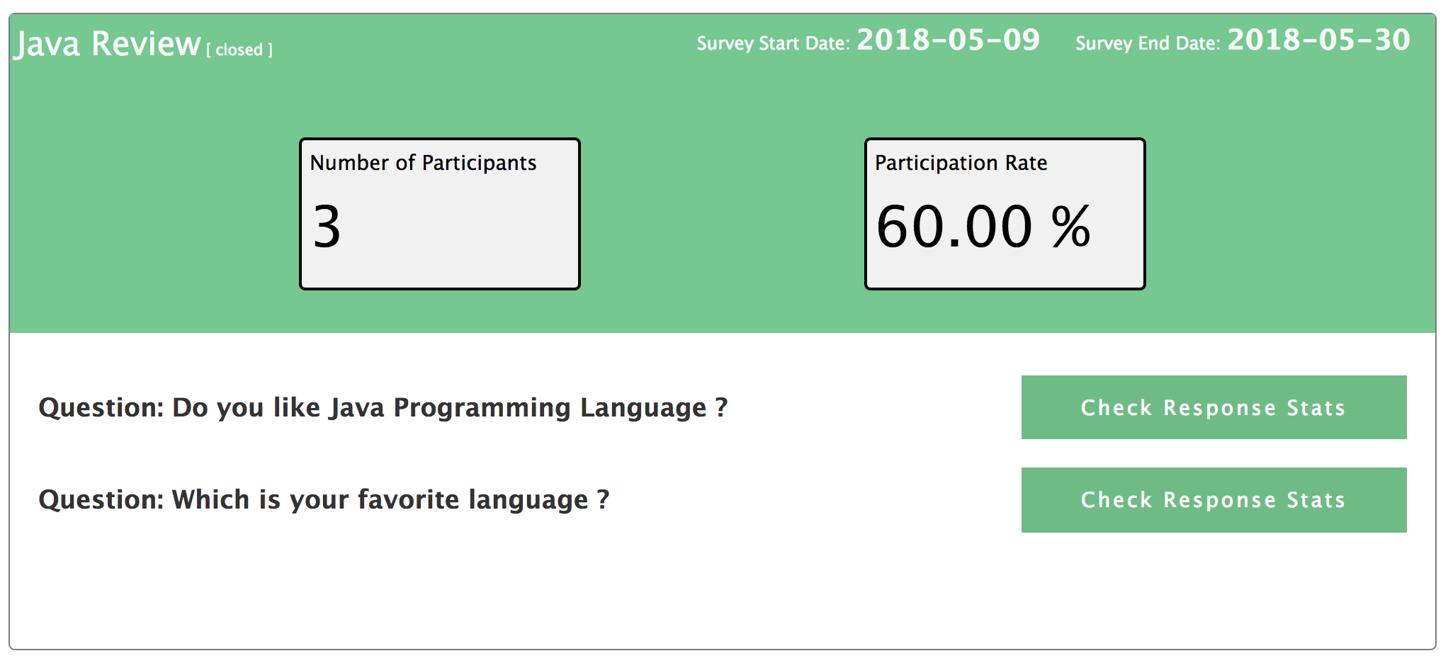
Feature 5 : Statistics Dashboard

