Slide 1
RANKING RESTAURANTS ON THE BASIS OF THEIR HYGEINE DURING THE COVID-19 PANDEMIC
A presentation for coursera/ibm course final assignment
By Vivek tiwari

Slide 2
RANKING RESTAURANTS ON THE BASIS OF THEIR HYGEINE DURING THE COVID-19 PANDEMIC
People are extra-cautious about which restaurant they want to visit as the pandemic has made hygiene a fundamental point in our lives. We find out the best, most hygienic restaurants in San Francisco neighbourhoods in our today's project.

Slide 3
Data acquisition
The neighborhoods and hygiene inspection datasets are easily accessible thanks to the Socrata API provided by the San Francisco Government
Foursquare API for Geolocating these restaurants
GeoJSON data to locate and match these restaurants to Foursquare API

Slide 4
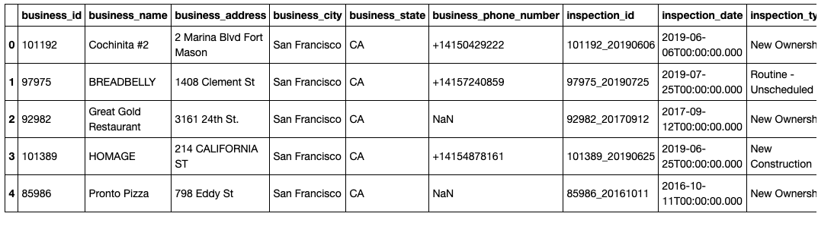
Locating restaurants
I was able to locate these restaurants via the Foursquare API.

Slide 5
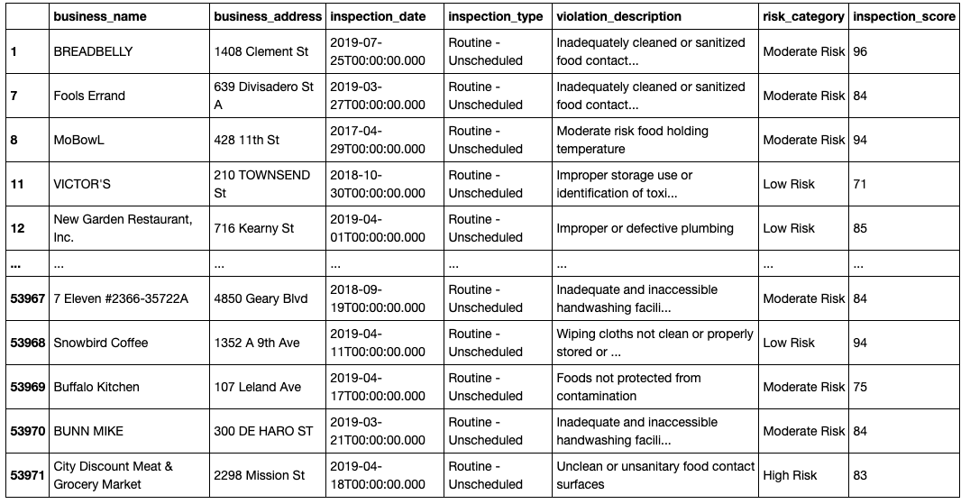
Ranking their inspection rankings

Slide 6
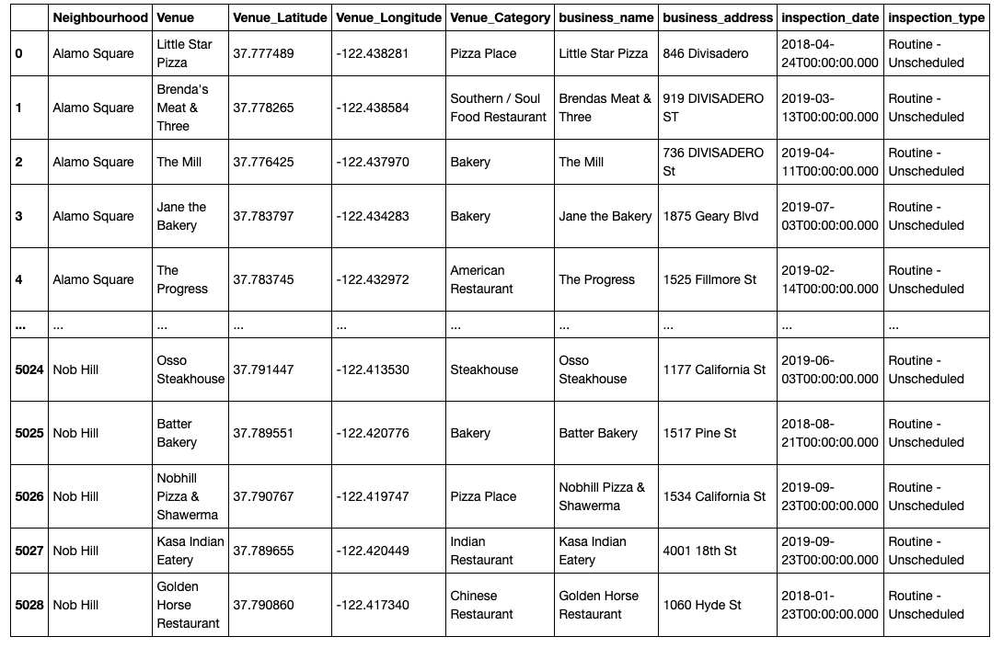
ALAMO SQUARE BEATS OTHER NEIGHBORHOODS

Slide 7
SURPRISINGLY, MIDDLE INCOME NEIGHBORHOODS BEAT HIGH-INCOME NEIGHBORHOODS WHEN IT COMES TO HYGIENE

Slide 8
CONCLUSION
ALAMO SQUARE – BEST PERFORMING NEIGHBORHOOD
NOB HILL – WORST PERFORMING NEIGHBORHOOD
HIGH INCOME AREA DOESN’T NECESSARILY MEAN IT’LL PERFORM BETTER
MIDDLE INCOME NEIGHBORHOODS PERFORM THE BEST

