Slide 1
Austin Residential Property Analysis
Team Members: Angie Bater, Ariana Monteiro, Gatlin Rash, Hadis Hashemi, Nicholas Durhman

Slide 2
Motivation and Summary
Initial Hypothesis: We wanted insight if location or landmarks affected the value of a home
Questions:
Where were the most desirable zip codes?
Which property types were most common in those areas?
How did age of home affect current home value?
What decade saw the largest increase of homes built?
What were the outliers in our data?
Summary:
Proximity to downtown and Lake Travis saw in increase in price per sq ft. Value based on decade built so no strong correlation but saw a decrease during the mid-century. Over the span of the century, more homes were built each year with a few exceptions. Single family residences (house) were the most common type across the 5 zip codes (see post mortem for why we excluded apartment complexes). Homes in 78702 (East Austin) had the largest variance of current market value.

Slide 3
Questions and Data
What available data sources are there out there to gather our research?
Are the API’s manageable? Are they complex to navigate?
What kind of limitations do the APIs have on accessing data?
Which specific regions of Austin will we be looking at?
78745 (SOCO)
78705 (West Campus)
78729 (North Austin)
78732 (Lake Travis)
78702 (East Austin)
We ultimately ended up choosing the ATTOM Developer API based on the amount of relevant data it had to offer.

Slide 4
Data Cleanup and Exploration
Data Cleanup:
Merged the five zip code CSV files into one dataframe
Removed irrelevant fields such as acreage lots and commercial buildings
Data Exploration:
Filtered data down to specific building types and by year built
Grouped home sales into decades by year built
Ran statistical analysis of mean and averages to find potential outliers
Calculated a price per square foot measurement to better assess value
Calculated counts of home types by region

Slide 5
Data Analysis

Slide 6
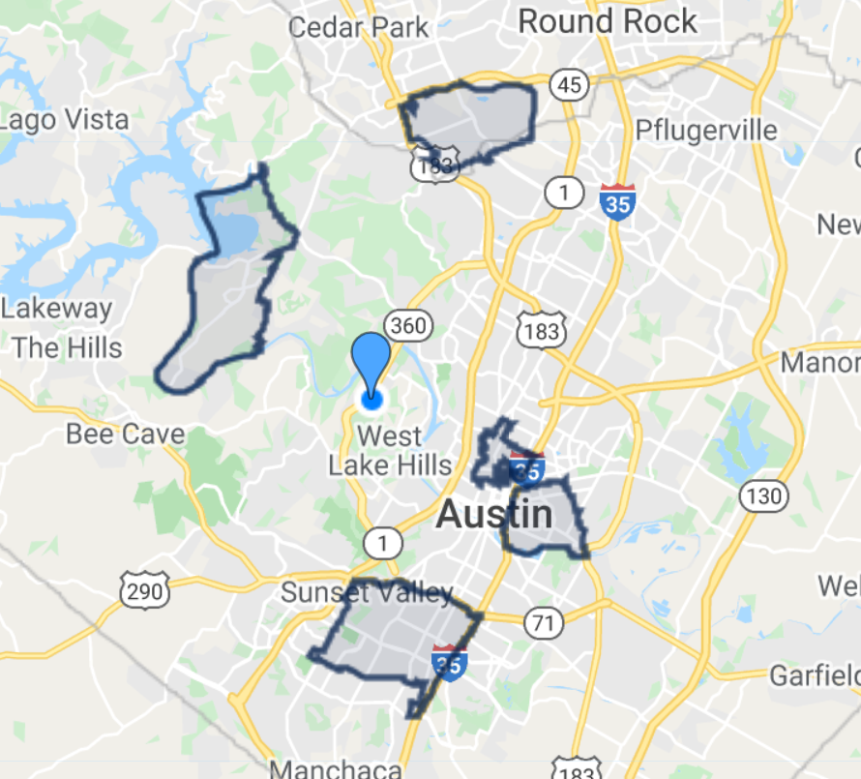
78729
78732
78705
78702
78745
Notes:
The areas highlighted are each of the zip codes we pulled data from. This is a snippet from a website

Slide 7
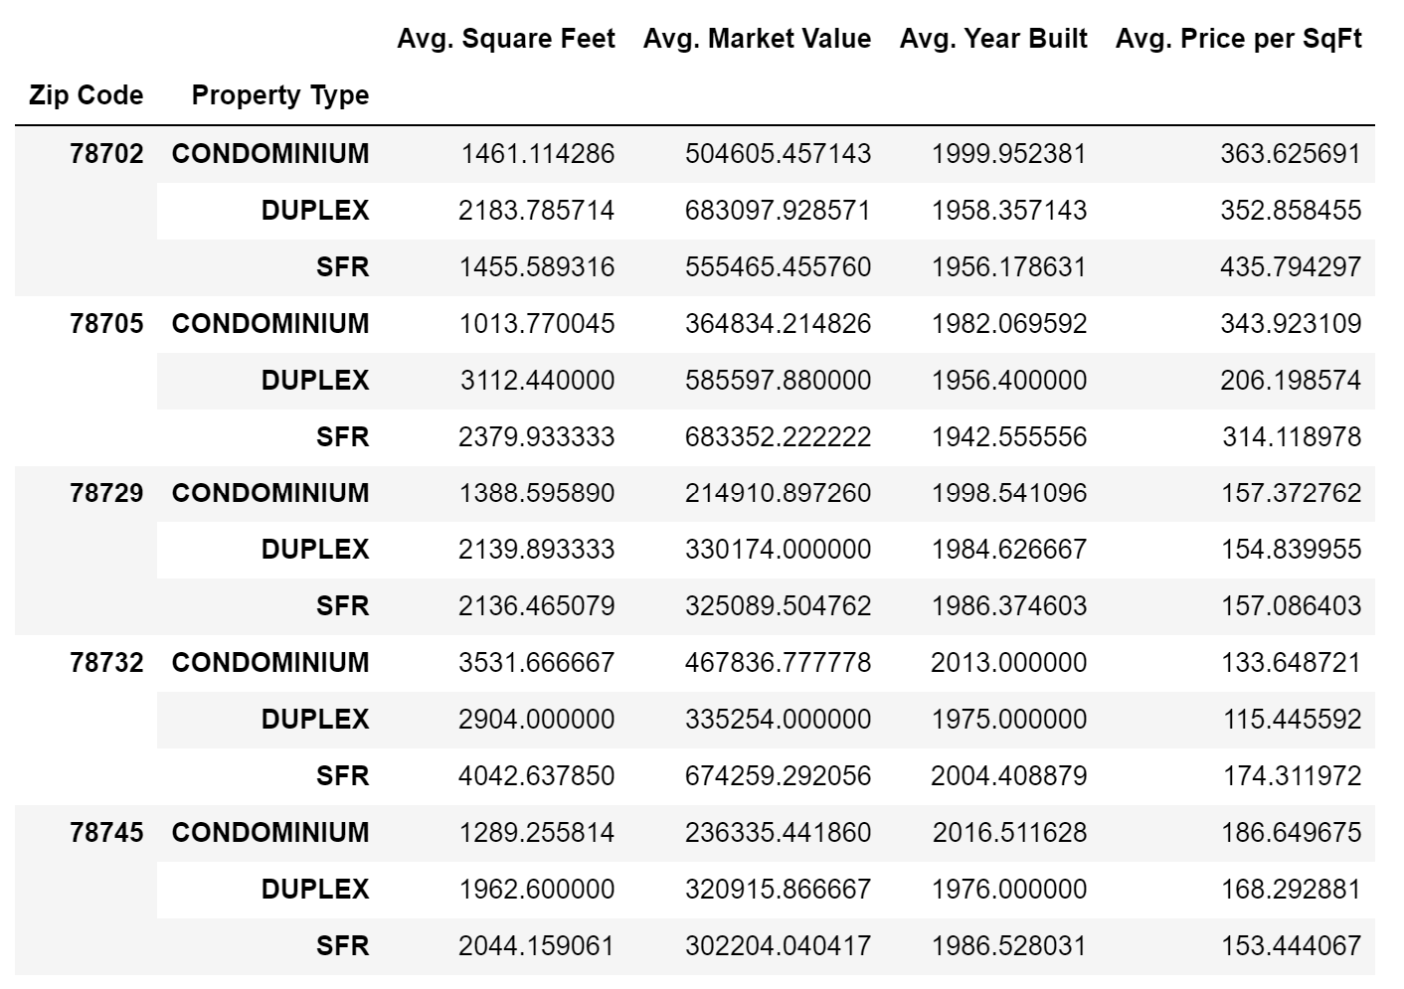
Property Data-Averages
•Properties near East Austin (78702) and West Campus (78705) have the highest average market value.
•Properties in West Campus are the oldest and properties near Lake Travis (78732) are the newest
•Properties near Lake Travis have the highest average square footage.
•Properties in East Austin have the highest average price per square foot.
Notes:
New data -5000 rows

Slide 8
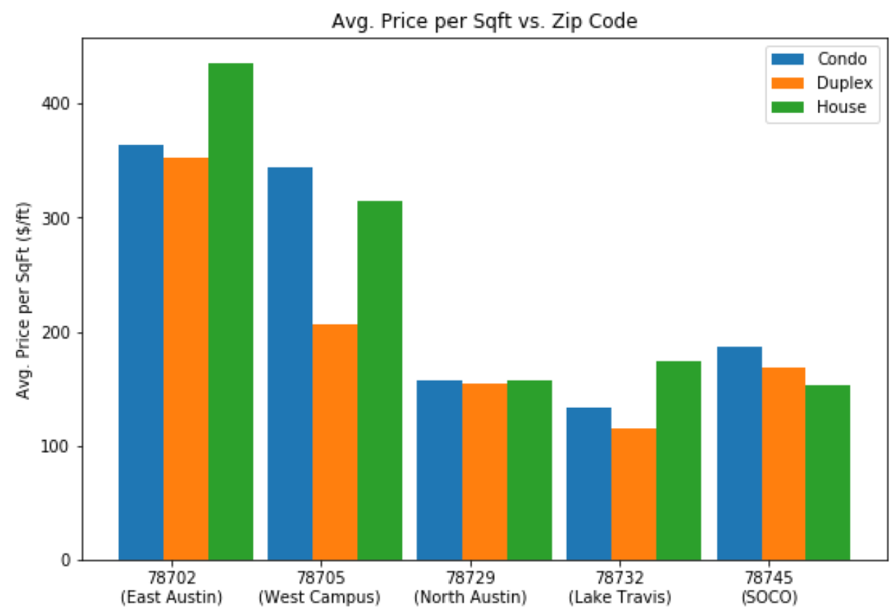
Average Price per Square Foot
•In general, houses and condos have higher average price per sq ft than duplex’s.
•East Austin and West Campus have the most expensive properties per sq ft.
•Properties near SOCO, North Austin, and Lake Travis all have relatively low average price per sq ft around 170 $/ft.

Slide 9
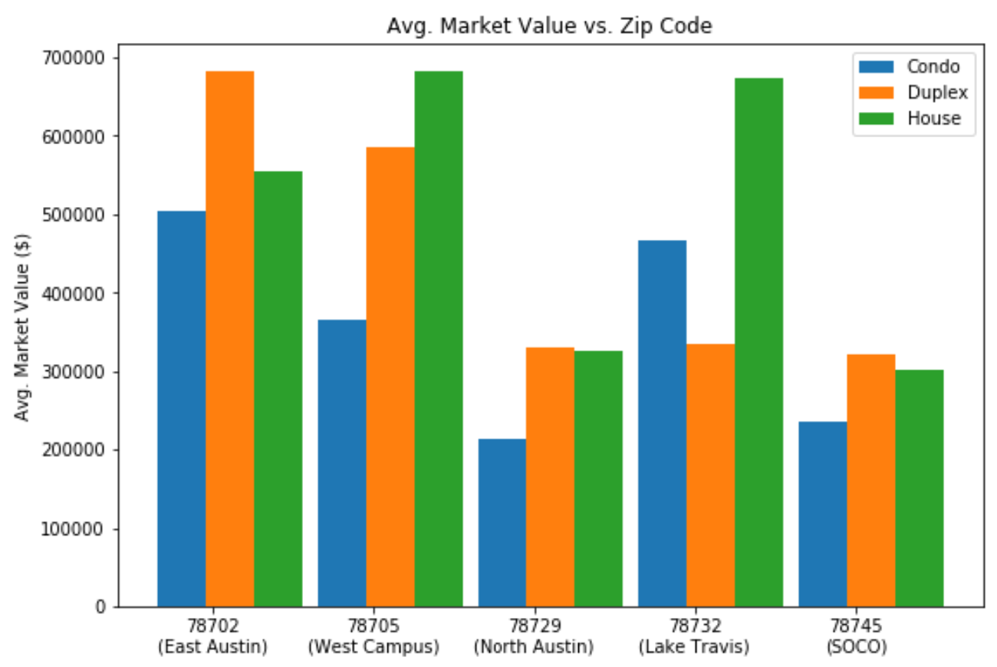
Average Market Value
•Houses near Lake Travis have a higher avg. market value but much lower avg. price per square foot than houses in East Austin.
.•The most expensive areas to buy houses are West Campus and near Lake Travis.
•Condos generally have the lowest market value compared to duplexes and houses.

Slide 10
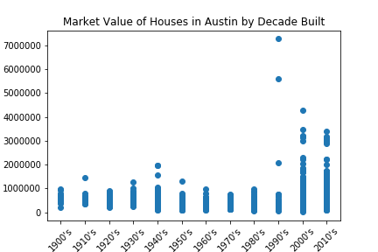
How Does the Decade Built Affect Current Home Value?
•Taking the data down to ‘SFR’ or ‘Single-Family Residence” and comparing Year Built and Market Value, can we see a trend?
•The inclusion of outliers makes it hard to see a trend; let’s fix that.

Slide 11
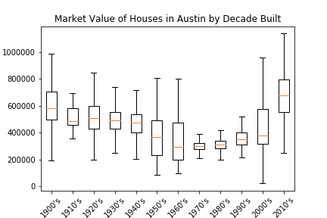
How Does the Decade Built Affect Current Home Value?
•By switching to a box-and-whisker plot, and leaving out the outliers, a trend arises.
•What happened?
•First a gradual decline until the seventies, then a quick rise.
•As these are the current market values (give or take a year or two), what are some possible explanations?
Market Value ($)

Slide 12
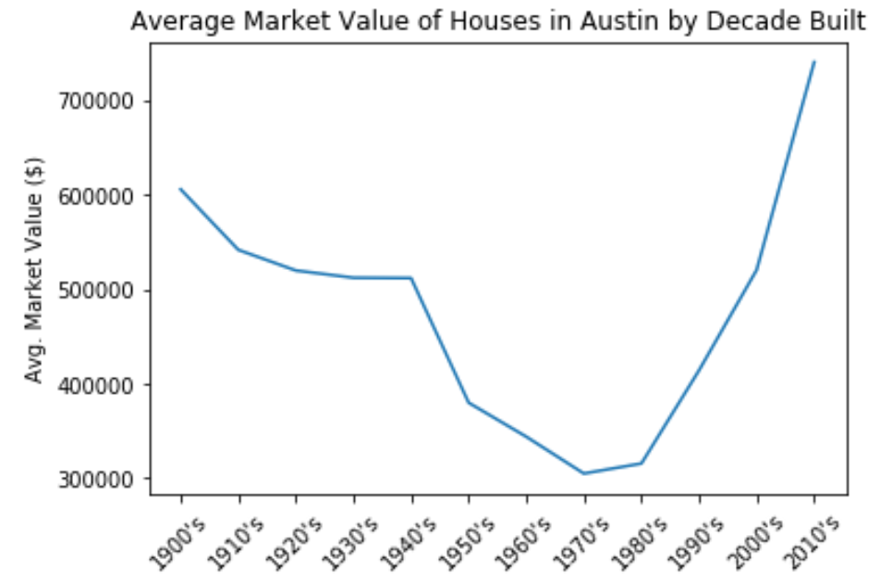
How Does the Decade Built Affect Current Home Value?
•Looking at the trend by taking the average market value per decade gives a similar picture.
If not perhaps a bit easier to see.
•Remember, this is not showing market value over time, this is current value of SFR’s over decade built.

Slide 13
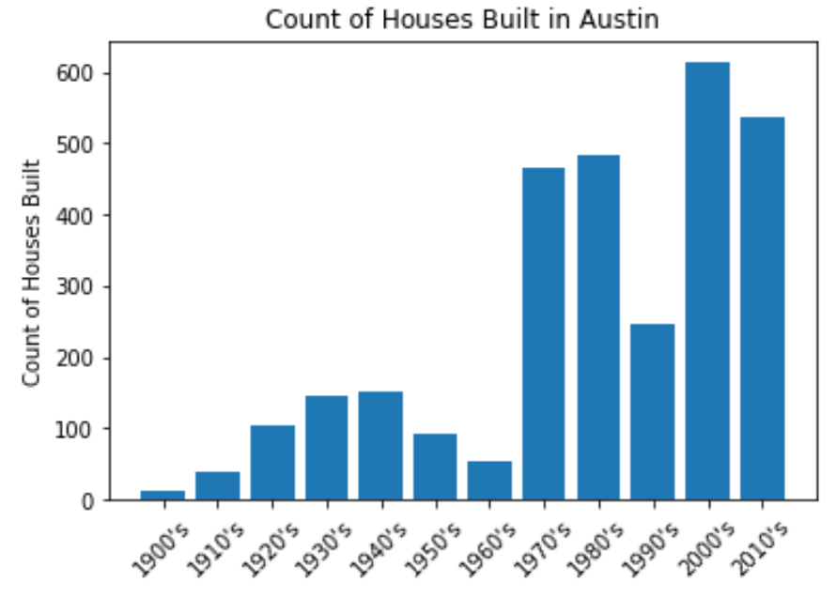
When were houses being built in Austin?
There was an increase in houses being built in the 1930s-1940s.
There was a sharp decline in houses being built in the 1990’s
The peak decade for houses being built was 2000’s

Slide 14
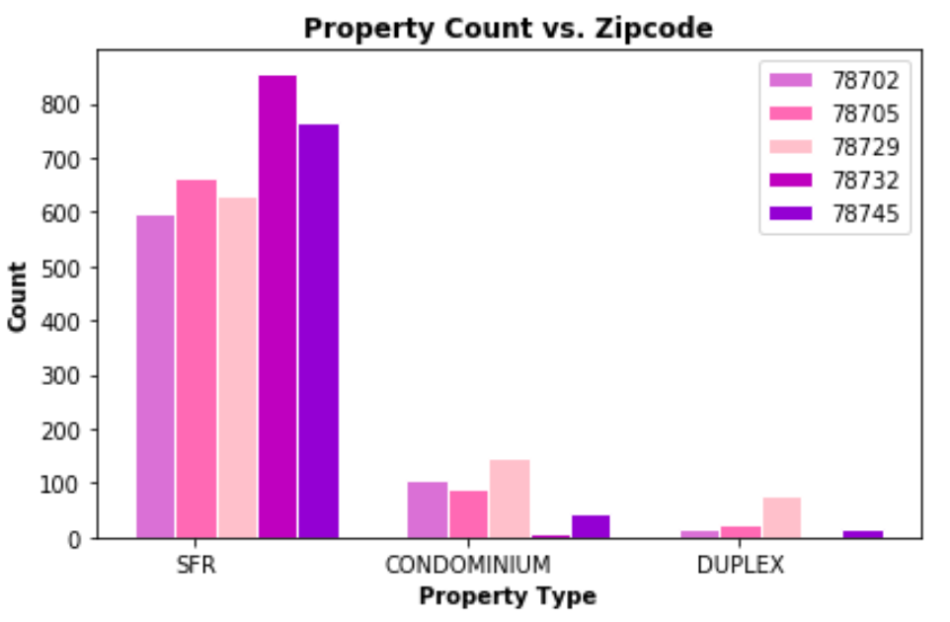
Property Counts per Zip Code
There are more SFR’s in each zip code than condominiums and duplexes.
The highest amount of duplexes and condominiums are located in zip code 78729 (North Austin).
The highest amount of SFR’s and lowest amount of duplexes is located in zip code 78732, which is near Lake Travis.

Slide 15
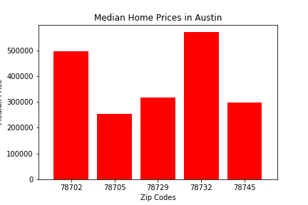
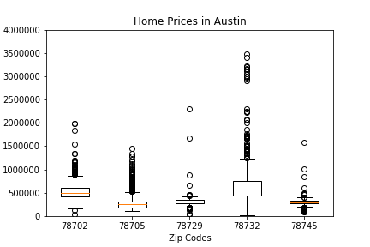
Home Prices in Austin by Zip Code
Price in Dollars
Price in Dollars
Median home prices is a better way to compare values across zip codes because a few outliers, particularly the handful of multi-million dollar homes in the 78732 zip code, can skew averages with misleading information.

Slide 16
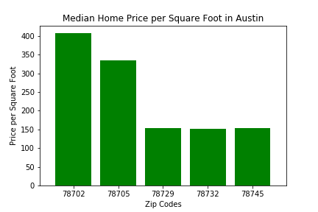
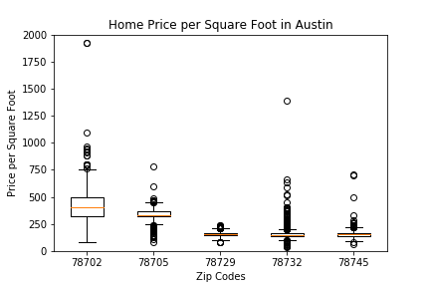
Home Prices per Square Foot in Austin by Zip Code
Price per square foot gives a better evaluation of a property’s utility relative to other homes in the city.

Slide 17
Discussion
We found that the closer a property is to downtown Austin or Lake Travis, the more expensive it is.
In general newer properties have a higher market value than older properties, though the varying trends since the 1900’s might have interesting explanations.
Generally more houses were being built each decade.
In terms of property count, houses are more popular than condos and duplexes across the 5 zip codes.
Homes in 78732 zip code are more expensive than the other zip codes.

Slide 18
Post Mortem
We ran into difficulties pulling data from the ATTOM API (see Supplemental Slides)
Additional questions that arose:
Analyze all of the zip codes in Austin rather than just 5
Research the history of why certain trends are the way they are
Analyzed apartment data as well

Slide 19
Questions?
* Open-floor Q&A with the audience

Slide 20
Supplemental Slides

Slide 21
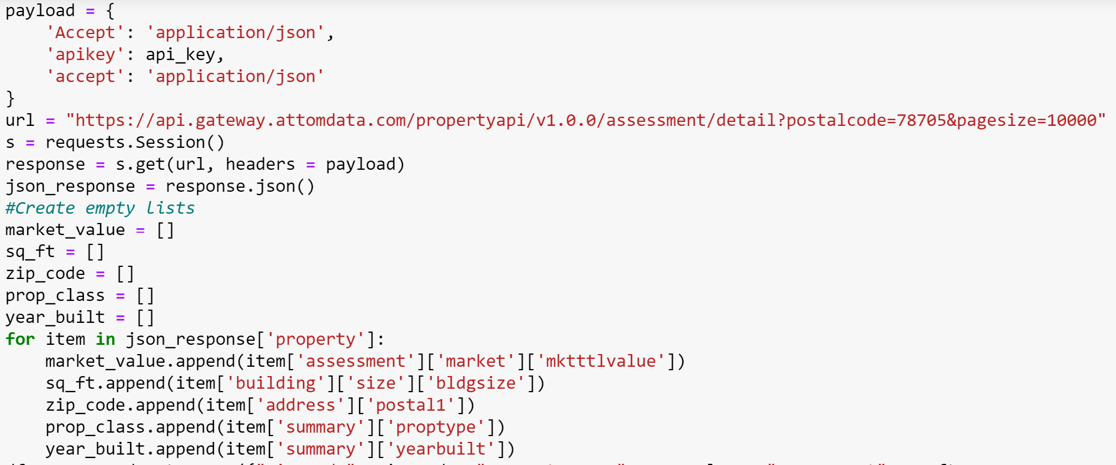
Original code: looped through 10,000 properties for each zip code
Notes:
We made the page size 10,000 so that our code could loop through every property in the API

Slide 22
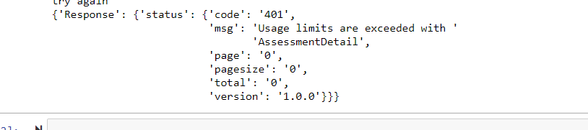
ATTOM API Usage Limitations
After maxing out our pull limits we started to get this error after every subsequent query:

Slide 23
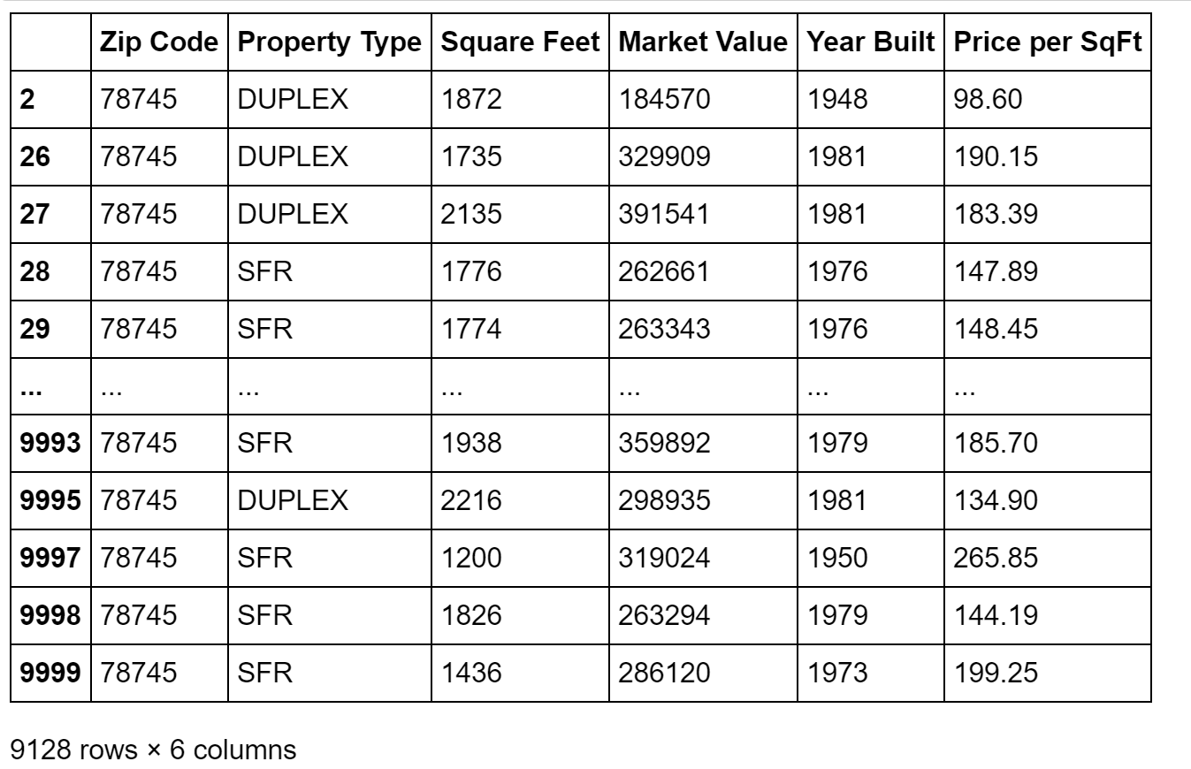
Notes:
This was what the API was originally giving us: ~10,000 rows of property data for each zip code.

Slide 24
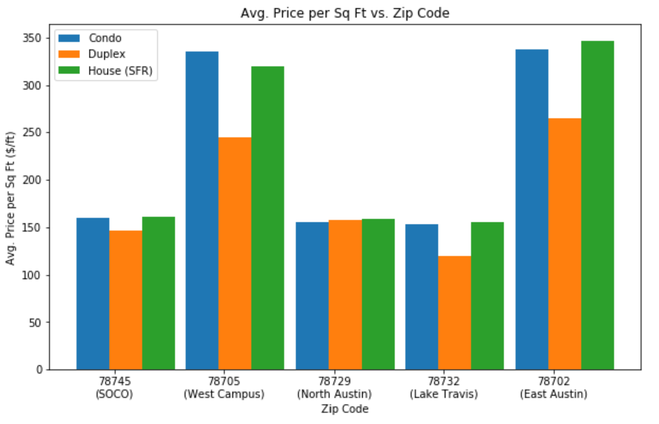
Average Price per Square Foot
•In general, houses and condos have higher average price per sq ft than duplex’s.
•Downtown Austin and West Campus have the most expensive properties per sq ft.
•Properties near SOCO, North Austin, and Lake Travis all have relatively low average price per sq ft around 150 $/ft.
Notes:
This bar chart was created using matplotlib-with 10,000 properties per zip code

Slide 25
Limitations of the ATTOM API
1. Can only make 10 pull requests per minute
2. Can only make 500 pull requests per day
•Due to these limitations after a few days of making pull requests we started to run into JSON Decode Errors.
•We were making requests for data that was larger than internet protocol allows and the response we were getting back was incomplete and did not have ay closing brackets so JSON could not interpret the response.

Slide 26
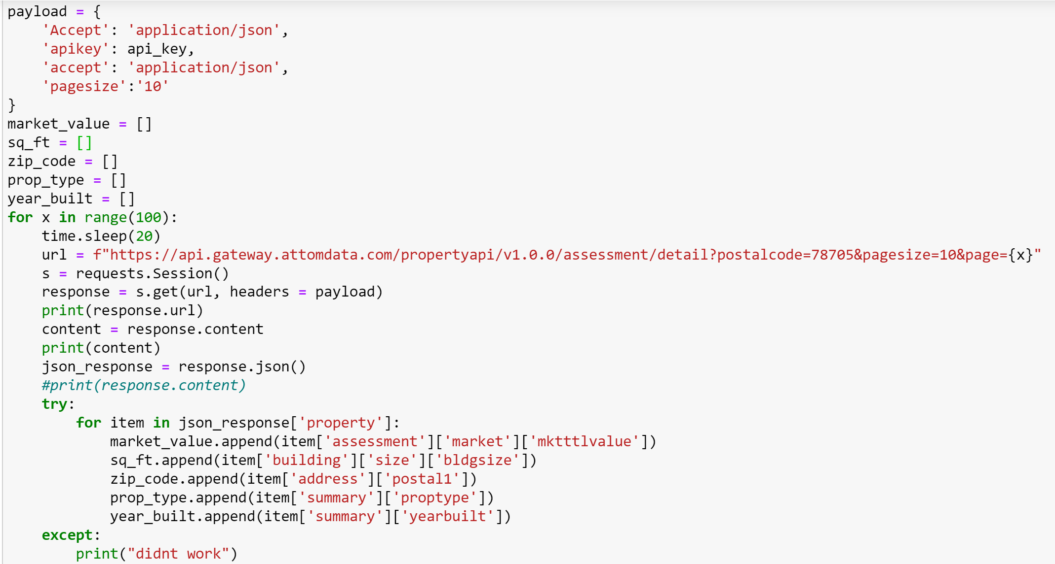
Notes:
We had to edit our original code to loop through 100 pages at a time with only 10 properties per page. We put a time limit on how fast the program executes so that we did not exceed the limitations of the API request, it takes a request every 20 seconds. We each ran this code for the 5 different zip codes and were able to get data on 1,000 properties per zip code.

