Slide 1
CAMP DATA
Areli Muñoz, Tyler Sanchez, David Benitez

Slide 2






Problem:
200 men come to camp with paper applications and payment information
Entering the data is monotonous and takes about 5 hours
The data takes too long to retrieve since it has to be physically looked-up
Create an application to be filled out internally
Create users to allow leaders to view their group’s information
Create an ability to search by all criteria
This data will be stored in a database for ease of access

Slide 3
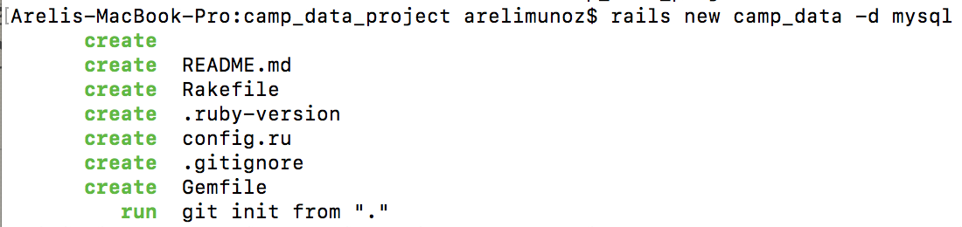
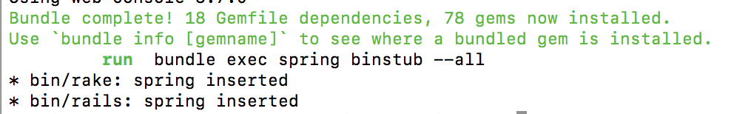
Step By Step:
Step 1: Make directory
mkdir camp_data_project
&
cd camp_data_project
Step 2: Create Rails Project
rails new camp_data -d mysql

Slide 4
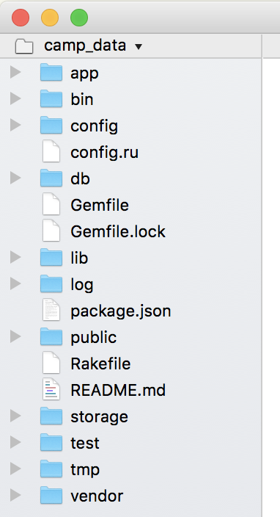
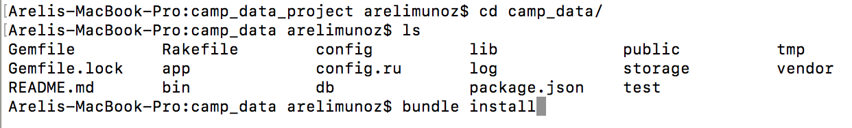
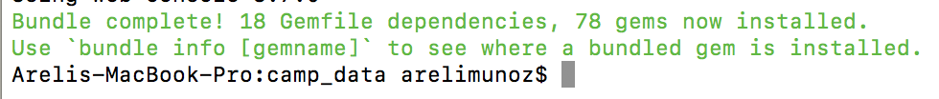
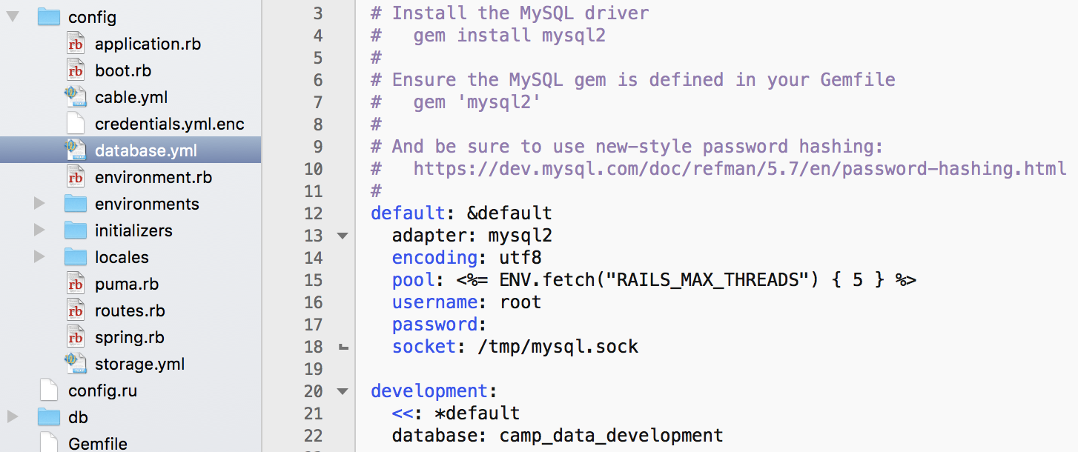
Step By Step:
Step 3: Change working Directory
& open a text editor
cd camp_data
bundle install
Step 4: Open config/database.yml
& configure log in credentials
Copy:
camp_data_developmentd

Slide 5


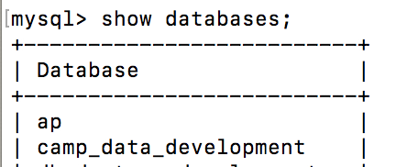
Step By Step:
Step 5: Log into mysql
mysql -u root -p
Step 6: While in mysql,
create database for rails project
CREATE DATABASE camp_data_development;
*view database when created
show databases;

Slide 6
Step By Step:
Step 7: Open new terminal,
Navigate to project folder
cd camp_data
Step 8: Create scaffold,
Type:
rails g scaffold Personal_Information firstName:string lastName:string phone:integer
email:string city:string state:string zip:integer dob:date
rails g scaffold Emergency_Contact firstName:string lastName:string phone:integer relationship:string personal_information_id:integer
rails g scaffold Church_Information personal_information_id:integer home_church:string phone:integer
rails g scaffold Users username:string password:string firstName:string lastName:string title:string is_super_user:boolean

Slide 7
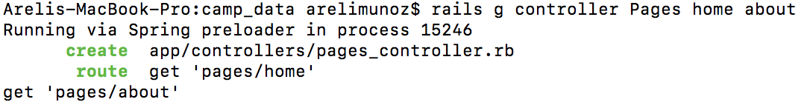
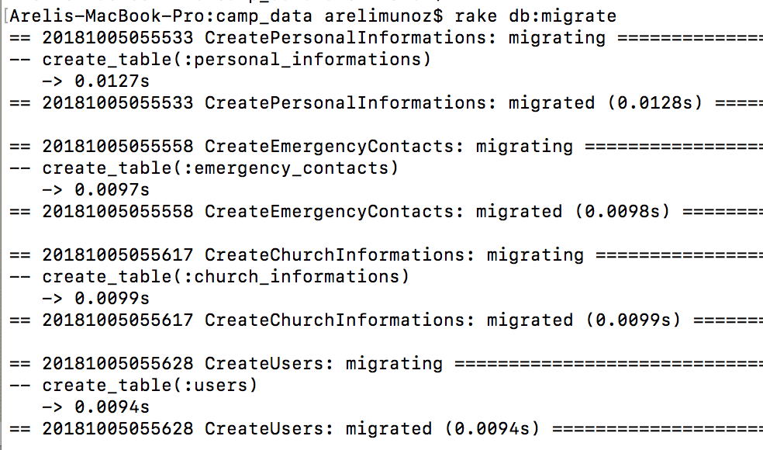
Step By Step:
Step 9: Create Scaffold
home and about page.
Routes to ‘Pages’ controller
rails g controller Pages home about
Step 10: Migrate Project
*Not in mysql
rake db:migrate

Slide 8
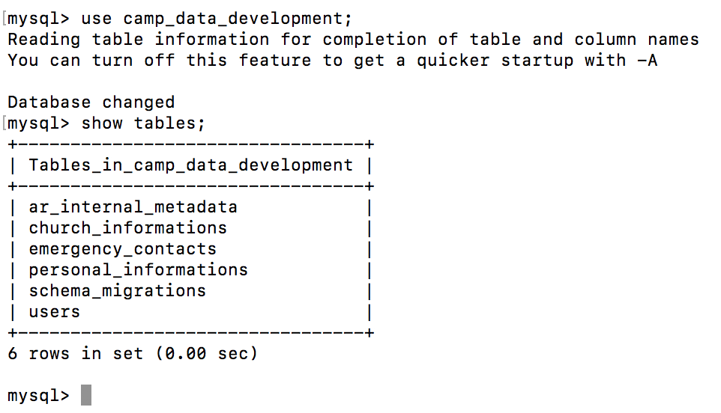
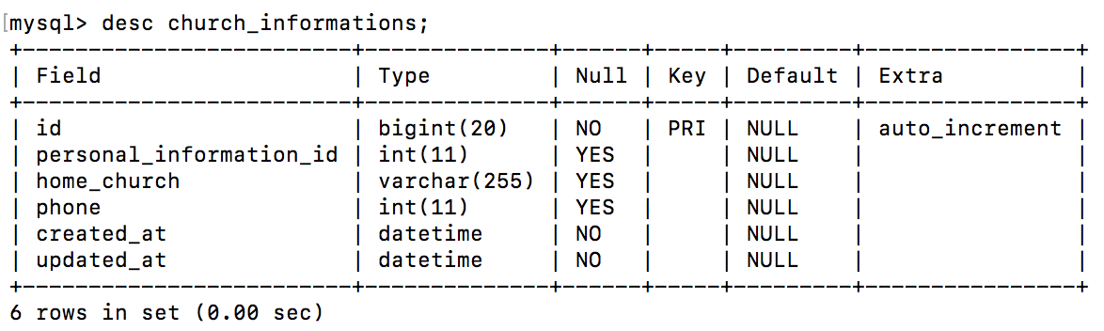
View Tables:

