Slide 1
Camp Data
Areli Muñoz, Tyler Sanchez, David Benitez

Slide 2
Updated Database:
Sets limit
rails g scaffold Camp_Member first_name:string last_name:string street:string city:string state:string{2} zip:string{5} phone_number:string{12} dob:date age:integer email:string home_church_id:integer paid:boolean payment_type:integer entered_on:date
rails g scaffold Emergency_Contact first_name:string last_name:string phone_number:string{12} relationship:string
rails g scaffold Payment_Information name_on_card:string card_number:string expiration_date:date cvv:string{3} amount_paid:decimal payment_type:string
rails g scaffold Church_Name church_name:string pastor_name:string mens_leader:string

Slide 3
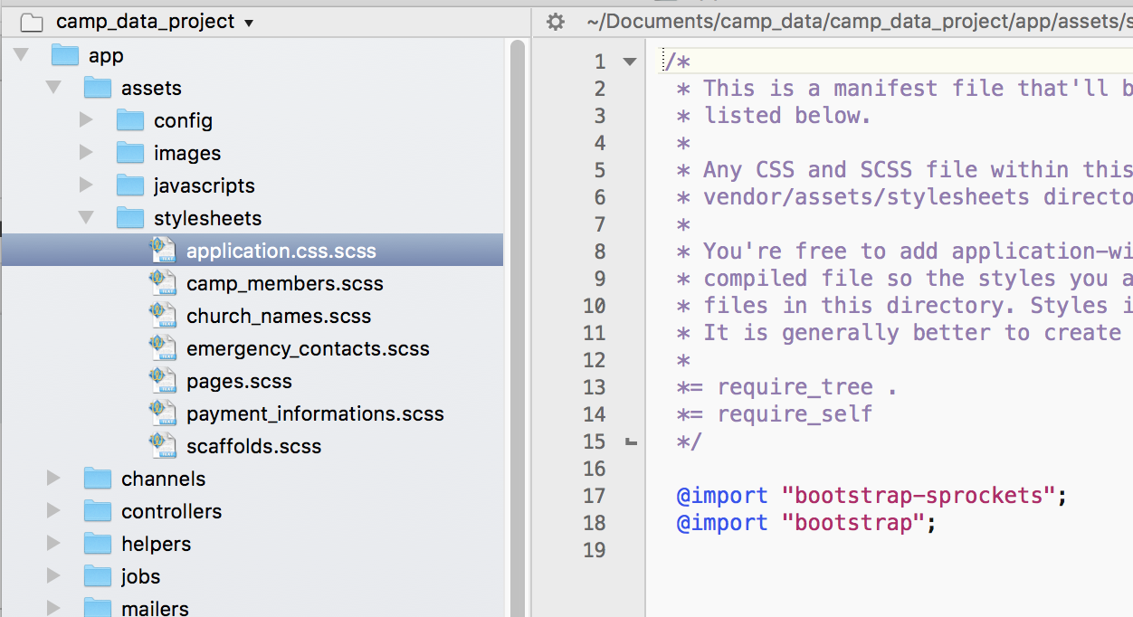
Connecting bootstrap with Rails:
In app/stylesheets/
: Renamed extension in application to .scss
Imported bootstrap-sprockets, bootstrap
Bundle install in rails application

Slide 4
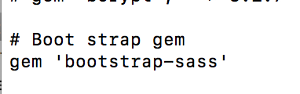
Connecting bootstrap with Rails:
In Gemfile:
Added gem bootstrap-sass
Bundle install

Slide 5
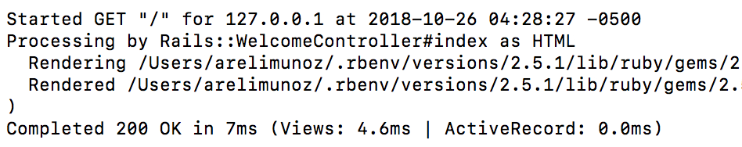
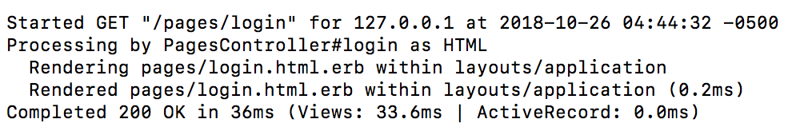
Worked:

Slide 6
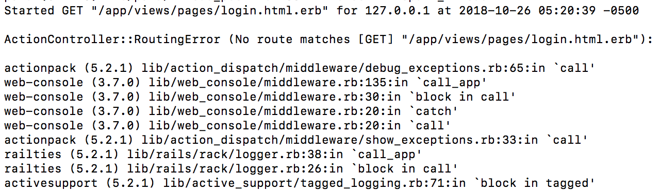
Failed: Routing Error

Slide 7
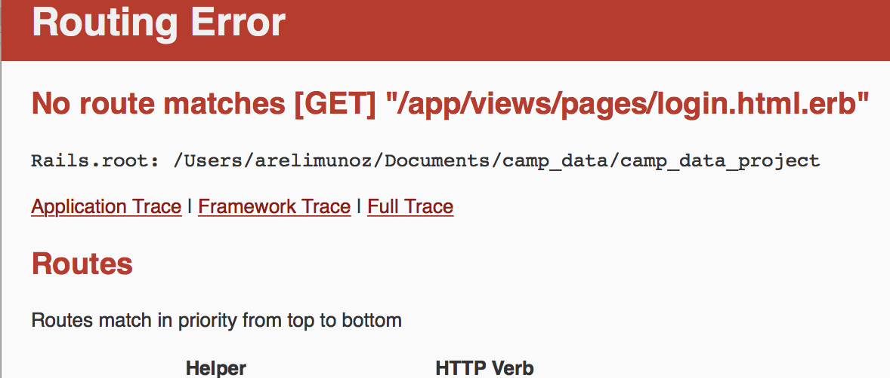
Display Error:

Slide 8

Edits:

Slide 9
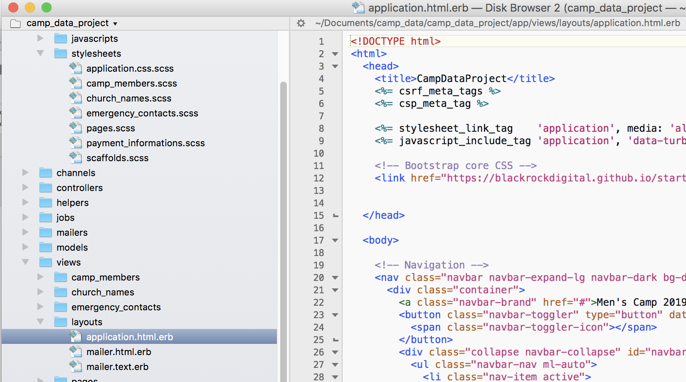
Broke:

Slide 10
Continue to work on
Continue to work on Gui so customer can view progress
Understanding foreign key display in scaffold
Understanding models and connections with classes in app/models/

