Slide 1
Camp Data
Areli Muñoz, Tyler Sanchez, David Benitez

Slide 2
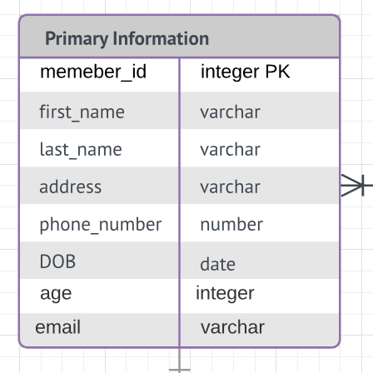
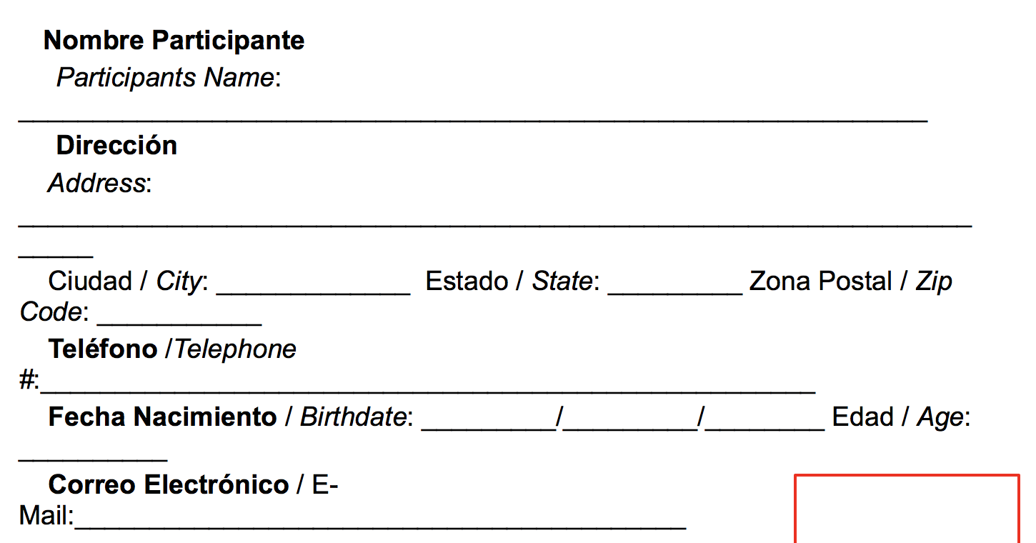
Attributes
Constraints
Table Name
Primary Key

Slide 3
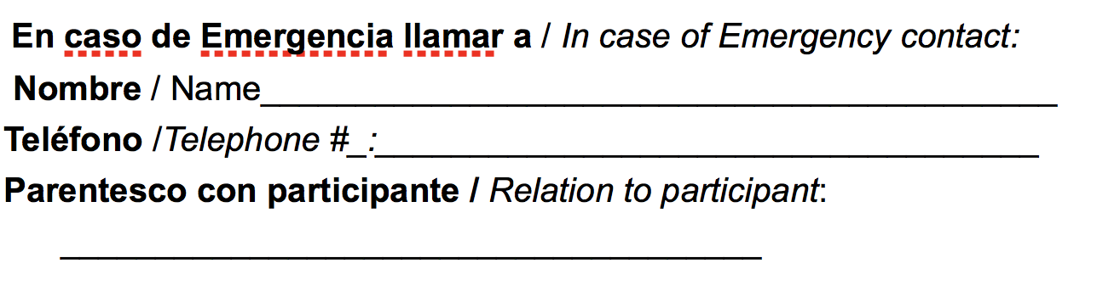
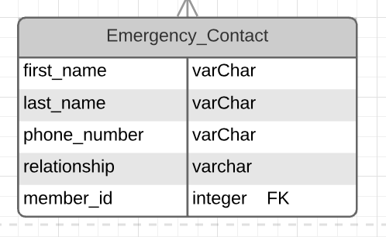
Table Name
Attributes
Constraints
Foreign Key

Slide 4
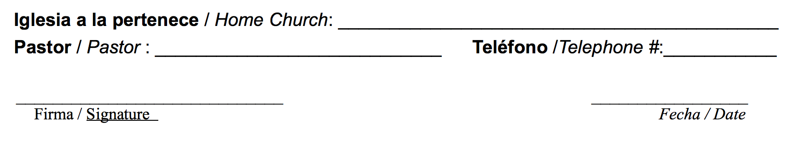
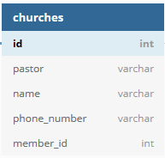
Primary Key
Constraints
Attributes of Form
Foreign Key to primary information table

Slide 5
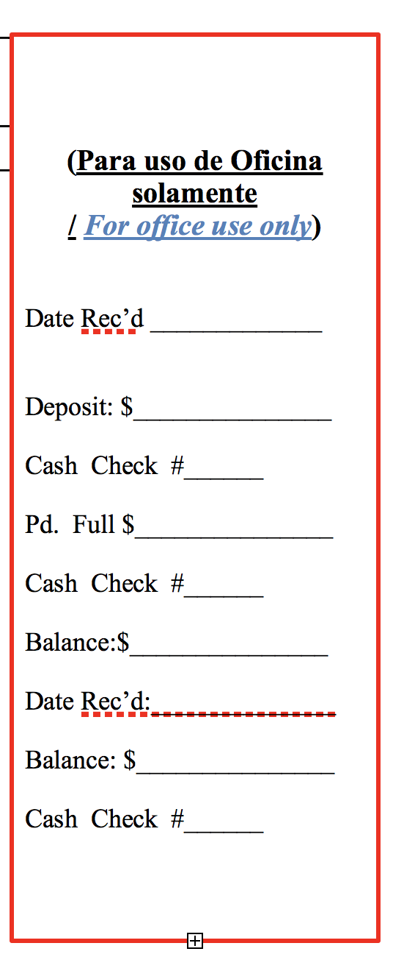
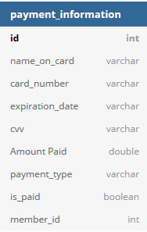
Primary Key
Constraints
Attributes
Foreign Key

Slide 6
