Slide 1
Camp Data
Areli Muñoz, Tyler Sanchez, David Benitez

Slide 2
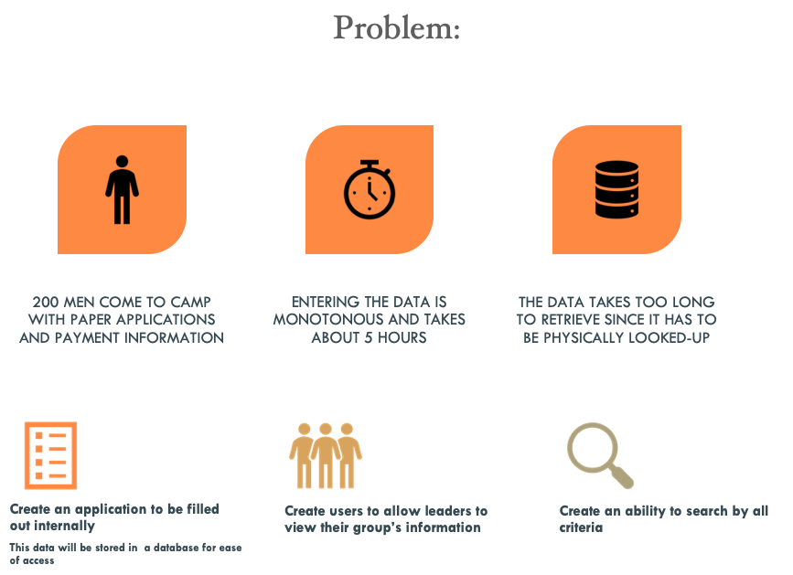

Slide 3
OverView
Login
HomePage
Tables
Audits
Triggers
Demo

Slide 4
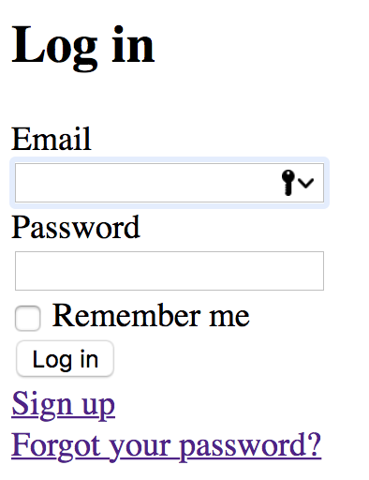
Log In
Users can sign up, login in
Will direct to homepage

Slide 5
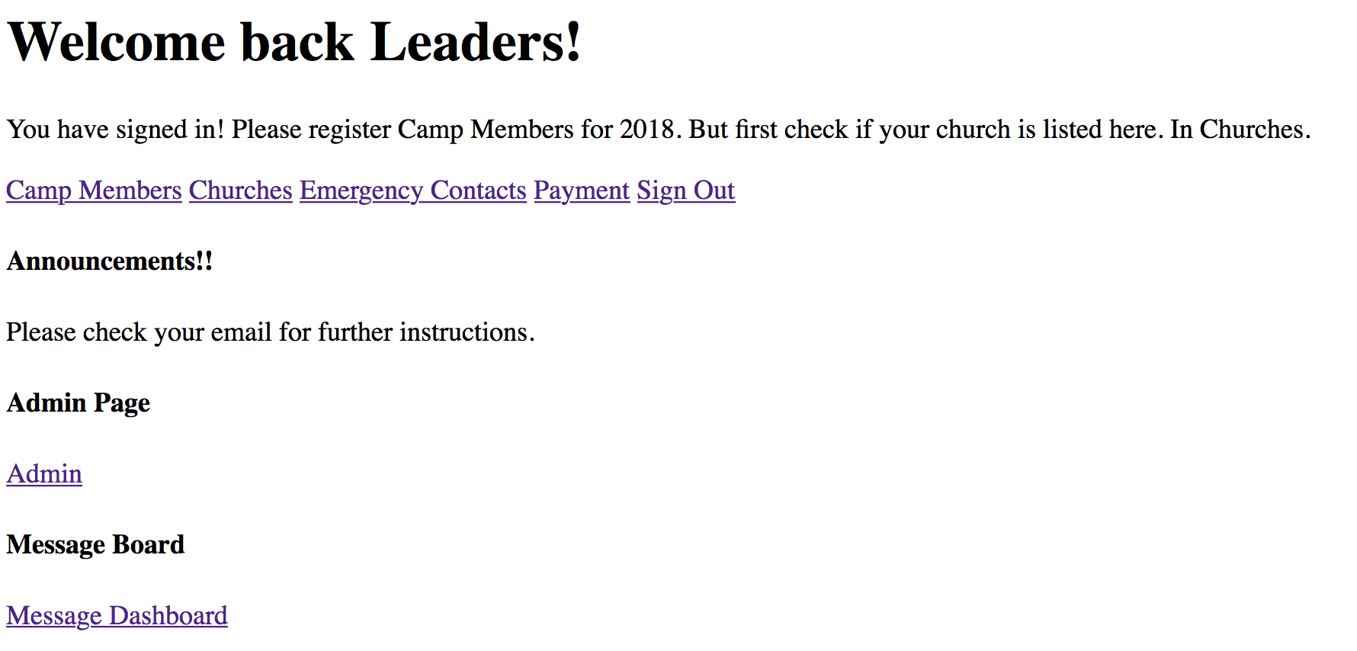
Home Page

Slide 6
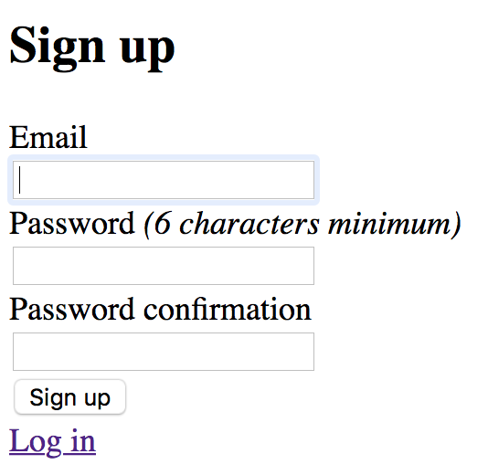
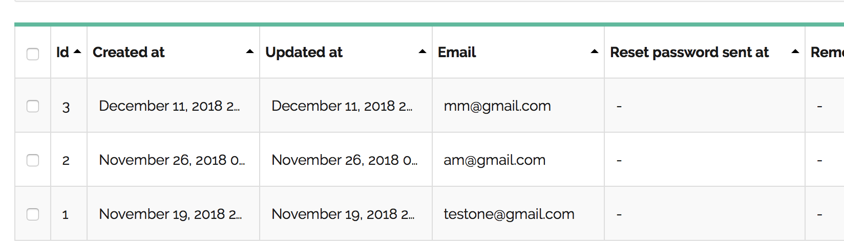
Add User
Sign up a user

Slide 7
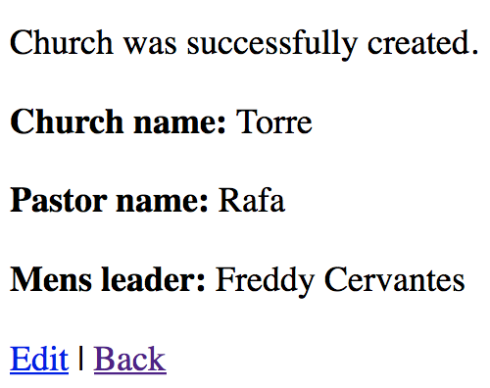
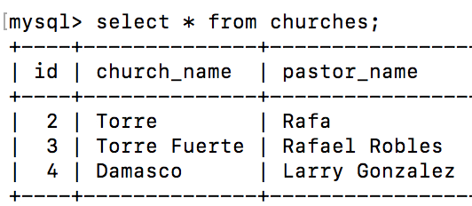
Church
Church is created-- see ID

Slide 8
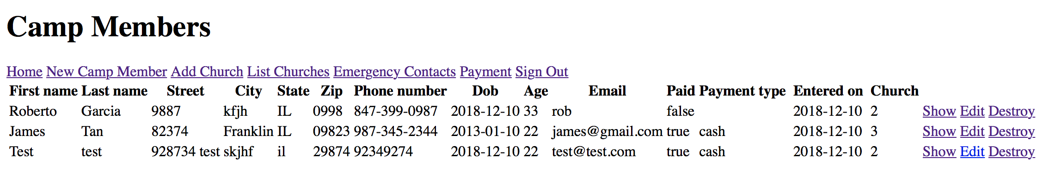
Member
Display list of camp members
Able to add members in: New Camp Member tab

Slide 9
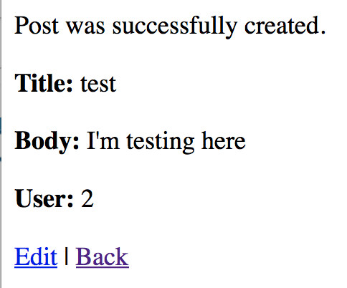
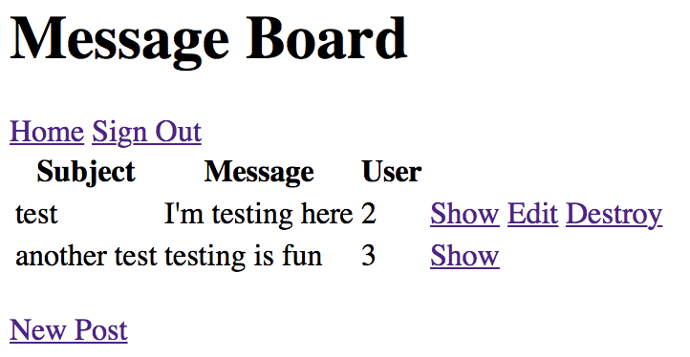
Message Board
Using cancancan gem
Give permissions to author; other users can’t edit

Slide 10
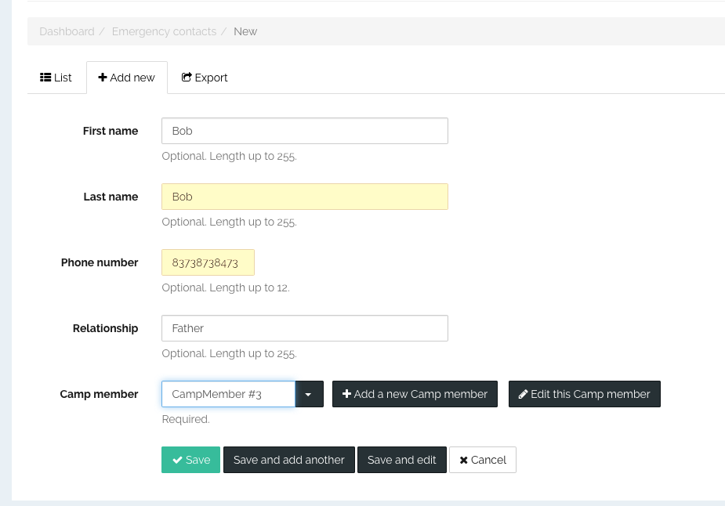
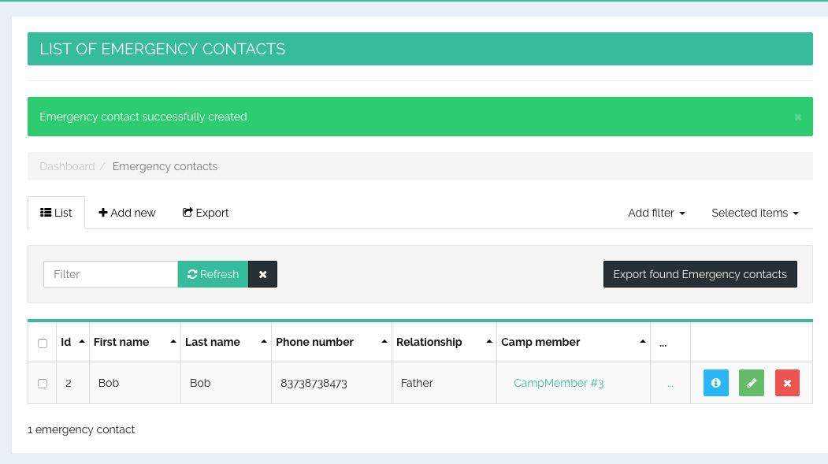
Emergency Contact
Links to Camp Member by ID

Slide 11
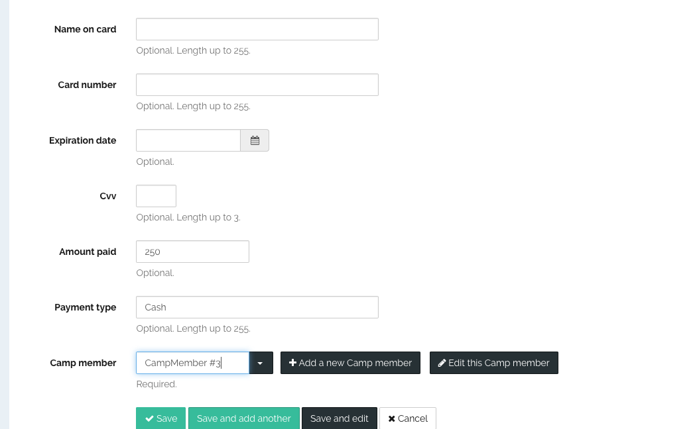
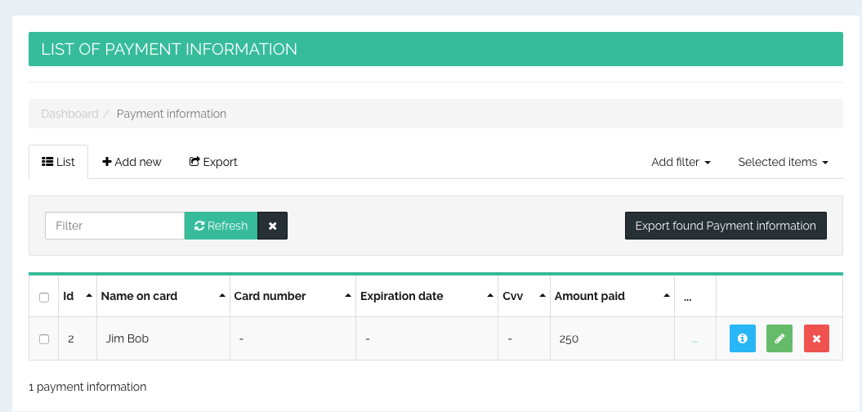
Payment Information
Shows how much member paid
Shows how they paid (Cash, Credit Card)

Slide 12
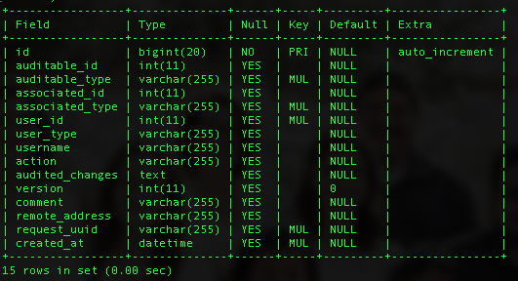
Audits
Shows made changes
When changes made
Shows what was changes

Slide 13
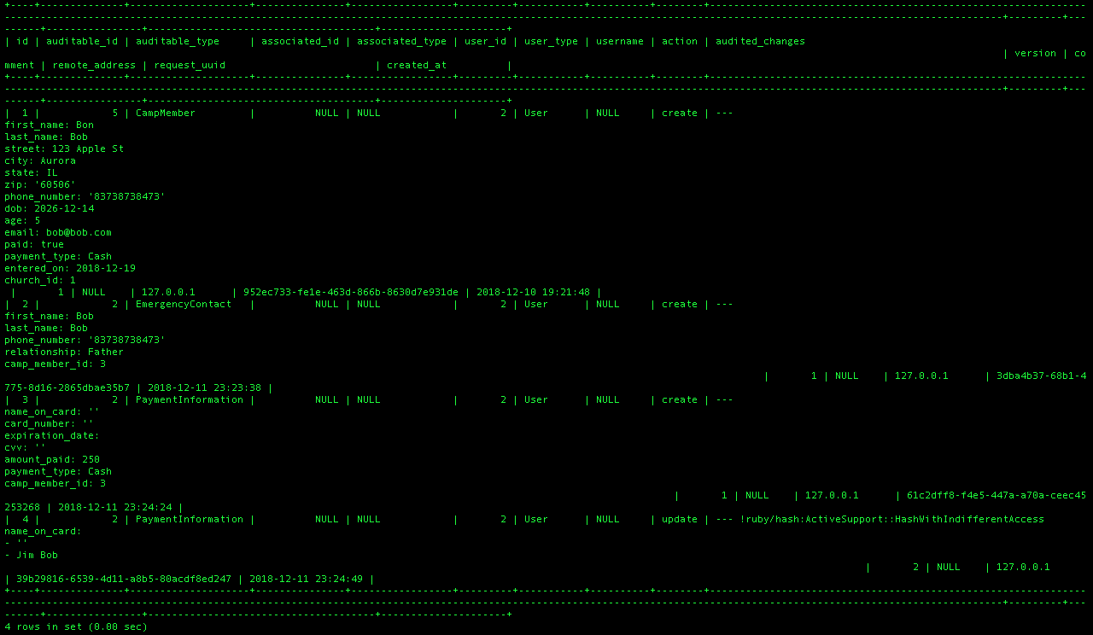

Slide 14
Trigger- Delete a user
You can’t just kill the parent and orphan the kids
Ruby will scream at you
Not because you’re a monster, but because it breaks the Foreign Key constraints
Therefore, I needed a triggeYou can’t just kill the parent and orphan the kids
Ruby will scream at you
Not because you’re a monster, but because it breaks the Foreign Key constraints
Therefore, I needed a trigger
You can’t just kill the parent and orphan the kids
Ruby will scream at you
Not because you’re a monster, but because it breaks the Foreign Key constraints
Therefore, I needed a trigger

Slide 15
DROP TRIGGER IF EXISTS delete_payment_and_contact_before_user;
DELIMITER //
CREATE TRIGGER delete_payment_and_contact_before_user
BEFORE DELETE ON camp_members
FOR EACH ROW
BEGIN
DELETE FROM emergency_contacts where emergency_contacts.camp_member_id=old.id;
DELETE FROM payment_informations where payment_informations.camp_member_id = old.id;
END //
DELIMITER ;

Slide 16
Demo

Slide 17
Github
https://github.com/arimunoz/CSC4500_Ministry.git

