Slide 1
Documentation for Mac Asp.Net Core 2.0
By: Matt Cowans

Slide 2
Github Link
https://github.com/arimunoz/SportsProj.git

Slide 3
Web Crawler Reference link:
https://html-agility-pack.net

Slide 4
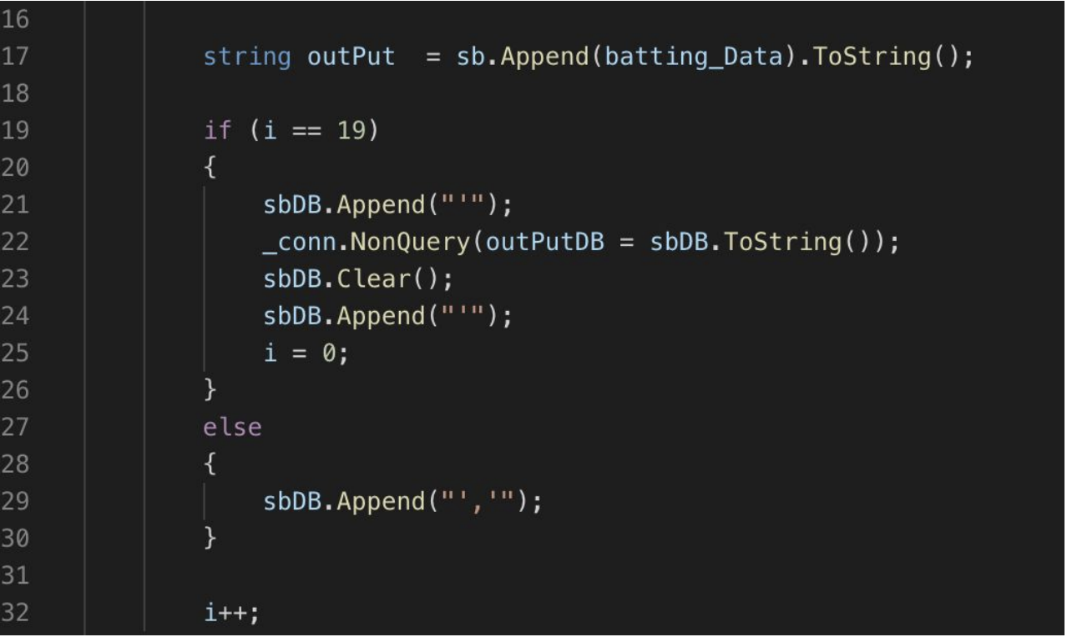
WebCrawler

Slide 5
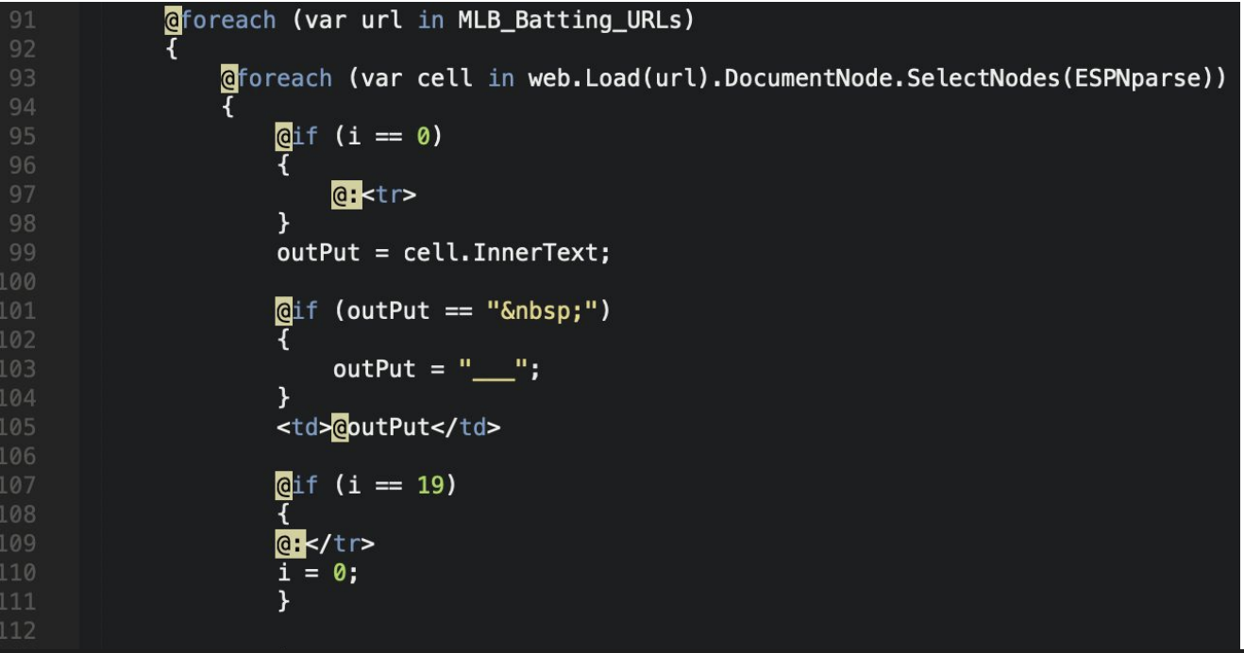
WebCrawler (Razor Pages)

Slide 6
Database Connection for Console Application Reference
https://www.codeproject.com/Articles/43438/Connect-C-to-MySQL

Slide 7
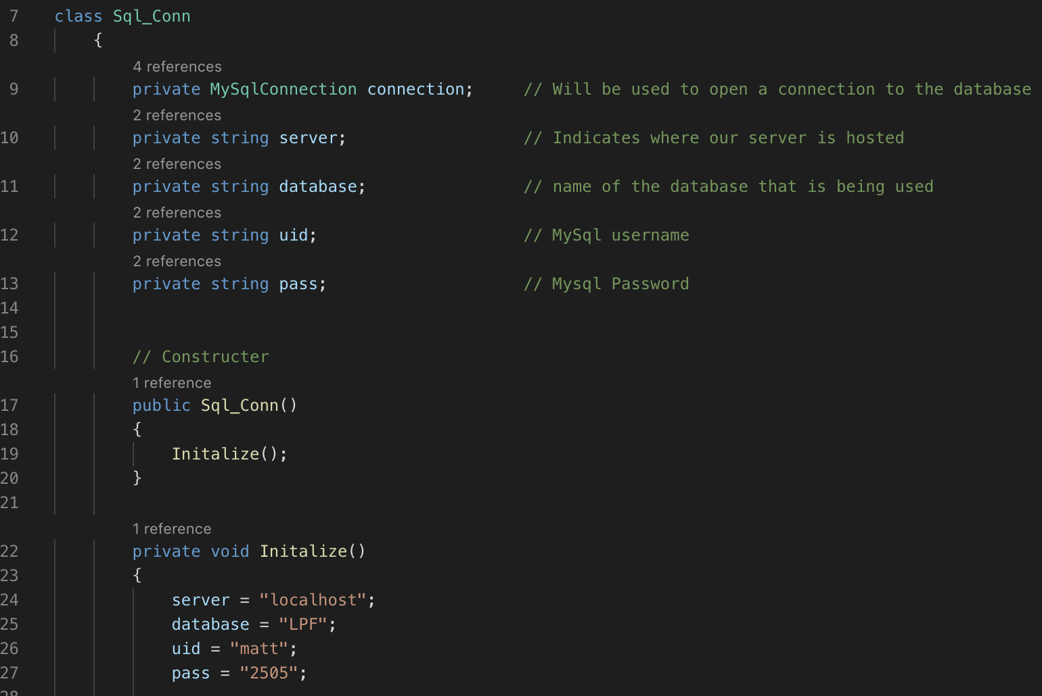
Database Connection

Slide 8
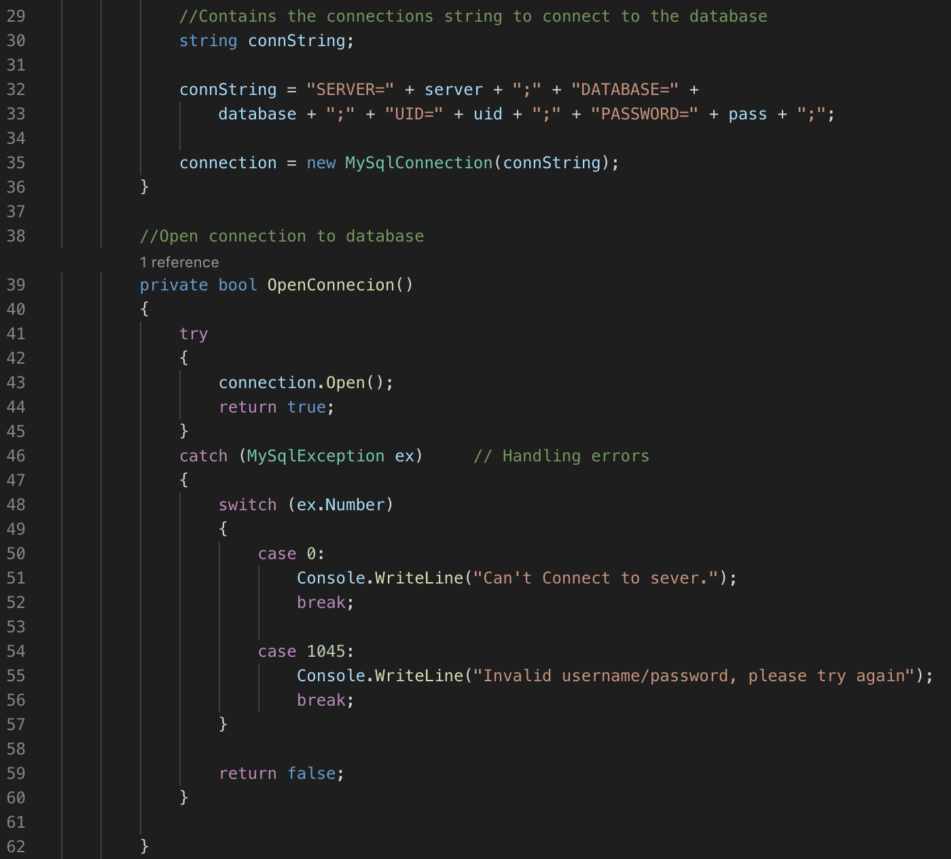
Database Connection

Slide 9
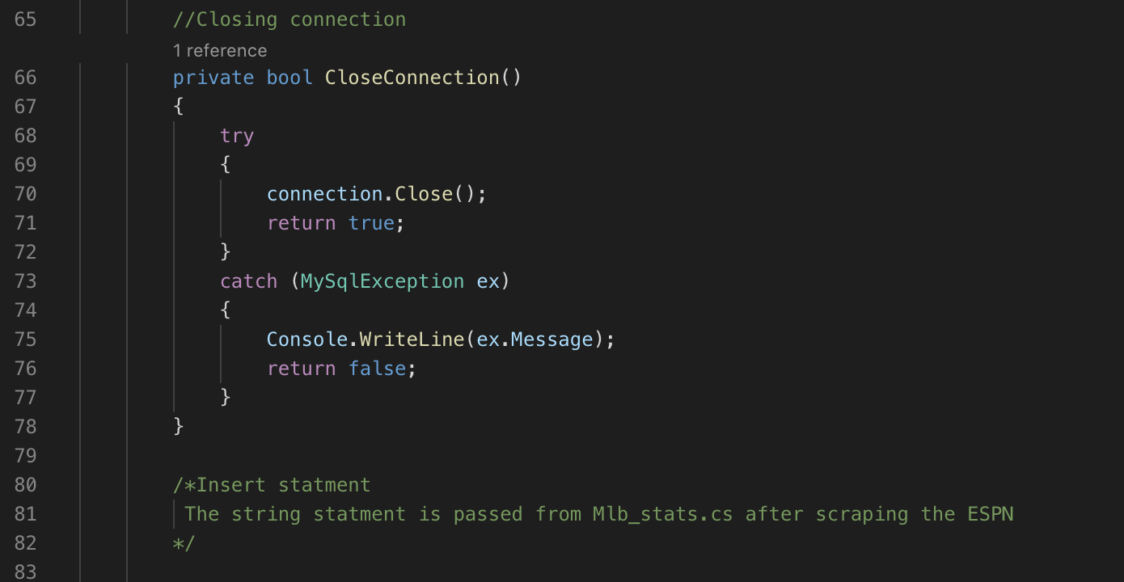
Database Connection

Slide 10
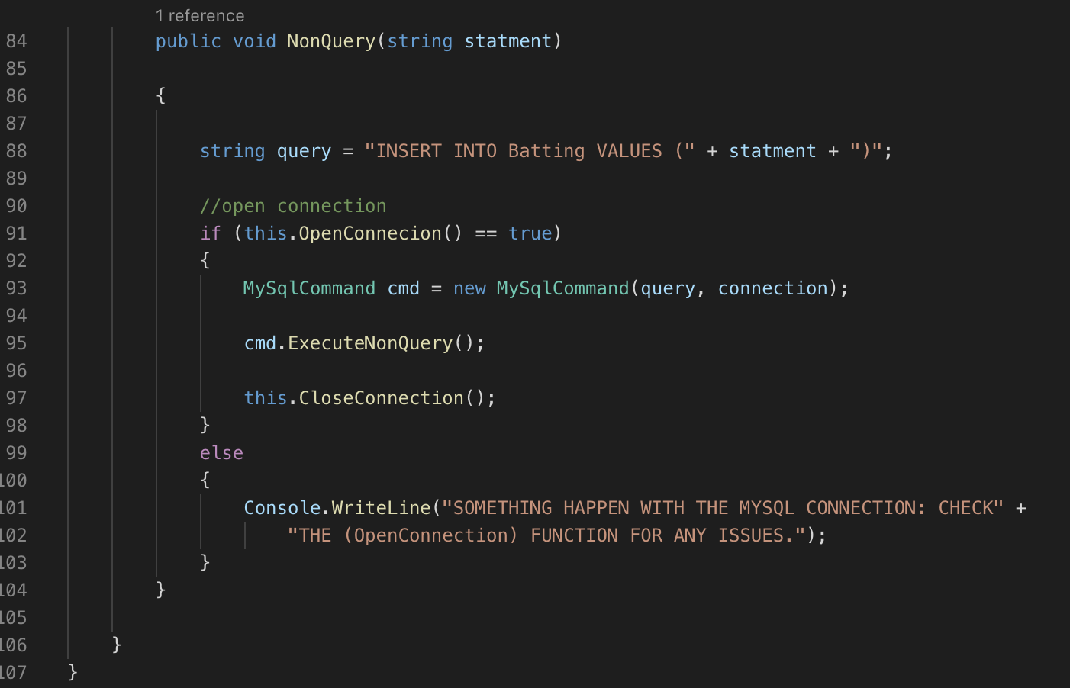
Database Connection

Slide 11
Database Connection for Razor Pagers References
http://www.mukeshkumar.net/articles/dotnetcore/crud-operations-in-asp-net-core-2-razor-page-with-dapper-and-repository-pattern

Slide 12
Database Connection for Razor Pages

Slide 13
Razor Pages “Amazing” Documentation
https://docs.microsoft.com/en-us/aspnet/core/tutorials/razor-pages/?view=aspnetcore-2.2

Slide 14
Razor Pages References
https://www.lynda.com/ASP-NET-tutorials/ASP-NET-Core-Razor-Pages/630622-2.html

Slide 15
Uploading to Server References
https://www.danielcrabtree.com/blog/481/how-to-setup-asp-net-core-2-1-on-linux-in-under-10-minutes
https://thomaslevesque.com/2018/04/17/hosting-an-asp-net-core-2-application-on-a-raspberry-pi/

Slide 16
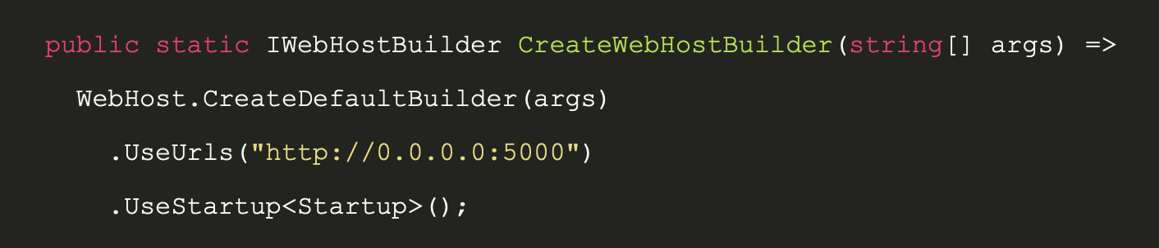


Uploading to Server

