Slide 1
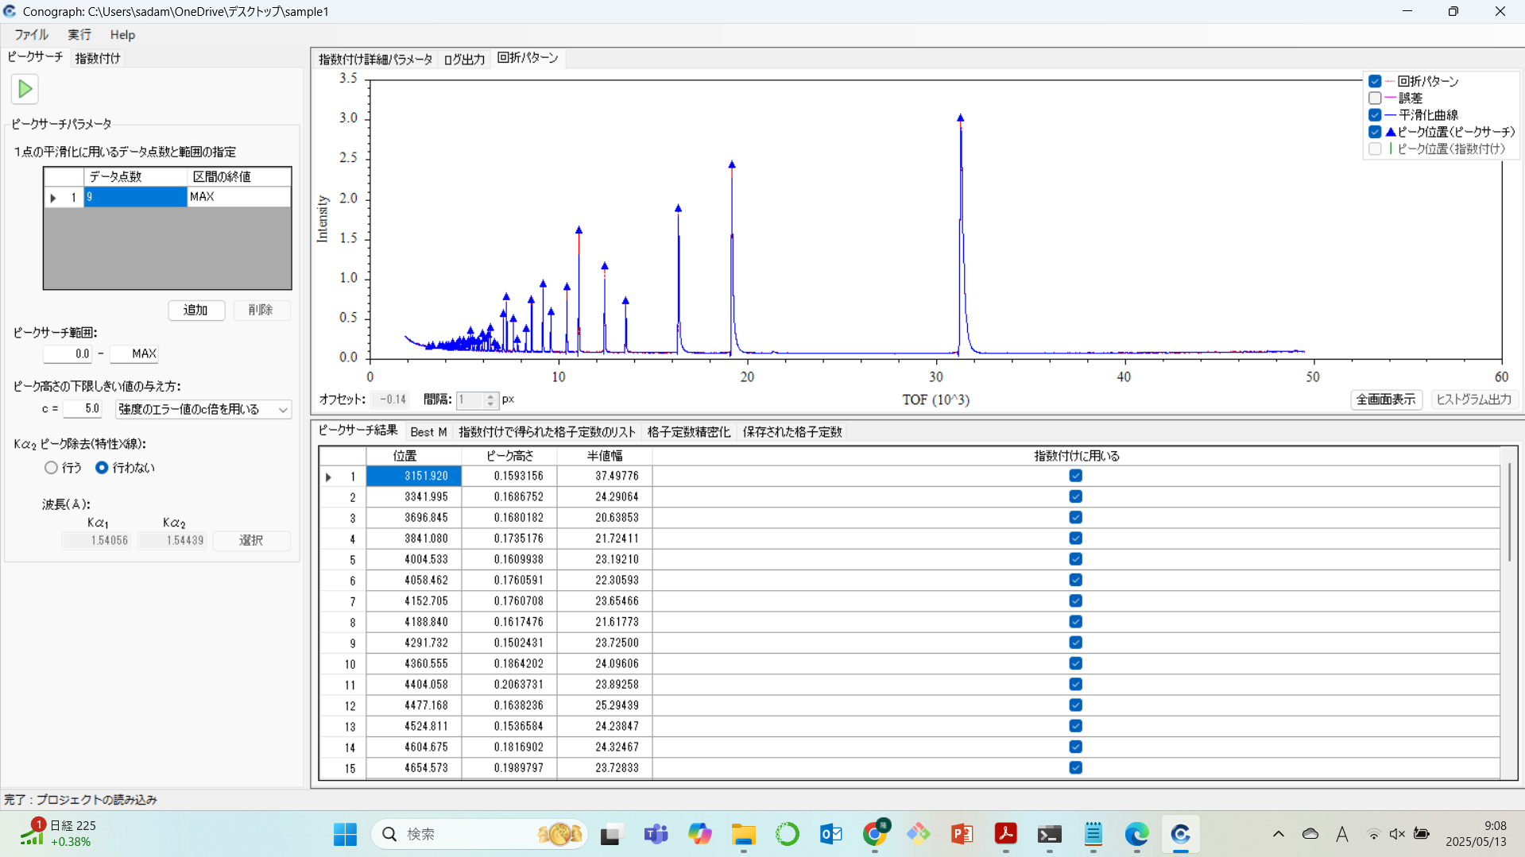
Conograph (GUI版)

Slide 2
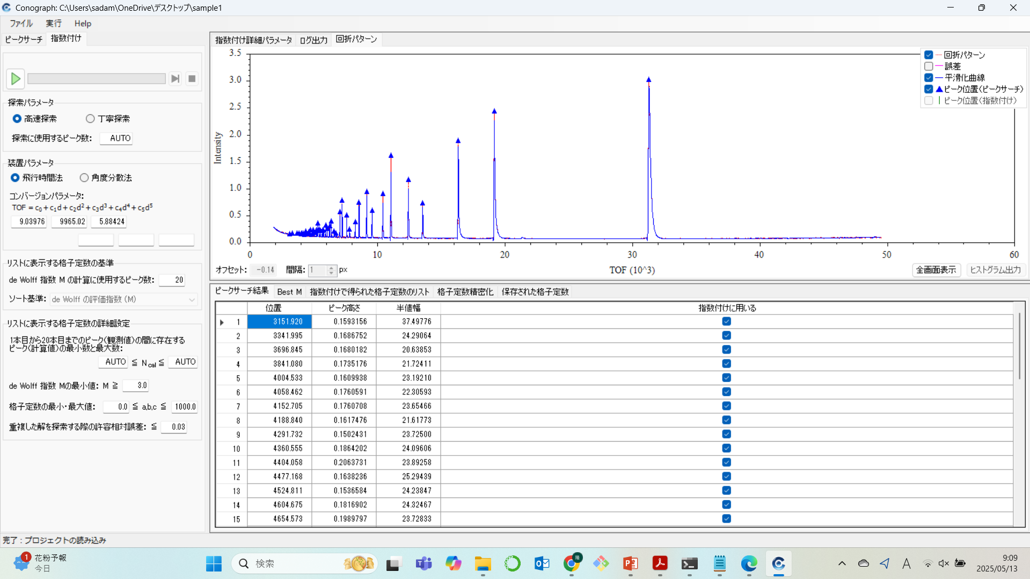
Conograph (GUI版)

Slide 3
PeakSearch（CUI版）
output/XXXX_pks.histogramlgor
cntl.inp.xml
<!-- File of input parameters． -->
XXXX.inp.xml
<!-- Histogram data file． -->
XXXX.dat or XXXX.histogramlgor
<!-- Name of output file. -->
output/XXXX_pks.histogramIgor
PeakSearch.exe
IGOR
WAVES/O xphase, yphase, err_yphase, smth_yphase
BEGIN
10.0000 1.500000E+01 3.872983E+00 NAN
10.0200 1.600000E+01 4.000000E+00 NAN
10.0400 2.600000E+01 5.099020E+00 NAN
10.0600 1.900000E+01 4.358899E+00 NAN
10.0800 3.000000E+01 5.477226E+00 NAN
10.1000 1.500000E+01 3.872983E+00 2.334033E+01
10.1200 2.300000E+01 4.795832E+00 2.373193E+01
10.1400 2.200000E+01 4.690416E+00 2.311888E+01
・・・・・
79.9600 1.100000E+01 3.316625E+00 NAN
79.9800 1.000000E+00 1.000000E+00 NAN
END
WAVES/O peak, peakpos, height, FWHM, Flag
BEGIN
1 2.842205E+01 1.020099E+04 1.666815E-01 1
2 4.726844E+01 4.984465E+03 1.514675E-01 1
3 4.742599E+01 1.915198E+03 6.768379E-02 1
4 5.608817E+01 2.612863E+03 1.405071E-01 1
5 5.626789E+01 1.147908E+03 9.668794E-02 0
6 6.909767E+01 5.790032E+02 1.454302E-01 1
7 6.930639E+01 2.707030E+02 1.248928E-01 0
8 7.634785E+01 9.660392E+02 1.489380E-01 1
9 7.657554E+01 4.747574E+02 1.374379E-01 0
END
X Display yphase, err_yphase, smth_yphase vs xphase
X ModifyGraph mirror(left)=2
X ModifyGraph mirror(bottom)=2
X ModifyGraph mode(yphase)=0, msize(yphase)=2
X ModifyGraph mode(err_yphase)=0, msize(err_yphase)=2
X ModifyGraph mode(smth_yphase)=0, msize(smth_yphase)=2
X ModifyGraph rgb(err_yphase)=(65280,43520,0)
X ModifyGraph rgb(smth_yphase)=(0,15872,65280)
X AppendToGraph height vs peakpos
X ModifyGraph mode(height)=3,marker(height)=17
X ModifyGraph rgb(height)=(0,65280,65280)
XXXX.dat
XXXX.inp.xml
NumberOfPointsForSGMethod：11
EndOfRegion : Max
SearchPeakRange (Begin : MIN, End : MAX)
UseErrorData : 0 (No) or 1 (Yes)
Threshold : 1.5
Alpha2Correction : 0 (No) or 1 (Yes)
Waves (Kalpha1WaveLength : 1.540600, Kalpha2WaveLength : 1.544390)

Slide 4
ZCodeParameters>
<PeakSearchPSParameters>
<ParametersForSmoothingDevision>
<!-- "ParametersForSmoothingDevision" can be set more than once in order to devide the smoothing range into several intervals. -->
<NumberOfPointsForSGMethod>
<!-- Number of points used for smoothing at a point (input an odd number >= 5). -->
11 </NumberOfPointsForSGMethod>
<EndOfRegion>
<!-- The end point of the range to which the corresponding figure in "NumberOfPointsForSGMethod" is applied. "MAX" is replaced with the end point of x-coordinates of the histogram. -->
MAX </EndOfRegion>
</ParametersForSmoothingDevision>
<PeakSearchRange>
<!-- The range in which peak search is carried out. "MIN" is replaced with the starting point of x-coordinates of the histogram. "MAX" is replaced with the end point of x-coordinates of the histogram. -->
<Begin> MIN </Begin>
<End> MAX </End>
</PeakSearchRange>
<UseErrorData>
<!-- Use errors of y-values in histogram data to compute a threshold for peak-search? 0 : No. (Use a constant given in "Threshold".) 1 : Yes. (Use a constant times of the errors.) -->
1 </UseErrorData>
<Threshold>
<!-- If "UseErrorData" is 0, this value is used as a threshold on peak-heights. Otherwise, "Threshold" times Error[y-value] is used as the threshold at a point. -->
1.5 </Threshold>
<Alpha2Correction>
<!-- alpha2 reflections are contained? 0 : No. (Deconvolution is not applied.) 1 : Yes. (Deconvolution is applied.) -->
1 </Alpha2Correction>
<Waves>
<!-- Input wave-lengths of alpha1 and alpha2. -->
<Kalpha1WaveLength> 1.540600 </Kalpha1WaveLength>
<Kalpha2WaveLength> 1.544390 </Kalpha2WaveLength> </Waves> </PeakSearchPSParameters> </ZCodeParameters>

