Slide 1

Mini Project on
CHAT BOT
Submitted in partial fulfillment of the requirement for the award of the degree of
BACHELOR OF TECHNOLOGY IN
COMPUTER SCIENCE & ENGINEERING
Submitted by:
Name - Arin Agarwal
University Roll no-2016664
Under the Mentorship of
Vikas Tomer
Assistant Professor (CSE)
Department of Computer Science and Engineering Graphic Era (Deemed to be University)
Dehradun, Uttarakhand January 2023

Slide 2
Chapter 1
Introduction
1.1 Introduction
Chatbot is a computer program that humans will interact with in natural spoken language and including artificial intelligence techniques such as NLP (Natural language processing) that makes the chatbot more interactive and more reliable.
Based on the recent epidemiological situation, there is boom in technology and development due to cheap data There is surge in use of internet and different sites for shopping health and
anything you can imagine right now everything is possible due to this a lot of user can have confusion about how to do something what to do etc. etc. to solve this problem chat bot came in picture that can make it easy to interact with people around them if someone has instead of directly contacting service center to get solution at ease without any extra maintenance cost and increasing our labor cost.
This project aims to build a chatbot for General purpose to answer every person who asks
about sports, literature, music etc. I have tried to make a general-purpose bot that can facilitate anything. As in today’s era Everything is online so chat bot are best alternatives to reduce cost of labor and also decrease dependency on humans
1

Slide 3
1.2 Challenges
Now that you've learned about the advantages of using AI chatbots, one can put its power to work to improve customer happiness. Whenever it comes to adopting AI chatbots within the company, unfortunately, there are some major challenges like –
    Chatbot security.
    Understanding the emotions and sentiments of your customers.
    They are susceptible to data security breaches.
    They can misunderstand user point of view.
    They can face spoken language problems.
    They can interrupt the user experience.
1.3 Problem Statement
To build a chat bot.
I built a general purpose and talkative chat bot that can talk to people and give response to them It has knowledge about music, literature, science, art, sports, trivia and many other
topics
It is a self-learning chat bot it learns from responses of user too so it has a good response to user queries
2

Slide 4
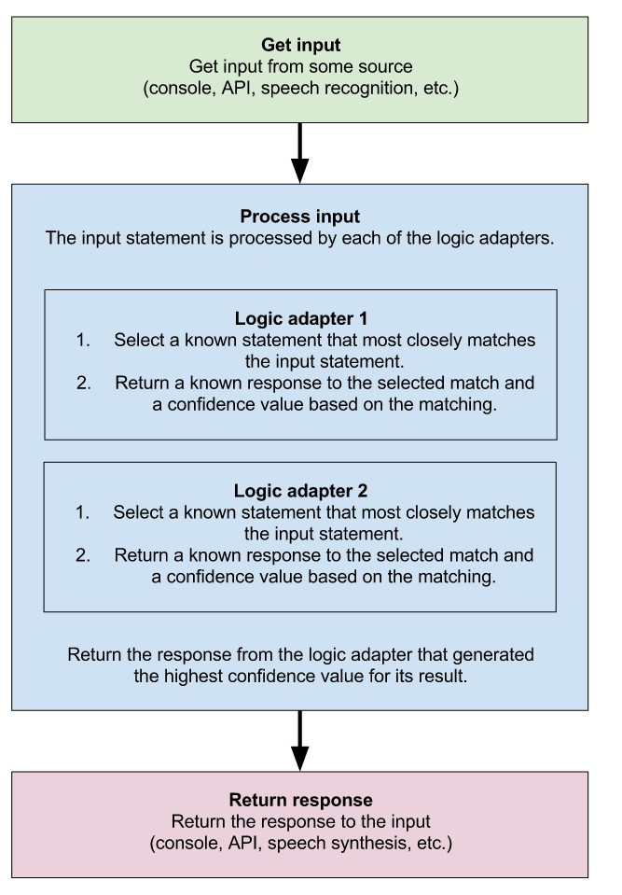
Chapter 2
Methodology
In this python project I have used machine learning library called chatterbot to make this bot. It is a python library designed to make it easy to create software that can engage in conversation. Chatterbot is a Python library that makes it easy to generate automated responses to a user’s input. ChatterBot uses a selection of machine learning algorithms to produce different types of responses. This makes it easy for developers to create chat bots and automate conversations with users
Basic working of chatterbot with diagram shown below
5

Slide 5
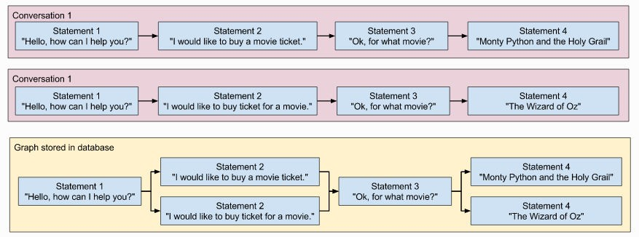
As I mentioned earlier that we have used machine learning module called chatterbot. So, I am using chatterbot dataset for training and also, I have included my own dataset from improving accuracy and give better result for our chatterbot
Training Testing is done by this library only so accuracy is high. I have also used tkinter that is python library like java awt and swing to make GUI (Graphical user Interface) of the bot
1) Created a chatbot object and for training the module has function called list trainer which we can use for training and testing the model I have given My own dataset with chatterbot dataset called chatterbot corpus
ChatterBot includes tools that help simplify the process of training a chat bot instance.
Chatterbot’s training process involves loading example dialog into the chat bot’s database. This either creates or builds upon the graph data structure that represents the sets of known statements and responses. When a chat bot trainer is provided with a data set, it creates the necessary entries in the chat bot’s knowledge graph so that the statement inputs and responses are correctly represented.
6

Slide 6
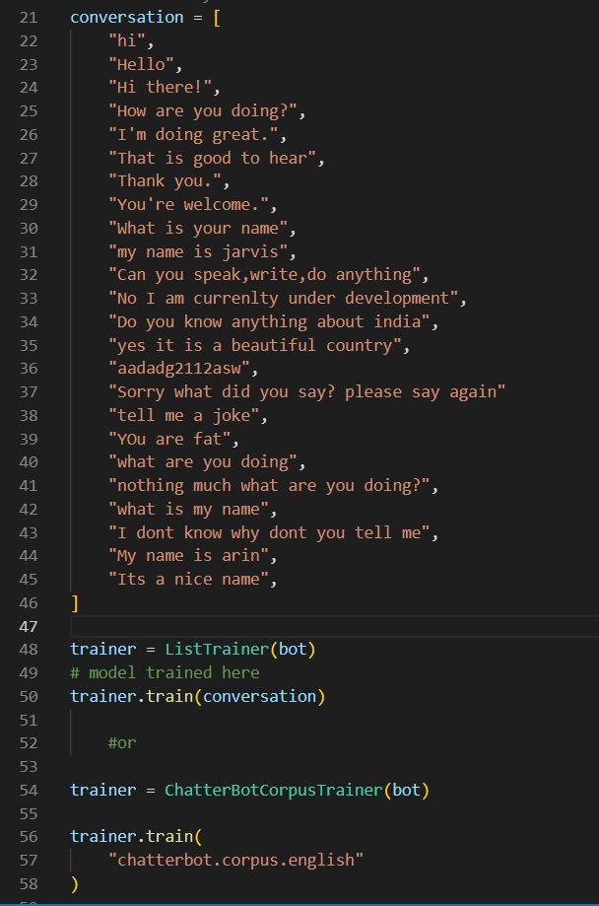
Our training code using chatterbot. This code is what I used to train my bot Named Jarvis. I have given training data in conversation including the training data which was already in chatterbot corpus.
7

Slide 7
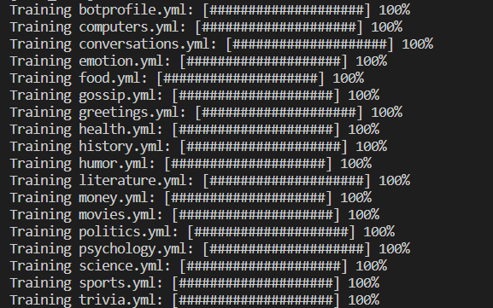
Now last and final step after training and testing is the displaying the responses from the bot and interface through which user can communicate through the bot
So, for this as mentioned earlier For GUI part I use pythons tkinter which has all things requited to build GUI i.e., buttons frames test field etc. I used many these functions to make
the GUI
For response Chatterbot has function to predict the answer from training and testing we did for our chatbot so using this we will have our result
Next, you will want to create a while loop for your chat bot to run in. By breaking out of the
loop when specific exceptions are triggered, we can exit the loop and stop the program when a user enters ctrl+c.
As we will be continuing looping through the user input and will only break if user wants to end the conversation with the bot
8

Slide 8
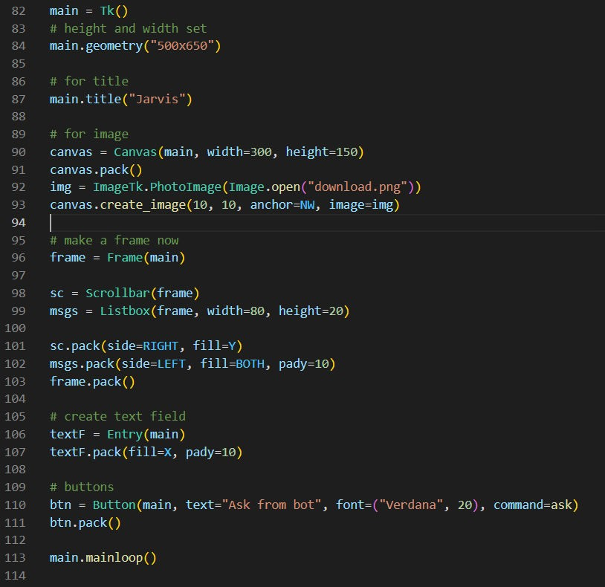
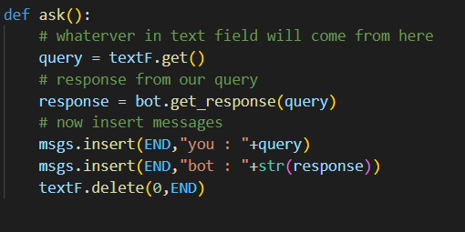
OUR BASIC CODE FOR GUI CREATION OF CHAT BOT
Code for Response for chatterbot we aren’t looping in this because we have used button so we don’t need to loop in it as whenever we click the button itself break
9

Slide 9
Chapter 4
Result and Discussion
The size of the dataset can have a significant impact on the accuracy of the chatbot model. In general, the larger the dataset, the more accurate the model is likely to be. This is because a larger dataset provides the model with more examples to learn from, which can help us to generate better results and answer to user queries given by the bot. In this guide, we used a
relatively small dataset to train the model, but in practice, you may want to use a larger
dataset to achieve even better accuracy. By using a larger dataset, you can create a more robust and accurate model that is capable of generating high-quality replies and answer to user queries. As this is a personal project, we have kept the dataset small enough but if you want to deploy it some real systems it needs a big and effective dataset
I tried to make my bot as much as general I could I have giving it a good number of datasets to reduce chances of error and improve accuracy. It gives almost answer to any of the queries that user can give it. It also has knowledge about music, literature any many more thanks to chatterbot robust dataset
10

Slide 10
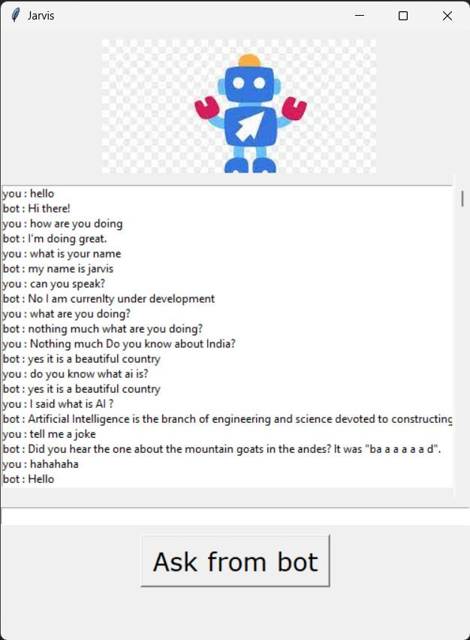
Output of our Chat Bot
11

Slide 11
Chapter 5
Conclusion and Future Work
5.1 CONCLUSION
In this project I made a chat bot application from scratch. It was a very difficult task as I got lot of errors but at the end, I learnt a lot while making this project. The completion of the project went quiet well, I learned much new things while I was building up it, and I get up to know various platforms which help us to learn all this stuff. I was able to learn the practical use of Machine Learning and was able to contribute to society as well. The practical helped me to learn the debugging of code and many libraries and modules of python essential for machine learning. I also learnt various algorithm related to chat bot and also got a good idea about NLP.
This project also made we use GUI so I got a good idea to how to make GUI by using python It was a hard task but at the end It taught me a lot.
Chat bot is an emerging technology that can provide many benefits. Chat bot can save resources and time, and even generate new income streams, for companies that implement it right.
Overall working on this project was great fun as I came up with great piece of knowledge and understanding of the topic
12

Slide 12
5.2 FUTURE WORK
As for future work, there are many potential directions that could be taken to continue the development of chatbots. Some potential areas of focus might include:
Improving the natural language processing capabilities of chatbots, such as by incorporating more advanced language models or developing new techniques for handling context and ambiguity.
Improving the natural language processing capabilities of chatbots, such as by incorporating more advanced language models or developing new techniques for handling context and ambiguity.
Increasing the adaptability and personalization of chatbots, such as by developing methods for adapting to individual users or to changing environments.
Investigating the use of chatbots in new application domains, such as education or healthcare.
Examining the ethical and social implications of chatbots, including issues related to privacy, bias, and the potential for automation to replace human jobs.
13

