Slide 1
Employee Data Analysis using Excel
STUDENT NAME: ARINA. A
REGISTER NO: 2213211042046
DEPARTMENT: B.Com (Corporate Secretaryship)
COLLEGE: PRESIDENCY COLLEGE, CHENNAI.

Slide 2
PROJECT TITLE
Employee Performance Analysis using Excel

Slide 3


AGENDA
Problem Statement
Project Overview
End Users
Our Solution and Proposition
Dataset Description
Modelling Approach
Results and Discussion
Conclusion
3/21/2024 Annual Review

Slide 4

PROBLEM STATEMENT
Every Performance ratings and working conditions of employees as well as their departments will be evaluated as part of the analysis.
organization seeks to maximize the allocation of human resources by assessing personnel qualifications across multiple areas.
To raise performance ratings and increase overall efficiency, we must identify skill gaps, training needs, and internal promotion opportunities.

Slide 5

PROJECT OVERVIEW
Creating a customized training program with modules covering fundamental, advanced, and pivot table operations in Excel, including data entry formulas, pivot tables, and data visualization; conducting a baseline evaluation to determine the employees' current proficiency in Excel and areas in need of improvement.
Testing, quizzing, or practical evaluations to gauge the training's efficacy and getting input to make necessary program revisions.

Slide 6

WHO ARE THE END USERS?
HR professionals utilize the data to evaluate training requirements, monitor staff advancement, and make sure employees are qualified for their positions.
Employees can use the brief letter to learn about the standards for excel proficiency, pinpoint areas for personal growth, and monitor their own advancement.
These experts use the short note to plan, carry ut, and assess training initiatives meant to enhance workers' Excel skills.

Slide 7

OUR SOLUTION AND ITS VALUE PROPOSITION
We create interactive Excel dashboards that offer managers instantaneous insights into employee qualifications, enabling them to quickly identify areas of strength and weakness.
We establish a centralized, readily available Excel-based database that contains all pertinent employee credentials. An excel-based system expedites the qualification tracking procedure, saving HR teams and managers time and reducing mistake rates.
The system is adaptable to various sectors, roles, and particular qualification requirements. It is also scalable, enabling it to expand with the business.

Slide 8
Dataset Description
Details on the particular credentials or licenses that every worker possesses, such as the titles of the courses taken, the degrees attained, and the completion date. documentation of any training sessions or seminars that the staff member attended, including the dates, subjects covered, and any results or grades.
Essential information such an employee's function, department classifications, and gender are also Provided.

Slide 9

THE "WOW" IN OUR SOLUTION
1. Interactive Dashboard: a dynamic Excel dashboard that provides updates on the qualifications and deficiencies of employees.
2. Automatic Reports: Produced automatically, these reports are customized for each department and emphasize important findings, areas in need of training, and chances for advancement.
3. Advanced Analysis Tools: For deeper insights, use Power Pivot and Power Query, two advanced Excel functions that enable predictive analysis and scenario planning.
3/21/2024 Annual Review
9

Slide 10
MODELLING
Modeling in Excel involves structuring data inputs, calculations, and outputs to simulate scenarios or analyze information. It typically includes organizing assumptions, using formulas to process data, and visualizing results through charts and tables. Key features like data tables, scenario analysis, and conditional formatting help users perform sensitivity analyses and present outcomes clearly. Proper labeling, documentation, and error checking ensure the model is understandable and reliable for decision-making.
10

Slide 11
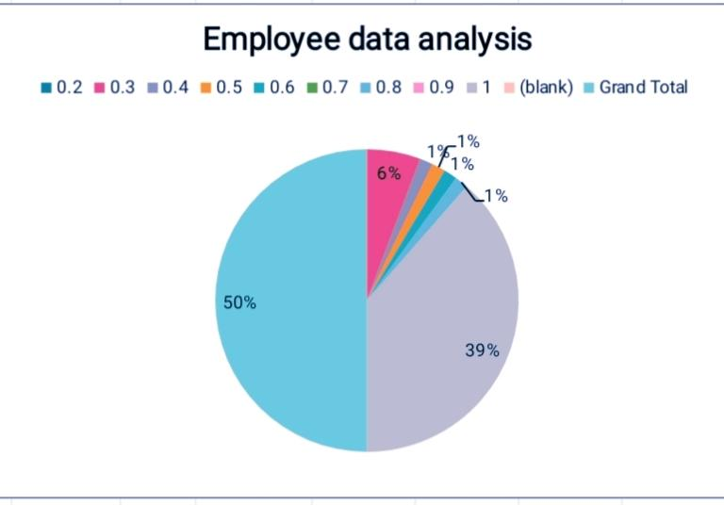
RESULTS
11

Slide 12
conclusion
1. The employee qualification analysis helps identify the current situation by efficiently aligning employee departments and their workspaces, as well as the number of employees in the organization.
2. The approach provides actionable insights for HR supporting better talent management and strategic workforce planning and establishing strategies through the use of Excel tools for data organization analysis and reporting.
3. The user-friendly method of seeing and acting upon the findings is provided by the interactive dashboard and customized reports.

