Slide 1
MACHINE LEARNING GUILD
MACHINE LEARNING 101

Slide 2
SCHEDULE
What is machine learning?
How do we develop a model?
Inferential vs. predictive modeling
Types of learning and models
Common pitfalls and model validation
Hyperparameters (and tuning them)
Model assumptions

Slide 3
INTRODUCTION
WHAT IS MACHINE LEARNING?
One of the most popular ways of untangling the nebulous definitions around machine learning and data science is Drew Conway's Venn diagram. Machine learning is the intersection between mathematics, statistics and computer science. When applied to real world problems, this is data science.
Computer Science
Math and Statistics
Machine Learning
Subject Matter Expertise
Data Science
“Danger zone!”
Traditional Research

Slide 4
INTRODUCTION
DATA SCIENCE LIFE CYCLE
Data science is an iterative process - the steps aren’t fully linear. generally data science work begins with a business problem and involves a lot of data preparation.
Business Problem
Data Gathering
Model Deployment
Data Cleaning
and Exploration
Model Evaluation
Model Development

Slide 5
HOW DO WE DEVELOP A MODEL?
MODEL DEVELOPMENT
There will be many questions in the development of any machine learning model, but answering these three key questions up front will help guide you throughout.
Frame business problem: What is the question I want to answer or problem I want to solve? What data do I have available to do so? (inferential vs predictive)
What kind of algorithm do I want to apply to these data? (classification vs. regression vs clustering, supervised vs unsupervised)
What testable measures (evaluation criteria) will I use to determine if my model is successful? (this also includes assumptions validation)

Slide 6
INFERENTIAL VS. PREDICTIVE MODELING
WHAT IS INFERENTIAL MODELING?
Inferential modeling aims to draw conclusions and making inferences around the relationships of variables. This features heavily in experimental design where researchers ask questions such as “Does drinking coffee have an effect on COVID-19 resistance?”
Generally inferential models operate with a more strict set of model assumptions which can (but not always) lead to a slight loss in predictive power. Traditional statistical models and tests such as ordinary linear regression, logistic regression, and ANOVA all easily allow for inference to be made on the “why.” In the case of logistic regression and ordinary linear regression, these models can also be used for prediction.

Slide 7
INFERENTIAL VS. PREDICTIVE MODELING
WHAT IS PREDICTIVE MODELING?
Predictive modeling attempts to use previously observed data to make predictions on future data. These models are highly prevalent throughout all industries and can answer questions such as “What is the probability that this individual with their medical history and caffeine consumption is going to contract COVID-19?”
Many of these models can operate with far fewer sets of assumptions, but become a bit of a “black box” where they become unable to explain exactly which variables are driving the prediction. Techniques such as SHAP and partial dependency plots can help, but answering “why” becomes a much more difficult problem.

Slide 8
TYPES OF LEARNING AND MODELS
TYPES OF LEARNING
Once we understand the business problem and whether or not there is inference required, we can look at our data to understand type of training we can use to build our model.
Supervised | Unsupervised | Reinforcement Learning | Semi-Supervised
Data has known labels or target variables we want to understand or predict | Data has no target variable or labels, focused on understanding the data | Build an agent to make decisions based on input from an environment | Data has partially known labels and a blend of supervised and unsupervised methods is used to construct a model
Regression Classification | Clustering Dimensionality Reduction | Deep Q Networks SARSA | TSVM Self-labeling

Slide 9
TYPES OF LEARNING AND MODELS
SUPERVISED MODELING: NAMING
CONVENTIONS
Height₁ | Age₁ | Coffee₁
Height₂ | Age₂ | Coffee₂
… | … | …
Height_{n} | Age_{n} | Coffee_{n}
COVID₁
COVID₂
…
COVID_{n}
Features, inputs, independent variables, model matrix, design matrix, X
Response, target, output, dependent variable, Y

Slide 10
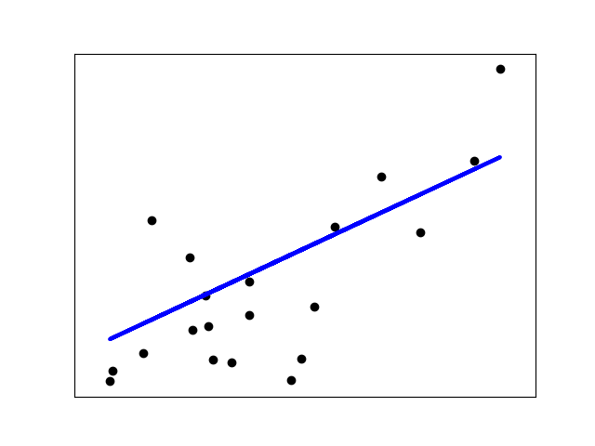
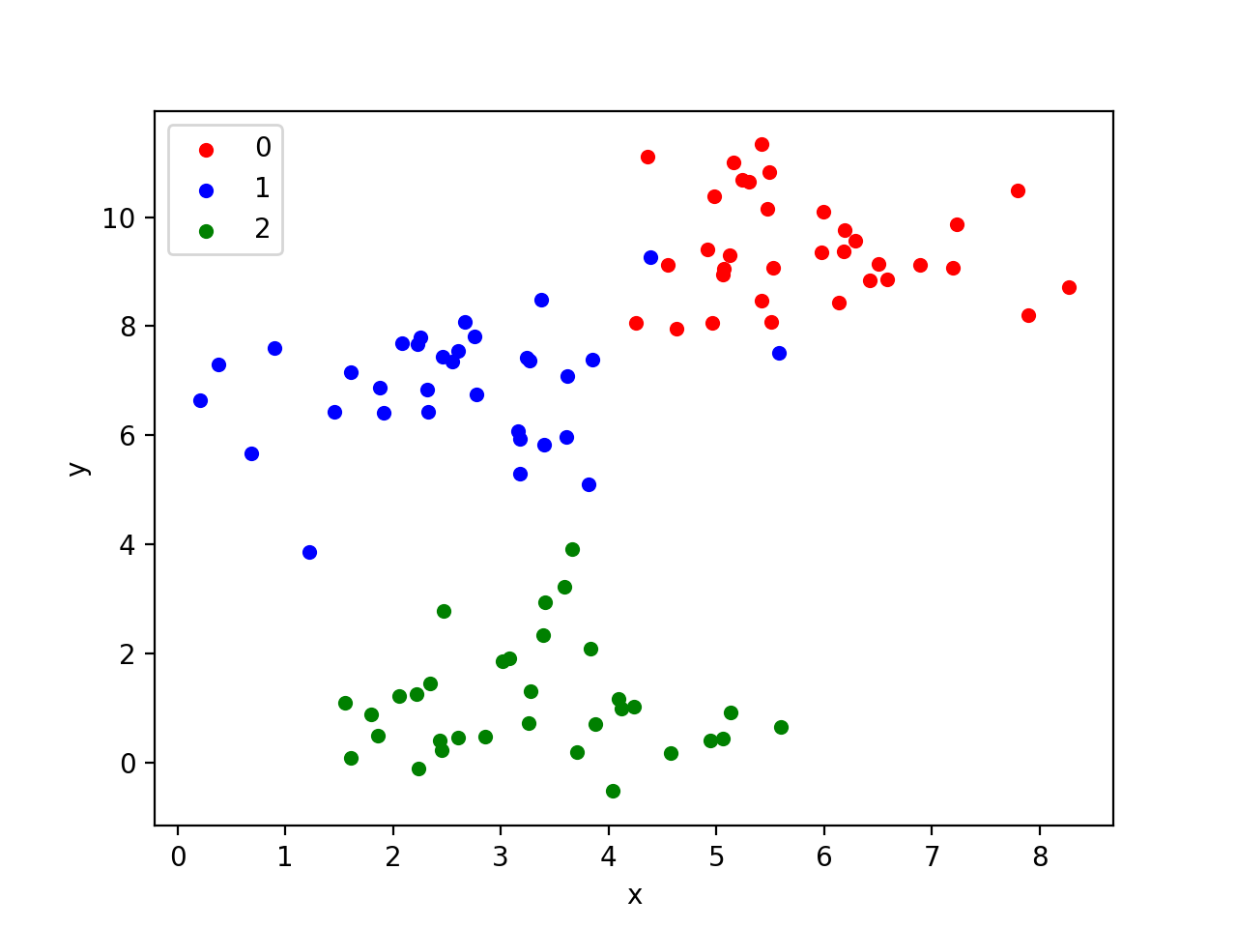
TYPES OF LEARNING AND MODELS
TYPES OF MODELING
Regression | Classification | Clustering
Model predicts a continuous response, features and can be a combination of continuous and discrete | Model predicts a discrete response, features and can be a combination of continuous and discrete | Model partitions the data into similar looking groups called clusters

Slide 11
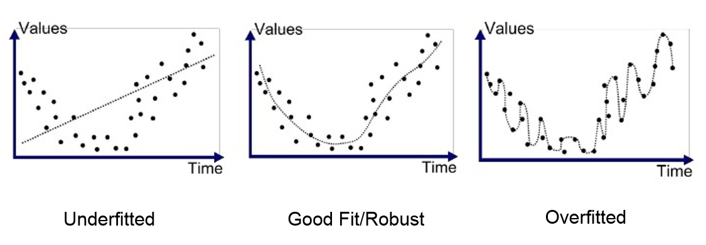
COMMON PITFALLS AND MODEL VALIDATION
UNDERFITTING AND OVERFITTING
What does it mean for a model to fit well?
A well-fit model is generalizable makes “good” predictions on data it hasn’t seen.
There’s natural variability within the data, so fitting a model that too closely follows the data it was trained on is called overfitting.
It is also possible to not fully learn from all available data. Poor hyperparameter specification, low training time, and more can lead to underfitting.

Slide 12
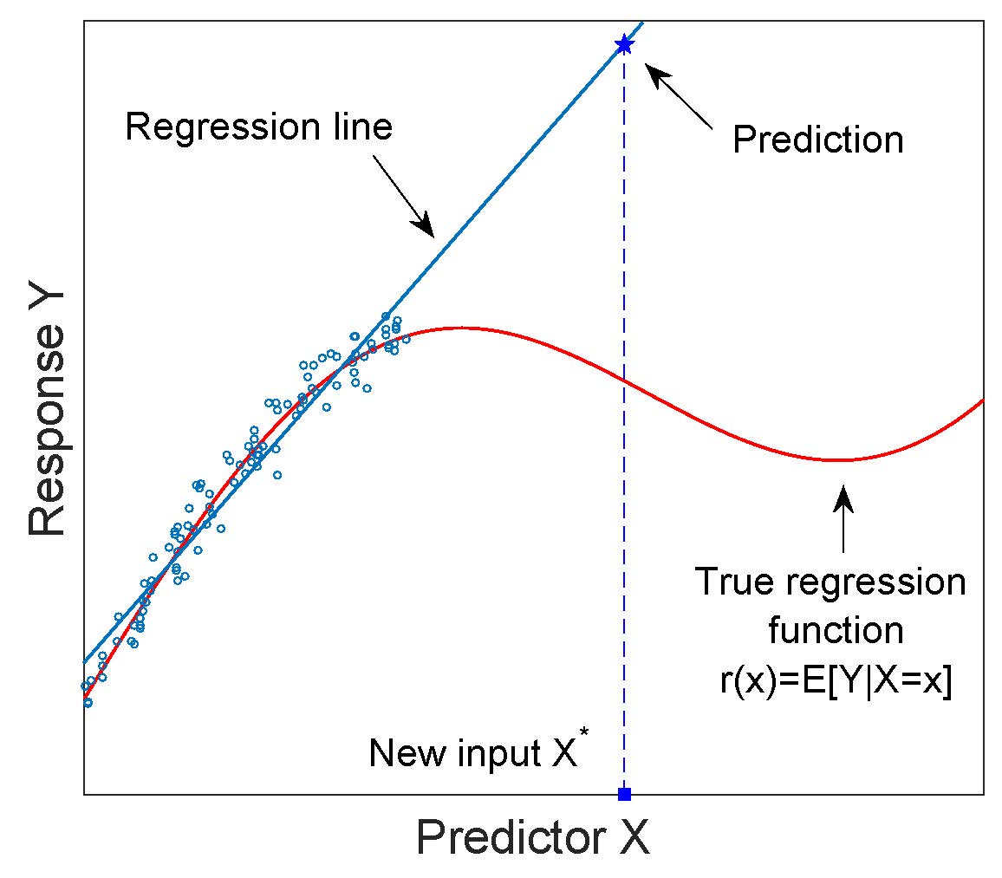
COMMON PITFALLS AND MODEL VALIDATION
EXTRAPOLATION
Extrapolation is when predictions outside of the data in the models training data. Models are optimized over the space of training dataset. Generally models will have lower performance outside of this range, though some models such as time series do train for “light” extrapolation.

Slide 13
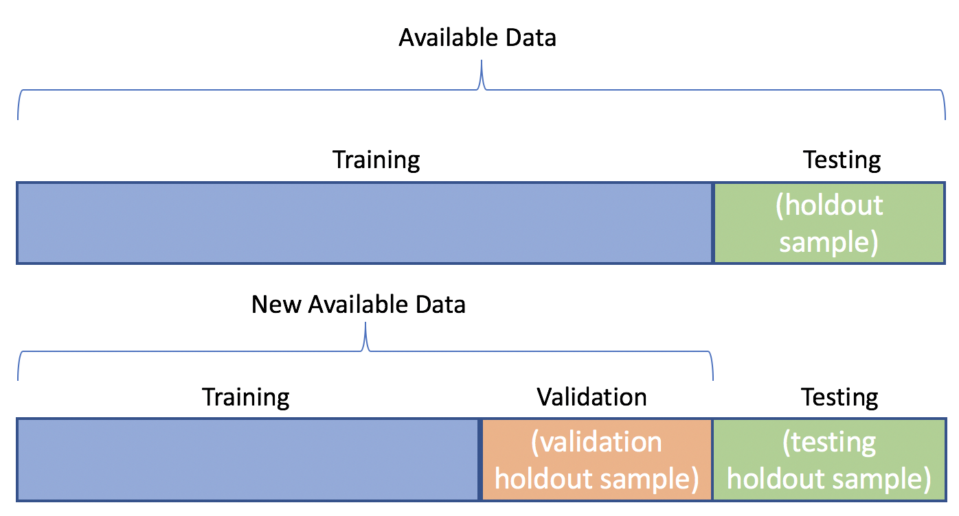
COMMON PITFALLS AND MODEL VALIDATION
MODEL VALIDATION
Evaluating a model performance with more than a couple of features is very difficult to visually. A test-train or test-validation-train split can be performed to help evaluate how well a model generalized. These splits allows us to evaluate model performance as a function of algorithm, hyperparameters, and newly engineered features.

Slide 14
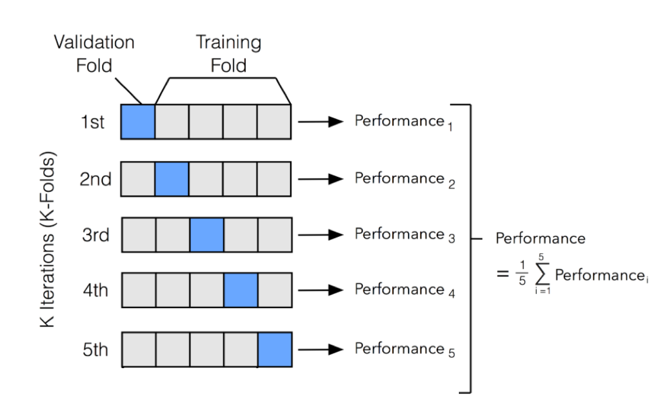
COMMON PITFALLS AND MODEL VALIDATION
K-FOLD CROSS-VALIDATION
Cross validation is the averaged generalization of the test-train split. The dataset is split in k equally sized folds, and k models are trained with each fold being held out in one model. In situations where model training is relatively quick, or can be parallelized simply this will generally outperform a test-train or test-val-train split in preventing overfitting and increasing performance.

Slide 15
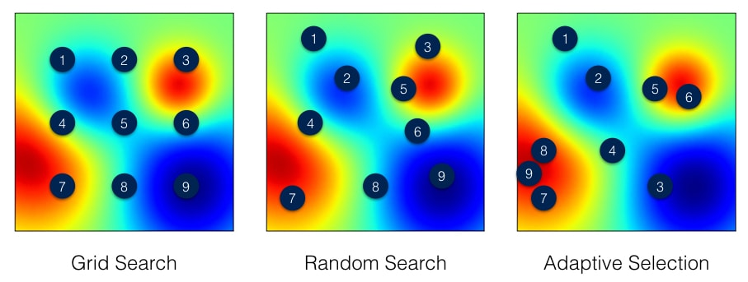
HYPERPARAMETERS (AND TUNING THEM)
WHAT IS A HYPERPARAMETER?
Hyperparameters are fixed values set prior to training which affect how machine learning algorithms operate. Some parameters affect the selection and classification decisions made, where others just affect training speed and quality.
These can have a huge impact on how the model performs, and informed selection can increase accuracy, reduce training time, and prevent overfitting.
We can use cross-validation to help select ideal parameters plus techniques such as grid search, random walks, and Bayesian optimization.

Slide 16
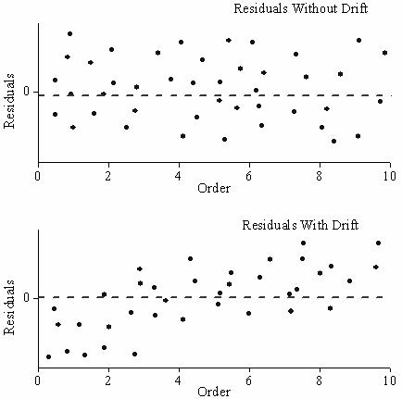
MODEL ASSUMPTIONS
WHY DO WE VALIDATE MODELS?
Almost all traditional statistical models (OLS, Logistic Regression, ANOVA, etc.) have strict assumptions associated with them. Failure to validate these assumptions can result in misleading model performance diagnostics.
While most other machine learning have relatively few true assumptions, it means that extensive EDA and diagnostic evaluation are required. It’s also generally considered best practice to baseline model performance against a “traditional” model.

