Slide 1
MACHINE LEARNING GUILD
MATH, STATS, AND COMP. SCI. FUNDAMENTALS

Slide 2
SCHEDULE
A quick (re)view of calculus
The foundations of probability
Types of numbers
Common distributions
The parts of a computer
Effective compute

Slide 3
MATH
WHAT IS A WEIGHTED AVERAGE?
A weighted average is an average where values can be summed by different weights.
A weighted average where all weights are the same is a standard average.
X | Even weight | Weighted Value
10 | 1/3 | 3.33
15 | 1/3 | 5.00
20 | 1/3 | 6.66
Total | 1 | 15
X | Custom weight | Weighted Value
10 | .1 | 1
15 | .5 | 7.5
20 | .4 | 8
Total | 1 | 16.5

Slide 4
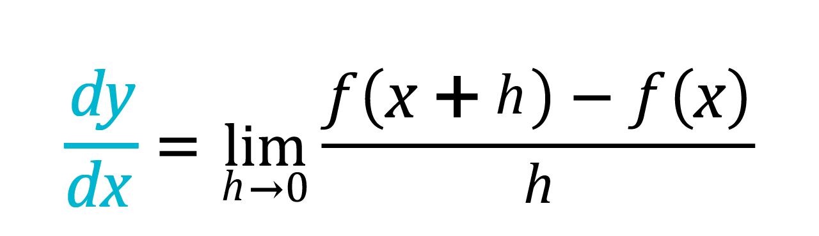
MATH
WHAT IS A DERIVATIVE?
A derivative is one of the two primary operations in calculus and is defined is the rate of change of a function at a given point:
This is used in optimization to either find closed form solutions to minimize loss, or estimate step “direction” in gradient descent optimization.

Slide 5
MATH
WHAT IS A DERIVATIVE?

Slide 6
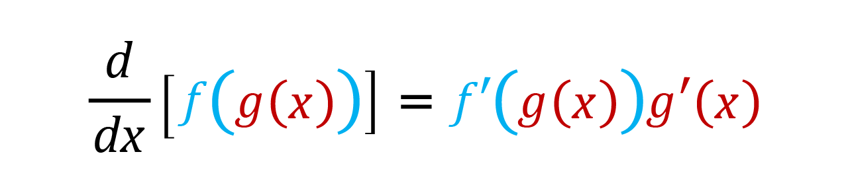
MATH
WHAT IS THE CHAIN RULE?
When taking more complicated derivatives, we can apply the chain rule. This is used throughout deep learning in estimating gradients for earliest layers in networks.

Slide 7
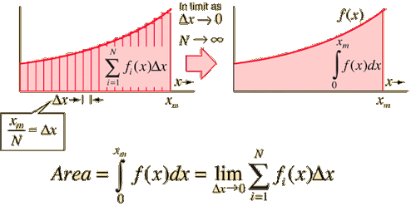
MATH
WHAT IS AN INTEGRAL?
Integration is the second main operation of calculus, the inverse of differentiation. Definite integrals (over a finite interval) represent the signed area under (or above!) the function.
Some of the places integrals are used in machine learning are expectation, stochastic gradient descent, reinforcement learning.

Slide 8
MATH
WHAT KINDS OF NUMBERS ARE
THERE?
To understand the output type we want for our problem, our data should map to a set of potential responses.
Finite: Has a set size (cardinality) that is some element of the natural numbers, e.g. {0,1,2,3}, {Yes, No}, {green, yellow, blue}. All finite sets are countable.
Infinite: A set that is not finite. e.g. {0, 1, 2, …}, [0, ∞), (- ∞, ∞), [0, 10]
Countable: Number of elements is either finite {green, yellow, blue}, or a countably infinite set e.g. {0, 0.5, 1, 1.5, 2, …}
Uncountable: A set that has too many elements to be countable e.g. [0,1] (- ∞, ∞)

Slide 9
STATISTICS
WHAT IS PROBABILITY?
The Kolmogorov axioms are the foundation of probability and form the basis for most modern statistics.
The probability of any event is bounded inclusively between 0 and 1
The probability of all possible events sums up to 1
The sum of probabilities for mutually exclusive events is equal to the probability of any of those events happening.
Color | Probability
Red | 0.5
Blue | 0.3
Green | 0.2

Slide 10
STATISTICS
HOW CAN WE REPRESENT
PROBABILITY?
Common types of distributions can help model real world data. They are represented mathematically by probability mass functions (PMFs) or probability density functions (PDFs) for discrete and continuous variables, respectively.
Distribution | Support
Normal (Gaussian) | Real numbers
Bernoulli | {0,1}
Binomial | {0, 1, 2, … n}
Uniform | [0,1]
Poisson | {0, 1, 2, …}

Slide 11
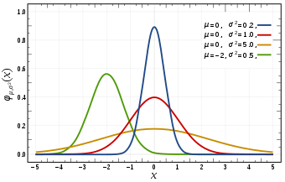
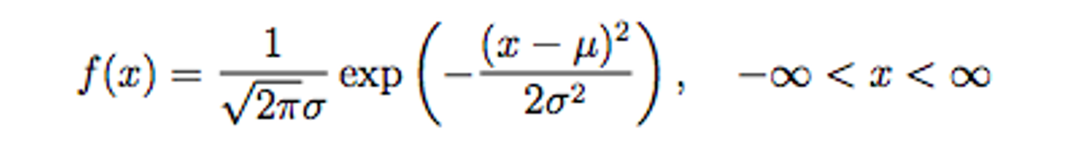
STATISTICS
THE NORMAL DISTRIBUTION
The normal distribution is a continuous distribution spanning the entire real number line, but centered at the mean µ, with spread controlled by σ.
It’s widely used in statistics, due to its simplicity to work with, relationship with OLS and ANOVA.
Many real world phenomena follow normal distributions, and the central limit theorem proves that averages of most random variables converge to normality.

Slide 12
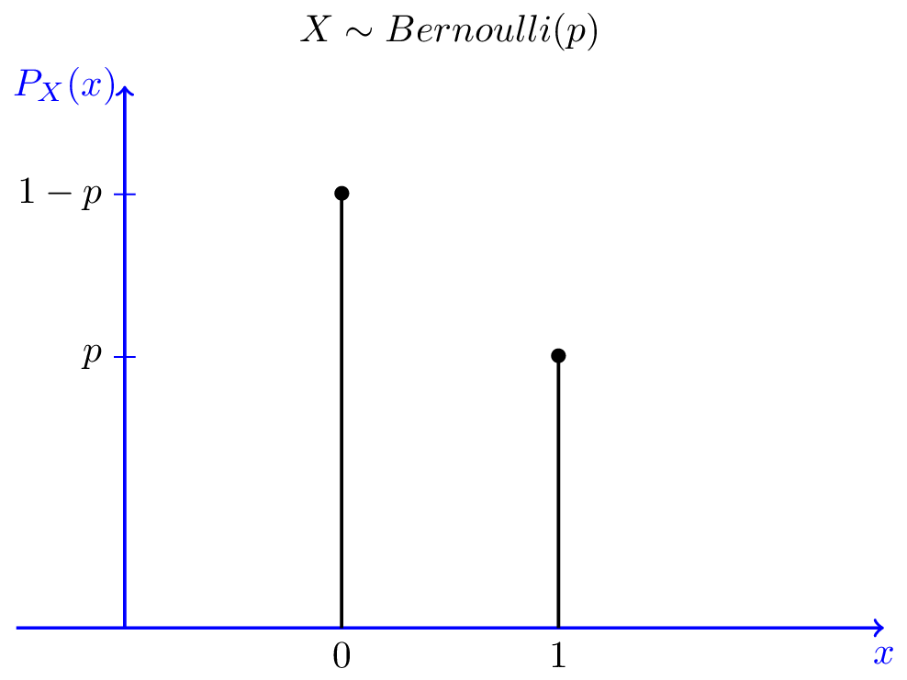
STATISTICS
THE BERNOULLI DISTRIBUTION
The Bernoulli distribution represents a single trial with a binary outcome, and a fixed probability of success defined as p.
f(X = x) = p, when x = 1
(1-p), when x = 0

Slide 13
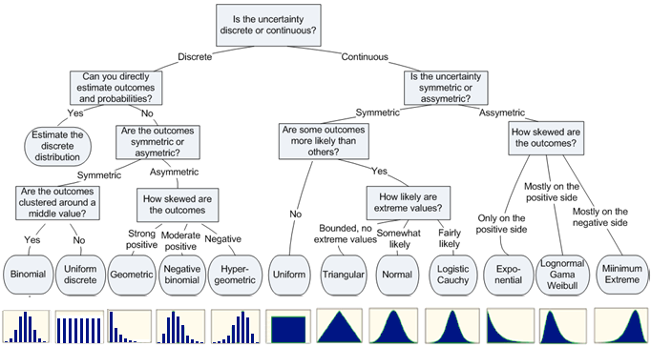
STATISTICS
DISTRIBUTIONS
There are a lot of distributions, most appropriate only a small amount of the time. While the below chart is incomplete, it servers as a reasonable starting point if trying to map data to a distribution.

Slide 14
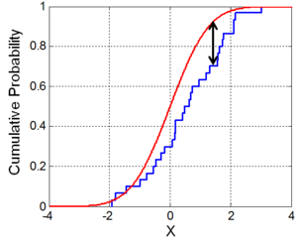
STATISTICS
TESTING DISTRIBUTIONS
Most statistical tests rely on data roughly following a distribution. While eyeball checks are helpful, goodness-of-fit tests like those below can confirm your data are closely aligned to the distribution you’ve estimated.
Kolmogorov-Smirnov test
Anderson-Darling
Shapiro-Wilk

Slide 15
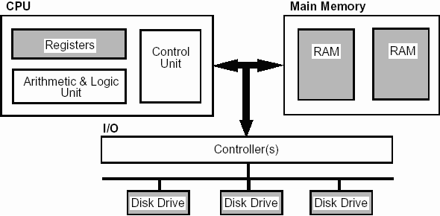
COMPUTER SCIENCE
HARDWARE
Understanding the high-level hardware architecture of computers can help make informed decisions around compute strategies. Hardware is the physical components that carry out operations as well as input and output devices.
Input Devices: Mouse, Keyboard, Headset
Output Devices: Monitor, Printer, Speakers
Internal Components: RAM, CPU, GPU, Hard Disks, Motherboard

Slide 16
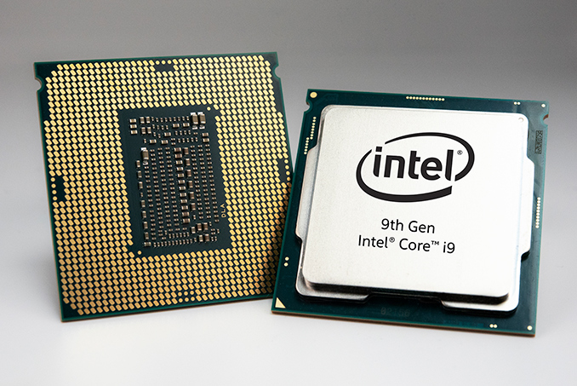
COMPUTER SCIENCE
CENTRAL PROCESSING UNIT (CPU)
The CPU is the component that executes provided instructions from other sources of input. CPUs excel at solving single, highly complicated tasks.
CPUs originally had only a single core, which meant that all jobs a computer wanted to do had to line up in order and the CPU would handle one at a time. Modern CPUs have multiple cores (4-8 on desktops, 200+ on servers) allowing for different jobs to queue on each core.
Software that can send single commands to be distributed between multiple cores is what is referred to as multithreading. Python does not support multithreading; however, it can be parallelized.

Slide 17
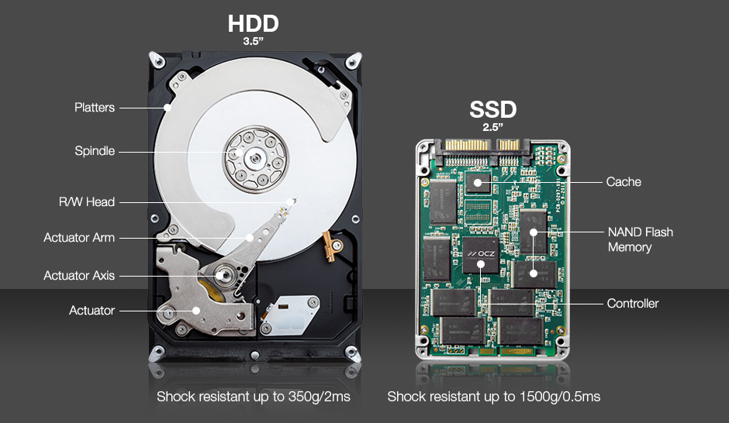
COMPUTER SCIENCE
HARD DRIVE DISKS AND
SOLID STATE DRIVES
Hard drive disks (HDD) are where data is written “permanently.” A magnetic tip attached to an arm in the disk writes bits out to the disk. This process is incredibly slow relative to CPU times.
Some speed improvements have been made with the dawn of the solid state drive (SSD). An SSD has no spinning components but rather a series of accessible chips (flash memory) that can be quickly directly referenced.

Slide 18
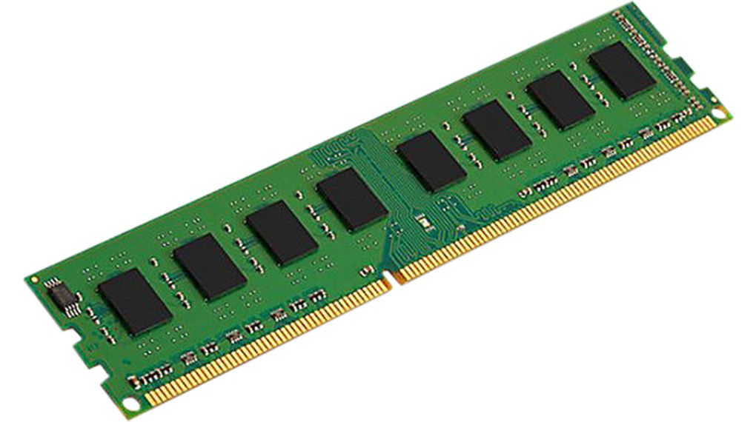
COMPUTER SCIENCE
RANDOM ACCESS MEMORY (RAM)
RAM is the component that stores short term data for CPUs. Instead of writing data directly to a drive/disk, RAM is designed to hold data in the short term.
RAM can bottleneck data science modeling when the training set or computation related to it (namely matrix inversions) requiring streaming data, multiple smaller models being fit, or distribute computing.

Slide 19
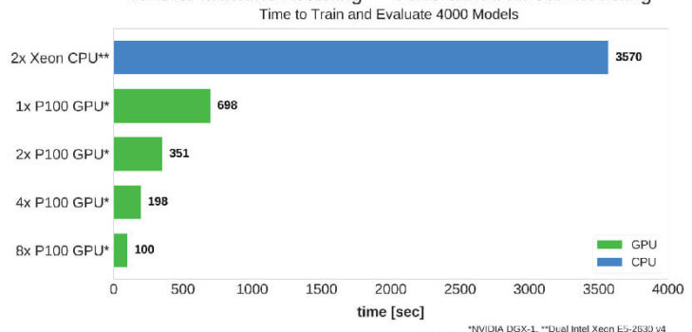
COMPUTER SCIENCE
GRAPHICS PROCESSING UNIT (GPU)
GPUs were invented to accelerate graphics for video editing and video gaming. To this end, these systems required many small processors which are underpowered relative to CPUs. They also contain their own internal memory.
Many machine learning algorithms require a large volume of very simple calculations such as matrix multiplication. These operations are easily handled by the huge number of cores, often ranging over 3500. GPU enabled libraries like TensorFlow and PyTorch have made deep learning feasible in recent years.

Slide 20
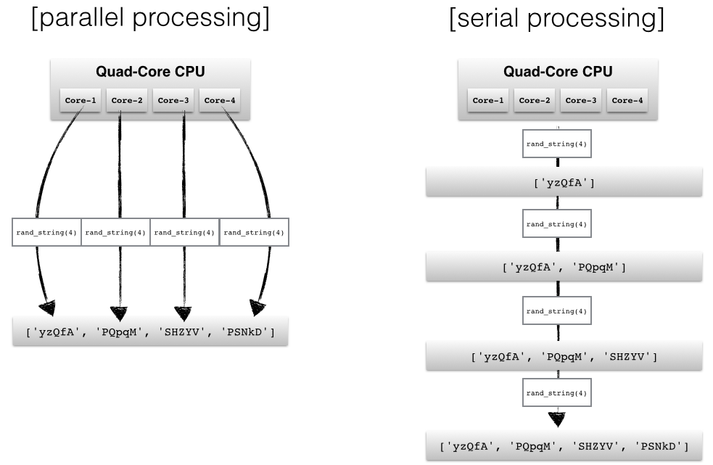
COMPUTER SCIENCE
EMBARASSINGLY PARALLEL
By default, Python and R will only utilize a single CPU. There are instances in data preparation, model development, and visualization where as task has to be applied to multiple items, but they can all be done independently of each other.
In principal all one does is partition and assign each block of data to one of the cores along with the relevant function. When feasible, parallelized processing can speed up your code by nearly a factor of however many cores are available.

