Slide 1
DSA 210 Final Project
Supplement, Sleep, and Fitness Performance Analysis

Slide 2
Objectives
Explore how supplements and sleep impact physical fitness.
Use EDA and ML to analyze a 60-day personal dataset.

Slide 3
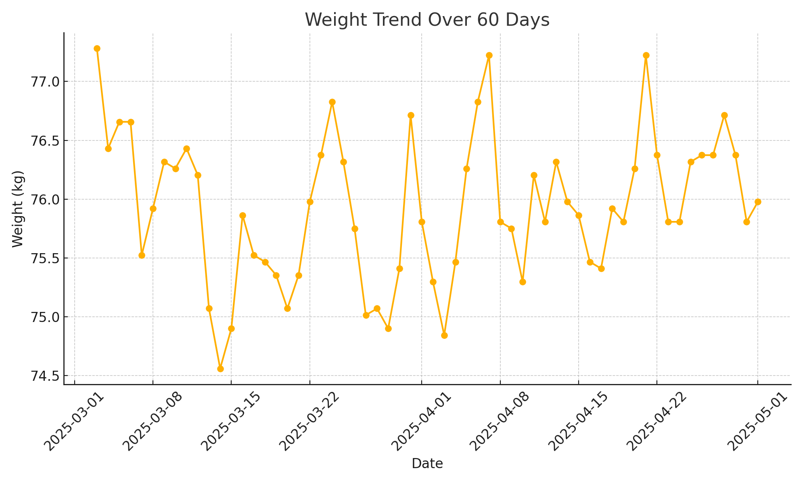
Weight Trend

Slide 4
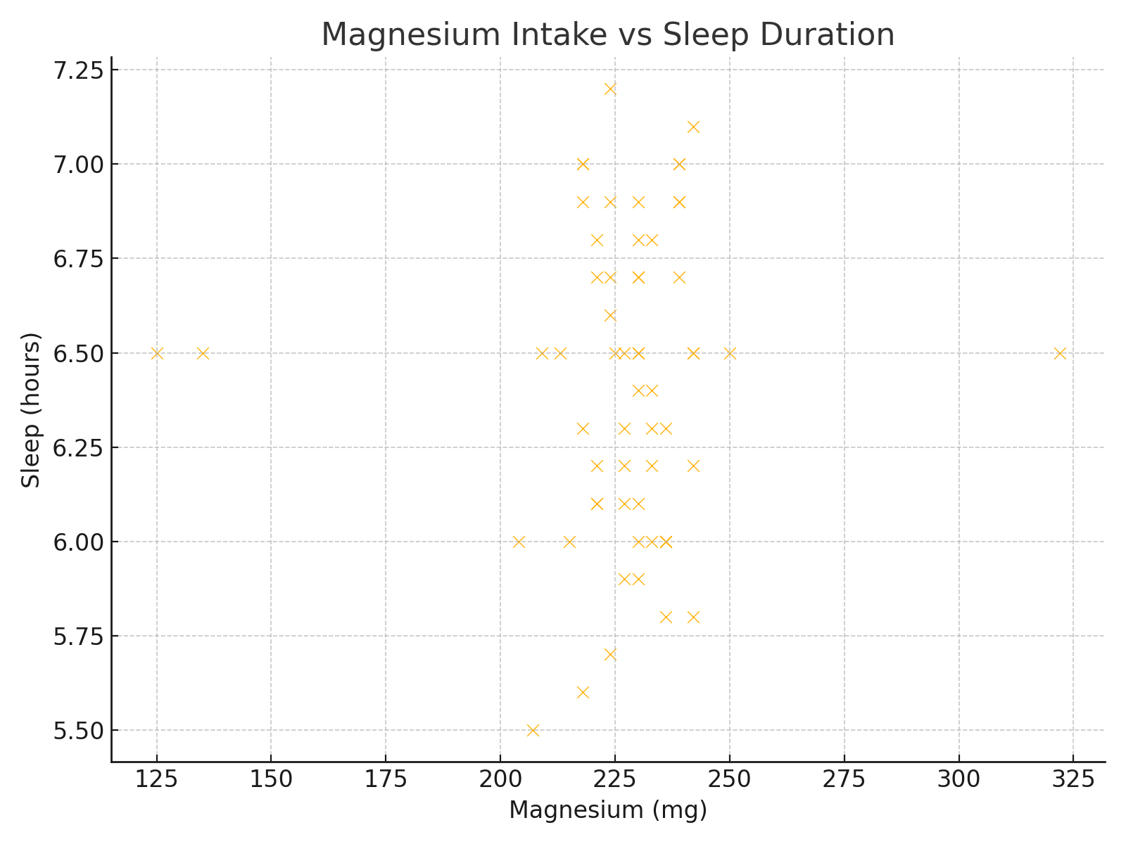
Magnesium vs Sleep

Slide 5
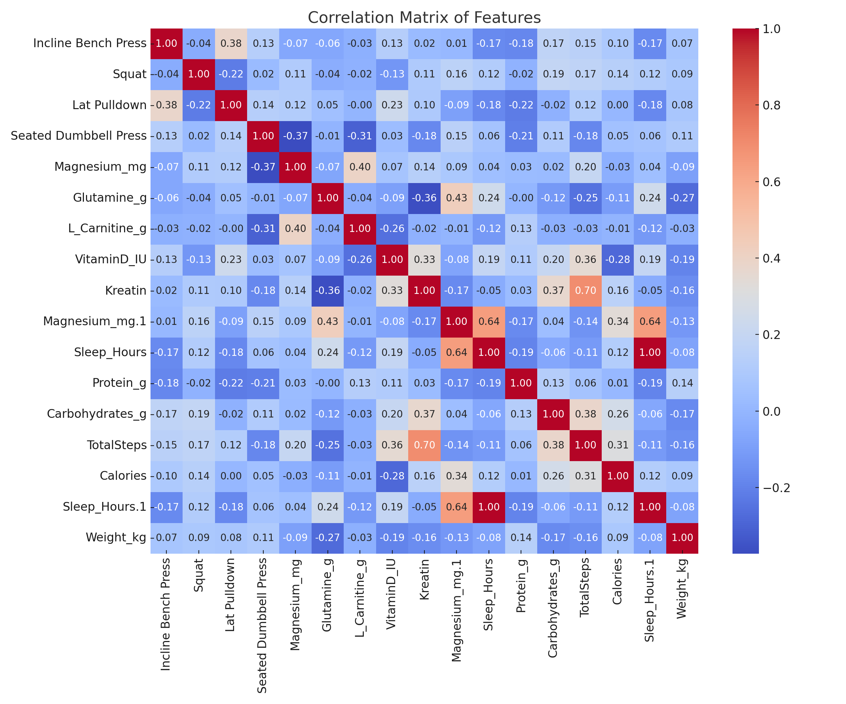
Correlation Matrix

Slide 6
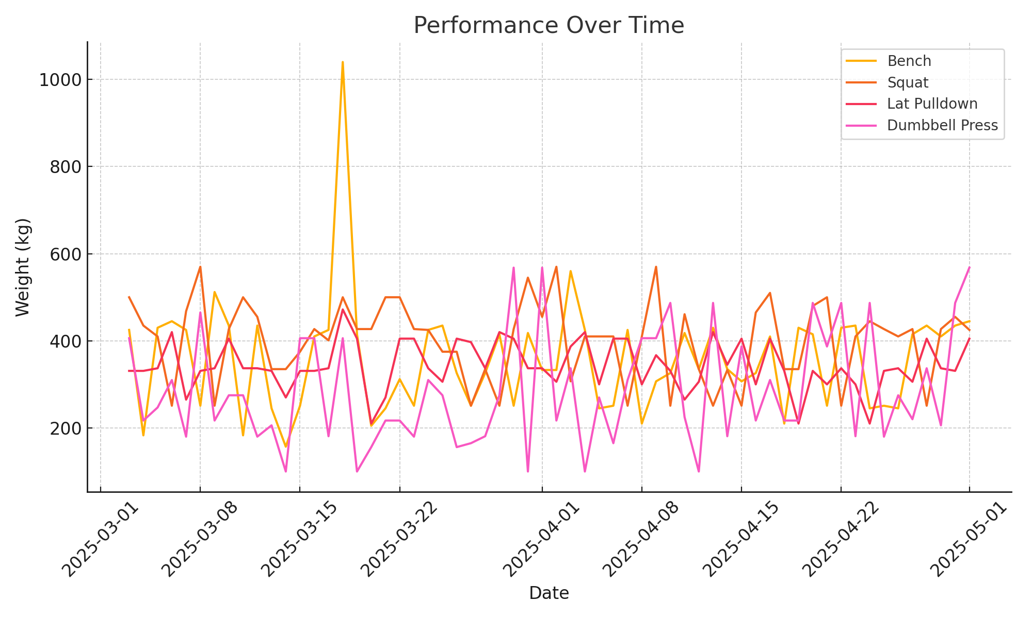
Performance Comparison

Slide 7
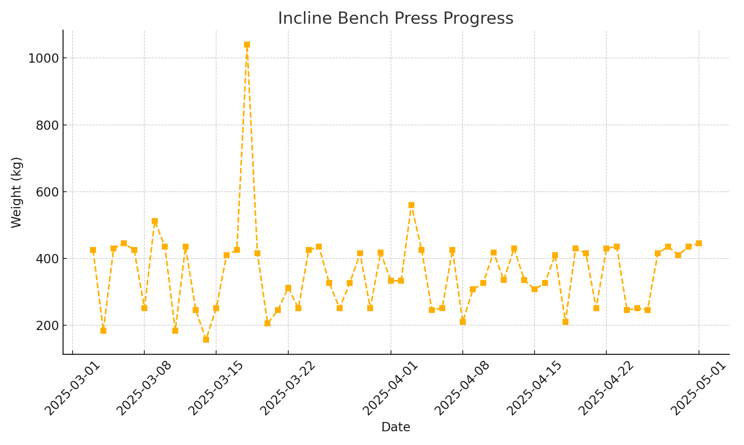
Bench Press Progress

Slide 8
ML Regression Summary
Best R²: Dumbbell Press and Lat Pulldown (~0.3)
Weight prediction had weakest model performance
Magnesium and sleep had minimal predictive power

Slide 9
Conclusion
Creatine and protein moderately affect strength.
Weight change is not well-explained by supplements alone.
Training volume consistency is critical for performance.
ML models reveal trends but lack precise predictions.

