Slide 1
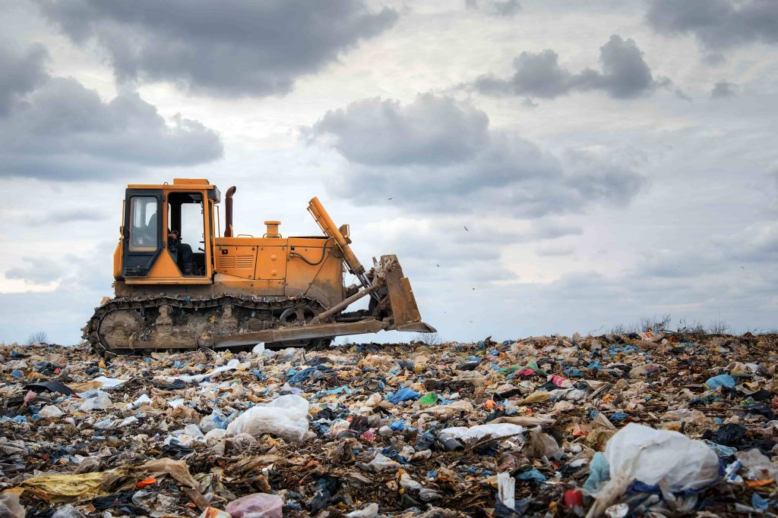
Regional Variations in Waste Management Practices: A Case Study of Australia
-Arindam and Aishwarya

Slide 2
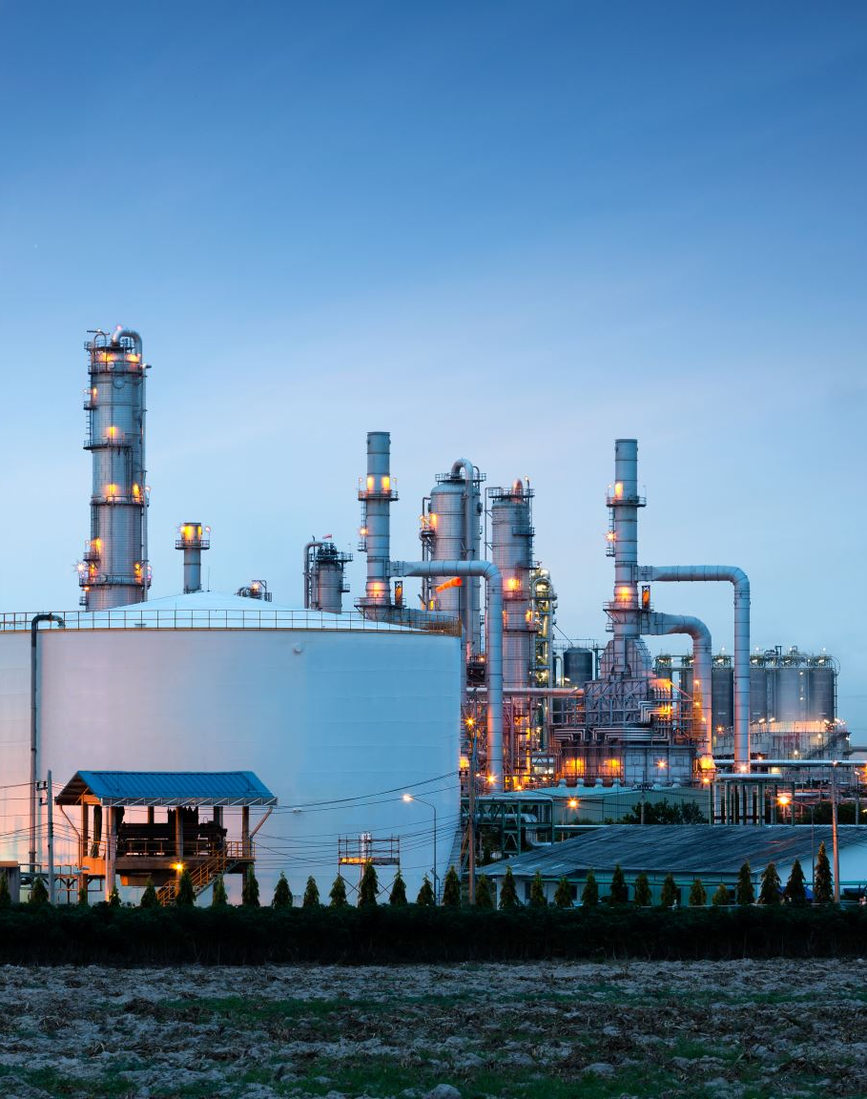
Content
What is the national waste management problem in Australia ?
Which are the states with highest producing waste ?
What are the dominating waste types in each state ?
Is hazardous waste generation on the rise across Australia ?
What are the waste management techniques applied in the top 3 hazardous waste generating states ?
What is the composition of the hazardous waste generated ?
Key recommendations
What is the source of hazardous waste ?

Slide 3
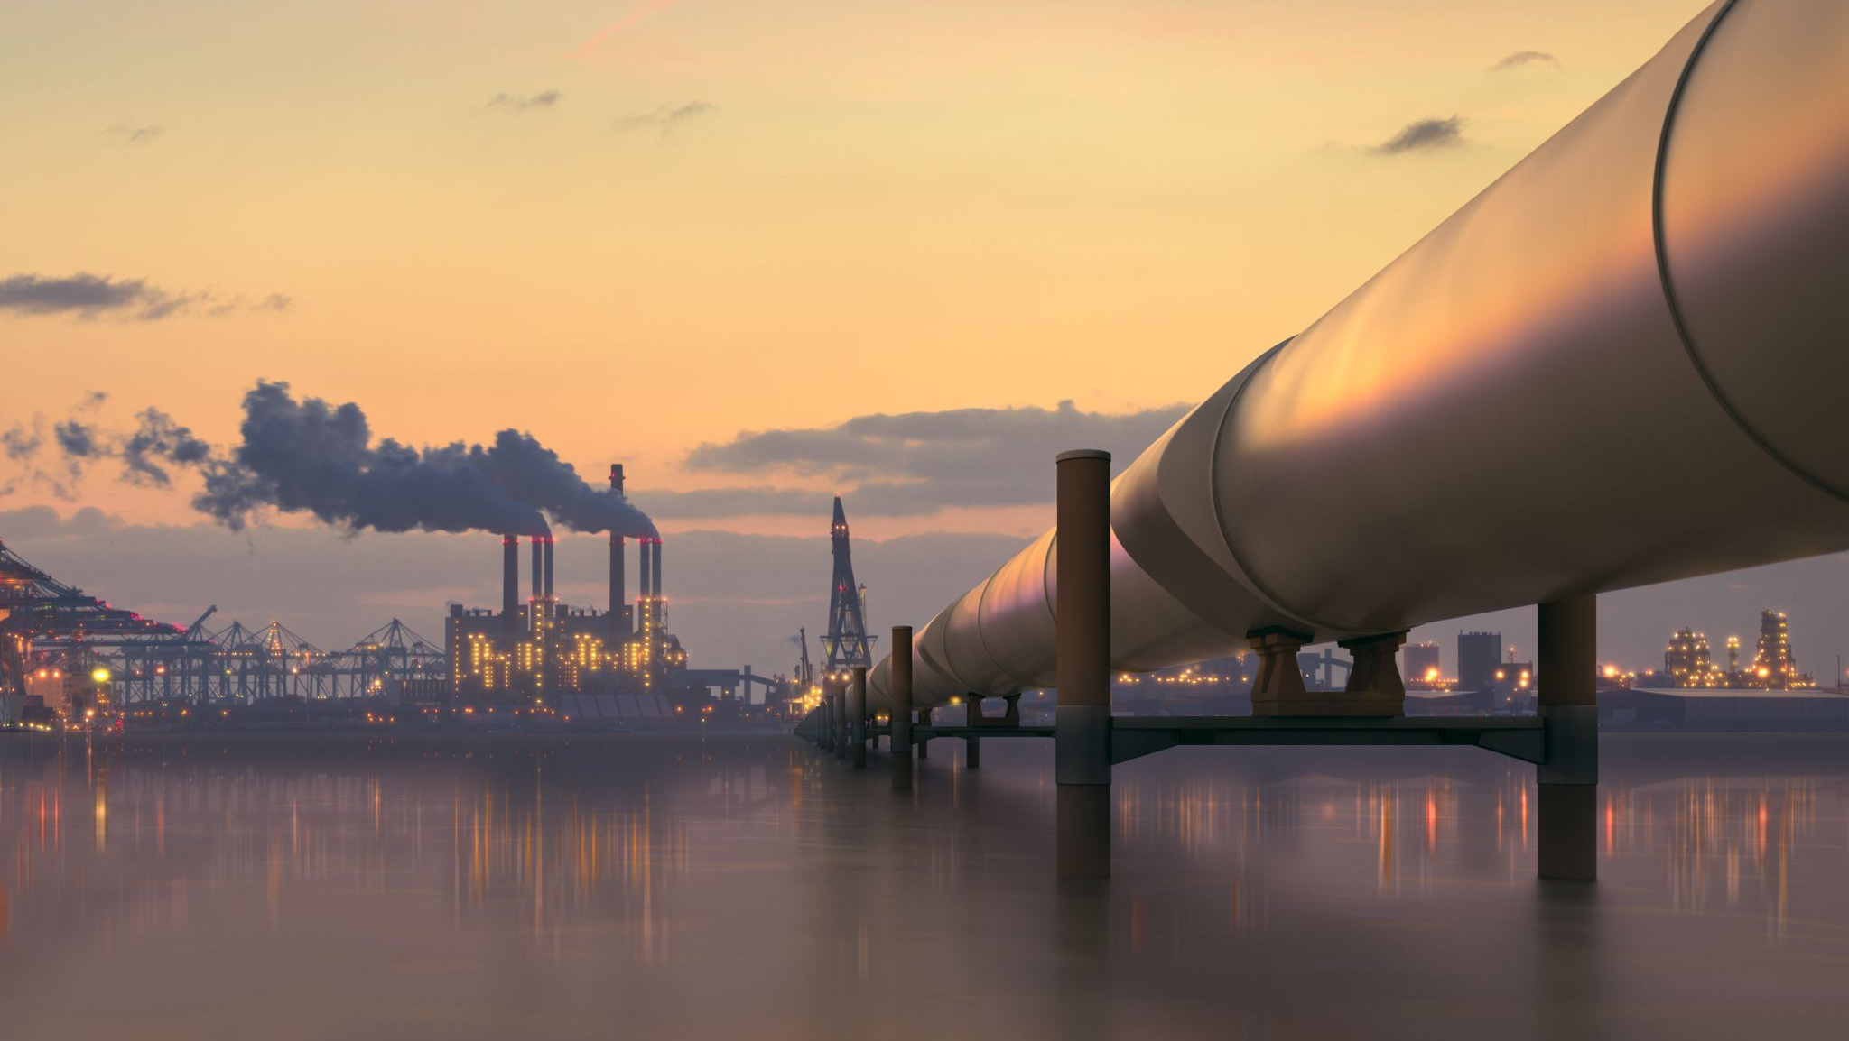
The national waste generation problem of Australia
High per capita waste generation due to the consumer culture leading to the high usage of single use packaging.
High dependence on landfills which result in soil, water and air pollution.
Uneven waste management infrastructure across the country.
Heavy polluting industries such as mining and the steel industry.
Electronic waste (e-waste) is a growing problem in Australia, with the increasing use of electronic devices and appliances. Managing e-waste responsibly is a complex issue due to the hazardous materials contained in electronic products.

Slide 4
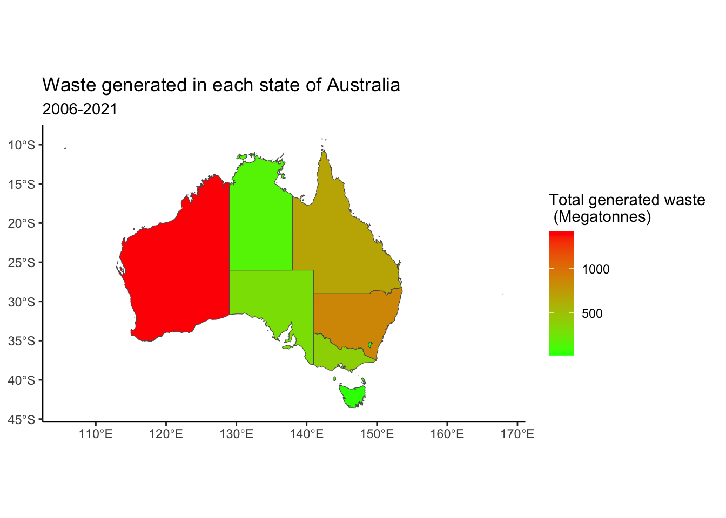
Which are the states with highest producing waste ?
WA leads the waste generation by state with 37 % of the national waste produced followed by NSW (22 %) and QLD (17.4 %).
Despite a population lower than QLD and NSW, it is interesting to note the high generation of waste by WA. (Approx. 1500 Mega Tonnes).

Slide 5
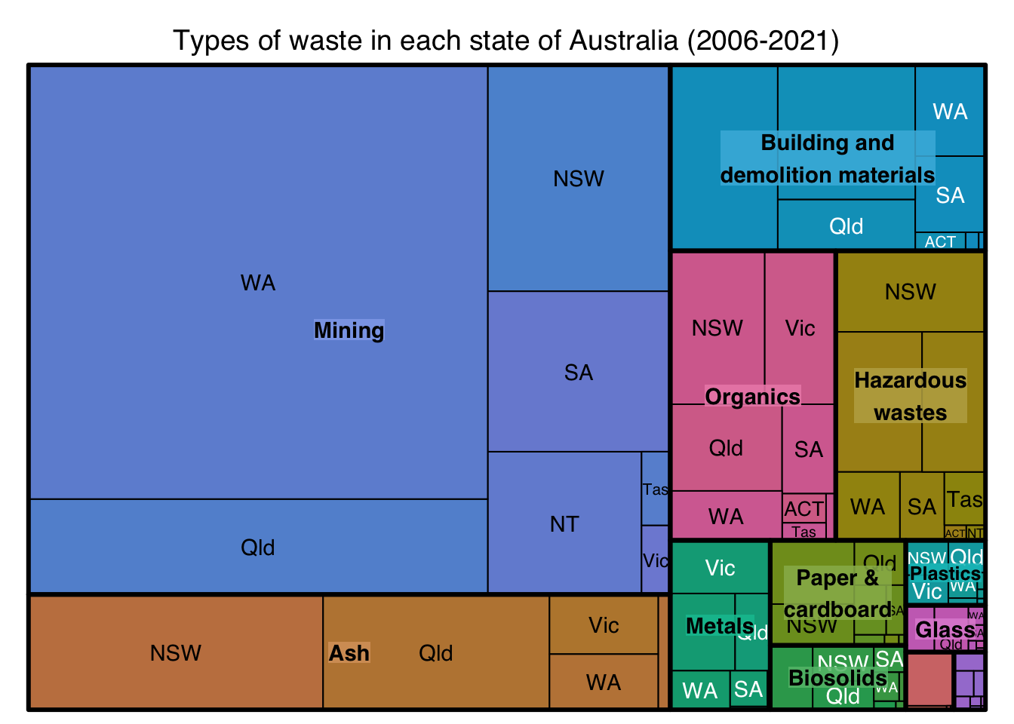
What are the dominating waste types in each state ?
Nearly 45 % of Australia’s waste is generated from the mining industry.
WA is the leading producer of waste from the mining industry. These include iron, nickel, coal and lithium mines.
Based on the Australian treasury, the mining industry adds about 270 billion $ every year, making it a significant addition to the Australian economy.
WA’s reliance on the mining industry and the nature of its large-scale pollution could be the reason why despite a low population, the state is the highest contributor to the waste generation

Slide 6
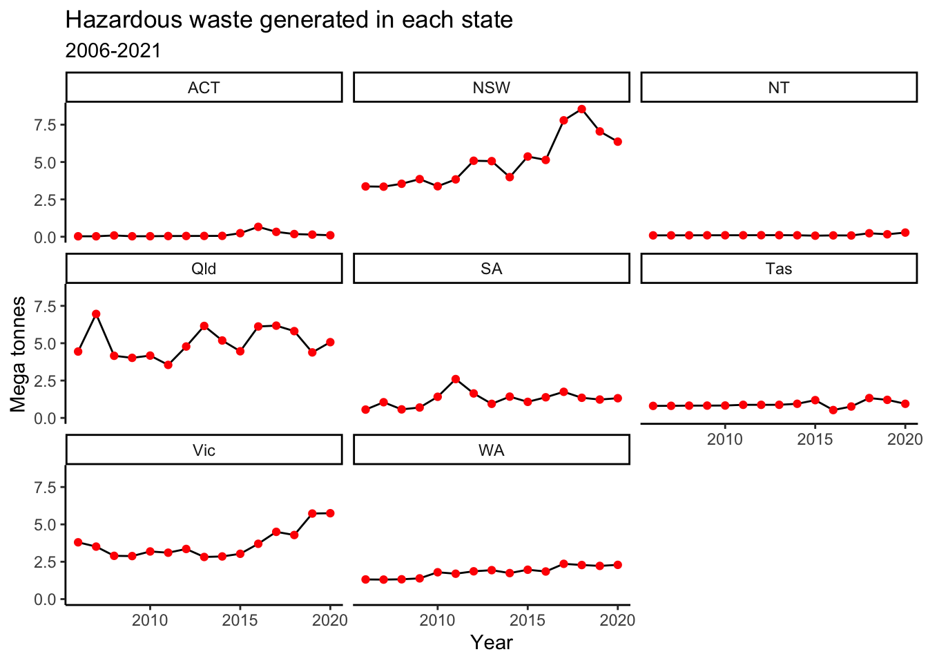
Is hazardous waste generation on the rise across Australia ?
While WA is the highest contributor to the national waste generation, it is NSW who is the leading generator of hazardous wastes (Upto 8 mega tonne) followed by QLD ( 7.5 mega tonne) and VIC (5.5 mega tonne).
The hazardous waste generation is observed to be on a rise in NSW and VIC while it has been consistent in QLD between 2006-2020.

Slide 7
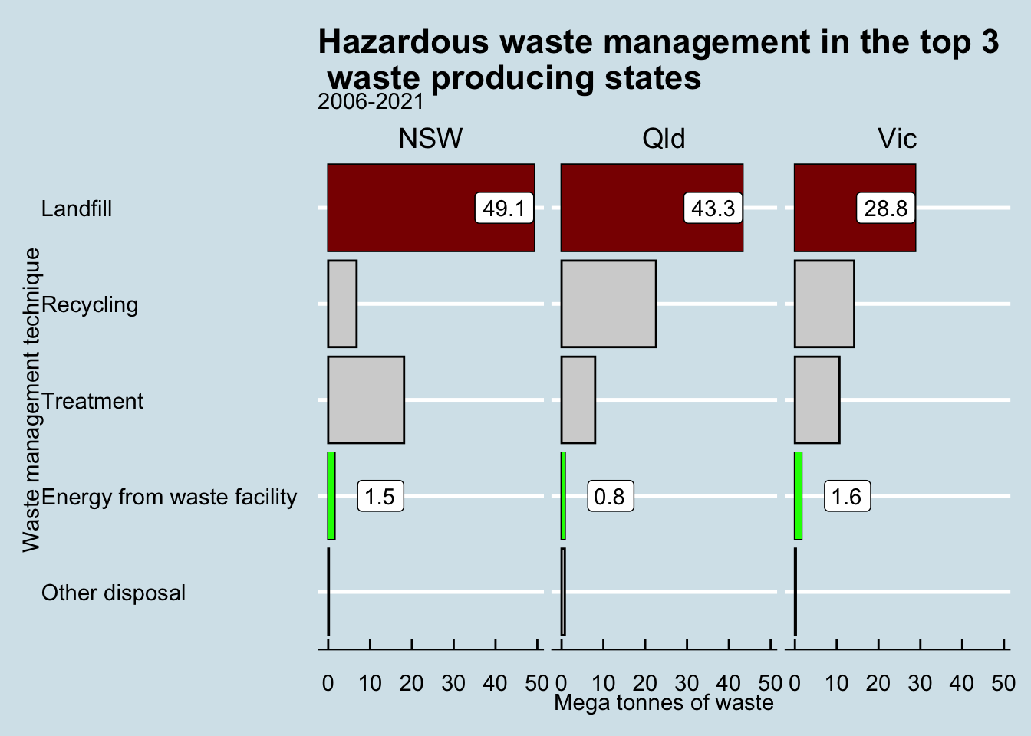
What are the waste management techniques applied in the top 3 hazardous waste generating states ?
Majority of the hazardous waste is disposed in the landfills.
This is concerning as these wastes end up polluting the water bodies and the underground potable water, consequently leading to loss of marine lives.
There is still a technology gap to be able to effectively harness the hazardous waste for producing energy.

Slide 8
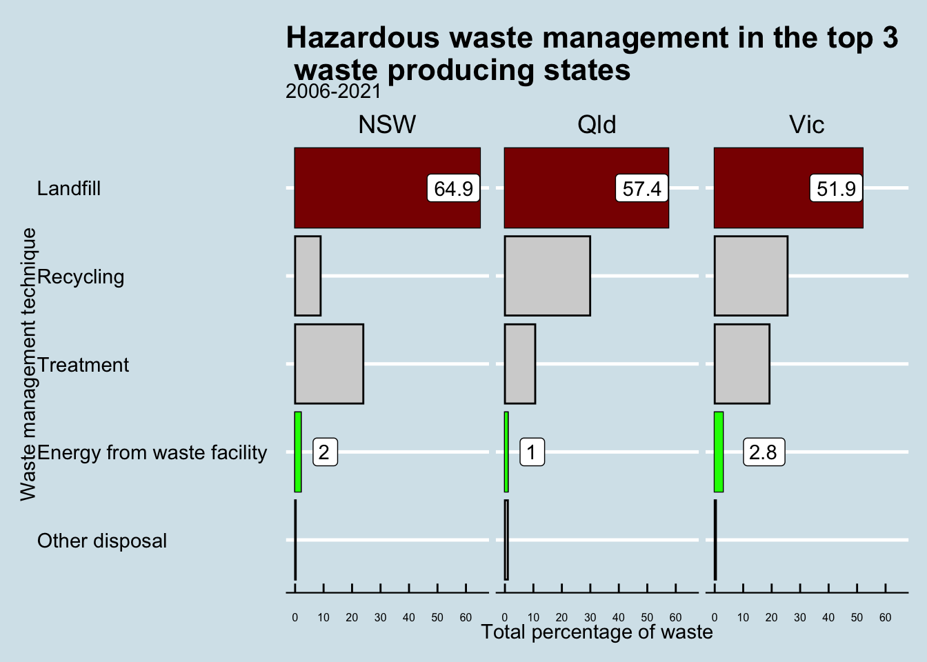
What are the waste management techniques applied in the top 3 hazardous waste generating states ?
It is however interesting to note that despite the lower generation of hazardous waste in VIC, they are also leading in the race to utilize these wastes to obtain energy.
While this could suggest that VIC has adopted a better way to deal with hazardous waste that allows them to convert the waste into energy, it could also be dependent on the type of hazardous waste present in the two states.

Slide 9
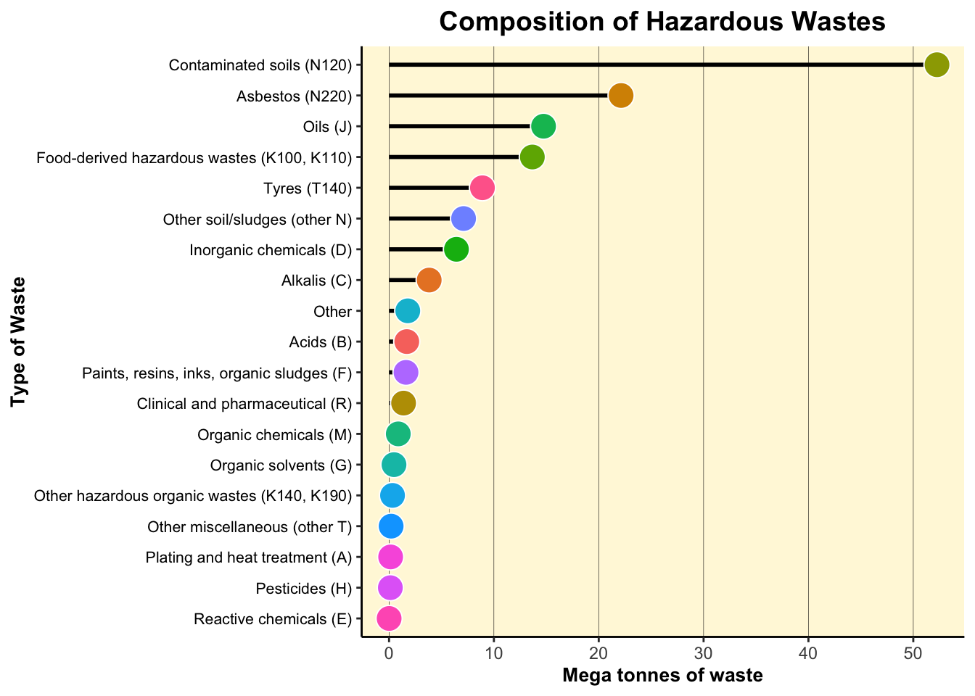
What is the composition of the hazardous waste generated ?
Upon diving deeper into what constitutes these hazardous wastes, we could observe that contaminated soils are the largest source followed by asbestos.
But what is the source of such waste and how are they being treated ?

Slide 10
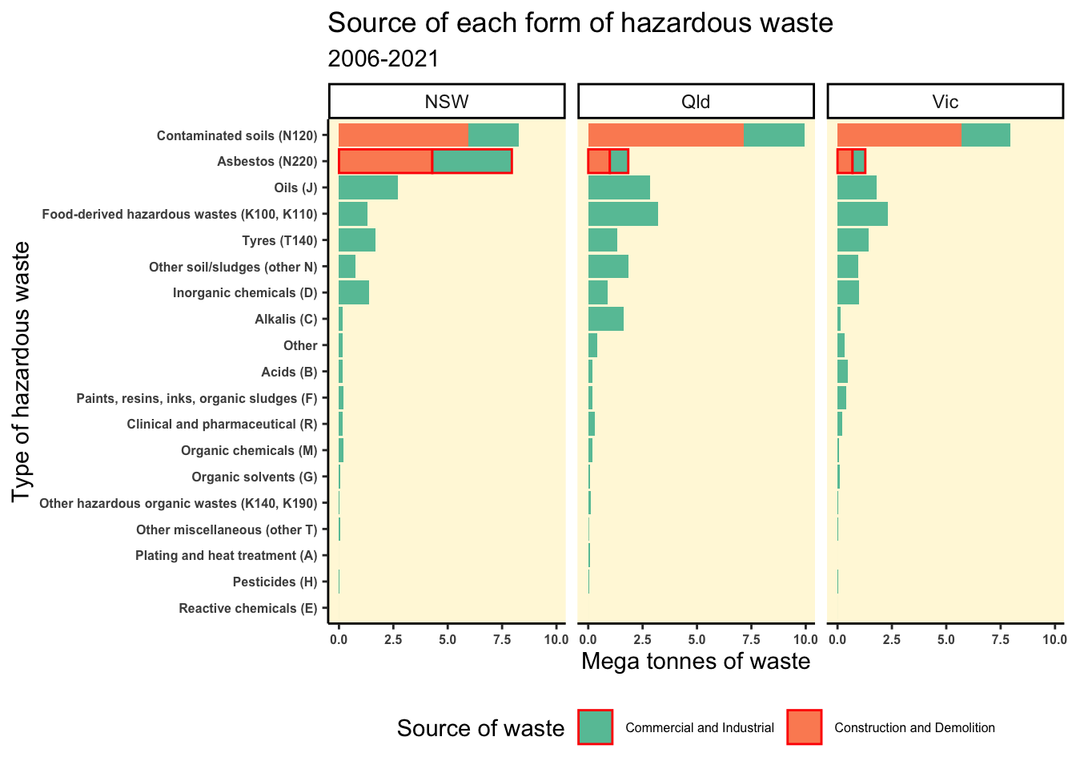
What is the source of these hazardous wastes ?
Largest hazardous waste sources are from two major sources: 1. Commercial and Industrial
2. Construction and Demolition
It is interesting to note that while most hazardous wastes are similarly distributed across all 3 states, the differentiating factor which results in higher waste generation for NSW is Asbestos.
Asbestos waste generation is approximately equally contributed by both the Commercial and Industrial as well as the Construction and Demolition.

Slide 11
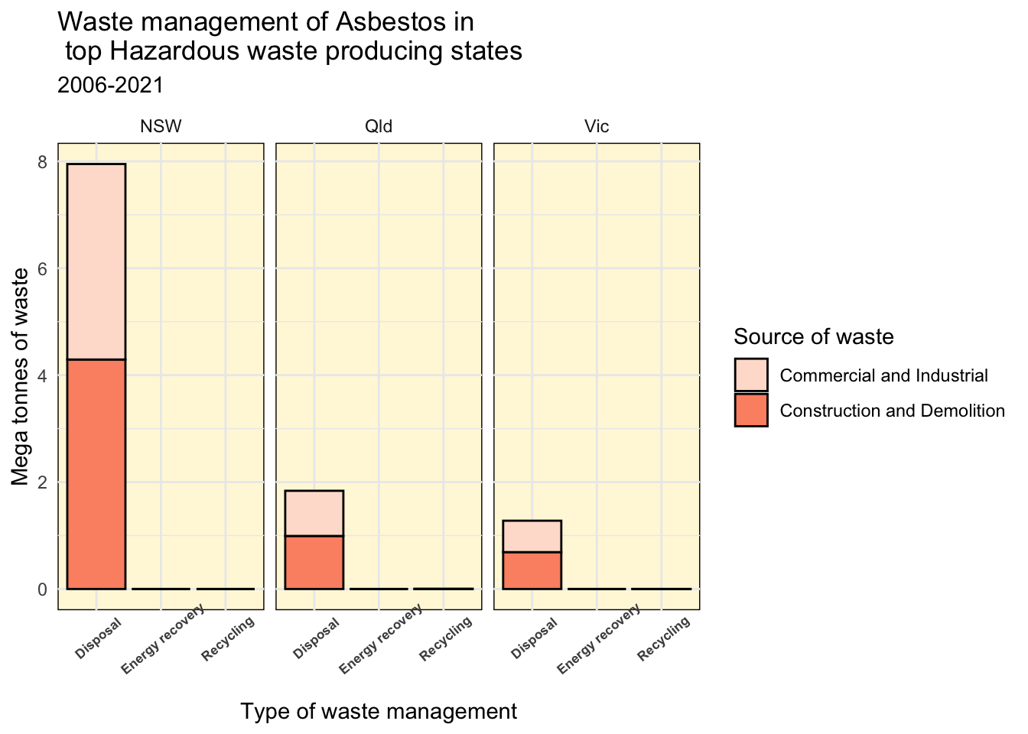
How is Asbestos treated ?
We observe that Asbestos is especially harmful for the environment since it is non-biodegradable in nature.
This inevitable leads to bigger landfills and consequent rise in land, water and air pollution.
Asbestos is additionally carcinogenic in nature, thereby causing direct health risks to lives.

Slide 12

Key recommendations
While adopting sustainable practices is the need of the hour, it is especially important to address the processing of hazardous wastes.
Hazardous wastes are seldom bio-degradable and need innovative techniques to be converted into a usable form such as energy.
Higher allocation of funds for R&D to develop ways to harness energy from these wastes can be a big game changer for Australian states. Eg: Carbon Capture Utilisation in steel industries developed by ArcelorMittal Belgium (https://doi.org/10.1007/978-3-319-66981-6_33).
Governments in each state should be wary of industries using hazardous materials such as Asbestos in construction or manufacturing which can only be dumped in landfills that lead to various types of pollution. Sanctions and penalties imposed can greatly motivate construction and industries to explore alternative and sustainable materials.

Slide 13

Thankyou

Slide 14
References
RStudio Team (2020). RStudio: Integrated Development for R. RStudio, PBC, Boston, MA URL http://www.rstudio.com/.
H. Wickham. ggplot2: Elegant Graphics for Data Analysis. Springer-Verlag New York, 2016.
Wickham H, Averick M, Bryan J, Chang W, McGowan LD, François R, Grolemund G, Hayes A, Henry L, Hester J, Kuhn M, Pedersen TL, Miller E, Bache SM.
Australian Government, Office of The Australian Treasury.
Bollen, J. (2018). Role of Carbon Capture and Storage (CCS) or Use (CCU) on Climate Mitigation. In: Benetto, E., Gericke, K., Guiton, M. (eds) Designing Sustainable Technologies, Products and Policies. Springer, Cham. https://doi.org/10.1007/978-3-319-66981-6_33

