Slide 1
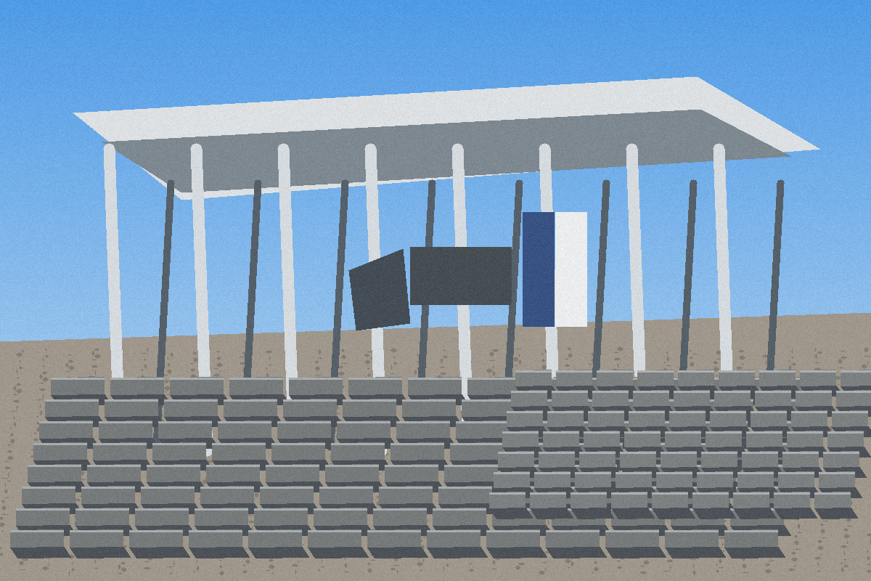
Funding Ask
UGX 130M to launch a lean concrete products factory in Mbarara, Uganda.
Phase 1 cost: UGX 128M
Protected buffer: UGX 2M
Profit target: UGX 20M per month
Funding ask
Phase 1 cost
Buffer
UGX 130,000,000
UGX 128,000,000
UGX 2,000,000
Mbarara Integrated Concrete Products Factory | Funding Pack | 2026-07-09
1

Slide 2

Founder Story
Hillary Arindamukama is a 25-year-old FAU Clean Energy Processes student building a practical manufacturing venture for Western Uganda.
International student founder
Engineering and energy process background
Mission: jobs, quality, and disciplined production
Mbarara Integrated Concrete Products Factory | Funding Pack | 2026-07-09
2

Slide 3
Problem
Western Uganda construction demand is growing, but supply is fragmented, quality is inconsistent, and delivery reliability is weak.
Contractors need reliable blocks and pavers
Hardware stores need predictable supply
Projects need documented batch quality
Data confidence: Estimated / Quotation Required. Re-verify all market and quotation data before investment decisions.
Mbarara Integrated Concrete Products Factory | Funding Pack | 2026-07-09
3

Slide 4
Solution
A lean, quality-controlled factory producing blocks, pavers and kerbstones first, then expanding into heavy precast and ready-mix later.
Batch IDs and test certificates
Inventory, ERP, QC and market intelligence systems
Direct-to-site sales and delivery coordination
Data confidence: Estimated / Quotation Required. Re-verify all market and quotation data before investment decisions.
Mbarara Integrated Concrete Products Factory | Funding Pack | 2026-07-09
4

Slide 5
Phase 1 Products
Manufacture only the essentials first.
6-inch hollow blocks
8-inch hollow blocks
solid blocks
60 mm pavers
80 mm pavers
kerbstones
Data confidence: Estimated / Quotation Required. Re-verify all market and quotation data before investment decisions.
Mbarara Integrated Concrete Products Factory | Funding Pack | 2026-07-09
5

Slide 6
Use of Funds
The UGX 130M budget is designed around necessity, not luxury.
Semi-automatic block/paver machine, mixer, v - UGX 45,000,000
Starter moulds: 6-inch, 8-inch, solid, 60 mm - UGX 14,000,000
Site preparation, curing yard, drainage, bas - UGX 14,000,000
Electrical and water connection setup - UGX 7,000,000
Pallets, wheelbarrows, hand tools, racks, sa - UGX 8,000,000
Starter raw materials and packaging - UGX 24,000,000
Permits, basic laboratory tools, compliance - UGX 4,000,000
Launch labour, security, administration - UGX 7,000,000
Sales, local transport, customer visits - UGX 3,000,000
Semi-automatic block/paver machine, mixer, vibrator: UGX 45,000,000
Unallocated cash buffer - UGX 2,000,000
Starter moulds: 6-inch, 8-inch, solid, 60 mm, 80 mm, kerbstone: UGX 14,000,000
Site preparation, curing yard, drainage, basic shed works: UGX 14,000,000
Mbarara Integrated Concrete Products Factory | Funding Pack | 2026-07-09
6

Slide 7
Financial Model
Using the app costing model, the Phase 1 sales scenario reaches the target.
Monthly revenue
Net profit
Target reached
ROI estimate
UGX 140,020,000
UGX 36,092,578
YES
338.4%
Monthly revenue: UGX 140,020,000
Net profit: UGX 36,092,578
Break-even revenue: UGX 39,334,142
ROI estimate: 338.4% annualised
Mbarara Integrated Concrete Products Factory | Funding Pack | 2026-07-09
7

Slide 8
Customers and Market
First campaign focuses on Mbarara City and Western Uganda customers with repeat construction demand.
Contractors
Hardware stores
Property developers
Schools and hospitals
Fuel stations
Government projects
NGOs and churches
Data confidence: Estimated / Quotation Required. Re-verify all market and quotation data before investment decisions.
Hotels and residential builders
Mbarara Integrated Concrete Products Factory | Funding Pack | 2026-07-09
8

Slide 9
Risk Controls
The plan is feasible only if pricing, procurement, curing, credit control and quality testing are managed tightly.
Quotation risk: Re-verify machinery, raw material and market prices before investment close.
Cement price volatility: Use supplier comparisons, minimum gross margin rules and bulk purchasing.
Quality failure: Batch IDs, curing logs, compressive tests and rejection controls from day one.
Cash collection: Deposits before production, balances before delivery, customer ledger discipline.
Premature expansion: Defer ready-mix, culverts and heavy precast until cash flow supports them.
Data confidence: Estimated / Quotation Required. Re-verify all market and quotation data before investment decisions.
Mbarara Integrated Concrete Products Factory | Funding Pack | 2026-07-09
9

Slide 10
Funding Ask and Next Steps
Raise UGX 130M, verify quotations, secure a site, order essential machinery, launch first sales campaign, and report monthly performance.
https://mbarara-concrete-factory.netlify.app/
https://mbarara-concrete-factory.netlify.app/Mbarara_Integrated_Concrete_Factory_Master_Report.pdf
Email: arindahillary222@gmail.com
WhatsApp: +4915751996877 / +256700194482
Data confidence: Estimated / Quotation Required. Re-verify all market and quotation data before investment decisions.
Mbarara Integrated Concrete Products Factory | Funding Pack | 2026-07-09
10

