Slide 1


Google Agentic Hackathon

Slide 2


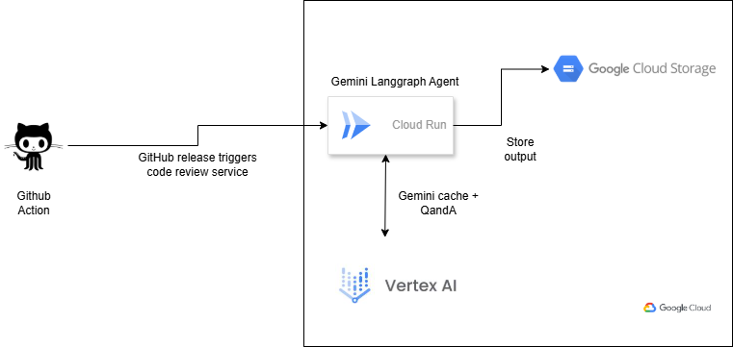
Description: This document outlines the architecture and workflow for an automated code review system that leverages Gemini, LangGraph, Cloud Run, and Google Cloud Storage. The system is triggered by new releases in GitHub or GitLab repositories, automatically reviews the codebase, and stores the review results in a Google Cloud Storage bucket.
Atos Intelligent AI Assistant
(Hackathon)
Automated Code Review: Maximizing Quality and Efficiency
Architecture:

Slide 3

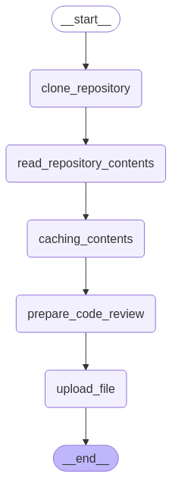



Automated code revie by Gemini
Langgraph workflow
Fast, Easy, and customizable approach to Gen AI built on open-source framework on GCP Infra
User Experience
Security
Business Impact
Git tag / release creation will automatically trigger the pipeline
After a small delay, the code review document will be available which can be retrieved from GCS
Cloud run service clones the repo retrieving credentials from Secret Manager.
The entire ci cd process was done using github to gcp workload identity federation.
No service is accessible without authentication
Every month significant amount of man hours spent on code review / application across our clienteles. This can be significantly reduce by this workflow.
Any new measure can be easily integrated to the system in order to be taken into account by the system.
It saves at least 80% of manual code review effort besides the automation tools like SonarQube etc.
Notes:
Voir Slide 20 de Romain, pour coherence avec Offre Globale
Reférences :
SNCF MISTRAL : Audit, … Eden Azure
SATAIR / Airbus : GCP
Estee Lauder Slide 23 :
INTELCIA : GCP

