Slide 1



Hashout Technologies
AEM Guides
R E V I E W
Mar 2026
X

Slide 2
Training Agenda
01
02
03
Introduction to Review
Content Status Lifecycle
Create & assign review tasks
04
05
06
Multiple maps review
Notifications & inbox
Export for external review

Slide 3
Aravind Anand
20+ Years AEM Industry experience
A Principal Consultant working at the intersection of content strategy, intelligent content architecture, and enterprise technology, with expertise in DITA and Adobe Experience Manager (AEM) Guides. I help organizations rethink and optimize how they create, manage, and deliver structured content by aligning business goals with scalable solutions.

Slide 4
Introduction to Review
Some of the main features offered by Adobe Experience Manager Guides to the initiators (or authors) are:
Create a DITA project for the review workflow.
Send one or more topics for review in a single review task.
Send a topic for review in multiple review tasks.
Create a review task by selecting a DITA map or topic based on their latest version, version on date, or a label (for topics) and Baseline (for map).
Share an updated version of the topic for review from the Review Dashboard.
Access comments shared on different versions of topic.
Easily tag users of specific review task in comments or replies for quick action and follow-ups. Tagged users are immediately notified through both AEM and Email notification.
Group and filter comments based on version of topic.
View side-by-side differences between different versions of topics shared for review.
Automatically import (deleted or inserted) comments into the version of topic that was shared for review.

Slide 5
Introduction to Review
Features available to the reviewers:
Get one composite view of the topics shared for review.
Switch between composite view and individual topic view.
Use the commenting tools, such as text insertion, deletion, highlight, and note/comment to provide their feedback.
Attach one or multiple files to a review comment.
Reply to a comment by tagging users involved in the same review task.
Download attachments from a comment.
Use the Review Panel to add comments or respond to comments from other users.
Easily know the version of topic under review.
Receive a notification when a task is assigned to them for review.
View differences between older and newer version of topic shared for review.
View comments made by other reviewers or replies on comments from author in real time.
Access comments given on older version of topic.
Review topics
Reassign review task using notification
Complete the review task as a Reviewer
Address review comments
Close or request re-review for a review task
Manage review tasks using the Review Dashboard
View a completed review task
Understanding review notifications

Slide 6
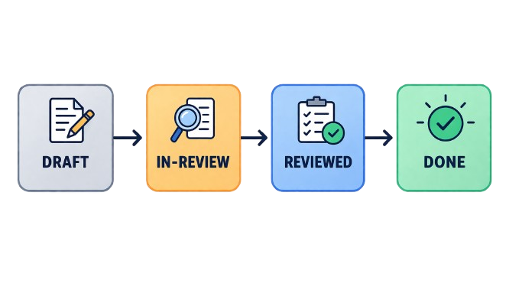
Content status lifecycle
Draft : In-Review : Reviewed : Done :

Slide 7
Create & assign review tasks
Editing the file from Repository Interface
You can select one or multiple files from the list for editing.
After selecting the desired files using the checkbox, the Edit option becomes available in the top-right corner of the Repository view.
Selecting Edit opens the selected file(s) in the Editor interface, where you can begin editing the file.

Slide 8
Multiple maps review
Explorer
Displays the content hierarchy stored in the AEM repository. Allows users to browse folders, create new assets (topics, maps, folders), edit content, and manage files. Access via: Select Editor in the dropdown(top-left section as highlighted in the image) → Select Explorer in the left pane.

Slide 9
Reviewer Experience
Editor
The Editor is the primary workspace where authors create and modify DITA content. It provides multiple authoring modes — Author, Source, and Preview — along with options to insert topic references, reusable content, and topic groups. Double clicking a map or topic opens the file in Editor view

Slide 10
Notifications & Inbox
Map View
Provides a structured outline of the DITA map and all topics referenced within it. Authors can visualize the map structure, manage topic references, reorder content, and open or edit individual topics directly from the hierarchy.
To open Map View: double-click a map file when in the Repository View.

Slide 11



Slide 12


