Slide 1


Data-analysis-chatbot Streamlit App with DevOps & Jenkins
This presentation covers a Data-analysis-chatbot app architecture.
Uses Streamlit frontend, Python backend, and automated DevOps.
by Arindam Maji

Slide 2

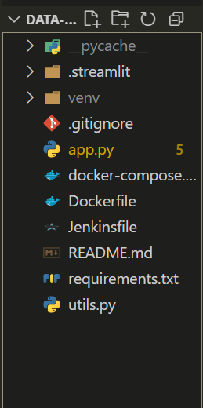
Folder Structure Overview
.streamlit/config.toml
It is a configuration file used by Streamlit to customize the app’s
Appearance, security, and behaviour.
App.py/
Runs a Streamlit-based chatbot app where users can upload a data file (CSV, Excel, JSON)
, ask natural language questions about it, and receive automated analysis, visualizations,
and insights using Hugging Face models and rule-based logic.
docker-compose.yml
Configuration for multi-container Docker setup
Jenkinsfile
Defines CI/CD pipeline for automated building and deployment

Slide 3
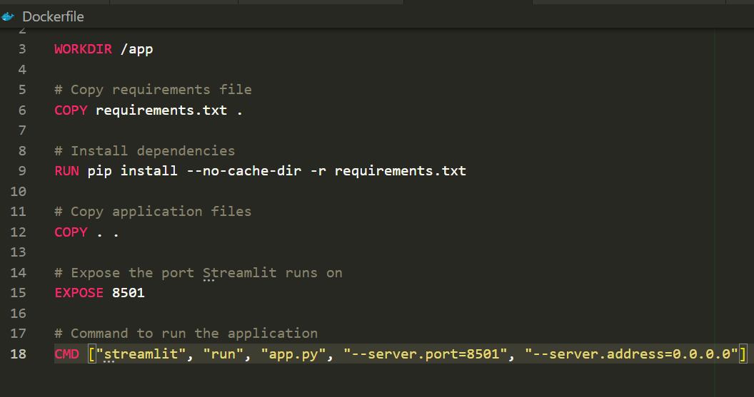
Dockerfile
Base Image
Build Process
Uses a lightweight Python 3.9 image to reduce size while retaining Python functionality.
Sets the working directory inside the container to /app.Copies requirements.txt and installs dependencies using pip.Copies all remaining project files (app.py, utils.py, etc.) into the container.
Expose
Declares port 8501 open, which is the default port used by
Streamlit, so Docker knows which port to map to your
host.
Run
Starts the Streamlit application by running app.py.--server.address=0.0.0.0 ensures the app is accessible from outside the container (e.g., your browser).

Slide 4

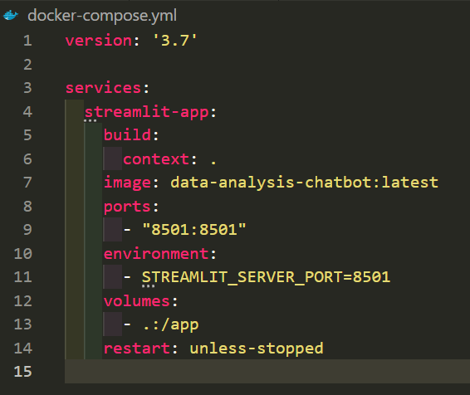
Docker Compose Setup
Service
Description
Ports
Dependencies
app.py
Python Streamlit container
8501:8501
server

Slide 5
Docker Compose Workflow
Build Containers
Image
Service Isolation
Access
Builds the Docker image using the Dockerfile in the current directory (.).
Equivalent to running:
docker build -t data-analysis-chatbot:latest .
image: data-analysis-chatbot:latest
Containers networked with dependencies and port mappings
App frontend is accessible at localhost:3000 in browser

Slide 6
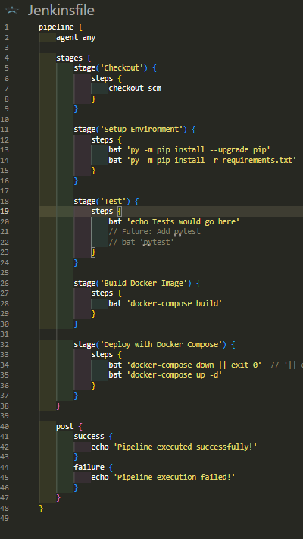




Jenkins CI/CD Pipeline
Checkout Code
Pull latest repository commit for build
Build Images
Run docker-compose build to create containers
Run Containers
Deploy containers in detached mode
Health Check
Verify backend is responding on port 8501

Slide 7
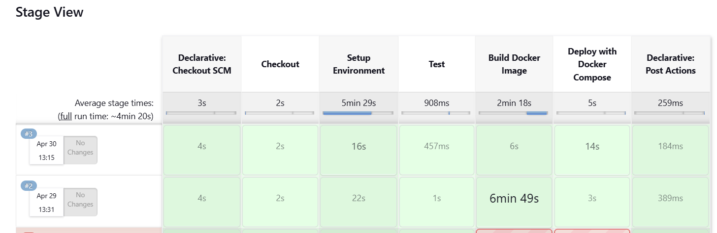
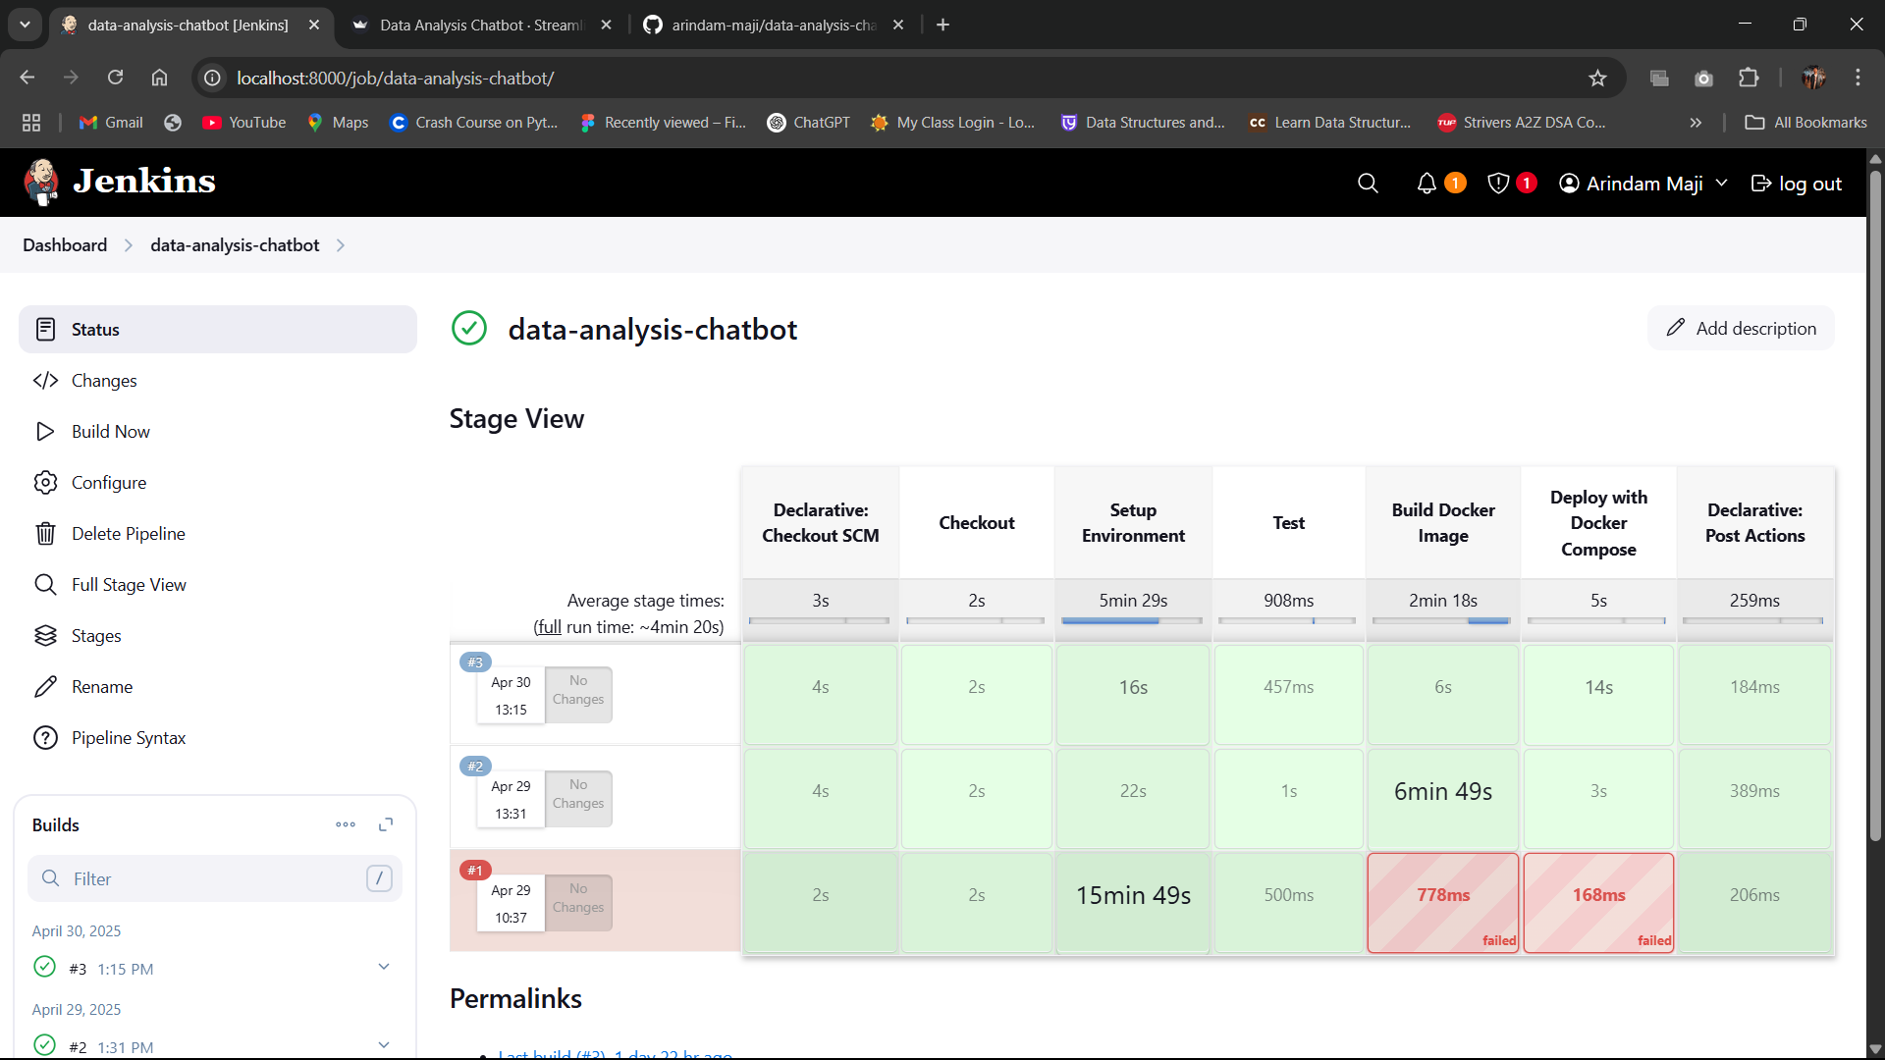
CI/CD Manual Execution Flow
Code Update
Manual Trigger
Developer pushes changes to GitHub repository
Jenkins job is started manually by developer
Pipeline Runs
Automates build, deployment, and health verification

Slide 8
DevOps Tools Summary
Docker
Docker Compose
Jenkins
Containerizes app components for consistent environments
Orchestrates multi-container application setup and networking
Automates CI/CD pipeline for building and deploying app
Combined, they deliver reliable local and CI/CD deployments.

Slide 9
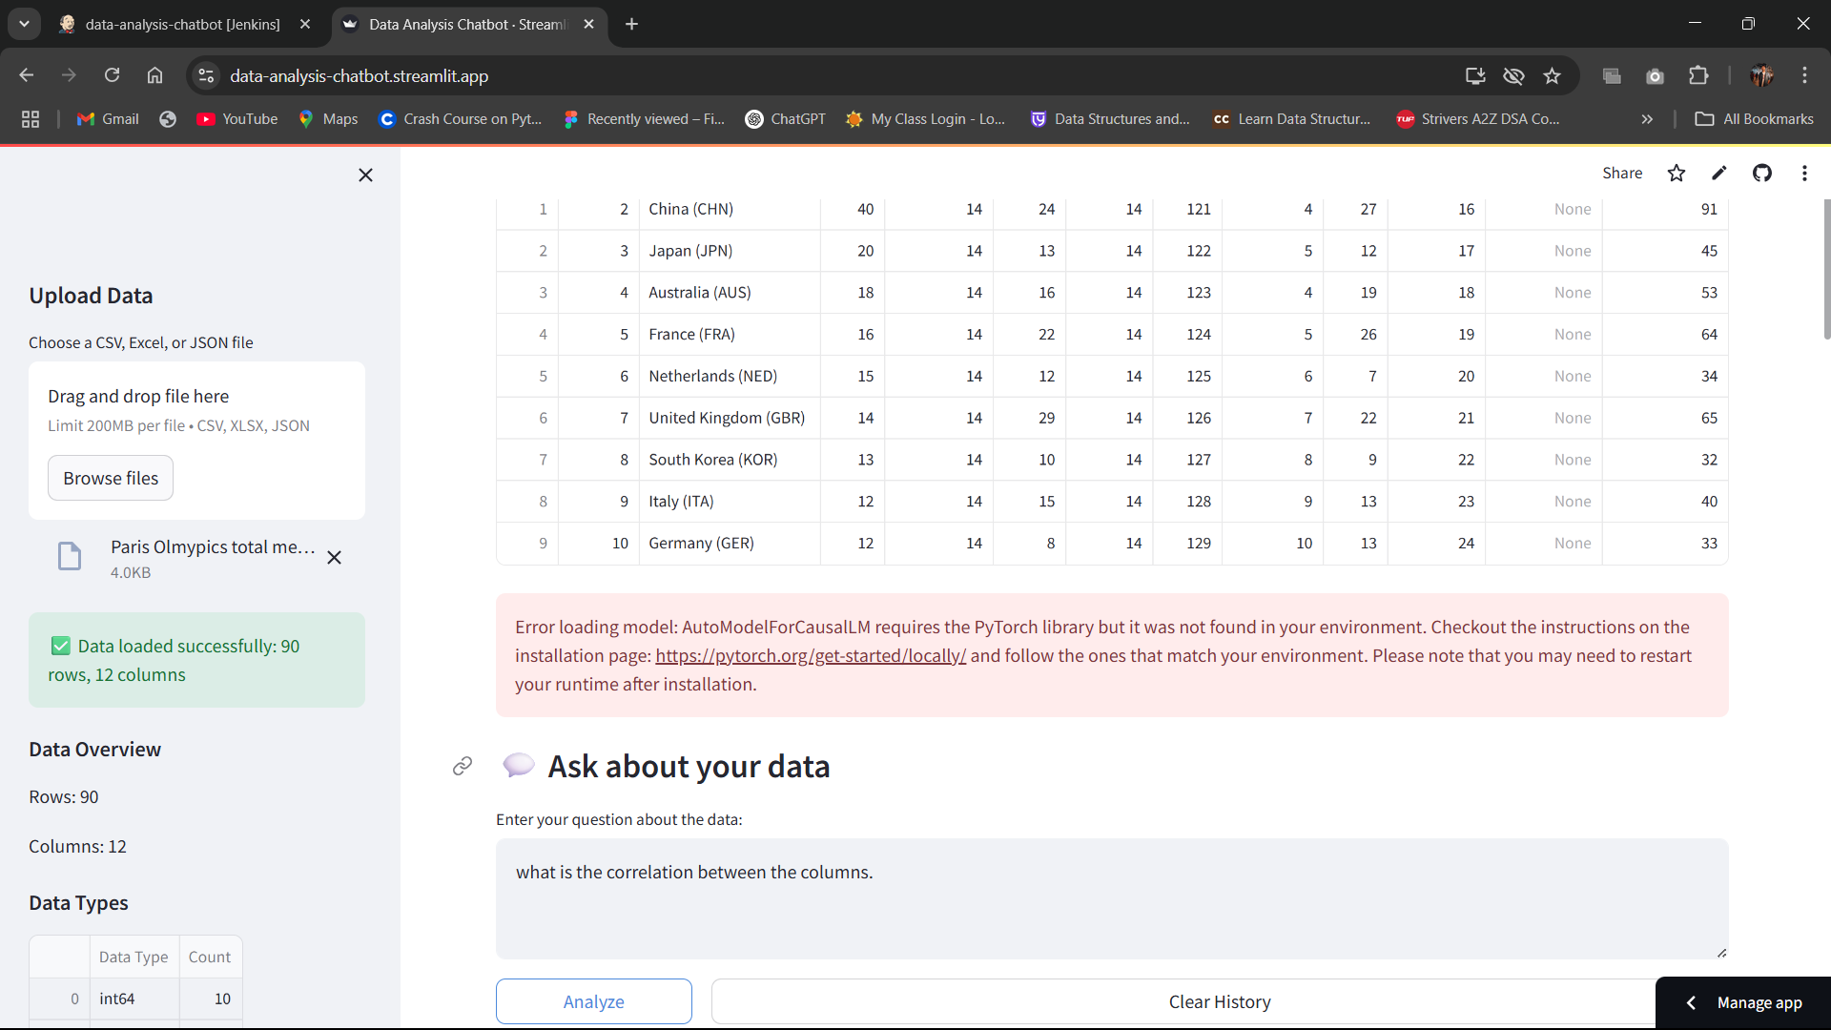
Thank You
Project by Arindam Maji
GitHub: https://github.com/arindam-maji/data-analysis-chatbot
App link : https://data-analysis-chatbot.streamlit.app/
LPU ID: 12208405

