Slide 1
INFRA-AS-CODE BLUEPRINTS

Slide 2

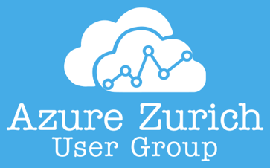

Slide 3
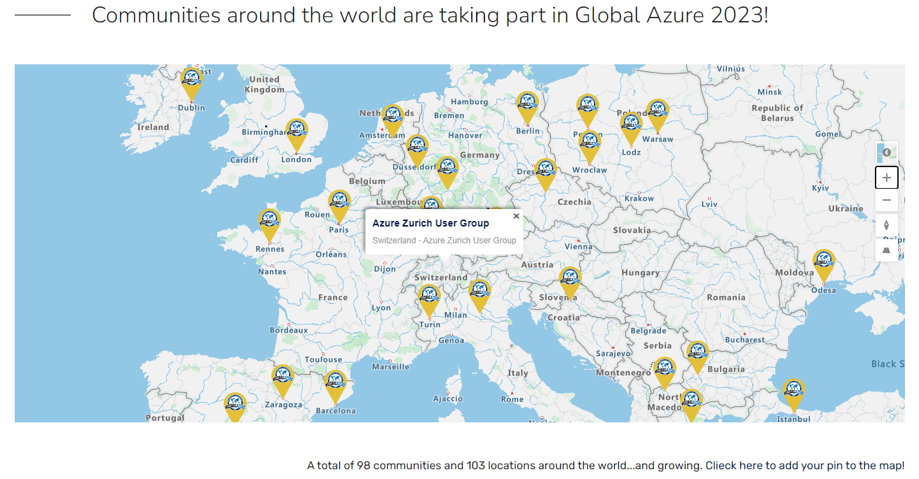

Slide 4






HELLO!
I am Arindam Mitra | Microsoft MVP in Developer Technologies | Azure Cloud Solutions & DevOps Architect | Technical Blogger | Speaker | Traveler | Citizen of the World
Today, I will be talking on IaC Blueprints.
You can look me at:
: https://github.com/arindam0310018
: https://dev.to/arindam0310018
: https://sessionize.com/arindam0310018
: https://www.linkedin.com/in/arindam-mitra-28981095/
: https://twitter.com/arindam0310018

Slide 5
AGENDA
DEMO TIME
Demo to illustrate IaC Blueprints
MITIGATION
Was the Identified Problem Statements Mitigated ?
EXAMPLES IAC BLUEPRINTS
Common Scenerios based on project`s design parameters
TECHNOLOGY STACK
Technology Stack Requirement for IaC Blueprints.
MOTIVATION
Problem Statements which led to the concept of IaC Blueprints.
CONCEPTS
What is IaC Blueprints ?

Slide 6
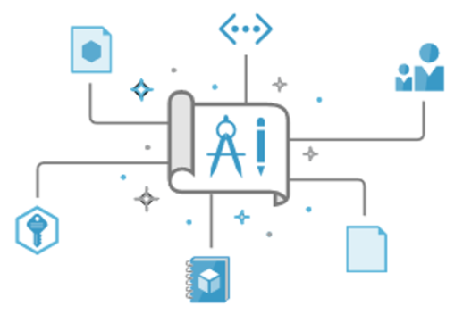
CONCEPTS
IaC Blueprints:-
It allows a Devops Architect/Engineer to write Repeatable and Reusable IaC based on Project`s design parameters.
IaC Blueprints is based on Organisation standards and is Security Complaint.
Helps rapidly build and start Green/Brown Field Use Cases
Speed up Development and Delivery.

Slide 7

MOTIVATION
Motivation behind IaC Blueprints:-
Problem Statements identified in day to day Azure Architecture, Automation, build and Run.
How to quickly onboard a new member in Azure & Devops team ?
How to improve delivery of Azure Projects ?
How to effectively scale your DevOps Team ? Is No. of Projects directly proportional to No. of Resources
Hashicorp Case Study:
Should My Team Really Need to Know Terraform? https://www.hashicorp.com/resources/should-my-team-really-need-to-know-terraform
Terraform for Platform Teams? https://www.hashicorp.com/resources/terraform-for-platform-teams

Slide 8

TECHNOLOGY STACK
Technology Stack for Building IaC Blueprints
Terraform
Biceps
Azure CLI
Powershell
Azure Devops
Github Actions
...
However, In our Session throughout, we will talk around, Azure Devops, Azure CLI, Powershell and Terraform.

Slide 9

EXAMPLES: IAC BLUEPRINTS
Examples of IaC Blueprints follows below:-
Subscription Blueprint
Resource Group Blueprint
Devops Project Blueprint
Catalog and Access Package Blueprint
Resource Group, DevOps Project with Catalog and Access Package Blueprint
Network Blueprint
Web App Blueprint
Databricks Blueprint
AKS Blueprint
…

Slide 10
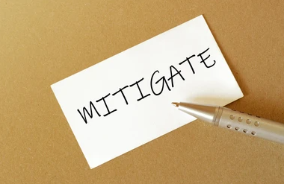
MITIGATION
How IaC Blueprints Resolved the Identified Problem Statements
Reduces the requirement of skilled Devops Engineer. We can then onboard an resource in our Devops team with Limited to basic knowledge of IaC and Devops. It has advantages on both sides –
From Devops Team Perspective, hiring and onboarding is fast.
From Resource Perspective, delivery is more or less like other team members (Subject to little or No Support) using IaC without being overwhelmed.
Less time in Knowledge Transfer and No Impact in delivery.
Scalability of Team improves with time because based on Use cases, more IaC Blueprints gets added thereby allowing to use One Resource for Multiple Projects.

Slide 11

DEMO TIME
We will now run 4 Live demos covering 3 different area of IaC Blueprints –
Resource Group Blueprint – https://github.com/arindam0310018/13-May-2023__AZUG-MS-Global-Event
Setup and Configure Devops Project – https://github.com/arindam0310018/08-Apr-2022-DevOps__Power-Of-DevOps-CLI-And-REST-API
App Management with AAD Graph and Devops – https://github.com/arindam0310018/24-Mar-2023-DevOps__Automate-App-Management-with-AAD-Graph
Entitlement Management | Catalog and Access Package – https://github.com/arindam0310018/24-Feb-2023-Microsoft-Graph-Powershell_Create-Catalog-AccessPackage-Roles-Policies

Slide 12
Any Questions please, happy to answer to the best of my knowledge.

Slide 13
CREDITS
Special THANK YOU to THOMAS H and MANUEL M for providing the opportunity to speak on behalf of AZURE ZURICH USER GROUP (AZUG) in GLOBAL AZURE Event.

Slide 14

THANK YOU!!!
For any further questions?
You can write me at:
mail2arindam2003@yahoo.com
arindam0310018@gmail.com

