Slide 1
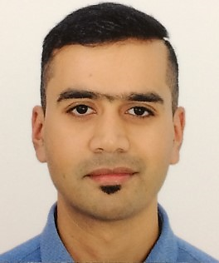






ARINDAM MITRA
Azure Cloud Architect | Cloud Services Lead
3 x Microsoft MVP | Sessionize Active Speaker 2023 |
Sessionize Active Speaker of Day 2025 | Blogger | Public Speaker |
Long Distance Runner | Hiker | Traveller | Citizen of the World
https://mvp.microsoft.com/en-US/MVP/profile/cd38a20c-0cce-ed11-a7c6-000d3a5603d3
https://dev.to/arindam0310018
https://github.com/arindam0310018
https://sessionize.com/arindam0310018
https://www.linkedin.com/in/arindam-mitra-28981095
https://x.com/arindam0310018
In Switzerland: 2013 – 2016 | 2019 – Till Date
Nationality: Indian
Global Career Exposure: India, Kuwait, Switzerland (Zurich, Baden, Olten), Hungary, USA (New York, Baltimore)

Slide 2
HOUSEKEEPING RULES
Please keep your phone muted.
Please raise your hand for any question(s).
This session is NOT being recorded. The slides will be shared afterward.
Be respectful of others’ speaking time and opinions.
Please stay for the full duration if you can.

Slide 3

Thank You Sponsors

Slide 4
TOPIC
MANAGE AZURE WITH KUBERNETES – ASO OR CROSSPLANE
Universal Cloud Control Plane

Slide 5
CONTENT
Presentation Storyline
Engineers Problem Statement
Evolution
Solution Comparison
Architecture - ASO
Architecture - Crossplane
Decision Framework
Demo

Slide 6
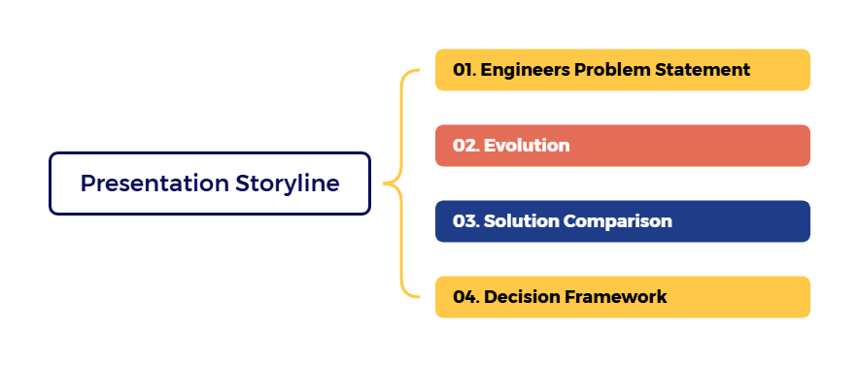
Presentation Storyline

Slide 7
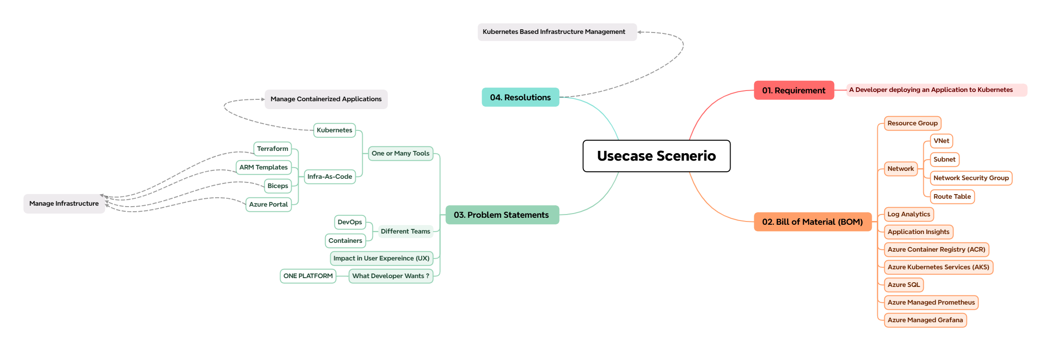
Engineers Problem Statement

Slide 8
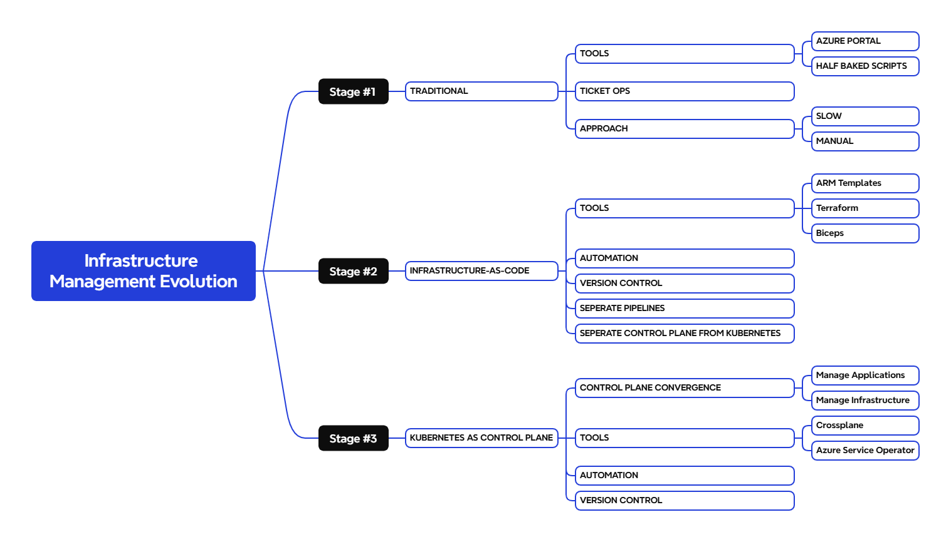
Evolution

Slide 9
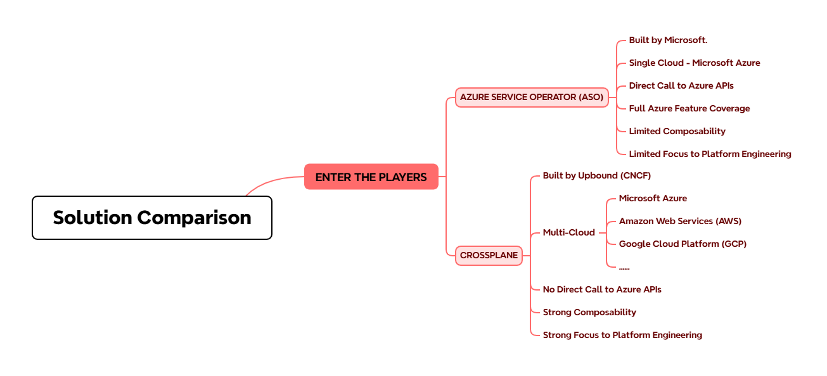
Solution Comparison

Slide 10
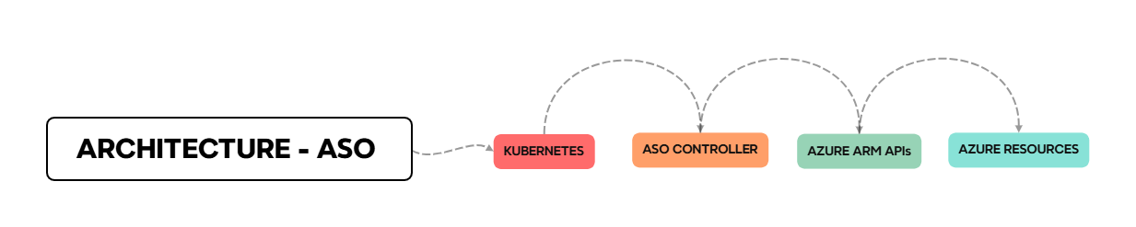
Solution Comparison

Slide 11
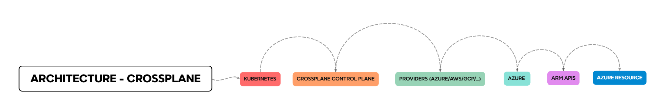
Solution Comparison

Slide 12
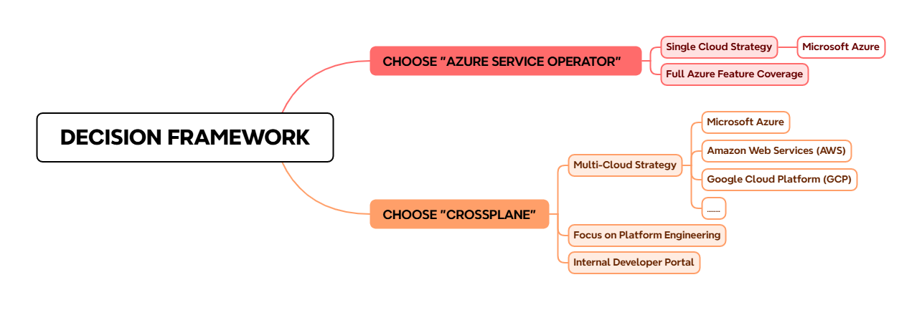
Decision Framework

Slide 13

The Wait is Over !

Slide 14



THANK YOU!!!
For any further questions ?
You can write me at:
arindam0310018@gmail.com

