Slide 1
INFRASTRUCTURE SECURITY USING AZURE DEVOPS

Slide 2






HELLO!
I am Arindam Mitra | Microsoft MVP in Developer Technologies | Azure Cloud Solutions & DevOps Architect | Technical Blogger | Speaker | Traveler | Citizen of the World
Today, I will be talking on INFRASTRUCTURE SECURITY USING AZURE DEVOPS.
You can look me at:
: https://github.com/arindam0310018
: https://dev.to/arindam0310018
: https://sessionize.com/arindam0310018
: https://www.linkedin.com/in/arindam-mitra-28981095/
: https://twitter.com/arindam0310018

Slide 3
AGENDA
DEMO TIME
3 Live demos covering 3 different areas of Cloud Infrastructure Security
MICROSOFT DEFENDER
Microsoft Defender for Cloud and Devops
SERVICES & AZURE DEVOPS
Measures to Protect Azure Services and Azure Devops
CONTROLS
Subscription, Resource Group and Role Based Access Control (RBAC)
IAM
Identity and Access Management
LAWS
Immutable laws of Security

Slide 4
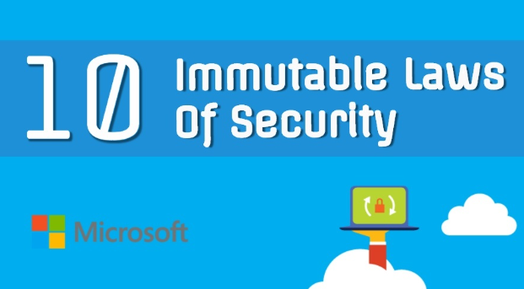
IMMUTABLE LAWS OF SECURITY
Accidental Running of Malicious Program.
Operating System Protection
Identity and Access Management Protection
Protect Active Website
Weak Passwords, Keys and Tokens
Network Security
Encrypted data is only as secure as its decryption key.
An out-of-date antimalware scanner is only marginally better than no scanner at all.
Absolute anonymous isn’t practically achievable, online or offline.
Technology alone is not going to make your systems secure.

Slide 5
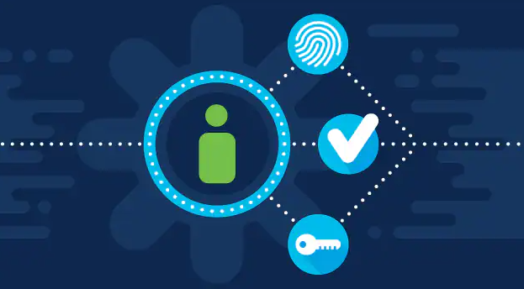
IAM
Accounts should be enabled with MFA (Multi-factor Authentication)
Implement PIM (Priviledged Identity Management)
Entitlement Management – Catalog Access Packages
App Management with AAD Graph and Single Sign On (SSO)
Azure Active Directory Group Management
Azure Active Directory User Management

Slide 6
IAM WITH DEVOPS
Example codes follows below:-
Entitlement Management Catalog Access Packages – https://github.com/arindam0310018/24-Feb-2023-Microsoft-Graph-Powershell_Create-Catalog-AccessPackage-Roles-Policies
App Management with AAD Graph and Single Sign On (SSO) – https://github.com/arindam0310018/24-Mar-2023-DevOps__Automate-App-Management-with-AAD-Graph
Create App Registration, Generate Secret and Store in Key Vault – https://github.com/arindam0310018/16-Aug-2022-DevOps__Create-SPI-Generate-Secret-Store-In-KV
Create App Registration Secret and Store in Key Vault – https://github.com/arindam0310018/17-Aug-2022-DevOps__Reset-SPI-Secret-Store-In-KV
Azure Active Directory Group Management – https://github.com/arindam0310018/26-Aug-2022-DevOps__Create-AAD-Group

Slide 7
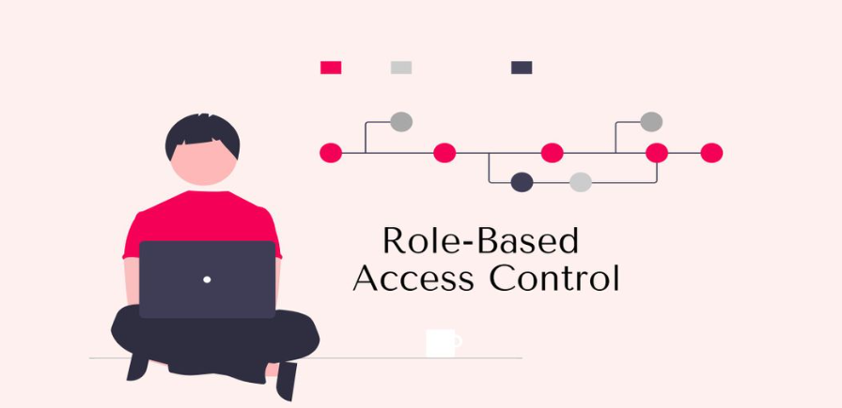
CONTROLS
Understanding Role Based Access Control (RBAC)
RBAC on Subscription
RBAC on Resource Group
RBAC on Resources
RBAC is always applied on AAD Group(s) and not on Individual Identity.
Proper Definition of Admin and Ops

Slide 8
CONTROLS WITH DEVOPS
Proper Definition of Admin and Operator is –
What RBAC is required for Cloud Platform Admin Team
What RBAC is required for Cloud Platform Operator Team
What RBAC is required for Cloud Application Admin Team
What RBAC is required for Cloud Application Operator Team
Once this Matrix is defined, we put in Infrastructure as Code (IaC) and implement it using Azure DevOps Pipelines
Example code follows below:-
https://github.com/arindam0310018/28-Jan-2023-DevOps__Terraform-Count-and-If-Else

Slide 9

SERVICES & AZURE DEVOPS
Evaluate each Azure Service as how it can be protected.
Based on the findings, prepare a Per Service Security Matrix
Per Service Security Matrix then defines below –
If it will be implemented by Infrastructure-As-Code (IaC), or
If it will be implemented by Azure Policy.
If implemented by Azure Policy, then below needs to be considered –
Where this Policy will be applied – Management Group or Subscription Level.
If Azure Policy will be implemented as Policy-As-Code-Workflows - https://learn.microsoft.com/en-us/azure/governance/policy/concepts/policy-as-code

Slide 10
SERVICES & AZURE DEVOPS
Protect Azure Devops Organization by –
Azure Active Directory
Policies
Protect Azure Devops Project by “Visibility” – Public or Private
Protect Azure Devops Project Access
Protect Azure Devops Repositories
Protect Azure Devops Branch Policy
Protect Azure Devops Pipelines
Manage Azure Devops boards and Access
Publish a GIT repo to a WIKI

Slide 11
SERVICES & AZURE DEVOPS
Example Codes and Blogs follows below –
Per Service Security Matrix can be found at – https://github.com/arindam0310018/28-April-2023-DevOps__Microsoft-Ireland-Presentation__Azure-Infrastructure-Security/tree/main/02-Azure-Services-Infrastructure-Security-Matrix
Scan Docker Images in Azure Container Registry using Aquasec Trivy and Azure Devops - https://github.com/arindam0310018/04-Apr-2022-DevOps__Scan-Images-In-ACR-Using-Trivy
Rotate Storage Account Keys and Store in Key Vault - https://github.com/arindam0310018/29-Aug-2022-DevOps__Rotate-Storage-Account-Keys
Azure Devops Branch Policy - https://github.com/arindam0310018/08-Apr-2022-DevOps__Power-Of-DevOps-CLI-And-REST-API
Azure Devops Best Practises - https://github.com/arindam0310018/13-Oct-2022-DevOps__Best-Practises-Learning-By-Doing
Devops Project Access Management - https://github.com/arindam0310018/28-April-2023-DevOps__Microsoft-Ireland-Presentation__Azure-Infrastructure-Security/tree/main/03-Devops-Project-Access-Management

Slide 12
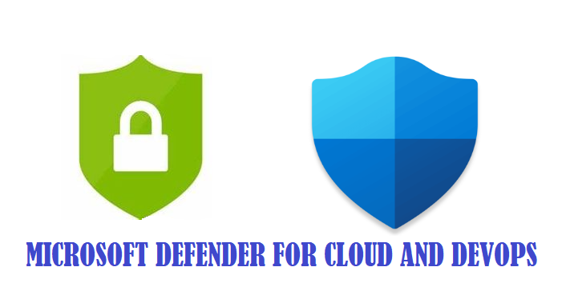
MICROSOFT DEFENDER
Microsoft Defender for Cloud | Scope of Security Review –
Recommendations
Security Alerts
Under “Recommendations”, make sure of below –
Target Subscription to be Reviewed
Select “All Recommendations”
Select “Recommendation Maturity” - “GA” and/or “Preview”
Based on the “Active Recommendations”, we will see “Secure Score”
Limitation –
Segregation of Recommendations and Security Alerts will be very difficult if a Project is shared within Subscription.

Slide 13
MICROSOFT DEFENDER & DEVOPS
Microsoft Defender for Devops –
https://github.com/arindam0310018/14-Oct-2022-DevOps__MS-Defender-4-Cloud-DevOps-Security-In-GitHub
https://github.com/MicrosoftDocs/azure-docs/issues/100017
https://github.com/MicrosoftDocs/azure-docs/pull/100739

Slide 14

DEMO TIME
We will now run 3 Live demos covering 3 different area of Azure Infrastructure Security using Devops –
Entitlement Management | Catalog and Access Package – https://github.com/arindam0310018/24-Feb-2023-Microsoft-Graph-Powershell_Create-Catalog-AccessPackage-Roles-Policies
Rotate Storage Account Keys - https://github.com/arindam0310018/29-Aug-2022-DevOps__Rotate-Storage-Account-Keys
Scan Docker Images in Azure Container Registry using Aquasec Trivy and Azure Devops - https://github.com/arindam0310018/04-Apr-2022-DevOps__Scan-Images-In-ACR-Using-Trivy

Slide 15
Any Questions please, happy to answer to the best of my knowledge.

Slide 16
CREDITS
Special THANK YOU to MATTHEW BROWNE and FRANK FALVEY for providing the opportunity to speak in MICROSOFT IRELAND – AZURE & SECURITY Event.

Slide 17

THANK YOU!!!
For any further questions?
You can write me at:
mail2arindam2003@yahoo.com
arindam0310018@gmail.com

