Slide 1
AM IN JTTC TALKS ON MS AZURE ASSOCIATE CERTIFICATION (AZ-104)

Slide 2
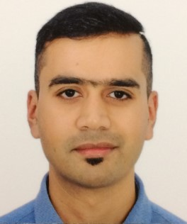




HELLO!
I am Arindam Mitra
Today, I will be talking on Microsoft Azure Administrator Associate Certification Track (AZ-104).
You can look me at:
: https://www.linkedin.com/in/arindam-mitra-28981095/
: https://github.com/arindam0310018
: https://dev.to/arindam0310018/-my-contributions--3bgp
: https://sessionize.com/arindam0310018

Slide 3
LETS DIVE IN !!!

Slide 4

THANK YOU!!!
For any further questions?
You can write me at:
mail2arindam2003@yahoo.com
arindam0310018@gmail.com

Slide 5
CREDITS
Special THANK YOU to MATTHEW BROWNE and DAN REY for the providing the opportunity to speak @ JOURNEY TO THE CLOUD 7.0 Session.

