Slide 1
Chest X-Ray Disease Diagnosis
Amol Singbal, Anush Ananthakumar, Arindam Duttagupta
Georgia Institute of Technology

Slide 2
Why do we need to automate disease diagnosis?
Accurate classification of X-ray images is a vital task as it is a precursor for future treatment
Hence, incorrect classification may lead to a wrong treatment entirely; thus may worsen the patient condition
Secondly, clinical diagnosis of X-ray images often require teams of trained radiologists to accurately estimate the type of disease which often consumes time and is expensive
Knowledge that Deep Learning Models perform extremely well for classification tasks

Slide 3
Why didn’t this idea come earlier?
Learning Models typically require huge training datasets for them to converge and get better as size of the training data increases
Manual labelling of X-Rays require trained doctors and hence, there is no publicly available Dataset till recent times
X-Ray Images are typically high resolution images, hence there is a limitation of computational resources limiting the research of X-ray disease diagnosis
Openi was the first one having 4143 images which initiated the applications of learning models of Chest X-Ray disease diagnosis

Slide 4
Dataset Description
For the purpose of this article, we have used a sample of the open source Chest X-Ray Dataset provided by the National Institute of Health.
Contains 119,120 images distributed among 15 classes; Each class corresponding to a chest ailment (e.g Pneumonia)
Each image is a 1024x1024 represented by 8-bit precision
Models trained on 5% sample of the NIH Dataset, containing 5,606 images
Also includes a .csv file containing the patient characteristics such as age ,gender which can give useful information about the patient demographics
Also ,the dataset has information about the bounding boxes pertaining to the infected regions in the images

Slide 5
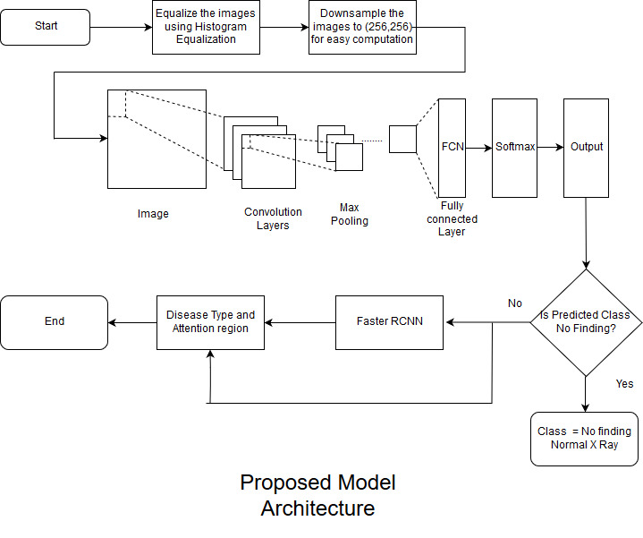
The initial architecture

Slide 6
Preprocessing
Some preprocessing steps are essential before inputting the images in the learning model
Firstly, we perform histogram equalization on the original images to increase contrast in the input images
The motivation behind using this is to make the probability distribution tend more towards the uniform PDF
The second step is down sampling the images to 256x256.
This is done to purely reduce the computational burden and speed up model training

Slide 7
Convolutional Neural Network (CNN)
Use a CNN as a classifier to classify a given image as one of the 15 classes
The classifier is trained on reduced NIH dataset to speed up model training
The network architecture employs 9 convolutional layers ,10 ReLU Layers,3 max pooling layers, 2 dropout layers and one soft max layer for classification
The trained CNN classifies the input image as being in one of 15 classes of the chest ailments

Slide 8
Is this enough?
Just classifying the type of chest ailment that an image belongs might suffice in some minor cases
But it would be better if we are able to reasonably estimate the region in the image which is anomalous as compared to the rest
Hence, a new requirement is that , we should have a ‘black box’ which spits out an ‘interest region’ which would help the radiologists and doctors in quickly estimating the region of the chest where the problem originates
So, do we have a way to incorporate this into our current architecture?
The answer is Yes!!

Slide 9
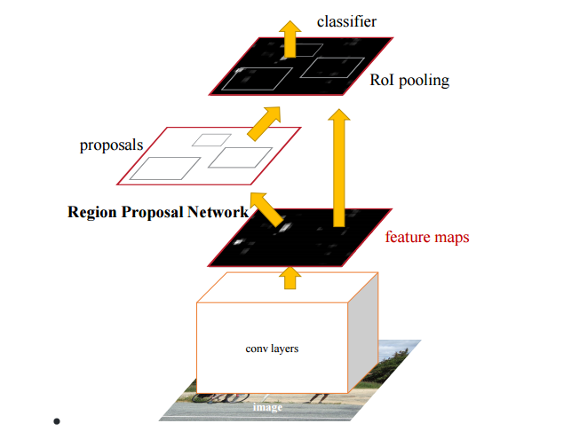
Faster RCNN
To estimate the attention region, we deploy a Faster RCNN after an image is classified by the CNN
Faster RCNNs find extensive applications in Object Detection wherein we require to not only detect the object but also find a box which bounds the classified object
As shown in the figure on the left, the feature maps generated by the convolutional layers are passed in the Region Proposal Networks(RPNs) which output a set of proposed regions where the ailment could be
The final stage involves combined the outputs of the RPNs with the corresponding image to generate the require output

Slide 10
Modified Architecture
Firstly , the images are histogram equalized and down sampled to 256x256 as part of the preprocessing step
Next, the processed images are propagated through a standard CNN which outputs the type of ailment that a particular image belongs to.
If the class belongs to a particular ailment , then we use a Faster RCNN to output a set of regions wherein the infection is actually present
This type of framework would actually give the doctors an effective but quick way to tackle the problem efficiently
The Faster RCNN though has to be trained on the images having their Bounding Boxes specified in the .csv file given in the Dataset

Slide 11
Modified Architecture

Slide 12
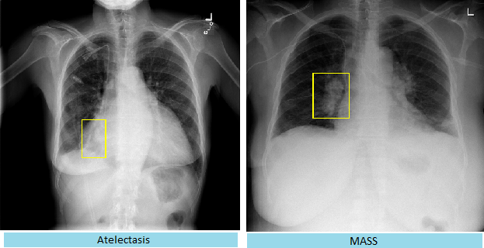
Results
The results obtained are shown on the right. The Faster RCNN gives bounding box which estimates the infected region of the chest

Slide 13
Conclusion
From the results, we infer that our proposed method would provide a focused approach for the physicians in accurately diagnosing chest ailments
To further improve on our results, we propose the following suggestions
Use the full NIH Dataset to incorporate more training data, which is expected to provide more classification accuracy
Instead of providing possible regions, we can instead output a semantic map showing the interest regions. This can be done using active contour methods which will be both visually appealing and convenient for the doctors

Slide 14
References
[1] Sepp Hochreiter; Jürgen Schmidhuber (1997). "Long short-term memory". Neural Computation. 9 (8): 1735–1780. doi:10.1162
[2] P. Rajpurkar et al. CheXNet: Radiologist-level pneumonia detection on chest X-rays with deep learning Dec. 2017 [online] Available: https://arxiv.org/abs/1711.05225
[3] Xue, Zhiyun & You, Daekeun & Candemir, Sema & Jaeger, Stefan & Antani, Sameer & Long, L & R. Thoma, George. (2015). Chest X-ray Image View Classification. Proceedings - IEEE Symposium on Computer-Based Medical Systems. 2015. 66-71. 10.1109/CBMS.2015.49.
[4] Cortes, Corinna; Vapnik, Vladimir N. (1995). "Support-vector networks". Machine Learning. 20 (3): 273–297
[5] M. T. Islam, M. A. Aowal, A. T. Minhaz, and K. Ashraf, “Abnormality detection and localization in chest x-rays using deep convolutional neural networks,” arXiv preprint arXiv:1705.09850, 2017.

Slide 15
Thank you

