Slide 1
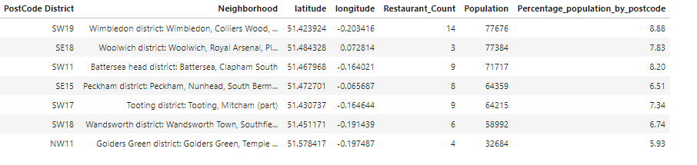
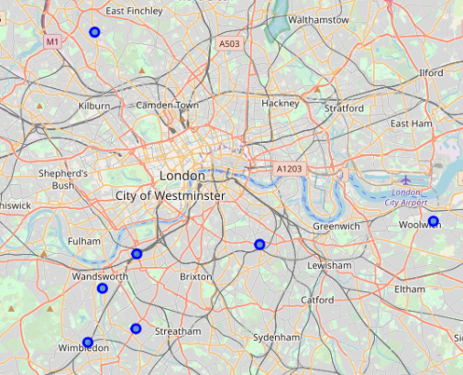
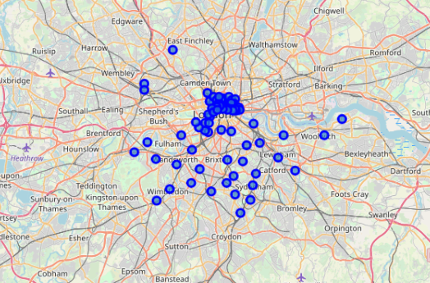
Geo Spatial Data Exploration for New Restaurants
Reporting system for data exploration
Uses data from Wikipedia, Freemaptools , Census data and Foursquare API to find the most suited place where a prospective restaurant can be opened.
The prospective place can be plotted into a location map to give a clear visualization of Neighbourhoods where a restaurant can be opened
Report Layout

Slide 2
Introduction: --
A foreign restaurant chain wants to start his restaurant chain in London. He wants to find the best place / places in London where he can start his business by opening the first few restaurants. The requirements of restaurant chain are listed below: --
The potential restaurant must be opened in London.
The area in which the restaurant must be opened should be a populated area of any chosen region in London. The population of the neighborhood should be more than 20 thousand people.
The restaurant should be opened in an area which already has at least 3 running restaurant in nearby area.
The Districts and the neighborhood names should be clearly articulated in the final report.
The latitude and longitudinal position where potential restaurant must be opened should be plotted as dots in a map of London so that the most central location can be detected by looking into the map.
Implementation Methodology: --
The implementation methodology used to generate the report showing the places where potential restaurants can be opened, are listed below: --
Extraction of data from different sources.
Cleaning the data extracted from various sources.
Transforming the data into a tabular report showing potential places
Plotting the places over the map of London.

Slide 3
Results
The results that was evident is listed below: --
There were 7 potential places where the restaurant chain can start their business in London. These places were: --
Wimbledon district
Woolwich district
Battersea head district
Peckham district
Tooting district
Wandsworth district
Golders Green district
Out of the 7 places four places were from South West London neighborhood, two from South East and one from North West London.
Restaurant count was very high in Wimbledon district. It was 15 in number and has the highest populated neighborhood in London.
Recommendation and Observation
Based on the results that are obtained, it is recommended that along with a districts population density and restaurant counts the average income of the people living in the neighborhood can also be considered. This is a data that is difficult to obtain, and a masked data of income can lead to erroneous results.
The population density when taken on whole (both rural and urban) was not giving a meaningful result, it was observed that only when Rural population was accounted for the report the results made more sense.
Conclusion
This analysis can be used by any restaurant chain that wants to open their business in foreign country. The data it should use, is of existing restaurant counts and the population density. There were 7 prospective locations determined in London to open a restaurant.
References
Wikipedia
Foursquare Api
Census data UK
Freemaptools

