Slide 1
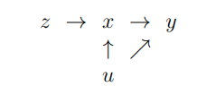
High Alert
Police
Crime

