Slide 1

2020
Clustering Assignment
BY
ARINDAM SARKAR
[COMPANY NAME] | [Company address]

Slide 2
Objective:
We, HELP International humanitarian NGO, committed to fight poverty and provide the people of backward countries with basic amenities and relief during the time of disasters and natural calamities. We run a lot of operational projects from time to time, along with advocacy, drives to raise awareness as well as for funding purposes.
Problem statement:
During the recent funding programs, we have been able to raise around $ 10 million. As an analyst, we have to come up with the countries list that are in the direst need of aid.

Slide 3
Analysis Flow
1:-Data collection and cleaning
Import thedata
Identifying the data quality issuesandcleanthedata.
2:- EDA
Converting exports, imports and health spending percentages to absolute values
Visualizing the data
Visualizing few original data variables to look for any patternor correlation.
Outlier Treatment
  For all the columns, we will not cap or drop the outliers at the lower range but we will treat the upper range outliers and this is because, we may end up losing some countries are actually in the need of AID.
  For child_mort, we will not cap or drop the outliers at the upper range but we will treat the lower range outliers.
    1-99: Soft range
    5-95: mid-range
    25-75: hard range
3:- Hopkins Statistics
Tocheck ifdatahas tendencytoformclusters
4:- Scaling the data
Standardizing all the continuous variables using the standard scalar
5:- K means clustering
Identify the‘k’ bysilhouette analysis and sum of squareddistancesgraph.

Slide 4
Visualizingtheclusterswith various variables
Analyzingtheclusters
Identifyingthecountries which requiresaid.
6:-Hierarchical Clustering
Identify the ‘n’ via dendrogram.
Visualizing the clusters with various variables
Analyzing the clusters
Identifying the countries which requires aid.
7:-Decision Making
Identifying the countries which requires aid by analyzing both K- means and Hierarchical Clustering results.
EDA
Converting exports, imports and health spending percentages to absolute values
We will take soft range for all the outliers except for child_mort
For child_mort we will do for 0.01
With the Box plot we can see most of the variable are treated and caped for 99 percentile and child_mort for 0.01

Slide 5
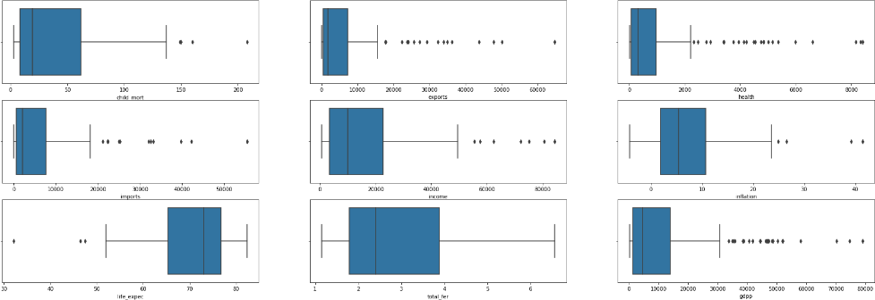
DATA VISUALISATION (BOX PLOT)

Slide 6
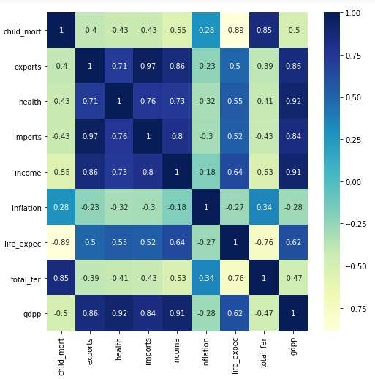
Correlation in the data
After data cleaning, we removed outlier from gdpp column because the country with high gdpp would not require any aid as there are already doing well
Looking at the heat map, we see that few variables like (total fertility, child mortality) , (income , gdpp) and (imports and exports) have high correlation .
Hopkins Statistics
Got a Hopkin score around 0.8726685011832948 , since the value is > 0.7 the given dataset has a good tendency to form clusters.

Slide 7
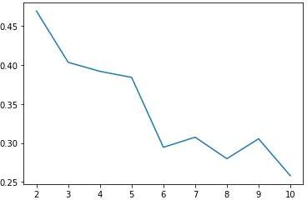
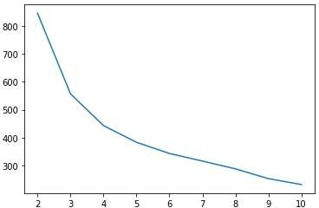
K-means
Silhouette score for n clusters
For | n_clusters=2, | the | silhouette | score | is | 0.4693935858809981
For | n_clusters=3, | the | silhouette | score | is | 0.40354406834617873
For | n_clusters=4, | the | silhouette | score | is | 0.39198304727104893
For | n_clusters=5, | the | silhouette | score | is | 0.3841728541997584
For | n_clusters=6, | the | silhouette | score | is | 0.30142918198786184
For | n_clusters=7, | the | silhouette | score | is | 0.2918346367687513
For | n_clusters=8, | the | silhouette | score | is | 0.2985089458653049
Silhouette Analysis
Sum of Squared Distances
By looking silhouette analysis, we see the highest peak is at k =3 and in sum of
squared distances graph , we see that the elbow is in the range of 3 to 4 , so we are going ahead with k as 3 .

Slide 8
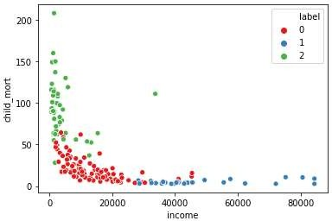
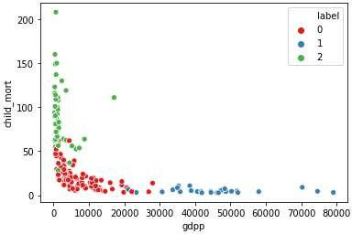
K-means
Scatterplot b/w components and Label:
Scatter plot gdpp , child_mort and label
Scatter plot gdpp , child_mort and label

Slide 9
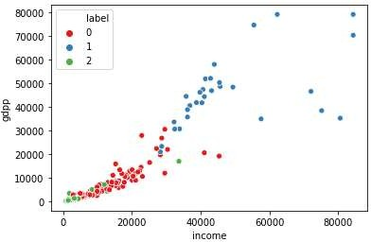
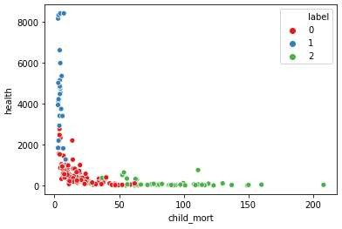
K-means
Scatter plot gdpp , child_mort and label
Scatter plot gdpp , child_mort and label

Slide 10
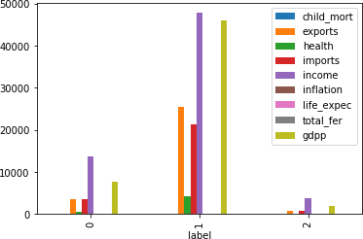
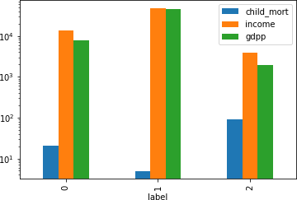
Cluster Profiling
Drawing inference for the clusters using gdpp , income and child_mort
As we can see cluster 2 is having high child mortality, low income and gdpp than other 2 clusters, hence we will pick it to check for the top 5 countries in need of the aid

Slide 11
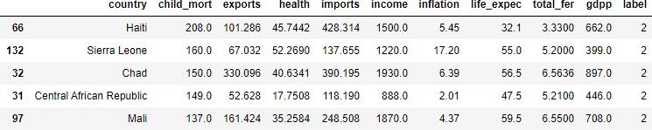
Sorting the countries on the basis of high child mortality and low income and gdpp.
As per K- means clustering, the country which are direst need of aid are:
Haiti
Sierra Leone
Chad
Central African Republic
Mali

Slide 12
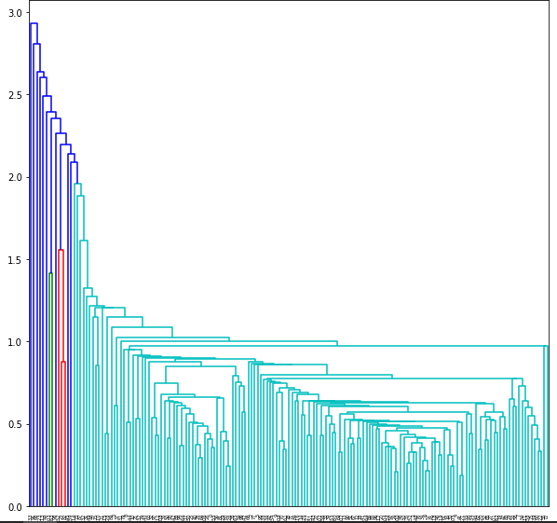
Hierarchal Clustering
Hierarchical clustering single method
By single method hierarchical clustering things are not clear, so let us go for complete hierarchical clustering method.

Slide 13
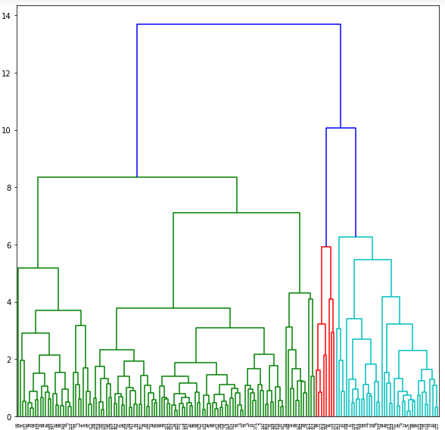
Hierarchal Clustering
Hierarchical clustering complete method
Let us cut the dendrogram vertically such that n_clusters = 3

Slide 14
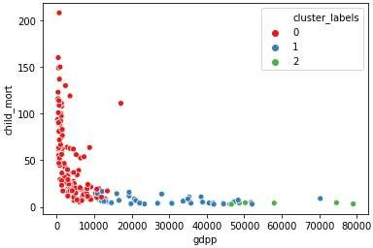
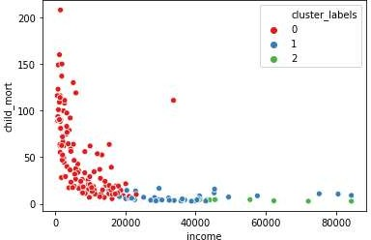
Hierarchal Clustering
Scatter plot gdpp , child_mort and cluster_label
Scatter plot income, child_mort and cluster_label

Slide 15
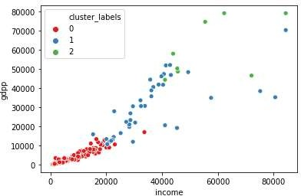
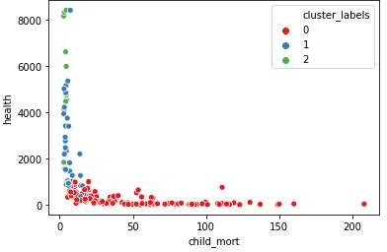
Hierarchal Clustering
Scatter plot gdpp , income and cluster_label
Scatter plot health , child_mort and cluster_label

Slide 16
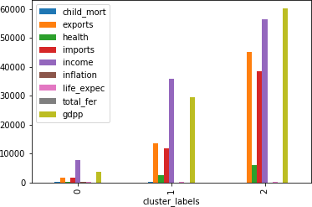
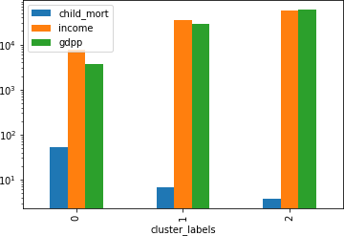
Cluster Profiling
Drawing inference for the clusters using gdpp , income and child_mort
As we can see cluster 2 is having high child mortality, low income and gdpp than other 2 clusters, hence we will pick it to check for the top 5 countries in need of the aid

Slide 17
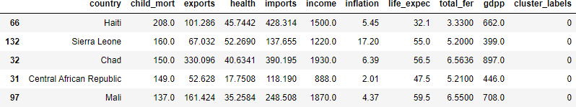
Sorting the countries on the basis of high child mortality and low income and gdpp.
As per Hierarchal clustering, the country which are direst need of aid are:
Haiti
2. Sierra Leone
3. Chad
4. Central African Republic
5. Mali
Decision Making
We got same countries by both K-means and Hierarchical Clustering: Therefore following are the countries which are in direst need of aid by considering socio – economic factor into consideration:
Haiti
2. Sierra Leone
3. Chad
4. Central African Republic
5. Mali

