Slide 1
Indexing
Parameswari Ettiappan

Slide 2
Indexing
MongoDB supports a wide array of indexes
Single field
Compound
Multikey
Geospatial
Text
Hashed
Time to live
Unique
Partial
Sparse
Case-insensitive

Slide 3
Index internals
Indexes, in most cases, are essentially variations of the B-tree data structure.
Invented by Rudolf Bayer and Ed McCreight in 1971 while working at Boeing research labs.
B-tree data structure allows for search, sequential access, inserts, and deletes to be performed in logarithmic time.
The logarithmic time property stands for both the average case and the worst possible performance, which is a great property when applications cannot tolerate unexpected variations in performance behavior.

Slide 4
Index internals

Slide 5
Index internals
In this diagram, we see logarithmic time performance as a flat line parallel to the x axis of the diagram.
As the number of elements increases, constant time O(n) algorithms perform worse, whereas quadratic time algorithms O(n^2) go off the chart.
For an algorithm that we rely on to get our data back to us as fast as possible, time performance is of the utmost importance.

Slide 6
Index Internals
Another interesting property of a B-tree is that it is self-balancing, meaning that it will self adjust to always maintain these properties.
Its precursor and closest relative is the binary search tree, a data structure that allows only two children for each parent node.

Slide 7
Index types
Case insensitive

Slide 8
Index types
Case insensitive
> db.books.find( { name: "Mastering MongoDB" } ).collation( { locale: 'en',
strength: 1 } )
We could specify a different level of collation as follows:
> db.books.find( { name: "Mastering MongoDB" } ).collation( { locale: 'en',
strength: 2 } )
Here, we cannot use the index as our index has collation level 1 and our query looks for collation level 2.

Slide 9
Building and managing indexes
Indexes can be built using the MongoDB shell or any of the available drivers.
By default, indexes are built in the foreground, blocking all other operations in the database.
This is faster but often undesirable, especially in production instances.
We can also build indexes in the background by adding the {background: true} parameter in our index commands in the shell.
Background indexes will only block the current connection/thread.

Slide 10
Building and managing indexes
We can open a new connection (that is, using mongo in the
command line) to connect to the same database:
db.books.createIndex( { name: 1 }, { background: true } )
Background index building can take significantly more time than foreground, especially if the indexes can't fit in available RAM.
Index early, revisit indexes regularly for consolidation.
Queries won't see partial index results.
Queries will start getting results from an index only after it is completely created.
Do not use main application code to create indexes as it can impose unpredicted delays.
Instead, get a list of indexes from the application and mark these for creation during maintenance windows.

Slide 11
Forcing index usage
We can force MongoDB to use an index by applying the hint() parameter:
db.users.find().hint( { age: 1 } )
This operation returns all documents in the collection named users using the index on the age field.
We can also use
db.users.find( { $query: {}, $hint: { age : 1 } } )

Slide 12
Building indexes on replica sets
In replica sets, if we issue a createIndex() command, secondaries will begin creating the index after the primary is finished creating it.
Similarly, in sharded environments, primaries will start building indexes and secondaries will start after the primary for each shard is finished.

Slide 13
Building indexes on replica sets
A recommended approach to build indexes in replica sets is:
Stop one secondary from the replica set
Restart it as a standalone server in a different port
Build the index from the shell as a standalone index
Restart the secondary in the replica set
Allow the secondary to catch up with the primary
This is a manual process, involving several steps for each primary/secondary server.

Slide 14
Building indexes on replica sets
The previous approach can be repeated for each secondary server in the replica set.
Then for the primary server we can do either of these things:
1. Build the index in the background.
2. Step down the primary using rs.stepDown() and repeat the preceding process with the server as a secondary now.

Slide 15
Staging Database Server
The staging database server contains the business data, such as marketing campaigns and product catalogs, and database resources that you want to stage to the database servers in the production environment.
Business users can update business data in the staging environment so that you can test and approve the changes before you incorporate the changes into the run-time environment.
The staging environment prevents disruption of the run-time site and services by isolating the test and production systems.

Slide 16
Building indexes on replica sets
Using approach number 2, when the primary steps down there will be a brief period when our cluster won't be taking any writes.
Our application shouldn't timeout during this (usually less than) 30-60 second period.
Building an index in the background in the primary will build it in the background for the secondaries too.
This may impact writes in our servers during index creation but on the plus side has exactly zero manual steps.
It is always a good idea to have a staging environment that mirrors production and dry run operations that affect the live cluster in staging to avoid surprises.

Slide 17
Managing indexes
Naming indexes
By default, index names are assigned automatically by MongoDB based on the fields indexed and the direction of the index (1,-1).
If we want to assign our own name, we can do so at creation time:
> db.books.createIndex( { isbn: 1 }, { name:
"international_standard_book_number_index" } )
Now we have a new index called international_standard_book_number_index instead of how MongoDB would have named it ("isbn_1)

Slide 18
Special considerations
The following are a few limitations to keep in mind around indexing:
Index entries have to be <1024 bytes.
This is mostly an internal consideration but we can keep it in mind if we run into issues with indexing.
A collection can have up to 64 indexes.
A compound index can have up to 31 fields.
Special indexes cannot be combined in queries.
This includes special query operators that have to use special indexes such as $text for text indexes and $near for geospatial indexes. (db.articles.find( { $text: { $search: "coffee" } } ))
This is because MongoDB can use multiple indexes to fulfill a query but not in all cases.
Indexes have a unique constraint on fields.
We cannot create multiple indexes on the same fields, differing only in options.

Slide 19
Using indexes efficiently
indexes via the shell, it can create problems down the line if we end up with too many or inadequately efficient indexes

Slide 20
Measuring performance
The explain() command when used in conjunction with a query will return the query plan that MongoDB would use for this query instead of the actual results.
> db.books.find().explain()
It can take three options: queryPlanner (the default), executionStats, and allPlansExecution.

Slide 21
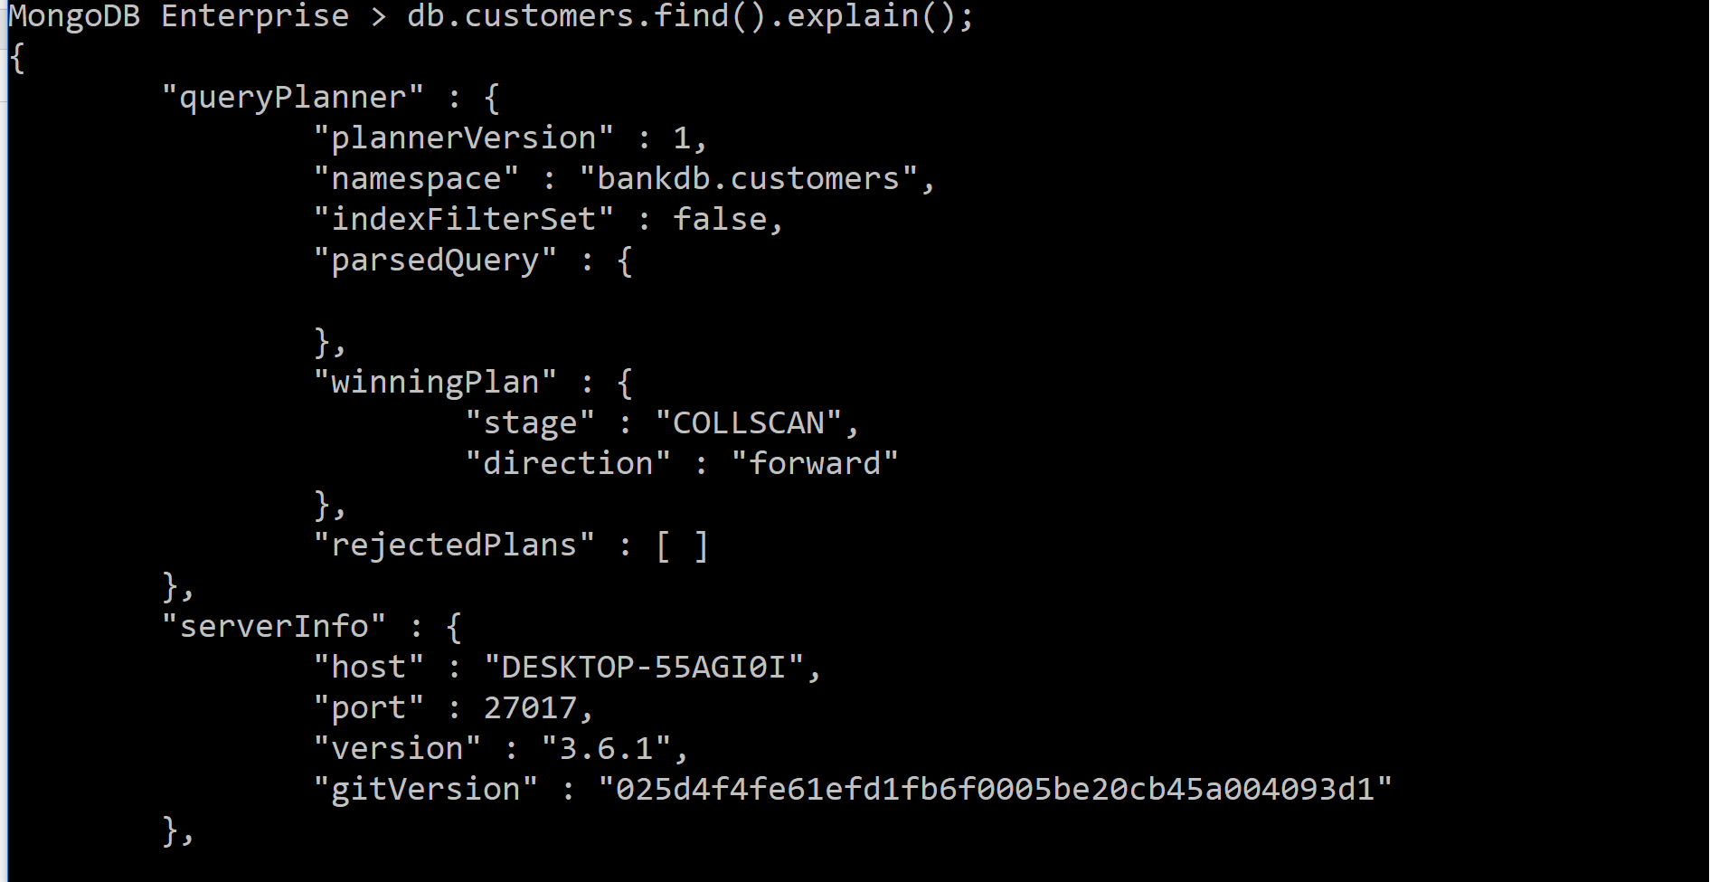
Measuring performance

Slide 22
Measuring performance
db.customers.find({}).hint({_id:1}).explain("allPlansExecution")
we can inspect the stage field and look for IXSCAN, which means that an index was used.
Then in the sibling indexName field we should see the name of our expected index.
we need to compare keysExamined with nReturned fields.
We ideally want our indexes to be as selective as possible with regard to our queries, meaning that to return 100 documents, these would be the 100 documents that our index examines.

Slide 23
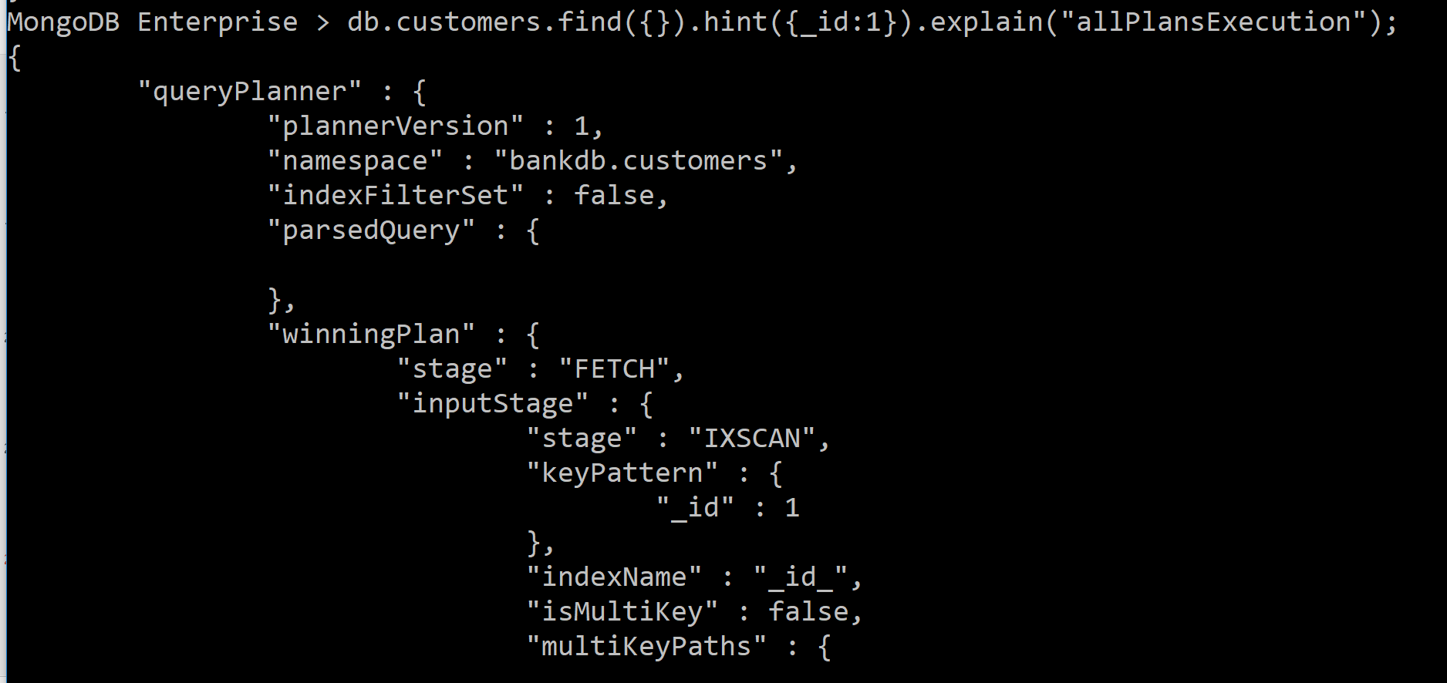
Measuring performance

Slide 24
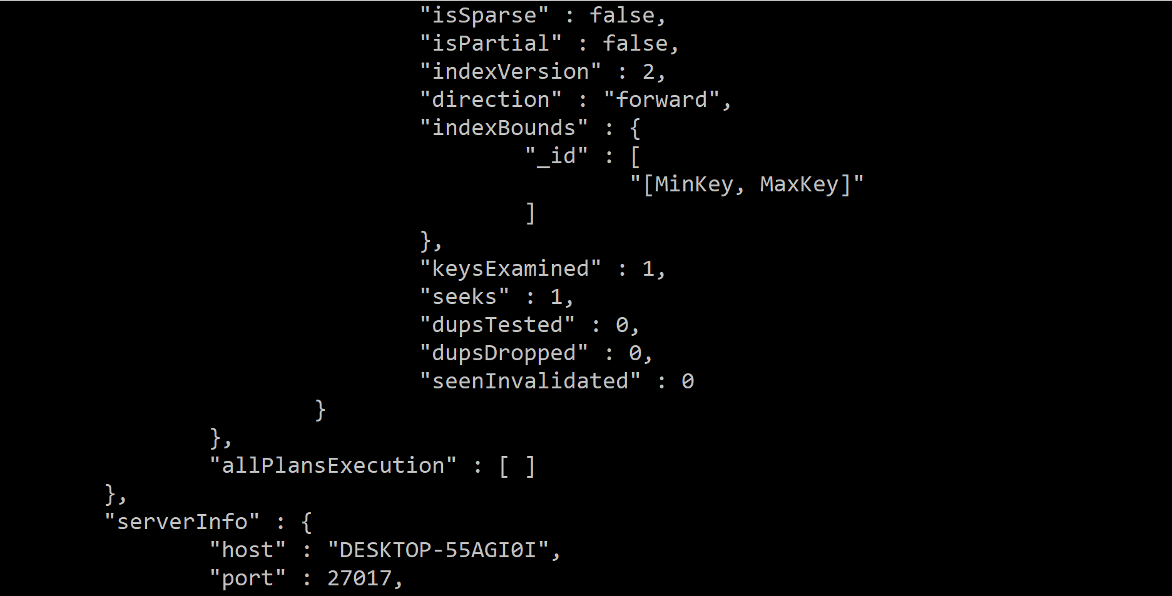
Measuring performance

Slide 25
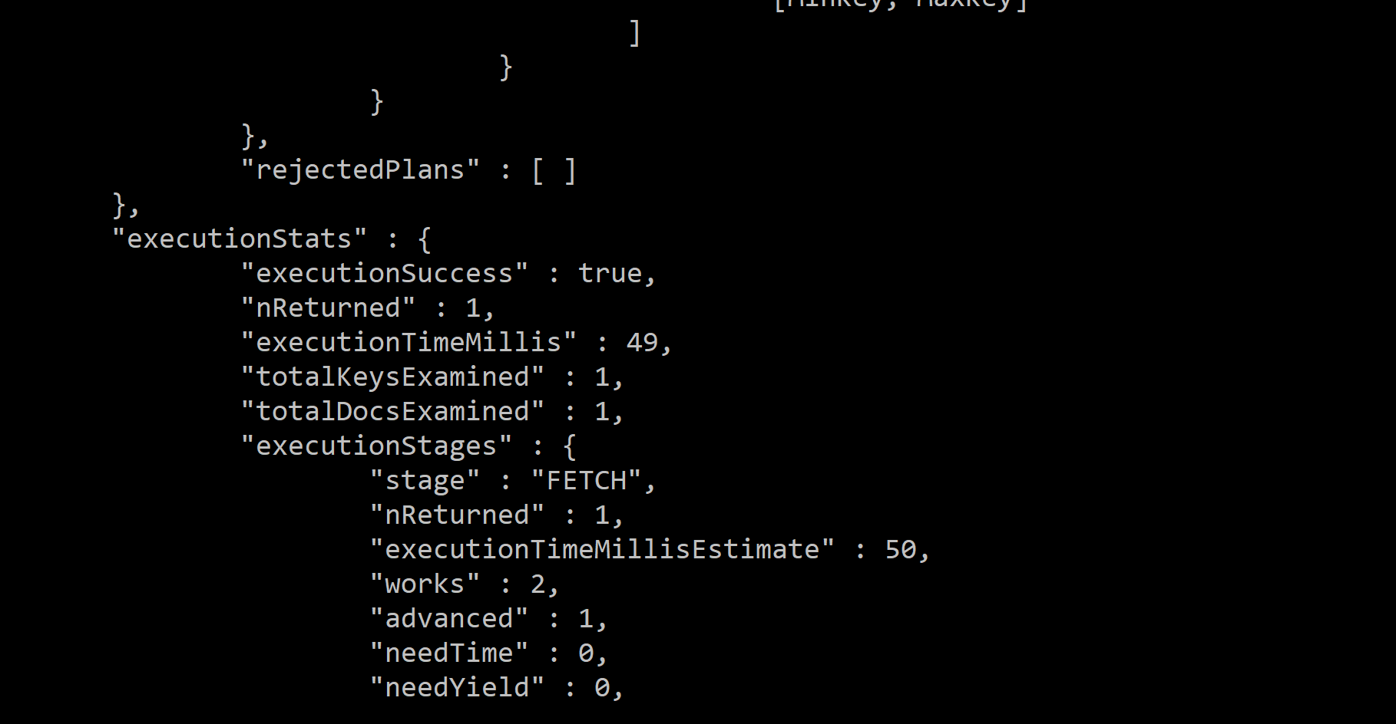
Measuring performance

Slide 26
Improving performance
It is a tradeoff as indexes increase in number and size in our collection.
We can have a limited number of indexes per collection and we definitely have a limited amount of RAM to fit these indexes so we must balance the tradeoff between having the best available indexes and these indexes not fitting into our memory and getting slowed down.

Slide 27
Improving performance
Fit in RAM
Ensure selectivity(nReturned and key examined)
Be used to sort our query results
Be used in our most common and important queries.

Slide 28
Index intersection
Index intersection can happen when we use OR ($or) queries by using a different index for each OR clause.
Index intersection can happen when we use AND queries and we have either complete indexes for each AND clause or index prefixes for some or all of the clauses.
> db.books.find({ "isbn":"101", "price": { $gt: 20 }})
with two indexes, one on isbn and the other on price, MongoDB can use each index to get the related results and then intersect on the index results to get the result set.

