Slide 1
Mongodb Ops Manager
Parameswari Ettiappan

Slide 2
Getting Started with Deployments
Ops Manager is a web application that lets you create, manage, monitor and back up MongoDB deployments.
The web application runs on the Ops Manager server, and software agents run on the servers running MongoDB.
You can use Ops Manager to create new deployments and manage existing ones.
To monitor existing deployments, you need to download Ops Manager agents to the servers in the MongoDB deployment.

Slide 3
Get Started with Ops Manager
Ask your Ops Manager administrator for your Ops Manager URL (or an invitation) and whether you have a pre-existing Ops Manager project
Open the Ops Manager URL in a browser
Click the Register link to create an account.

Slide 4
Deployment Prerequisites
System Requirements
Hardware and Software
Each server must meet the following requirements.
At least 10 GB of free disk space plus whatever space is necessary to hold your MongoDB data.
At least 4 GB of RAM.
If you use Amazon Web Services (AWS) EC2 instances, we recommend at least an m3.medium instance.
The Automation Agent must be installed only on 64-bit architectures.

Slide 5
Server Networking Access
To find the fully qualified domain names FQDN for each host:
On Linux / macOS hosts, run the following command in the Terminal:
hostname -f

Slide 6
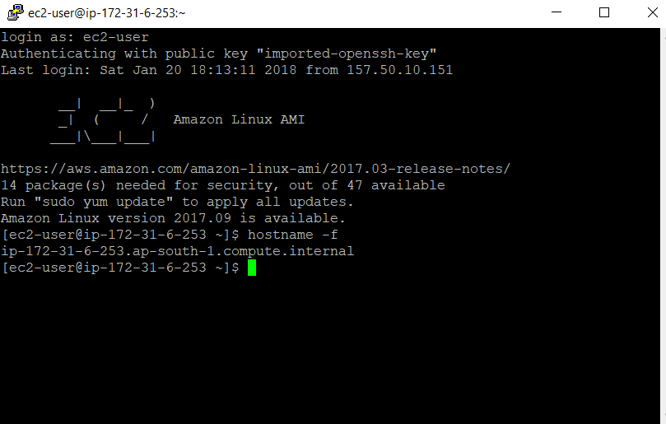
Server Networking Access

Slide 7
Server Networking Access
On Windows hosts, run the following command in Powershell:
net config workstation | findstr /C:"Full Computer name"

Slide 8
Server Networking Access
To resolve each FQDN to a unique IP address.
Run the following domain internet groper (dig) shell command to find the host’s IP address.
dig +short myip.opendns.com @resolver1.opendns.com

Slide 9
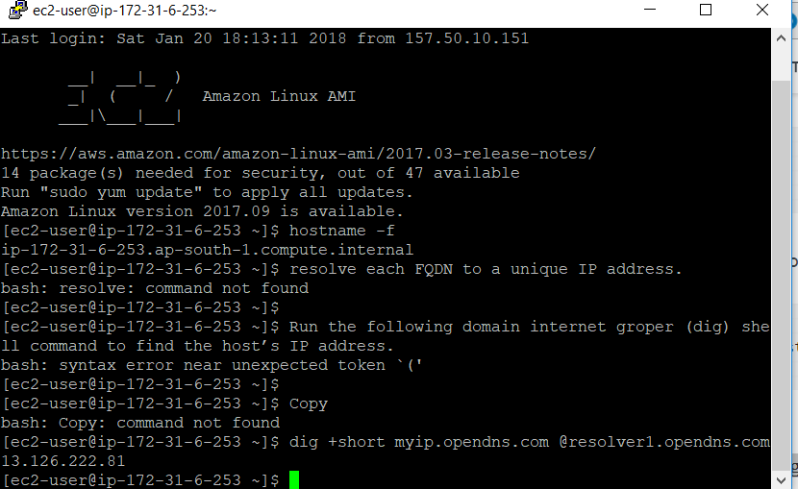
Server Networking Access
how to add servers for use by Ops Manager Automation or Ops Manager Monitoring.
Monitoring provides deployment metrics, visualization, and alerting on key database and hardware indicators. Automation provides all Monitoring functionality and lets you deploy, configure, and update your MongoDB processes directly from Ops Manager.
Provision Servers for Automation

Slide 10
Provision Servers
Adding servers for use by Ops Manager Automation or Ops Manager Monitoring.
Monitoring provides deployment metrics, visualization, and alerting on key database and hardware indicators.
Automation provides all Monitoring functionality and lets you deploy, configure, and update your MongoDB processes directly from Ops Manager.

Slide 11
Provision Servers for Automation
Procedure
In Ops Manager, click Deployment, then the Agents tab, then Downloads & Settings.
Under Automation, click your operating system and follow the instructions to install and run the agent.

Slide 12
Monitor your MongoDB deployments and manage alerts
Ops Manager sends an alert notification when a specified alert condition occurs, such as an unresponsive host or an outdated agent.
To view all alert notifications, click Alerts in Ops Manager.
When a condition triggers an alert, you receive the alert at regular intervals until the alert resolves or Ops Manager cancels it.
You can acknowledge an alert for a period of time, but if the alert condition persists, you will again receive notifications once the acknowledgment period ends.
You can temporarily suspend alerts on a resource by creating an alert maintenance window.
For example, you can create a maintenance window that suspends host alerts while you shut down hosts for maintenance.

Slide 13
Resolved Alerts
Alerts resolve when the alert condition no longer applies.
For example, if a replica set’s primary goes down, Ops Manager issues an alert that the replica set does not have a primary.
When a new primary is elected, the alert condition no longer applies, and the alert will resolve.
Ops Manager sends a notification of the alert’s resolution.

Slide 14
Cancelled Alerts
Ops Manager cancels an alert if the alert configuration that triggered the alert is deleted, disabled, or edited, or if the open alert becomes invalid.
Some examples of an alert becoming invalid are:
There is an open “Host Down” alert, and then you delete the target host.
There is an open “Replication Lag” alert, and the target host becomes the primary.
There is an open “Replica set has no primary” alert for a replica set whose name is “rs0,” and the target replica set is renamed to “rs1.”
When an alert is canceled, Ops Manager does not send a notification and does not record an entry on the Ops Manager Alerts lists.

Slide 15
Acknowledge an Alert
When you acknowledge the alert, Ops Manager sends no further notifications to the alert’s distribution list until the acknowledgement period has passed or until the you resolve the alert.
The distribution list receives nonotification of the acknowledgment.
If the alert condition ends during the acknowledgment period, Ops Manager sends a notification of the resolution.

Slide 16
Suspend Alerts by Adding a Maintenance Window
Specify maintenance windows to temporarily turn off alert notifications for a given resource while you perform maintenance.
To view maintenance windows, click Alerts, then the Alert Configuration tab, then the Maintenance Windows filter.

Slide 17
Back up MongoDB Deployments
Ops Manager backups, once started, are an ongoing and continuous process.
Data is continually backed up as long as the backup remains synchronized with the database.
This process works like replica set data synchronization

Slide 18
The backup process:
Performs an initial sync to back up all of your existing data in its current state.
In sharded clusters, this occurs on each shard and on the config servers.
Takes snapshots of the data directory in a deployment as often as your snapshot schedule specifies and then transfers the snapshots to a storage system.
Sharded Clusters also can enable checkpoints to permit restores at moments between snapshots.
Monitors the oplog constantly and adds new database operations to the latest backup to keep the local Ops Manager copy of the data curren

Slide 19
Backup Definition and Operational States
State | Retain Old Snapshots | Create New Snapshots | Apply Oplogs
Active | Yes | Yes | Yes
Stopped | Yes | No | No
Inactive | No | No | No

Slide 20
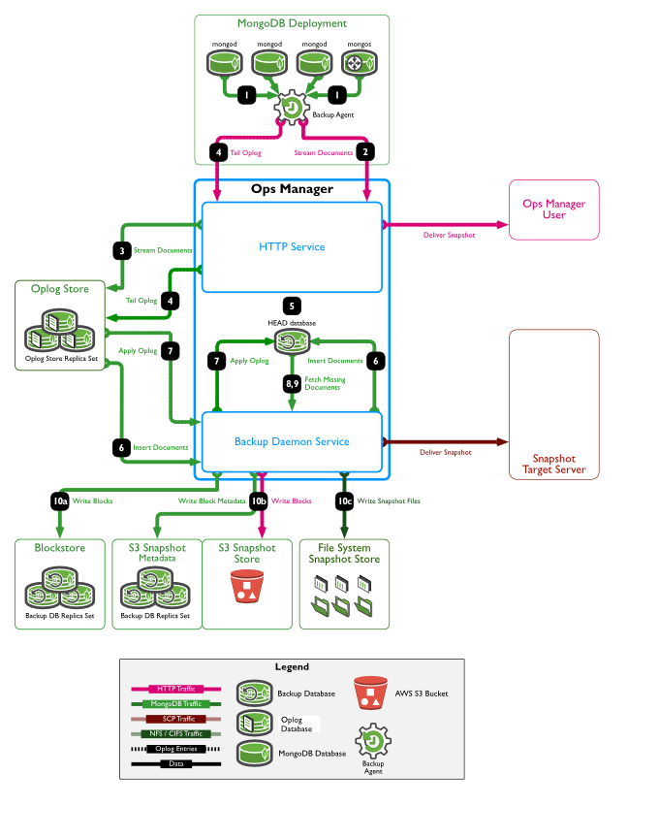
Backup Process Flows

Slide 21
Backup Process Flows

Slide 22
Backup Preparations
Backup Method Features
backup System Feature | File System on SAN | File System on NAS | AWS S3 Blockstore | MongoDB HABlockstore | MongoDB Blockstore
Snapshot Types | Complete | Complete | Many partial | Many partial | Many partial
Backup Data Deduplication | If SAN supports | No | Yes | Yes | Yes
Backup Data Compression | Yes | Depends | Yes | Yes | Yes
Backup Data Replication | If SAN supports | No | No | Yes | No
Backup Storage Cost | Higher | Medium | Lower | Higher | Lower
Staff Time to Manage Backups | Medium | Medium | Lower | Higher | Medium
Backup RTO | Lower | Medium | Lower | Lower | Medium

Slide 23
Snapshot Frequency and Retention Policy
By default, Ops Manager takes a base snapshot of your data every 24 hours.
If desired, administrators can change the frequency of base snapshots to 6, 8, 12, or 24 hours.
Ops Manager creates snapshots automatically on a schedule. You cannot take snapshots on demand.

Slide 24
Snapshot Frequency and Retention Policy
Snapshot | Default Retention Policy | Maximum Retention Policy
Base snapshot | 2 days | 5 days
Daily snapshot | 0 days | 1 year
Weekly snapshot | 2 weeks | 1 year
Monthly snapshot | 1 month | 3 years

