Slide 1
MEDICOLLAB
BY ARINDHAM ANEJA, YIRAN SHENG, PEIYU JIANG

Slide 2
PROJECT OVERVIEW
The purpose of Medicollab is to create a platform where:
Medical Students can collaborate with professors to research a topic on related subjects and gain work experience.
Students can search for professors based on their expertise in the subject and send them a request with a brief description of their incentive to work with the professor.
Professors can assign different tasks to students to help develop their knowledge
and grade students for their completed assignments.

Slide 3
SYSTEM OVERVIEW
This app will be developed using the Model-View-Controller architecture.
The Model contains the pure application data and interacts with the controller by providing it the information and getting updated in return
The Controller exists between view and model. It listens to events triggered by the user and executes the appropriate reaction by calling a method on the model and reflecting it in the view.
The View presents the data to the user. It is responsible for the visual representation of the app.

Slide 4
ARCHITECTURAL STYLE &
SYSTEM DIAGRAM
User
Professor Profile
Professor List
Edit Information
Professor Schedule
User Information
Modify Schedule
Student Profile
Student Request Data
Send Request
Student Schedule
Requests
Assignments
Respond
Tasks
Model
Update Assignments
Pending Assignments
Controller
Completed Assignments
View

Slide 5
ACTOR IDENTIFICATION
The actors include:
Uses the app to search for professors and work with them to gain experience and knowledge.
Student
Uses the app to mentor students, acquaint them with concepts of a particular medical subject and grade them on the basis of knowledge they display.
Professor

Slide 6
DESIGN PATTERN & FRAMEWORK
Factory Method
Provides approach to code for interface rather than implementation.
Provides abstraction between implementation and client classes through inheritance.
Removes the instantiation of actual implementation classes from client code.
Keeps the code more robust, less coupled, and easy to extend.

Slide 7
SEQUENCE DIAGRAM

Slide 8
Web Client
Authentication
Server
Database
Student
openApp()
signIn(Email, Password)
verifySignin()
loadUserData()
signInSuccess()
loadUserData()
returnUserData()
signInDenied()
denySignin()
Null
displayWelcomeScreen()
viewProfessorList()
returnProfessorList
viewProfessorProfile()
viewProfessors()
returnProfessorProfile
sendRequest(ProfileID)
saveRequest(ProfileID)
requestSuccessfullySent

Slide 9
Web Client
Authentication
Server
Database
Student
viewMyTasks()
returnMyTasks
viewPendingAssignments()
returnPendingAssignments
viewCompletedAssignments()
checkProfile()
returnCompletedAssignments
viewMySchedule()
returnMySchedule
editMySchedule()
storeData()
updateSuccessful()
closeApp()

Slide 10
Web Client
Authentication
Server
Database
Professor
openApp()
signIn(Email, Password)
verifySignin()
loadUserData()
signInSuccess()
loadUserData()
returnUserData()
signInDenied()
denySignin()
Null
displayMySchedule()
editMySchedule()
returnMySchedule
viewstudentRequests()
searchRequests()
viewProfessors()
displayStudentRequests()
returnRequests
acceptRequest(ProfileID)
saveRequest(ProfileID)
studentAdded()
declineRequest(ProfileID)
studentDeclined()
closeApp()

Slide 11
Student
StudentID: String
CLASS DIAGRAM
sendRequest()
searchProfessor()
viewProfile()
viewAllAssignments()
seePendingAssignments()
viewCompletedAssignments()
viewClassSchedule()
editSchedule()
User
Name: String
Email: String
Password: String
School: String
Role: String
Settings
User Details:
Manages
signUp()
signIn()
resetPassword()
editProfile()
logout()
editName()
changePassword()
changeSchool()
Professor
ProfID: String
viewAllStudents()
acceptRequest()
rejectRequest()
viewAllRequest()
assignAssignment()
setClassSchedule()

Slide 12
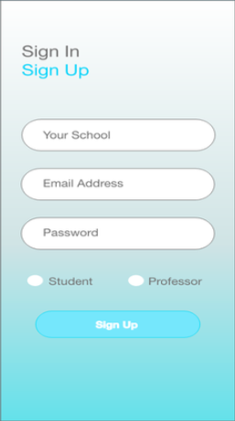
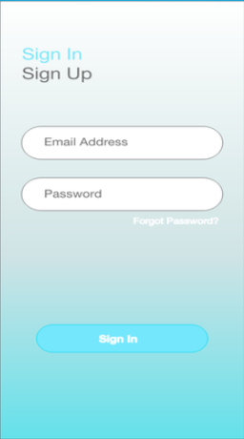
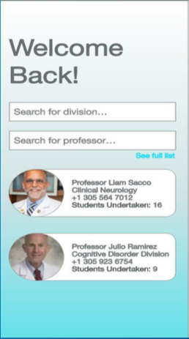
MOCK UP

Slide 13

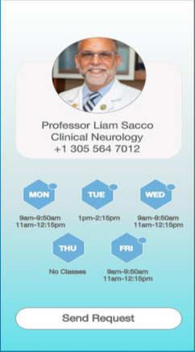
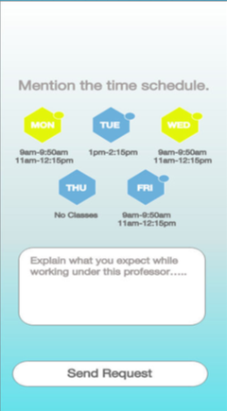
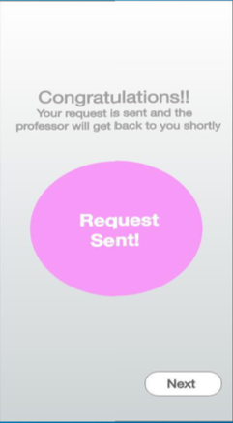

Slide 14
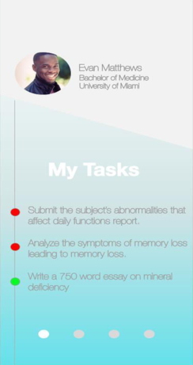
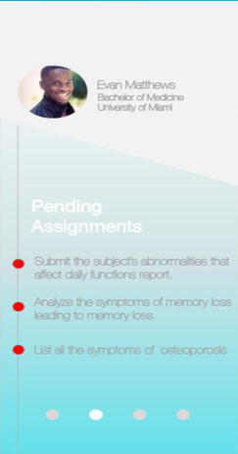
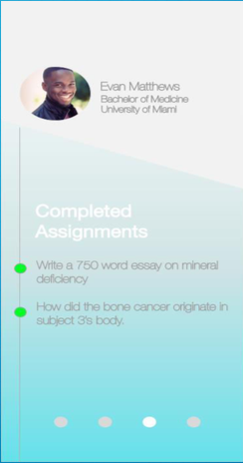
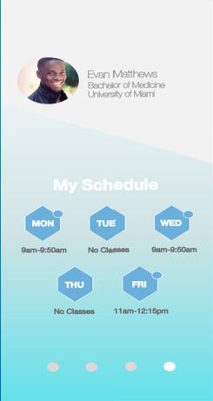

Slide 15
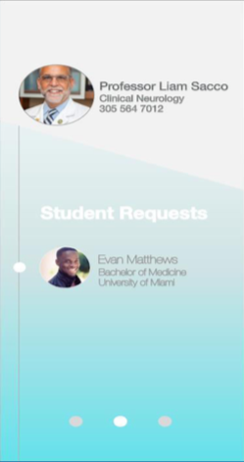
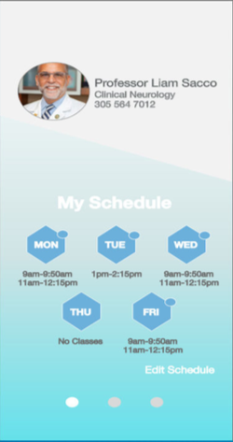
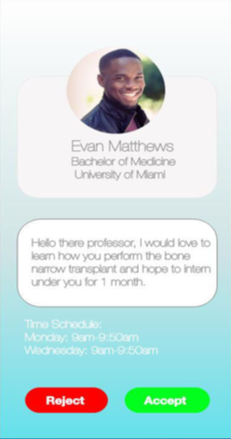


Slide 16
Thank you for listening any questions?

