Slide 1
Predicting Customer Churn
Using Explainable AI
SHAP & LIME on the Telecommunication dataset

Slide 2
Pipeline
Data Loading
& Cleaning
Exploratory
Data Analysis
Statistical
Tests
Feature
Engineering
Clustering
& Visualization
8 ML
Models
SHAP &
LIME
→
→
→
→
→
→
Explainability: SHAP (global feature importance) + LIME (local instance explanations)
Models: Logistic Regression, Decision Tree, Random Forest, XGBoost, LightGBM, 1D CNN, MLP (GELU), Transformer

Slide 3
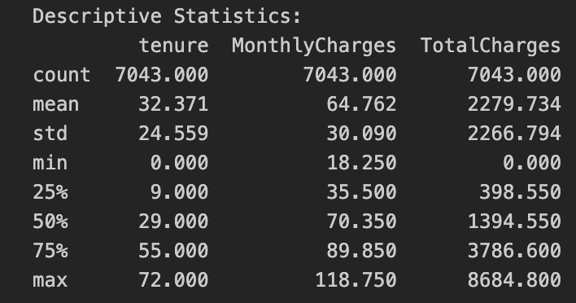
Dataset Overview
Dataset: WA_Telco Customer Churn.
Source: Kaggle
7,043
21
26.5%
Customers
Features
Churn Rate
Feature types: 3 numerical (tenure, MonthlyCharges, TotalCharges) + 15 categorical (Contract, InternetService, PaymentMethod, etc.) + customerID + Churn target
Class imbalance: No Churn = 5,174 (73.5%) | Churn = 1,869 (26.5%)
11 blank TotalCharges values (tenure=0 new customers) — filled with 0.

Slide 4
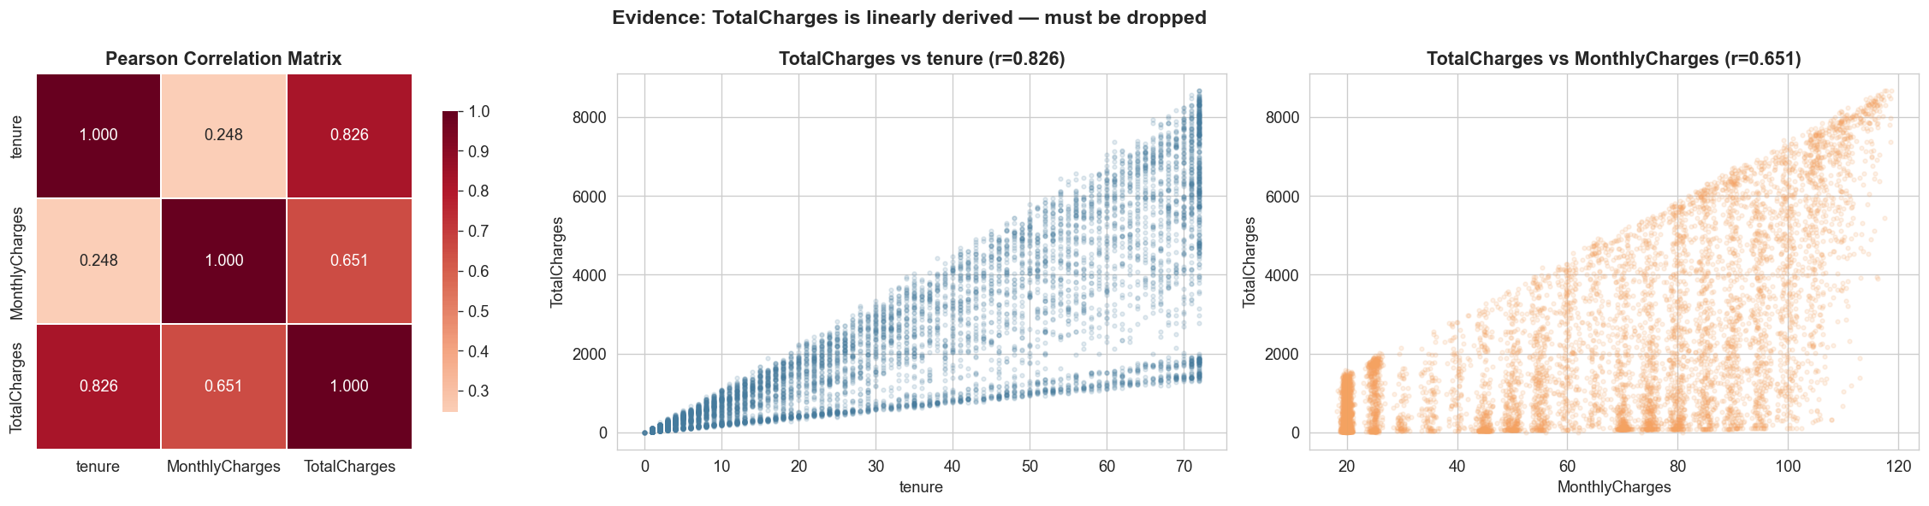
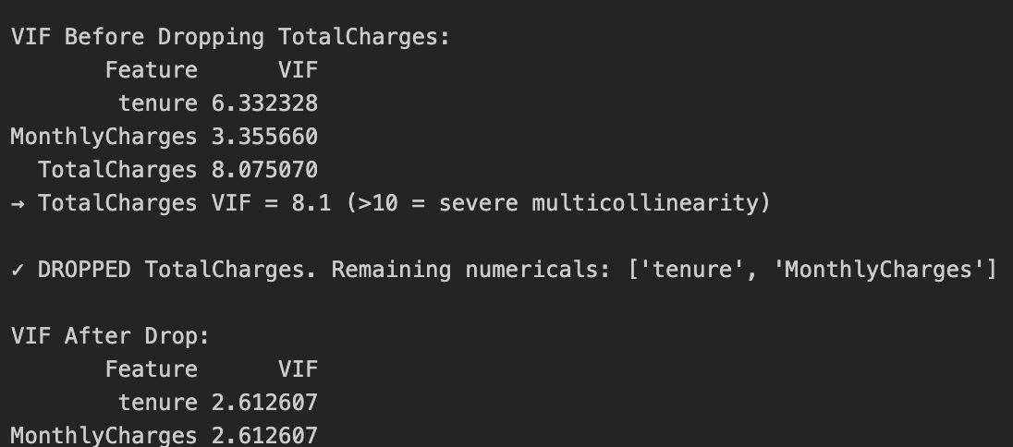
Multicollinearity Check — VIF Analysis
Decision: Dropped TotalCharges (VIF=8.08, r=0.83 with tenure). After drop: both remaining VIFs = 2.61.

Slide 5
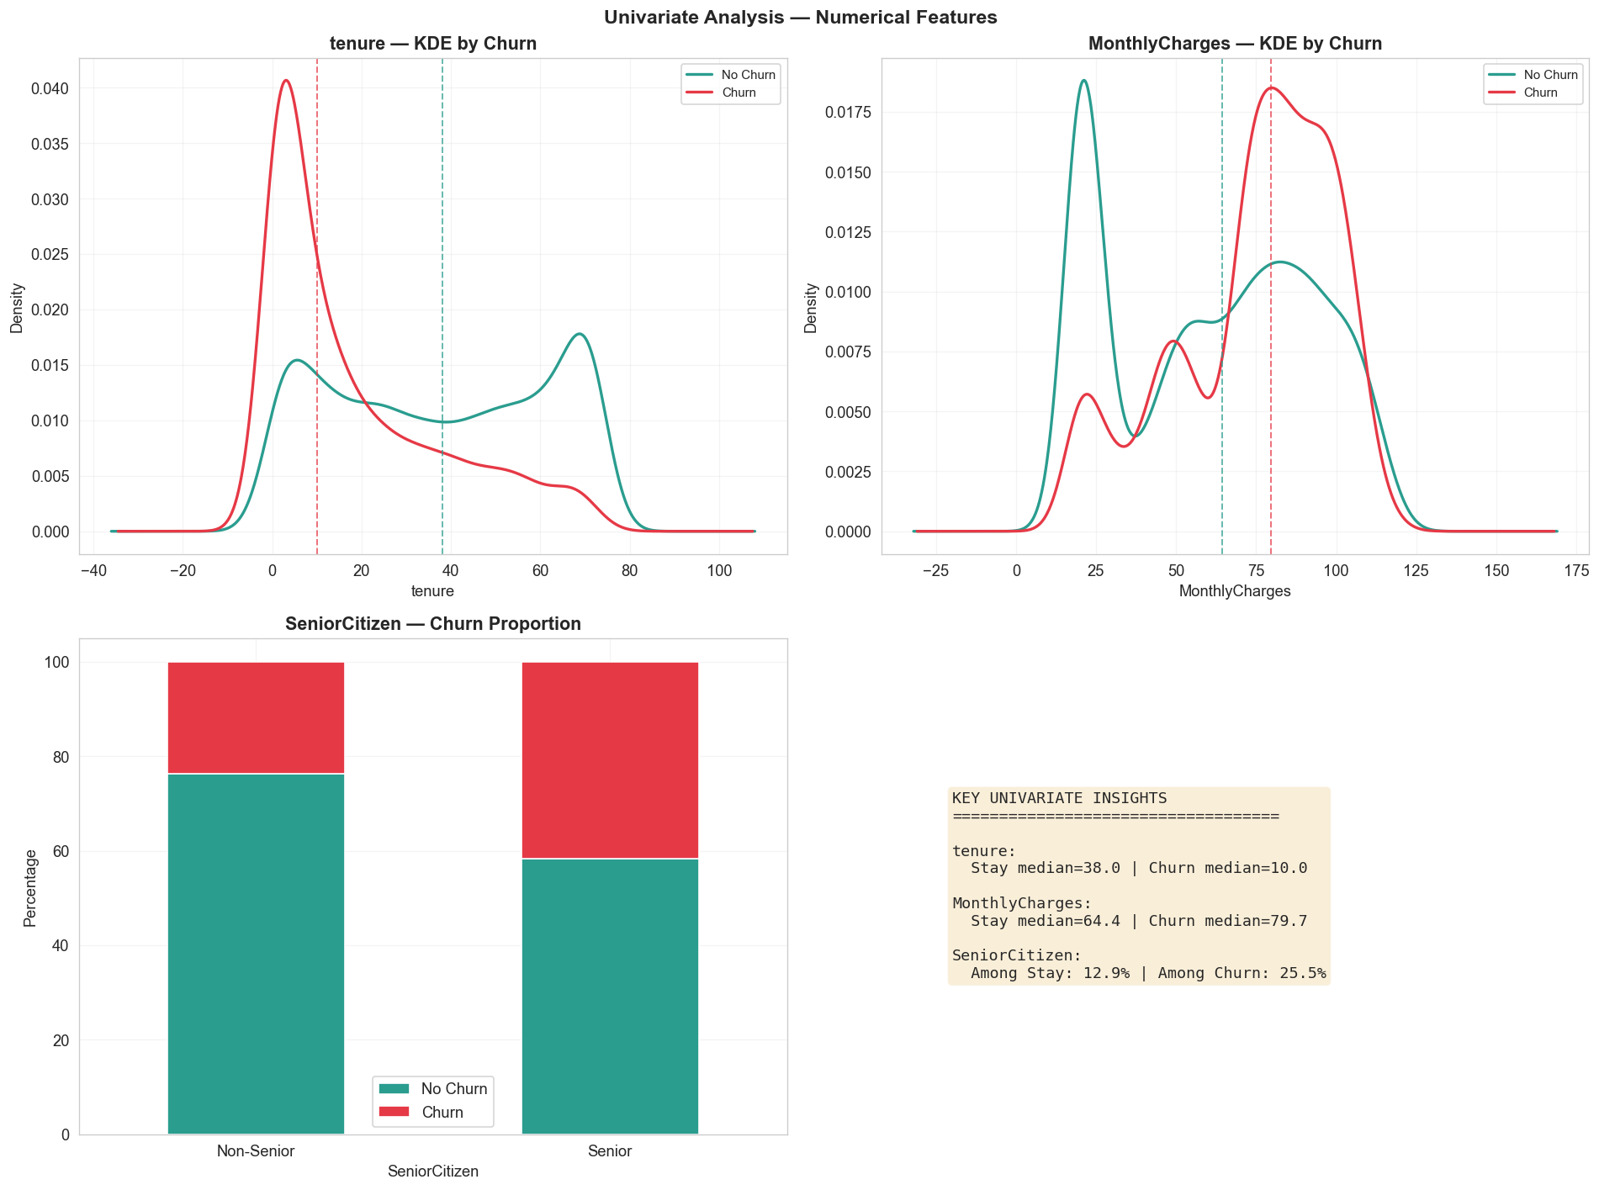
a. EDA — Numerical Features
Distribution of tenure and MonthlyCharges by churn status

Slide 6
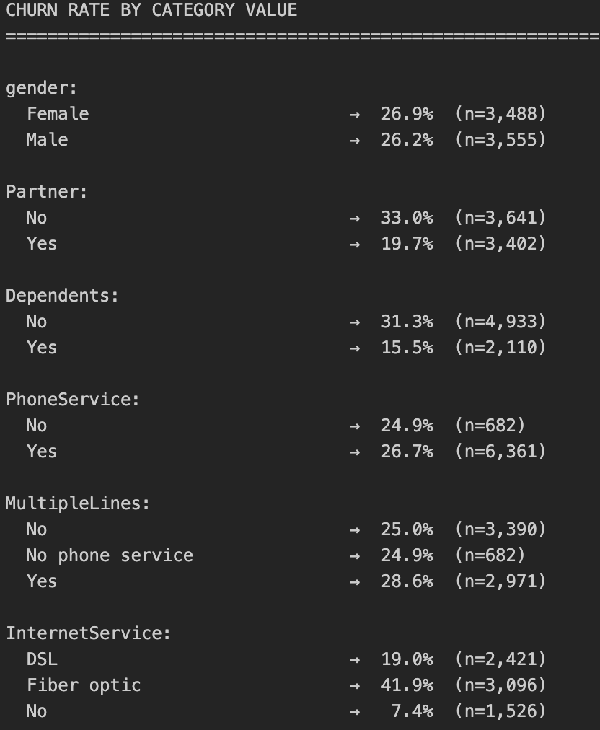
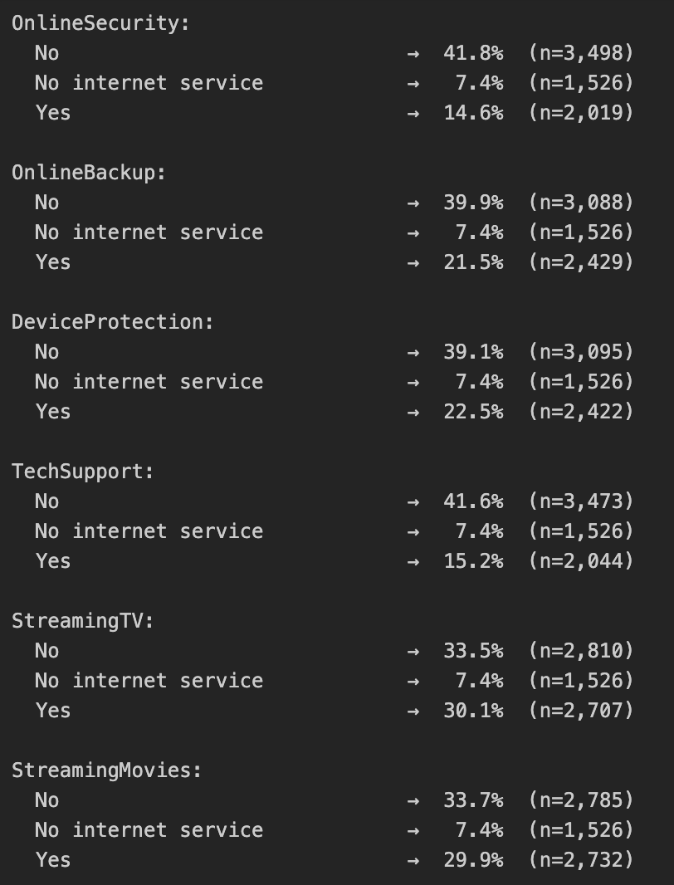
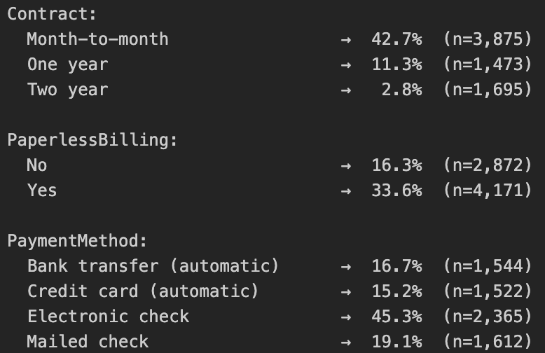
b. EDA — Categorical Features

Slide 7
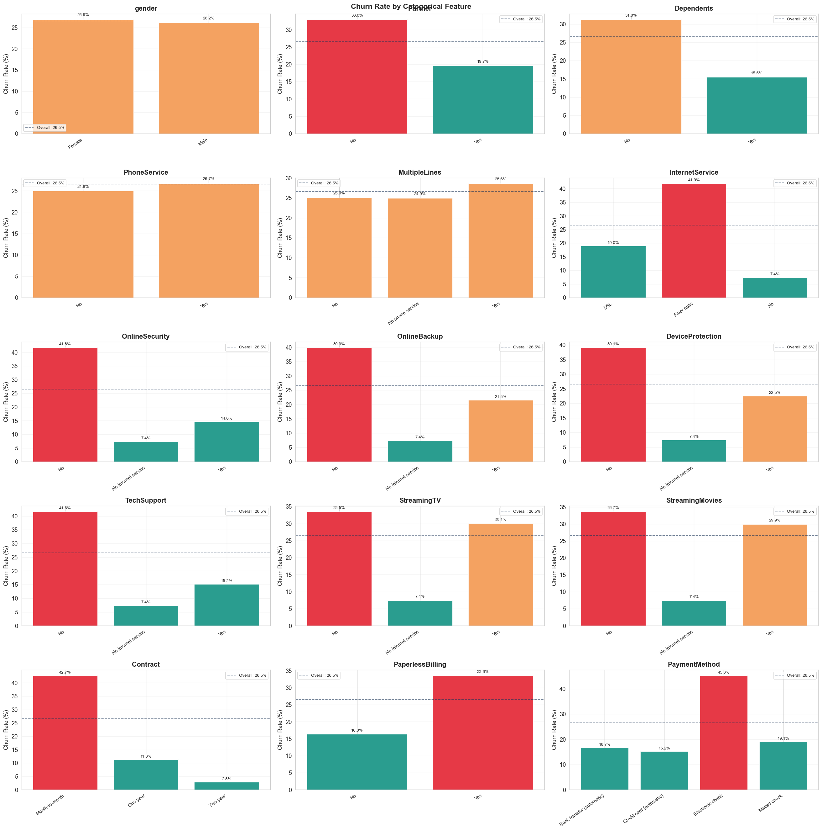

Slide 8
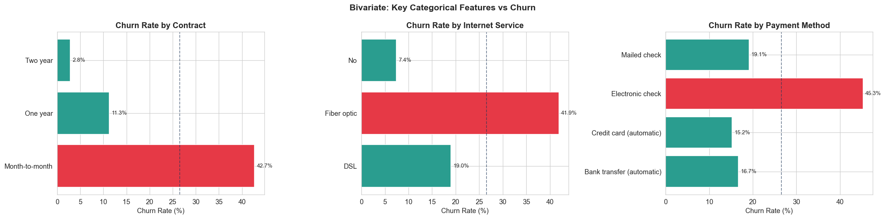
Key Churn Drivers
Churn rate by Contract, Internet Service, Payment Method
Key insight: Month-to-month contracts show ~43% churn vs 3% for Two-year. Fiber Optic users churn at 42% vs 19% DSL. Electronic check payers churn at 45%.
These three features will form the basis of our engineered features: IsMonthToMonth, HasFiber, and IsElectronicCheck. The churn rate differences are not marginal — they are 3x to 10x differences, which is why they turn out to be the most powerful predictors across all models.

Slide 9
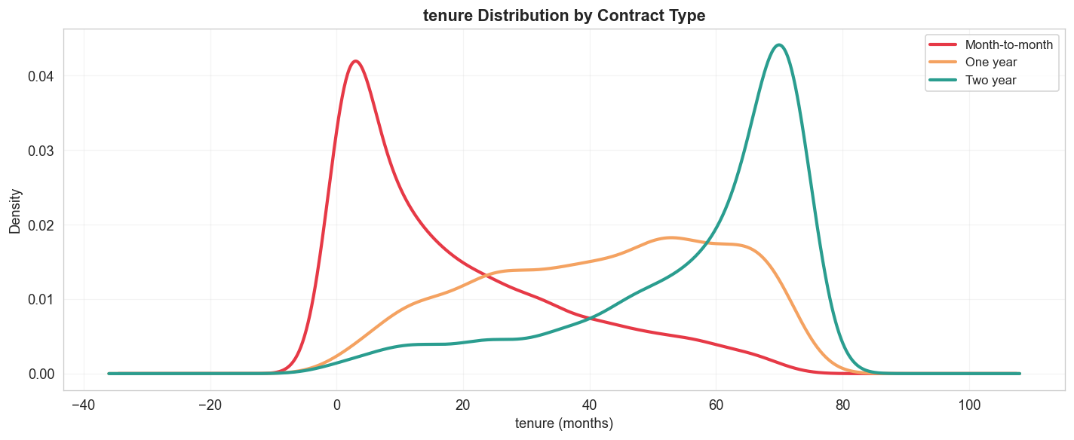
Tenure Distribution by Contract Type
KDE plot showing how contract type shapes customer lifetime
Month-to-month customers cluster at low tenure (peak ~1 month), while Two-year contracts build tenure over decades — a natural retention mechanism.
This plot is important because it shows that contract type is not just correlated with churn — it fundamentally determines the customer lifecycle shape. It also justifies why tenure and contract type together are so powerful for prediction.

Slide 10
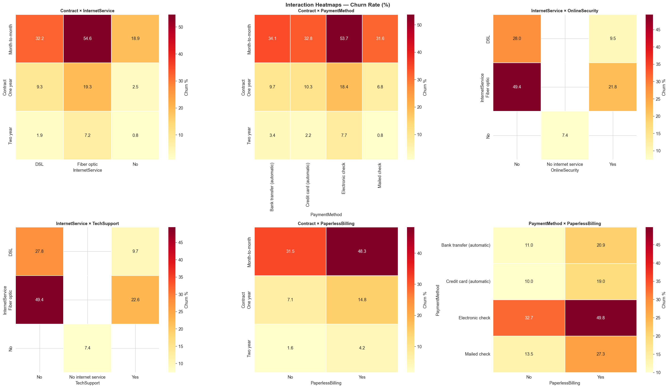
Multivariate EDA — Interaction Heatmaps
Churn rates across feature combinations
Highest churn combinations:
• Month-to-month + Fiber optic • Month-to-month + Electronic check • Fiber optic + No security • Fiber optic + No tech support
1.Month-to-month + Fiber: 54.6% churn (HIGHEST risk)
2.Fiber + No Security: 49.4% churn

Slide 11
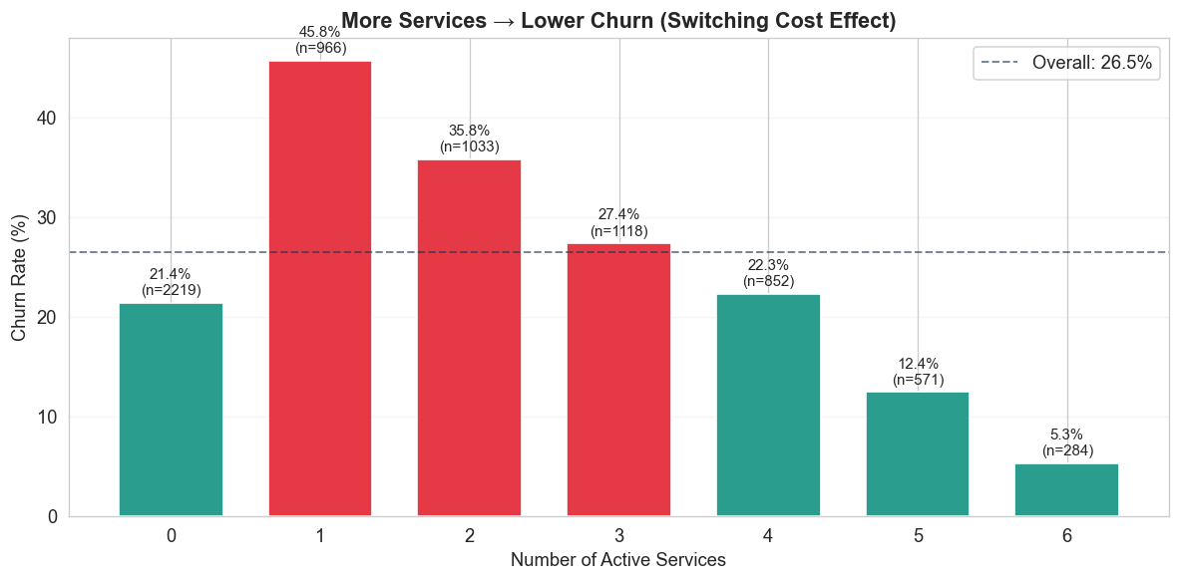

Slide 12
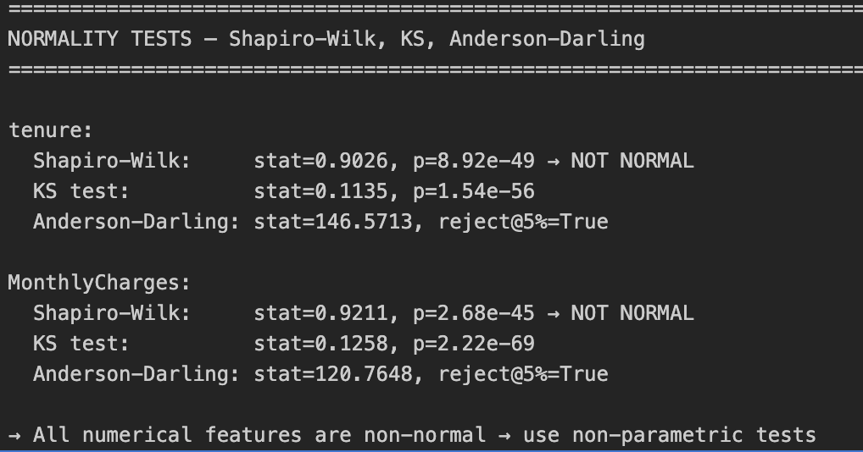
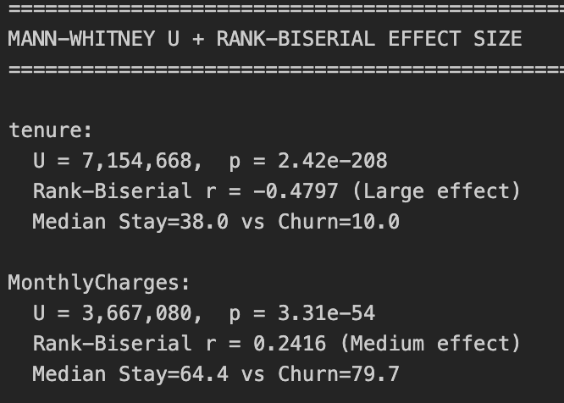
Statistical Tests — Normality & Group Differences
Normality Tests
Mann-Whitney U + Effect Size
Shapiro-Wilk, KS, Anderson-Darling
tenure:
Stat=0.9026, p=8.92e-49 → NOT NORMAL
MonthlyCharges:
Stat=0.9211, p=2.68e-45 → NOT NORMAL
→ All features violate normality
→ Use non-parametric tests (Mann-Whitney, Kruskal-Wallis)
Rank-Biserial correlation
tenure:
U=7.15M, p≈0
r = −0.48 (Large effect)-Customers who churn tend to have lower tenure.
Median: Stay=38 vs Churn=10
MonthlyCharges:
U=3.67M, p=3.31e-54
r = +0.24 (Medium effect)
Median: Stay=64.4 vs Churn=79.7

Slide 13
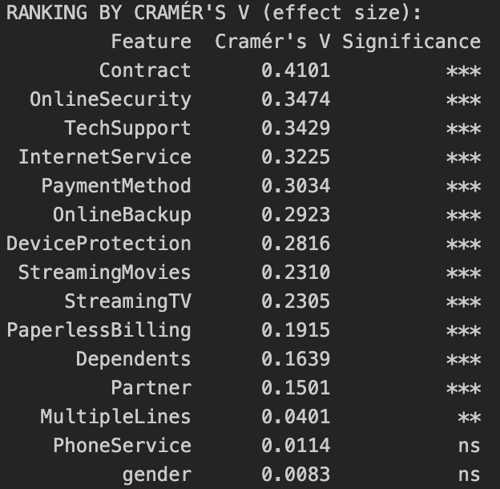
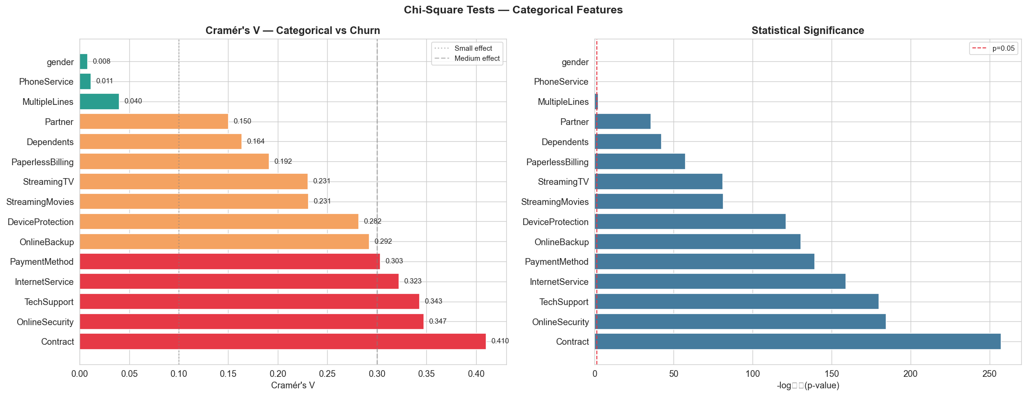
Chi-Square Tests & Cramér's V
Measuring categorical feature association with churn
Strongest associations: Contract (0.41), OnlineSecurity (0.35), TechSupport (0.34), InternetService (0.32).
Dropped: gender (V=0.008, p=0.49) and PhoneService (V=0.011, p=0.34) — no association.

Slide 14
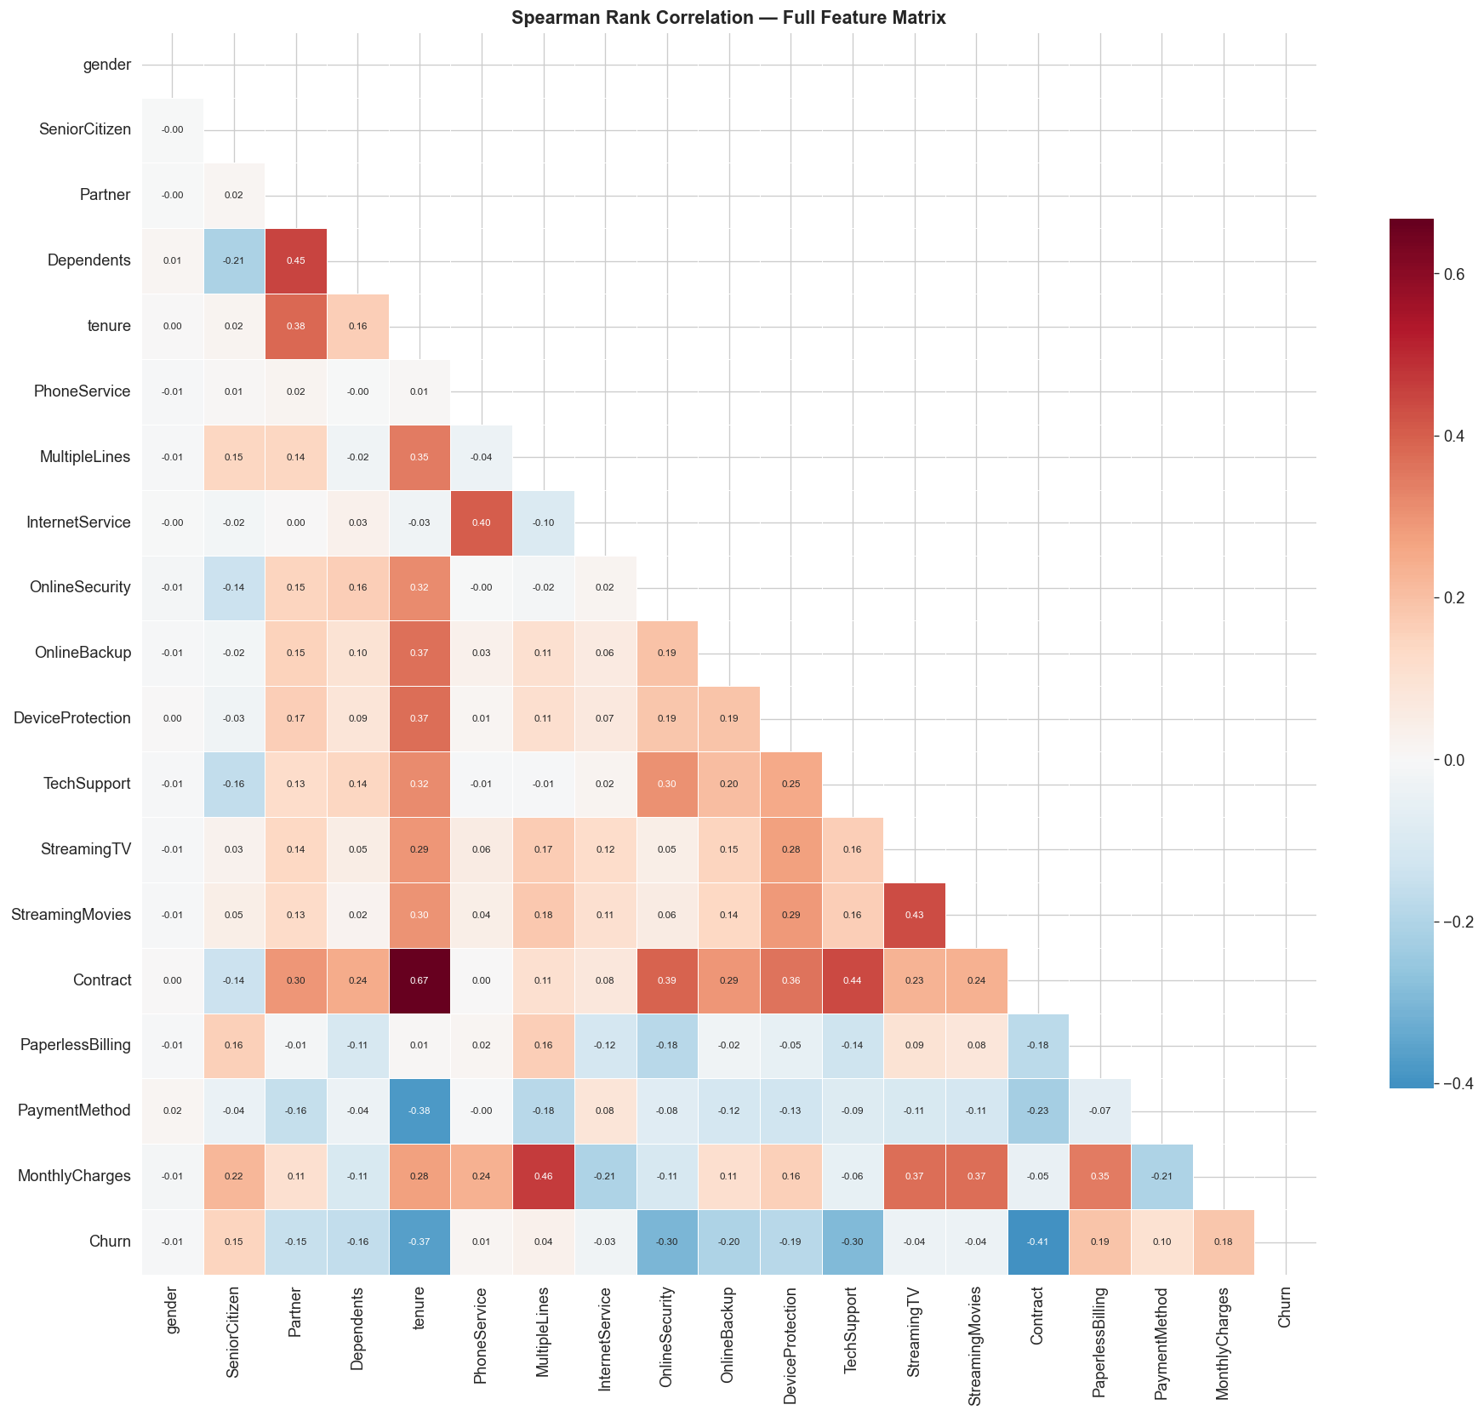
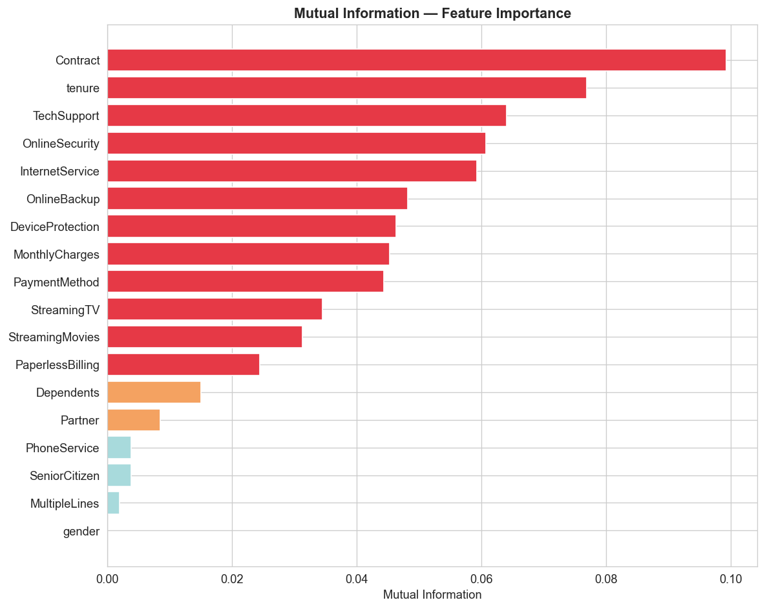
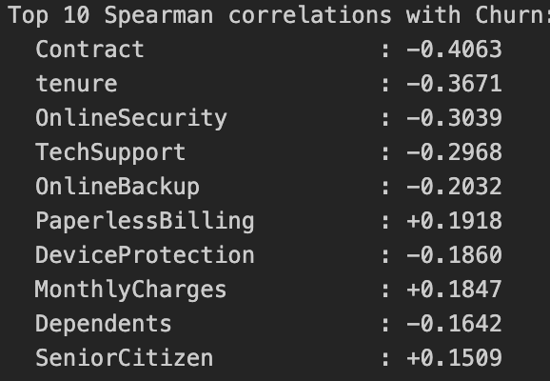
Spearman Correlation & Mutual Information
Monotonic and non-linear feature-churn relationships
Spearman captures monotonic trends; MI (right) detects any dependency including non-linear patterns . Contract, tenure, TechSupport, OnlineSecurity top both rankings — confirming their predictive power.

Slide 15
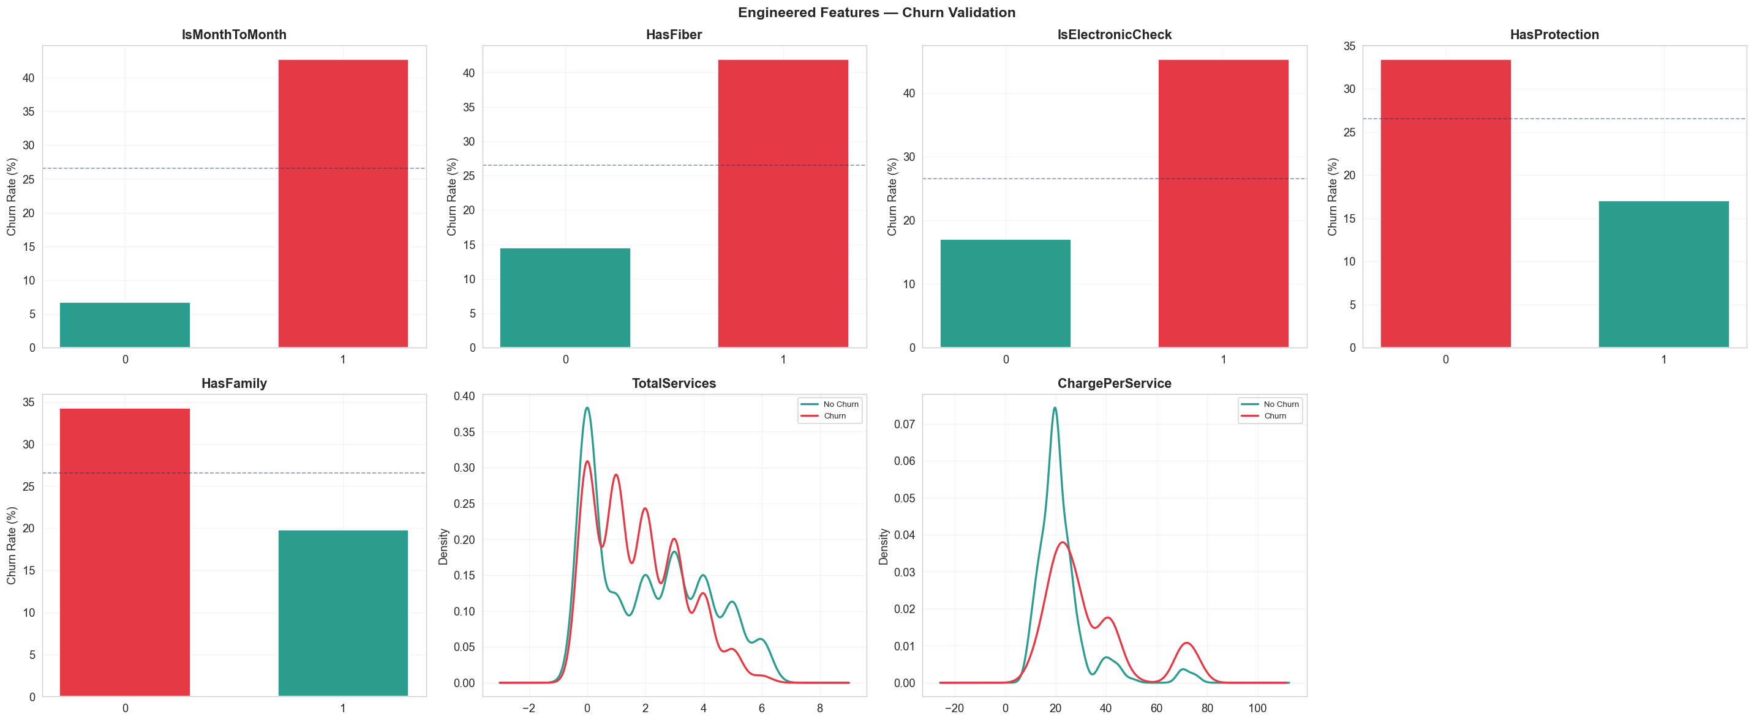
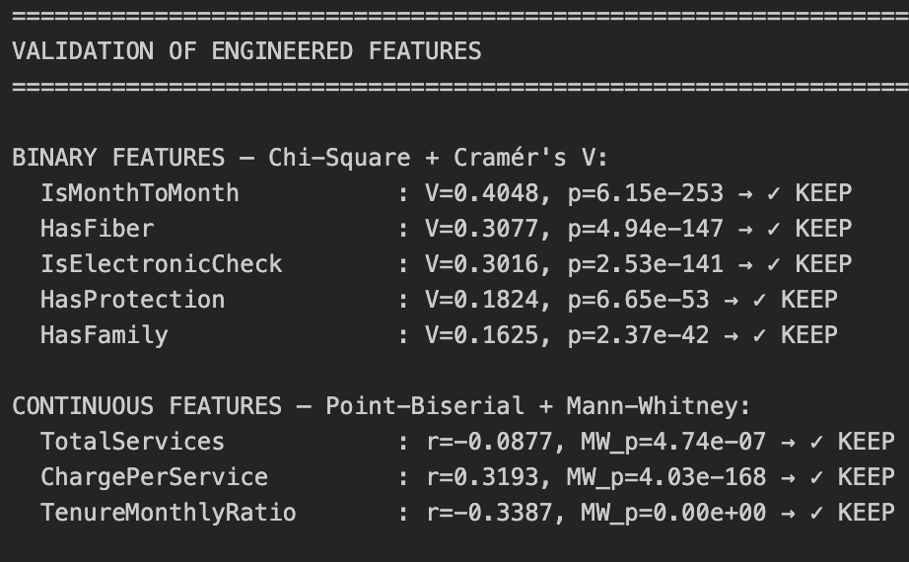
Feature Engineering
Engineered Features
1. IsMonthToMonth
2. HasFiber
3. IsElectronicCheck
4. TotalServices
5. HasProtection
6. HasFamily
7. TenureMonthlyRatio
8. ChargePerService

Slide 16
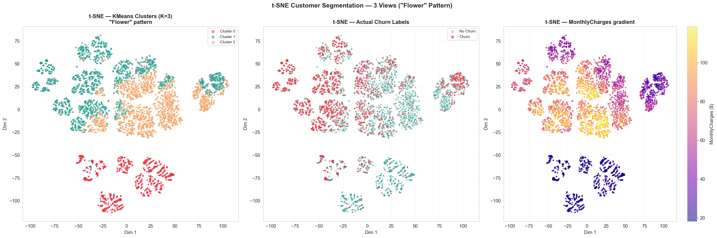
Feature-Space Clustering & t-SNE
K-Means (K=3) reveals natural customer segments
Cluster Profiles
 | Cl 0 | Cl 1 | Cl 2
Size | 1,533 | 3,040 | 2,470
Churn% | 7.2% | 47.7% | 12.5%
Tenure | 31 | 17 | 52
Monthly$ | $21 | $71 | $84
Services | 0 | 1.5 | 4
Cluster 1 (high charges, low tenure, few services) has 47.7% churn — the primary risk group.

Slide 17
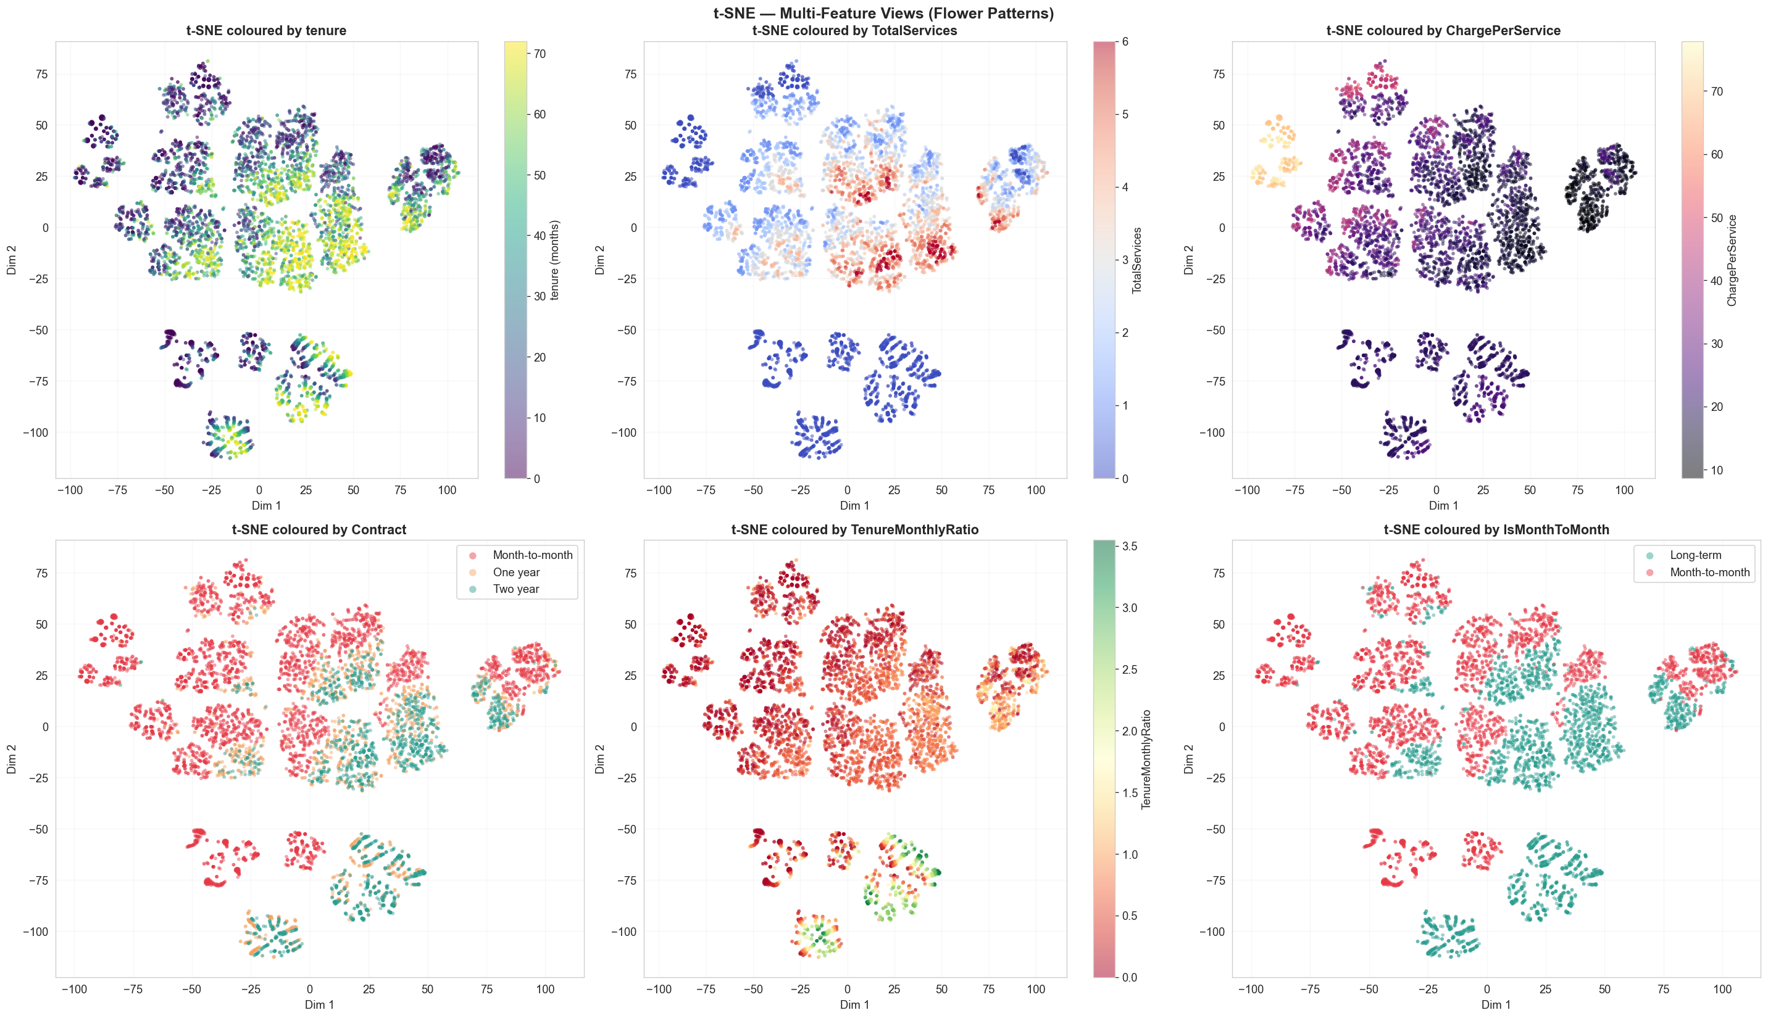
Multi-Feature t-SNE Views
Coloring t-SNE by different features to reveal separability patterns

Slide 18
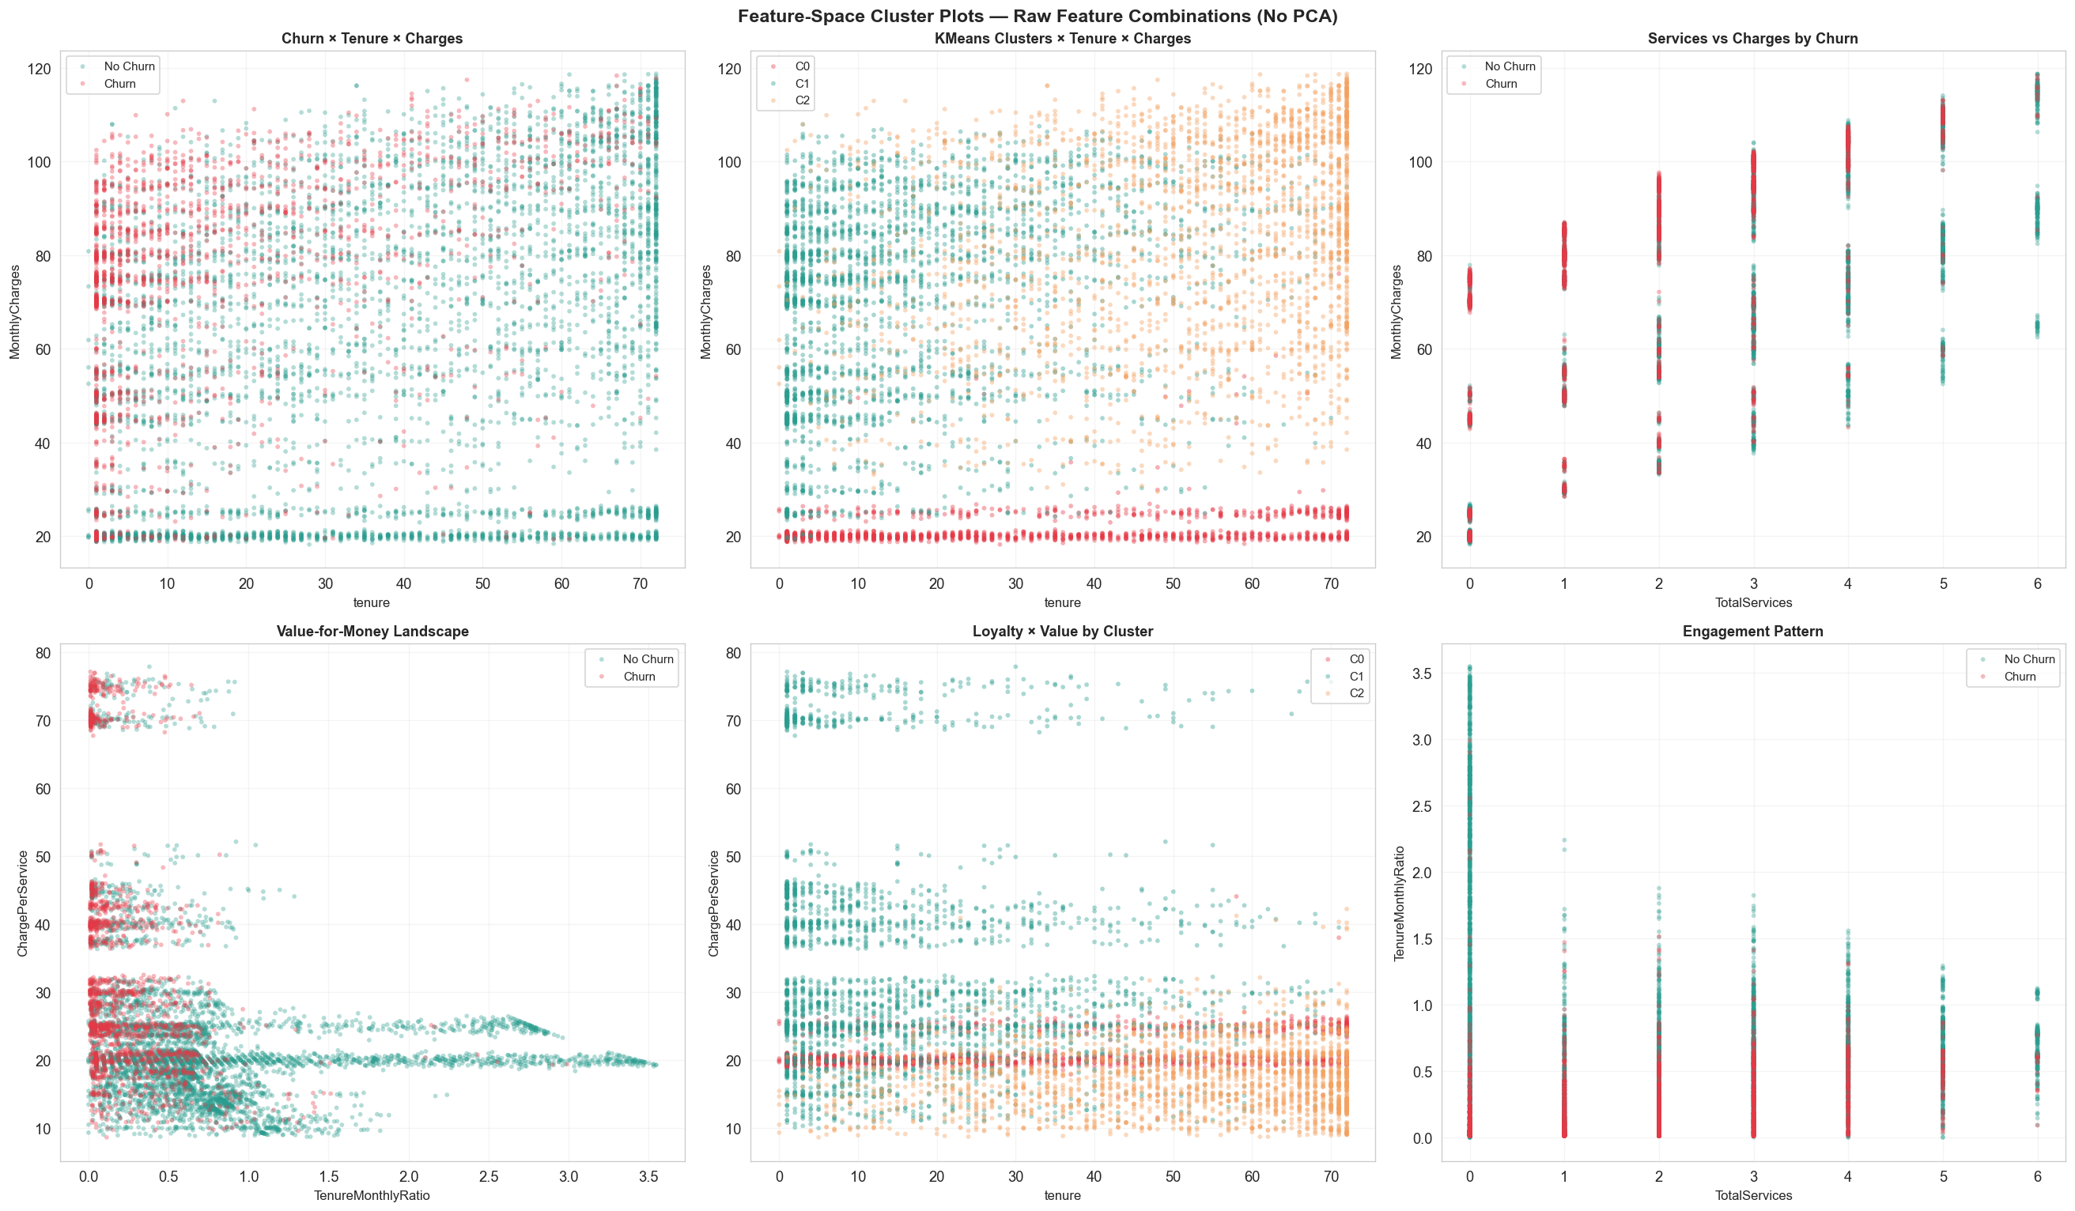
Feature-Space Scatter Plots
Direct feature combinations — no dimensionality reduction

Slide 19
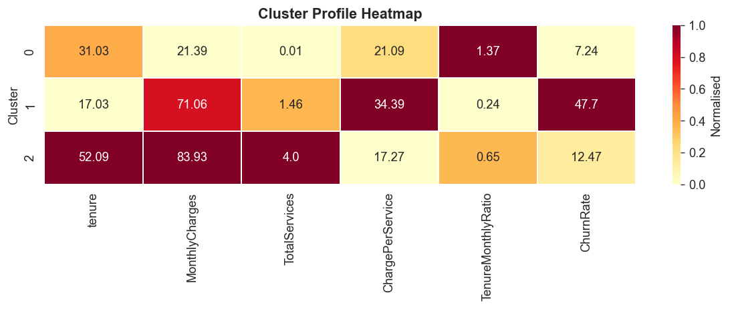
Retention strategy
Focus on customers with:
• low tenure • month-to-month contracts • few services
Upselling strategy
Encourage customers to adopt:
• bundled services • long-term contracts

Slide 20
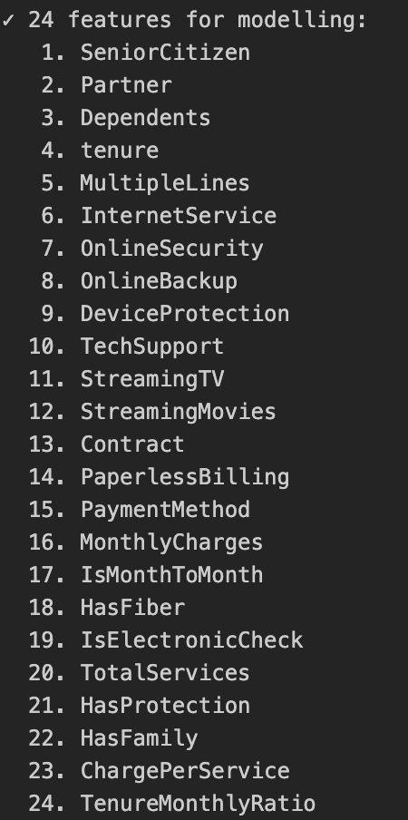
Feature Selection & Model Preparation
Final 24-feature set after encoding, SMOTE for class balance
Feature Selection
Train/Test & SMOTE
80/20 stratified split
Train: 5,634 | Test: 1,409
SMOTE applied to training set:
8,278 samples (4,139 each class)
StandardScaler on all 24 features
Deep Learning Architectures (proportional to n_features=24)
1D CNN
Conv1D(24)→Conv1D(12)→Dense(6)→1
MLP
24→12→6→3→1 (GELU)
Transformer
embed=32,, 2 blocks
17 / 32

Slide 21
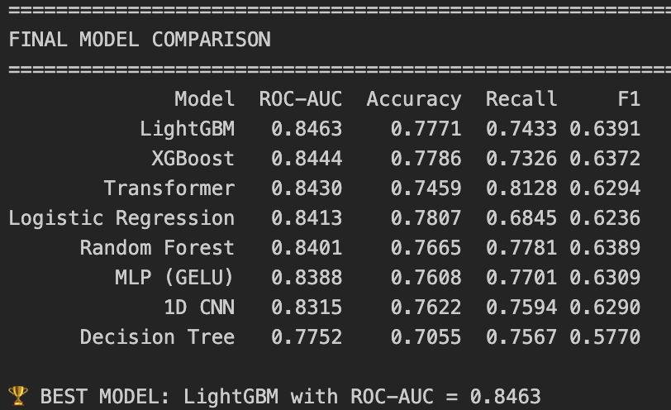
Final Model Comparison
All models ranked by ROC-AUC
Best: LightGBM closely followed by XGBoost and Transformer. Tree ensembles dominate on tabular data, but the Transformer is competitive.

Slide 22
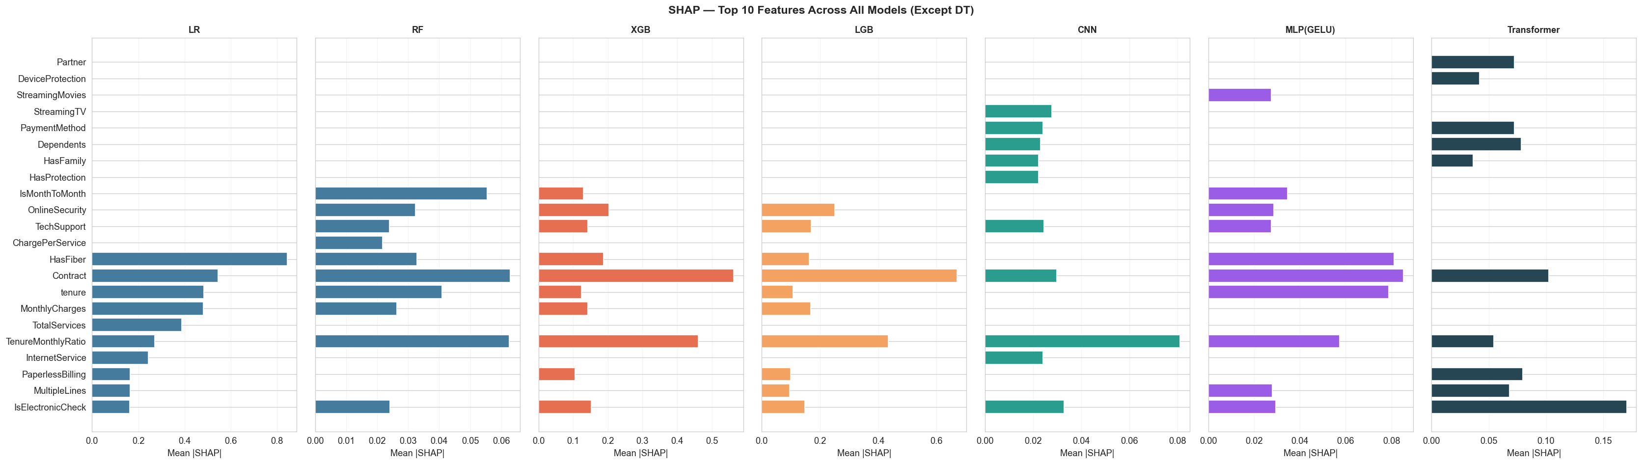
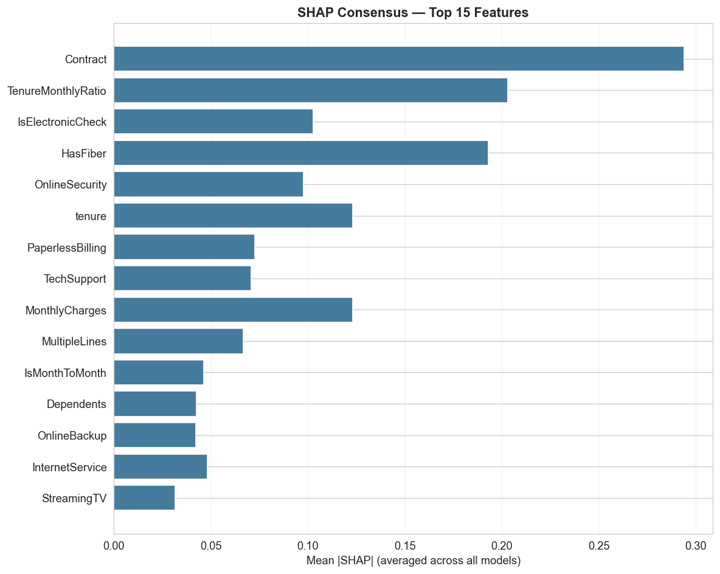
SHAP — Global Feature Importance
Mean |SHAP| across all 7 models (excluding Decision Tree)
Consensus top features: Contract, TenureMonthlyRatio, IsElectronicCheck, HasFiber, OnlineSecurity

Slide 23
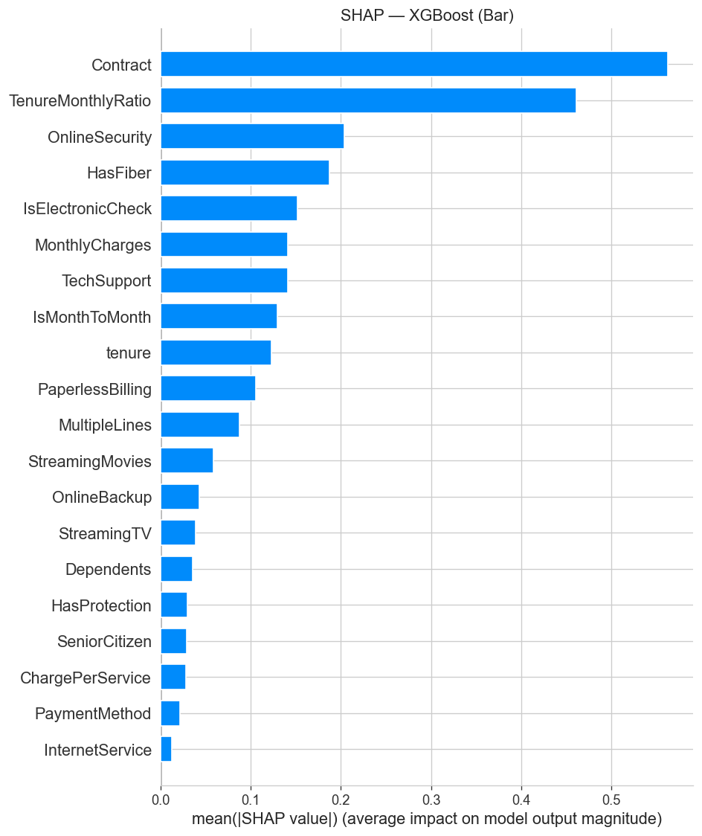
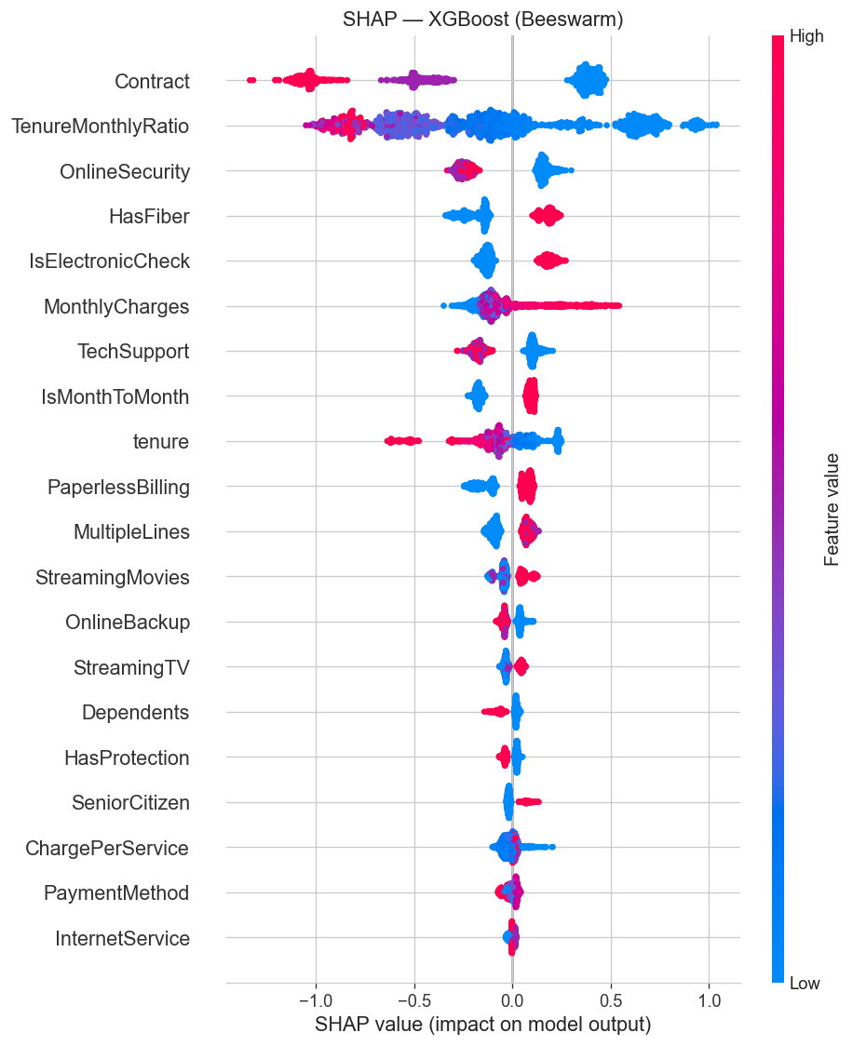
SHAP Detail — XGBoost
Bar plot + Beeswarm plot
Beeswarm shows direction: higher Contract value (longer term) reduces churn SHAP; higher HasFiber increases it.

Slide 24
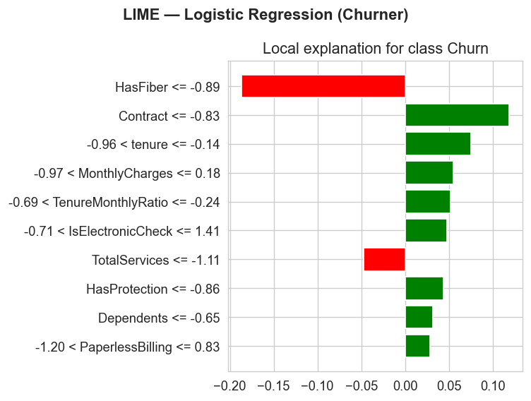
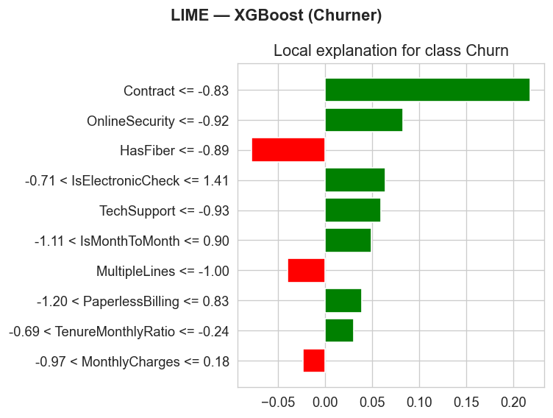
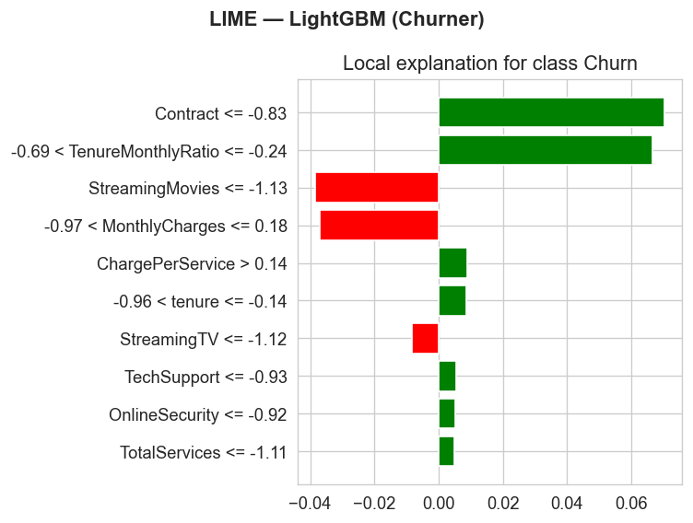
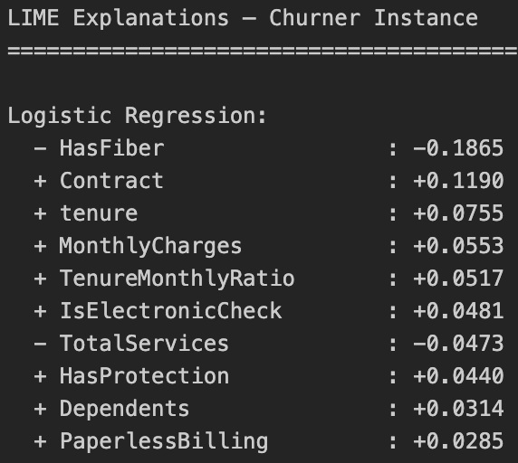
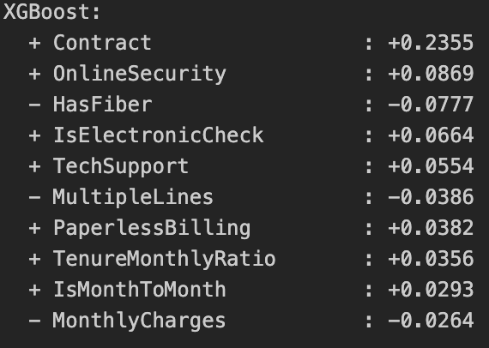
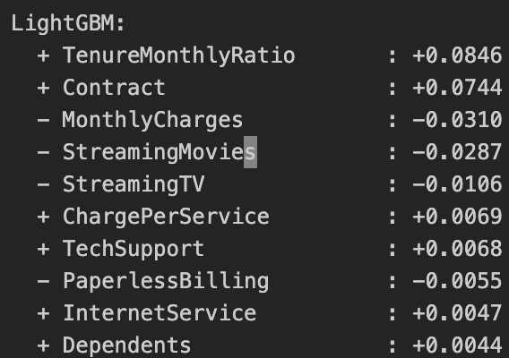
LIME — Local Instance Explanations

Slide 25


Service Bundle & Cluster Profile Analysis
Bundle adoption rates and cluster behavioral heatmap
#Customers with more service bundles churn less. Cluster heatmap confirms Cluster 1 (high churn) has low service adoption + short tenure.
#Target M2M Fiber users with no security

