Slide 1

My making of a Metasploit module
Notes:
I built a Metasploit module - learned a lot and this was the process.

Slide 2
Who I am not
Rapid 7
A paid developer of any kind
Notes:
I don’t do this as a job.

Slide 3





Hi,
I’m Ringo
@AlphaRingo
aaron-ringo
Notes:
Misc personal info

Slide 4
Disclaimer: This project was my first time using git for more than just backing up my stuff or pulling software down.
Notes:
Holy heck github is made for collaboration

Slide 5
What I’ll cover
Quick overview of the framework
Why you might want to contribute
My module
Dev environment setup needed
Just enough git
Module testing
Putting in a pull request

Slide 6
What’s Metasploit
?
“ open source project that provides the infrastructure, content, and tools to perform penetration tests and extensive security auditing.” -
Rapid7 (Company behind Metasploit)
Notes:
Definition from - https://metasploit.help.rapid7.com/docs/getting-started , this isn’t needed since everybody and there mama knows Metasploit.

Slide 7
Why Contribute ?
Pros
Get into the mindset of making
Who knows where it will lead?
Free training
Work with accomplished helpful devs
Learn how the Sausage is made, by making it

Slide 8
Why Contribute ?
More Pros
Low barrier to entry
Modular code is minimal and quick to develop
Lots of example code to “repurpose” (double edged sword). Ruby codebase is from 2007.
There is a place for you
The large project has tons to do, even little things like improving documentation are up for grabs

Slide 9
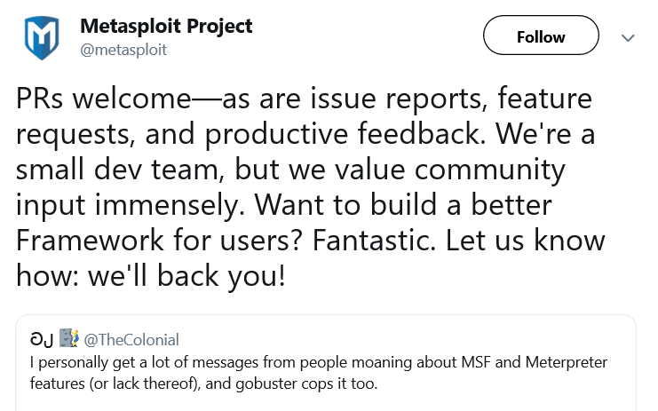
Why Contribute ?
The metasploit project is up for it

Slide 10

Ask Questions ?
& IRC
Notes:
The r7 people on these have the patience of Angels.

Slide 11
Metasploit Directories
lib | Libraries that provide the core functionality and allow the magic to happen
modules | This is the place! - Encoders, nops, payloads, post, auxiliary, exploits
tools | Scripts to help create exploits
plugins | Extends Metasploit to work with external programs
scripts | This is where stuff used to be. A lot popular functions are located here.
?
Notes:
Heres where the stuff is

Slide 12
My first module
Found a popular exploit, and searched for a module
Xorg privesc
Spent about 4 hours making & testing module
Put on github (messed that up) then 100+ comments in a couple days - comments were not about how awesome the module was
Notes:
Just search Xorg if you want to see the code.

Slide 13

Looking at modules
Simple layout, Copying brings the work down
Ruby - I don’t know Ruby..I know Python, I’m still not competent in Ruby /shrug
External modules can be written in Python and GO !!
Not all types are available, less examples
Grep approach
Notes:
How was it made so fast ?

Slide 14
Basic Module
Imports
Information about the module - Most of a module !
Check section - not always needed
Exploit/Run Section - Code that runs
Notes:
Very simplistic structure.

Slide 15
Code stuff I picked up
datastore[‘registered_option’] - some created by default
var = “#{var}” - string interpolation similar to pythons f-strings requires double quotes, use single for just text strings
@variable = instance variable, lives within class can be accessed by all methods in your code
end - Almost all things come to an end
cmd_exec “code to run on system”
Notes:
I mean I had to pick up some Ruby, but it was all rather simple.

Slide 16

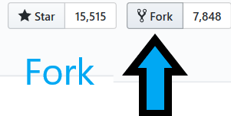
Initial Dev Setup
Setting Up a Metasploit Development Environment
https://r-7.co/MSF-DEV
Notes:
Even if you are not going to develop I’d highly recommend installing Metasploit on Ubuntu. Under Kali you actually can’t actually update metasploit until offensive security gives you the go ahead. The official directions for setting up a development environment are awesome, but you have to follow it to the T.

Slide 17
Setup Reminder
Msftidy is a tool that checks and makes sure there are no obvious errors.
git hook needs set for MSFTIDY
Somehow my hook got messed up when I did my second module
This is one of the biggest mistakes I see for newbs (like me)
Notes:
Omgerd don’t forget this, or you will look like a turd.

Slide 18
Git Commands
git clone
Copy your code down to another computer
git checkout -b <branch-name>
Create a branch to make the module & docs in.
Don’t work in Master
git status
Lists current branch, files that have changed and what is being tracked

Slide 19
Always more to git
git add <modules and docs>
Starts tracking files for changes
git commit -m “<change msg>”
Saves the changes locally with a message for what changed

Slide 20
git it done
git rebase -i HEAD~4
# last 4 commits
Interactively get several commits into one
Replace "pick" with "squash" & then exit the text editor
Allows for one unified commit messages
git push origin branch-name
Pushes changes to github
--force will overwrite old on server

Slide 21
Git Flow
You@github
Forked Metasploit Framework
Master
Branch for putting code and docs
Pull Request (PR)
Metasploit Framework Master
Push
Local Dev box
Metasploit Framework from
your Master
RAPID 7
Fetch
ORIGIN
Branch for putting code and docs
Notes:
You hang out on the right of this until you are ready to incorporate your code into Metasploit.

Slide 22
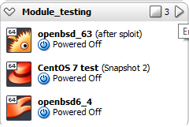
TEST, TEST, [
reload <module_name> command from within metasploit that will read any changes in the module without restarting msfconsole
reload_all
will reread all modules
Setup targeted VMs, I did a group with set IPs to allow group control
relied heavily on rc scripts to save time after system resets.
Notes:
The VM methods were born from my using my laptop and needing multiple OSes. I needed a way to get quick sessions and test.

Slide 23
An Example RC my centos.rc
# First get a session
use auxiliary/scanner/ssh/ssh_login
setg lhost 172.30.0.2
setg rhosts 172.30.0.60
set username root
set password Here2T3stSomeStuff
exploit
# load module to test / set initial options
use exploit/linux/local/yum_package_manager_persistence
set session 1
set verbose true
Then Launch with
./msfconsole -r centos.rc
Notes:
RC scripts are cool.

Slide 24
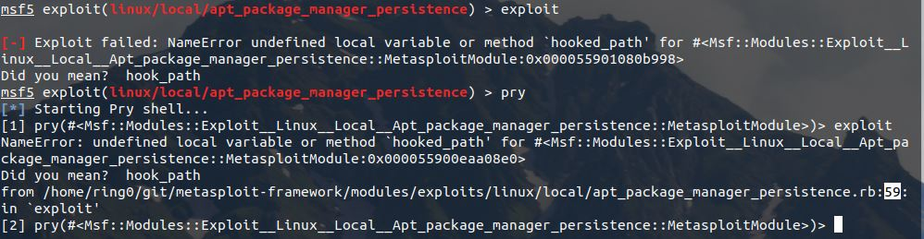
If Something is broke
Pry - built in debugger, to the rescue !
Notes:
A built in debugger that can point the way to your bugs. In the image it shows the exact line with pry.

Slide 25

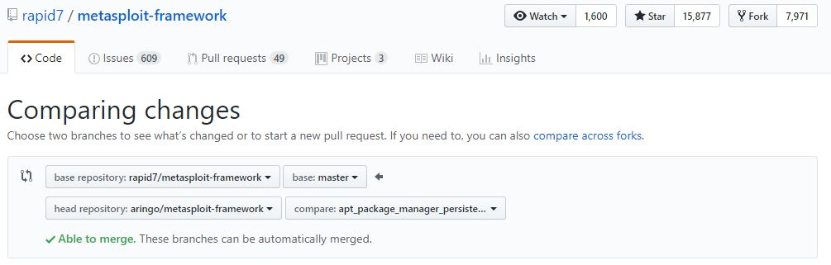
The PR (Pull request)

Slide 26

The PR (Pull request)
Document how to test
All files should be in branch
Wait for feedback - popular exploits / common operating systems seem to get tested quicker
Keep the Faith !
Notes:
Be patient, it’s worth it.

Slide 27
Thanks Rapid7 for making this such a great learning experience and Nolacon for having me.

