Slide 1


Machine Learning Hackathon
Team Name- Team Albatross
Team Leader Name- Arin Jain
Team Leader Email Address- arinjain789@gmail.com

Slide 2
Brief Description of the Problem at hand:
Given data set contain valuable information such as browser details, IP addresses, geographic locations, search patterns, site urls, and other relevant data. The objective of the hackathon is to build a robust model that can accurately predict whether a user belongs to the HCP category and its specialization id/taxonomy.

Slide 3
Solution proposed and description:
So we have to tell whether the given person is Healthcare Professional or not. If yes, then we have to tell its taxonomy(specialization).
I separately make neural network for checking given person is Healthcare Professional or not.
Then I use another model to predict taxonomy.

Slide 4
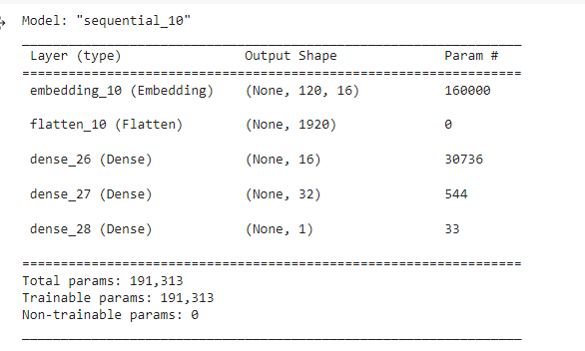
Approach:
For Healthcare Professional classification
I first fall tokenized the keyword column in data set and done padding of it and then fetch it into my Neural Network.
I make neural network with 5-Layers.Here are its detail

Slide 5
Approach:
For Taxonomy Prediction
Same as in case of Healthcare Professional classification.
I first fall tokenized the keyword and taxonomy column in data set and done padding of it and then fetch the data of only Healthcare Professional into the model.
I use XGBOOST Regressor from sklearn library for predicting Taxonomy.

Slide 6
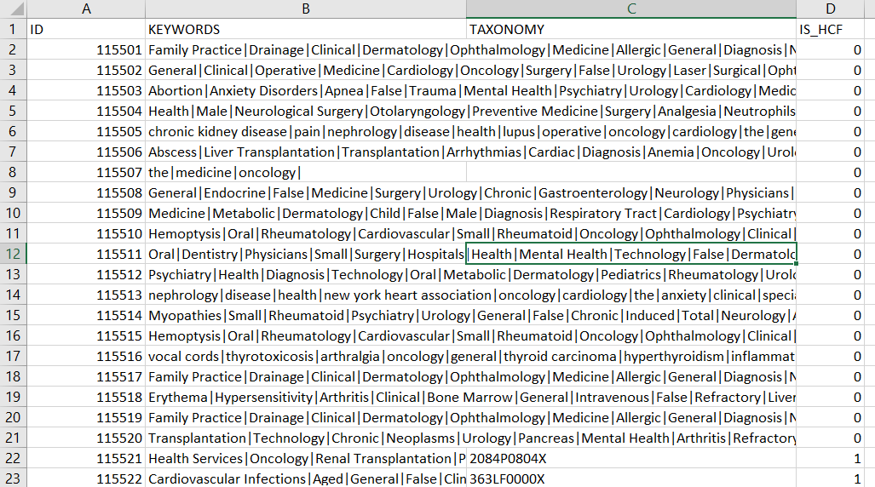
Execution Demo (Video/ Screenshots) of the solution:

Slide 7
Source code in ZIP file/Github URL:
https://github.com/arinjain373/Docerecc_ML_Hackathon/blob/main/DOCEREE_ML_Hackathon.ipynb

Slide 8
Additional comments (optional):
Overall it is nice experience to work with given data set. Learn lot thing during a hackathon. The most challenging part of this hackathon is processing the data.
THANK YOU for the Opportunity

Slide 9
THANK YOU!

