Slide 1
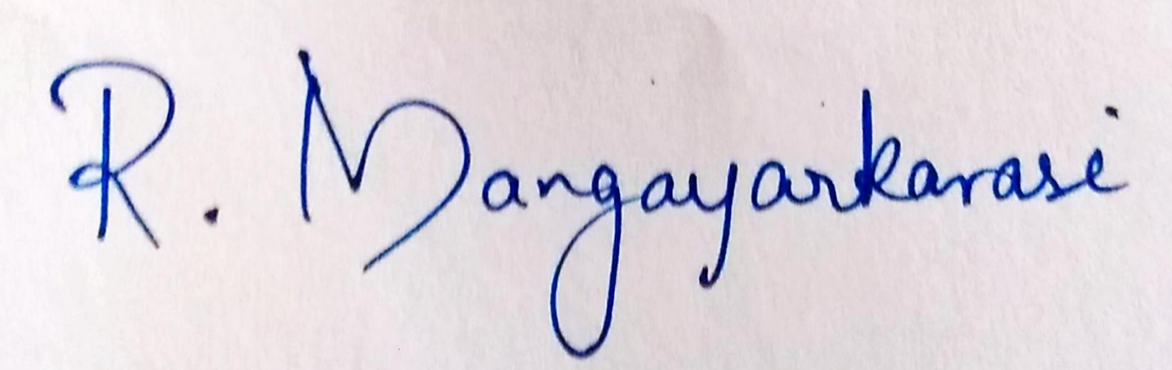
FINAL REVIEW PRESENTATION
ARINJAY JAIN 16BIT0059 GUIDE: MANGAYARKARASI R

Slide 2
Music Similarity Checker

Slide 3
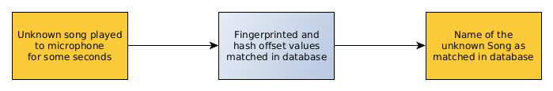
INTRODUCTION
What does it do?
Takes unknown song as an input through the microphone.
Returns the name of the song after matching in the database as the output.

Slide 4
MOTIVATION
The need for it:
It is useful to identify songs that someone hears in a movie, or in some other form of media but does not know the name or artist.
This project will be able to hear it alone with dialogue or other small noises and identify the name of the song by matching it with the database.
While not as accurate as matching original song recording, it is possible for new music creators to use the program to find out how much of their music matches to an existing song.

Slide 5
Related Work
Takahiro Hayashi et al. researched on Fast Music Information Retrieval with Indirect Matching.
Detailed their approach as small number of music clips called “representative queries”
These were randomly selected from a database for fast computation
The similarities of each clip in the database is recorded in a similarity table.
The similarity of a clip in the database and the input by user are quickly estimated before referring to the similarity table.
In 2003, Wang Avery published a paper on An Industrial Strength Audio Search Algorithm
It processed audio files and stored their hash tokens of the song in a database.

Slide 6
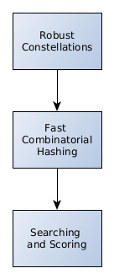
Related Work
It had 3 basic steps as shown:
For heavy noise filled inputs, the time for each query output was few 100 of milliseconds
For clean input, less than 10ms for each query

Slide 7
PROPOSED SYSTEM
In the proposed system, there will be a “fingerprint” created for every song that is stored in the database.
For each song in the database, fingerprint will be created by combining the hash values of peaks found in the spectrogram
The fingerprint value along with its offset is then stored in the database

Slide 8
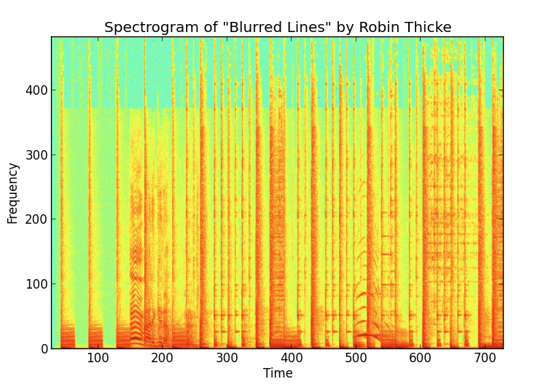
Spectrogram - Plot of amplitude as a function of time and frequency

Slide 9
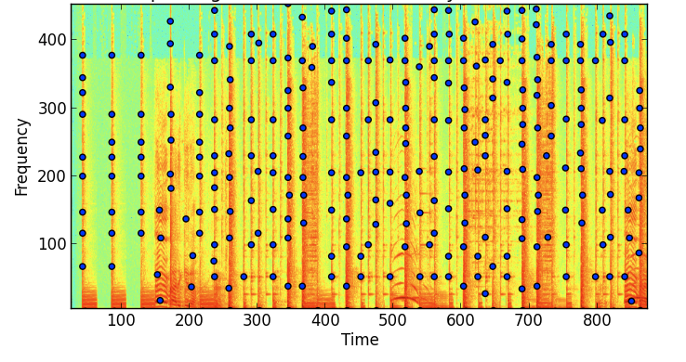
Peaks of the spectrogram that will be combined to make a fingerprint.

Slide 10
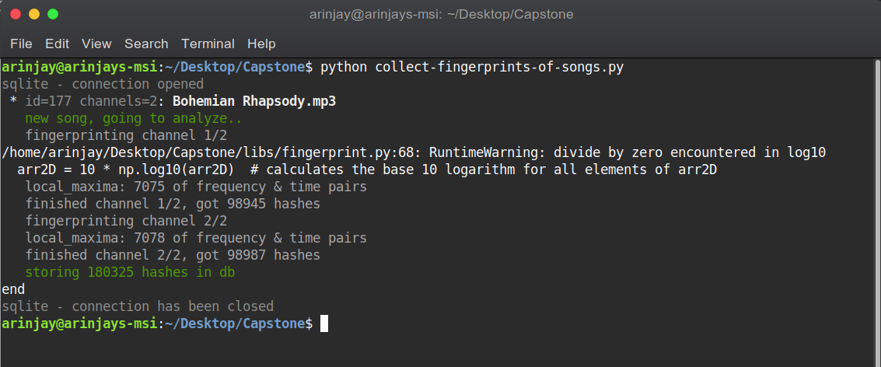
Inserting the song into the database after fingerprints are created in both mono and stereo channels

Slide 11
PROPOSED SYSTEM
After the database is created, input audio is required.
The input audio is played from the microphone and recorded through the terminal for the number of seconds required.
The input audio is then fingerprinted, and its values are matched with the existing database.

Slide 12
PROPOSED SYSTEM
For the matched hash values, time offset difference is calculated.
Match with constant offset differences with input signal is selected as the correct output and the name of the song is then displayed as the output along with the confidence of it being a correct match.

Slide 13
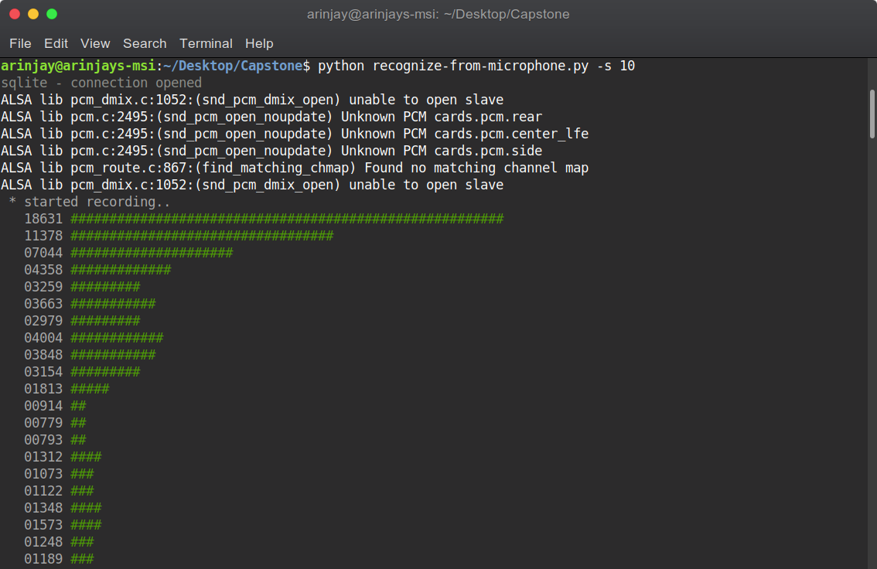
Input audio being heard for 10 seconds from the microphone

Slide 14
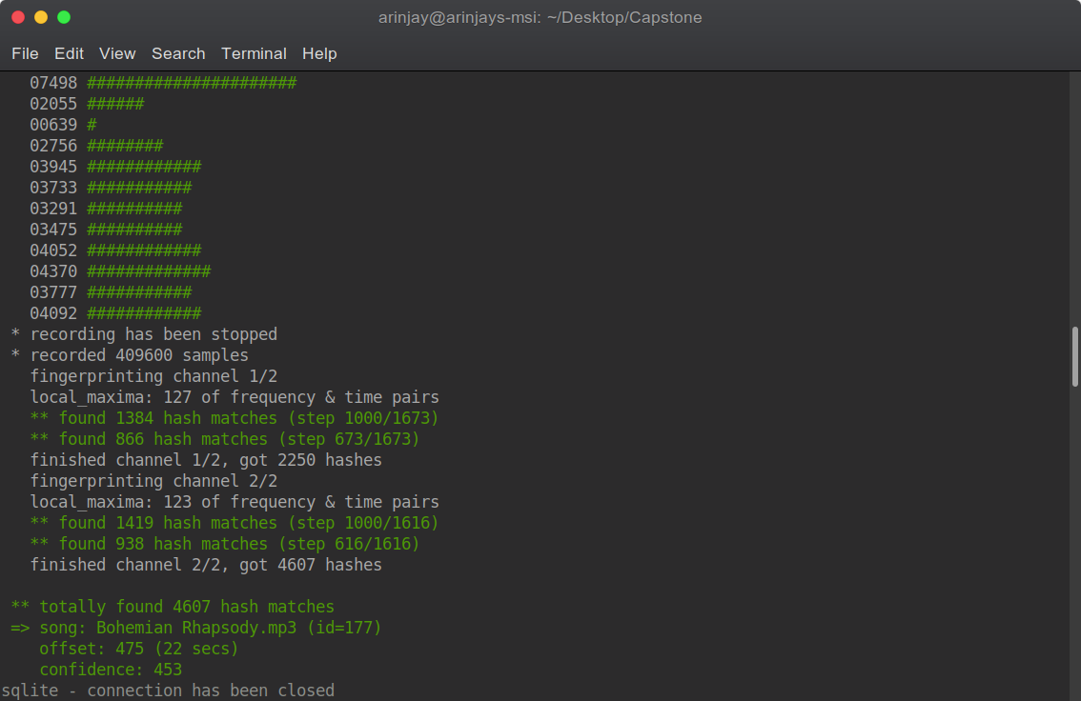
Fingerprints matched and time offset differences calculated for the match, output of song name “Bohemian Rhapsody” along with confidence is printed.

Slide 15
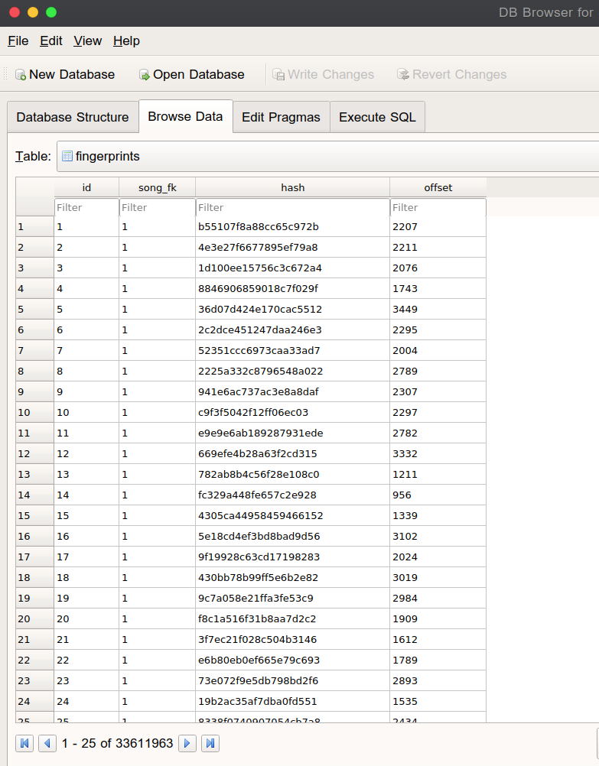
MODULES
Creating Database and Storing Values
SQLite databases is created with songs and fingerprints table
Songs are stored in a directory as .mp3 files
All of them are fingerprinted and added to songs (name and file hash) and fingerprints (hashed value of fingerprint, song id and offset value) table.

Slide 16
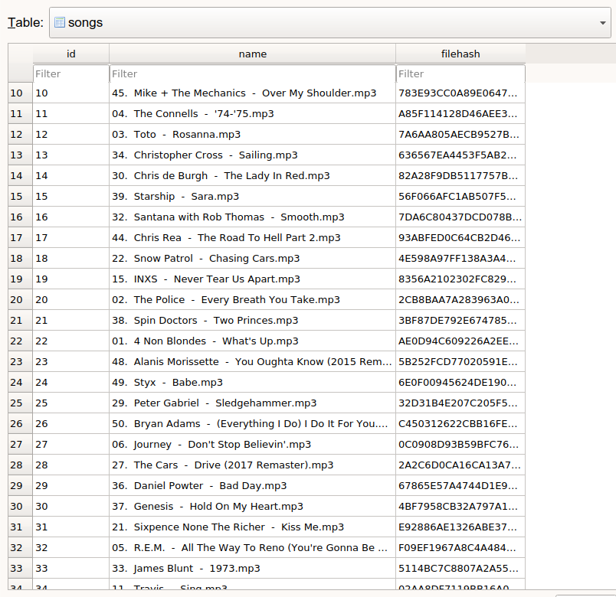
2. Fingerprinting Songs
Apply DFT to small time windows to create a spectrogram
Find the maximum value of amplitude and Mark the (frequency, time) point as a peak
Combine colliding peaks to form a fingerprint, along with its time offset value

Slide 17
3. Matching input audio with a song in database
Input audio wave is also fingerprinted
All the hashed fingerprint values are then matched with the database to find matches.
Time offset difference is calculated for each pair.
Database match which has constant offset difference with input audio wave is selected as the correct match and identified as the unknown entry song.

Slide 18
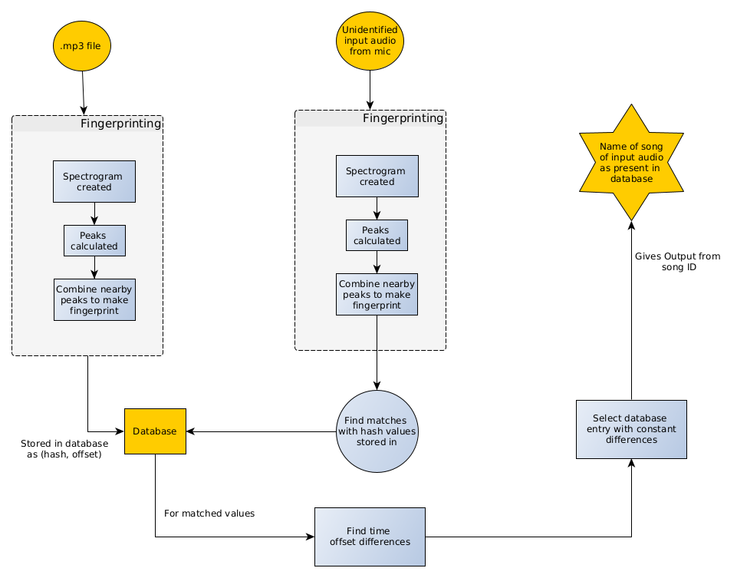
Algorithm

Slide 19
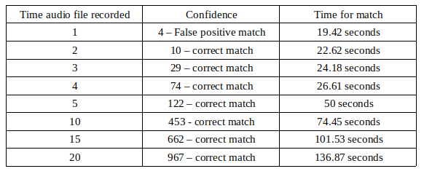
RESULT
It was noted that for a good confidence of a match atleast a minimum of 5 seconds of input audio had to be listened to by the program to generate sufficient fingerprints

Slide 20
It was also seen that the longer input audio file was listened to by the program, the longer it took to find a match in the database, but it was a much higher confidence match.
Accuracy of matches with regard to how long the input audio was listened to was also tested. Results showed that longer the time audio was listened to, higher the accuracy of matches and correct output.

Slide 21
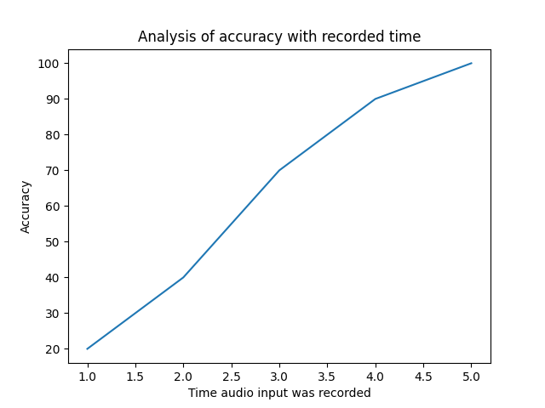
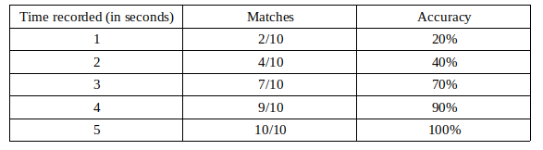

Slide 22
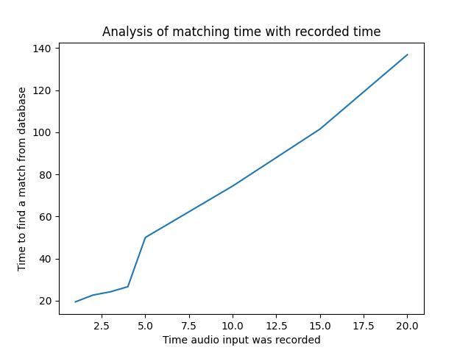
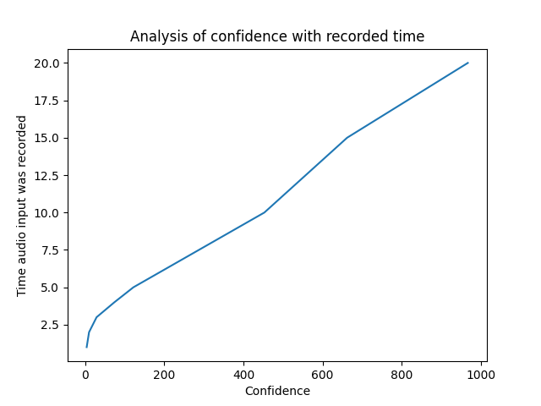

Slide 23
CONCLUSION
An argument is passed when the program is run instructing how long the audio file should be listened to.
From testing, a minimum of 5 seconds was needed to be listened to get an accuracy that was near 100%.
The confidence level with 5 seconds of listening was also high enough to classify it as a correct match and not a false positive.

Slide 24
FUTURE SCOPE
Some extra functionalities and classification can be added to the project such as:
Language Detection of Song
Genre Classification
Faster Retrieval and matching time
Cloud database for on the go matching

Slide 25
THE END

