Slide 1
UPI Transaction Analysis
Senior Data Analytics Capstone

Slide 2
Business Questions
Monitor transaction performance and failures.
Identify high-risk customers, devices and merchants.
Measure fraud-control effectiveness and customer experience.
Translate analytics into prioritized business actions.

Slide 3
Data & Architecture
7 relational tables | 100,000 transactions | 10,000 customers | 500 merchants.
Validation covers keys, nulls, categorical values and temporal consistency.
Workflow: Excel → SQL → Python/Statistics → Power BI.

Slide 4
Executive KPI Baseline
GMV INR 4,241,774 | Avg transaction INR 42.42
Success {success:.2%} | Failure {failure:.2%} | Fraud {fraud:.2%} | Reversal {reversal:.2%}
Satisfaction {fb.satisfaction_score.mean():.2f}/5 | Alert resolution {fa.resolved.mean():.2%}

Slide 5
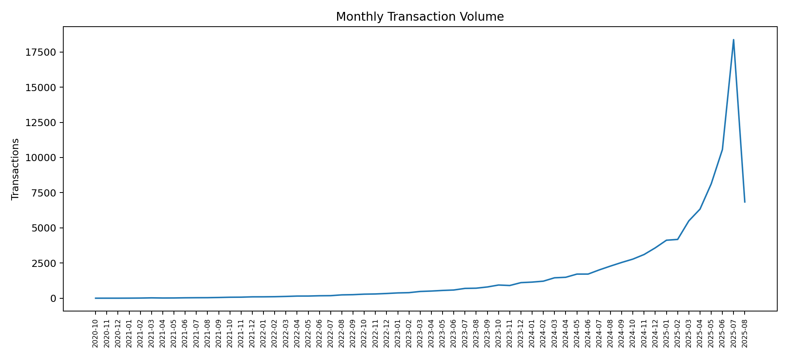
Monthly Transaction Volume

Slide 6
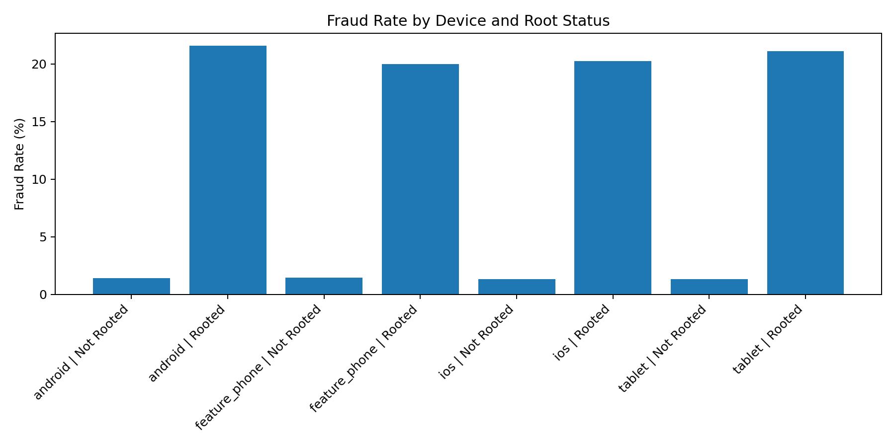
Fraud Risk — Rooted Devices

Slide 7
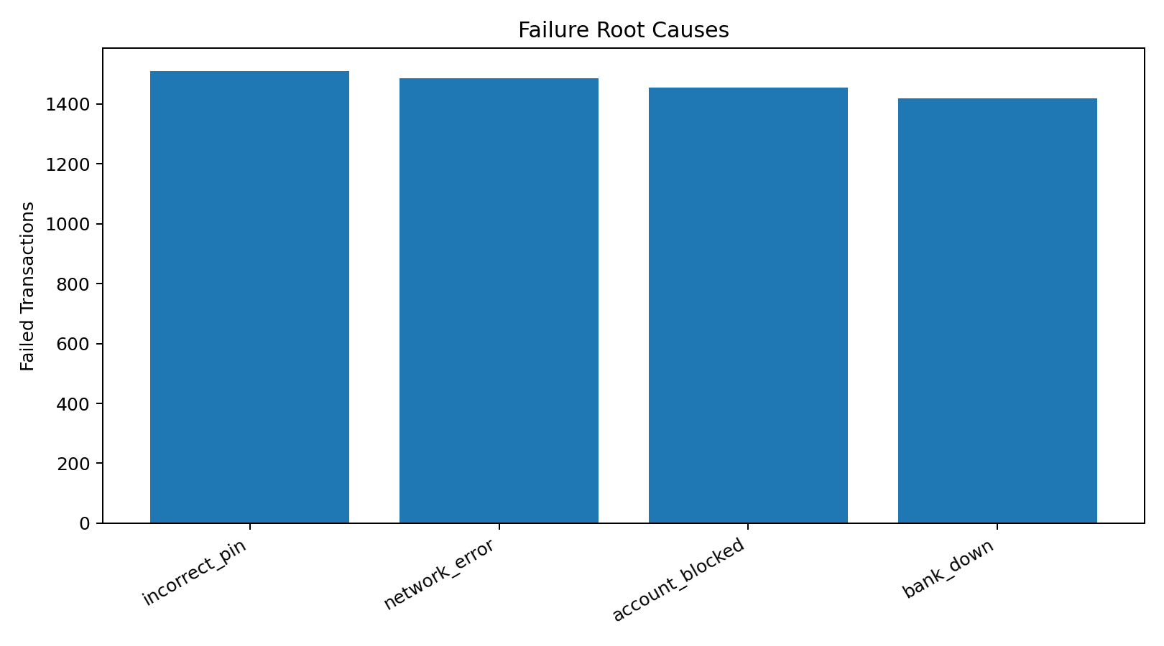
Failure Root Causes

Slide 8
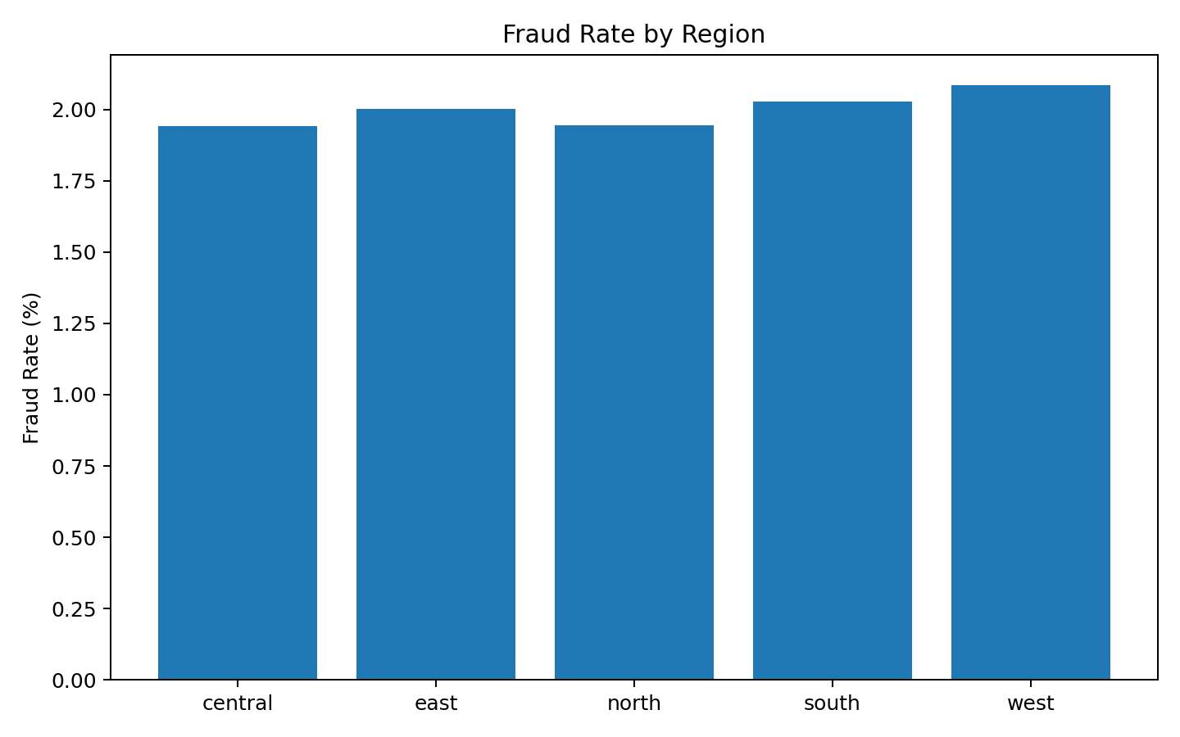
Regional Fraud Rate

Slide 9
Key Insights
Rooted-device fraud is 20.69% vs 1.39% — the clearest risk signal.
The rooted-device difference is statistically significant (p < 0.001).
Channel, device/status and merchant-type tests are not significant at 5%.
Failure analysis points to incorrect PIN and connectivity/bank issues as key operational levers.

Slide 10
Recommendations
Deploy device-integrity controls and step-up authentication.
Improve bank/network failure handling and customer retry guidance.
Introduce fraud-alert ageing/SLA monitoring.
Use Power BI drill-through for customer/device/merchant investigations.
Resolve source-system temporal/data-quality issues before production use.

