Slide 1


Laptop Price Prediction Using Various Regression Models
By Arindam Phatowali
Scholar ID- 214104021
Under the guidance of Dr. Amit Bhagat

Slide 2

INTRODUCTION
The project aims to predict laptop prices based on various features using regression models. The problem statement is that if any user wants to buy a laptop, then our application should be compatible to provide a tentative price of laptop according to the user configurations.

Slide 3
INTRODUCTION
PROBLEM STATEMENT:
Our project aims to predict laptop prices based on user input.
The problem we are addressing is that there are many different combinations of configurations that can be done, so if people want to buy a new laptop, then our model should have all the prices sorted by their configuration.

Slide 4
OBJECTIVE OF THE PROJECT:
Data Analysis & Visualization: To analyse a dataset of laptop specifications and their corresponding prices with the help of graphs, understanding the relationship between different features and how they influence the price.
Model Development: To develop a regression model that can accurately predict the price of a laptop based on its specifications.

Slide 5
OBJECTIVE OF THE PROJECT:
Model Evaluation: To evaluate the performance of the model using appropriate metrics and ensure it can make accurate predictions.
Business Application: To provide a tool that can be used by businesses for pricing their products, and by consumers to make informed purchasing decisions.

Slide 6
PROCESS:
The process of the project involves 7 major steps:
Data collection
Data pre-processing
Exploratory Data Analysis (EDA) and Feature Engineering
Model Building
Model Evaluation
Model Selection

Slide 7

Data Collection
The data for this project is collected from Kaggle. The dataset includes features such as the brand, screen size, processor type, RAM, storage type and size, graphics card, and more.

Slide 8

Data Preprocessing
The collected data is preprocessed to handle missing values, outliers, and categorical variables. For example- changes were made in weight and RAM column to convert them to numeric by removing the unit written after value.

Slide 9

Exploratory Data Analysis (EDA)
EDA is performed to understand the data better. This includes visualizing the distribution of different features and their relationship with the laptop price.

Slide 10
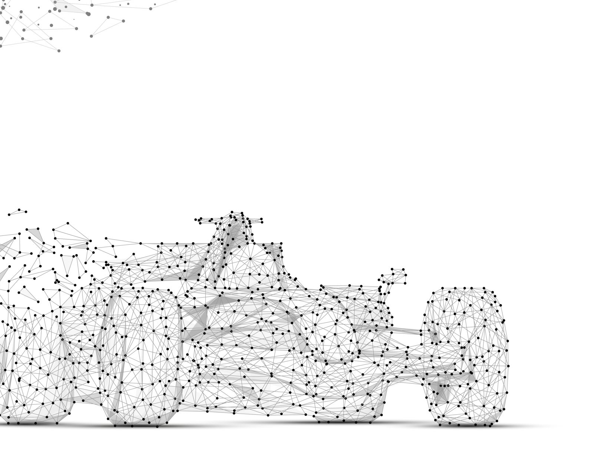
Feature Engineering
Feature engineering is a process to convert raw data to meaningful information. Feature engineering involves creation of new features based on existing ones and to select the most relevant features to improve the model’s performance.

Slide 11

Model Building
Various regression models are trained on the preprocessed data to find the best algorithm with highest accuracy. This includes linear regression, KNN regression, decision tree regression, and random forest regression.

Slide 12
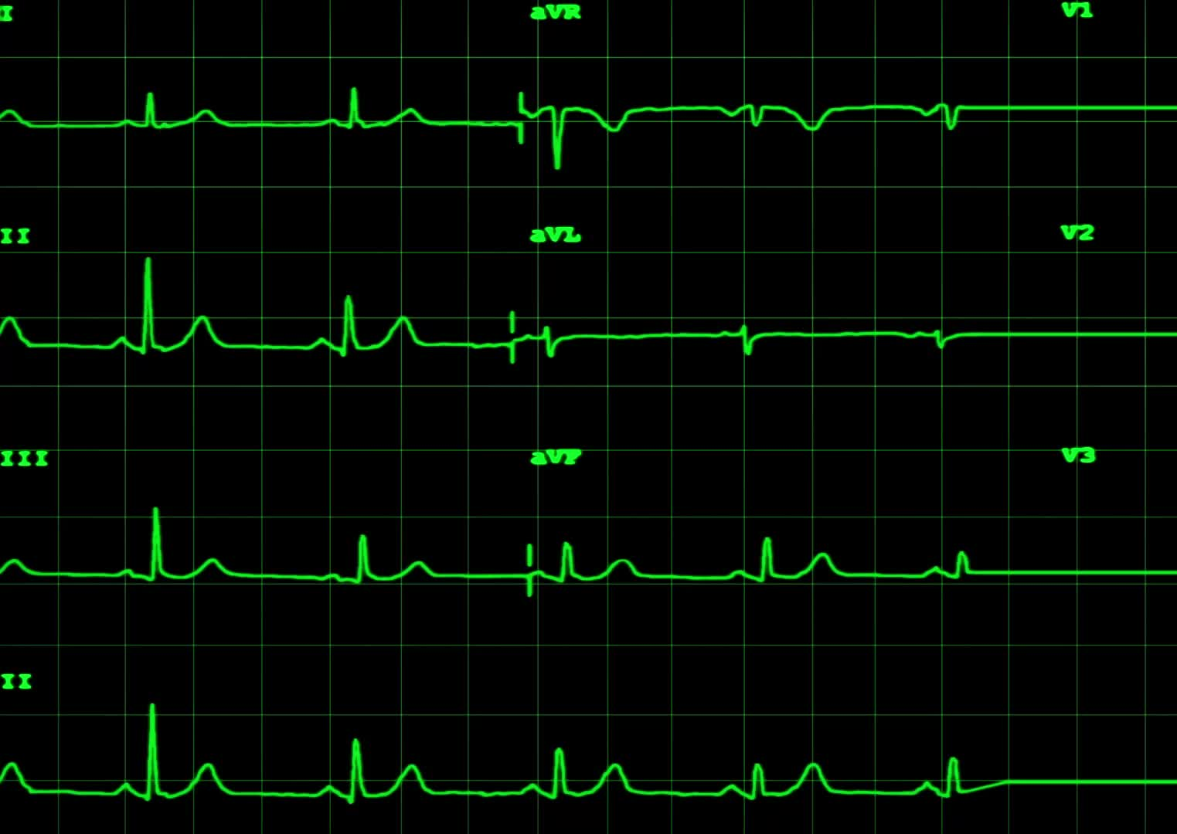
Model Evaluation
The performance of the models is evaluated using metrics such as Mean Absolute Error (MAE) and R-squared.

Slide 13

Model Selection and Deployment
The top three model with the best performance is selected and a voting regressor is used that fits the three regressors, each on the whole dataset and then averages the individual predictions to form a final prediction.

Slide 14
Conclusion
This project provides valuable insights into the factors that influence laptop prices and can be used to make informed decisions when buying a laptop.

Slide 15
THANK YOU

