Slide 1


OpenWERX Challenge

Slide 2
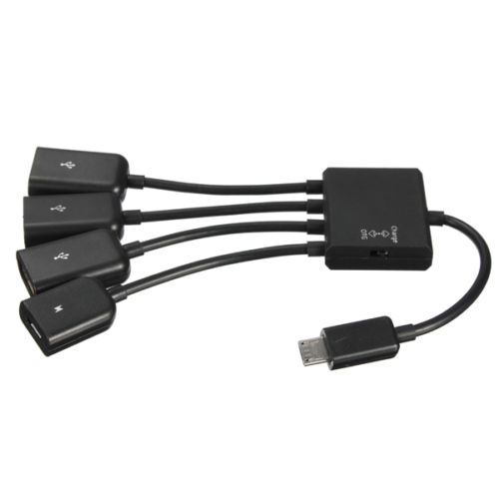
Hardware
Samsung Galaxy Tab
Suggested: OTG 4 Port Micro USB Host Hub (charge or data transfer)
Suggested: USB Software to Device Receiver (SDR)
Suggested: Infrared Camera FLIR DUO (or similar)
See objects over 100 yards away
In complete darkness
In Smoke
In Fog

Slide 3
Software
Android 5.1
Unity 3D: Platform for Development
Simulated AIS Data
Suggested: Direct Feed of Long Range Infrared Camera Data Point Correlation

Slide 4
Approach
Map View & Augmented Reality View for Greater Spatial Context
Quick Toggle to Change Between Map & AR Views
Toggle Light/Dark Mode in both Map and AR Views
Stacking Known Data Greater than 100 Nautical Miles from Current Position in AR View

Slide 5
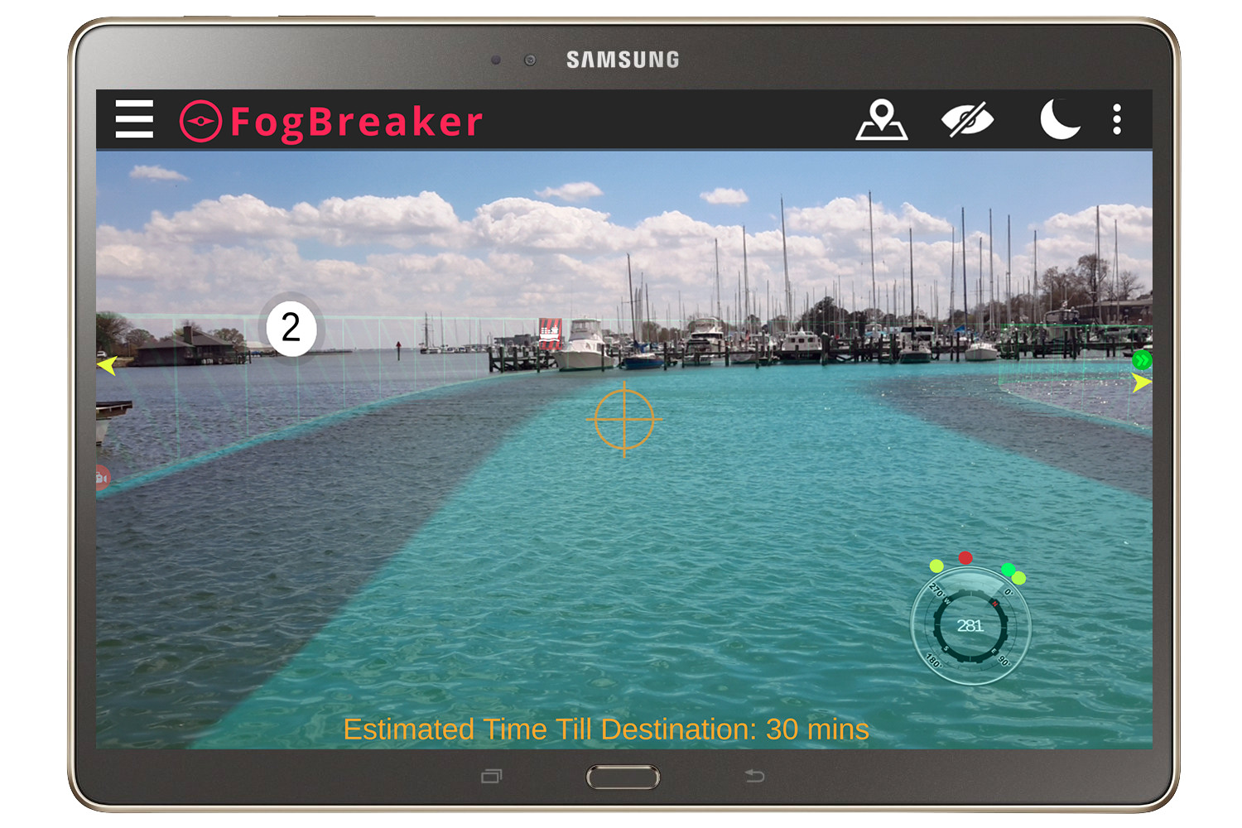
Design
Navigation

Slide 6
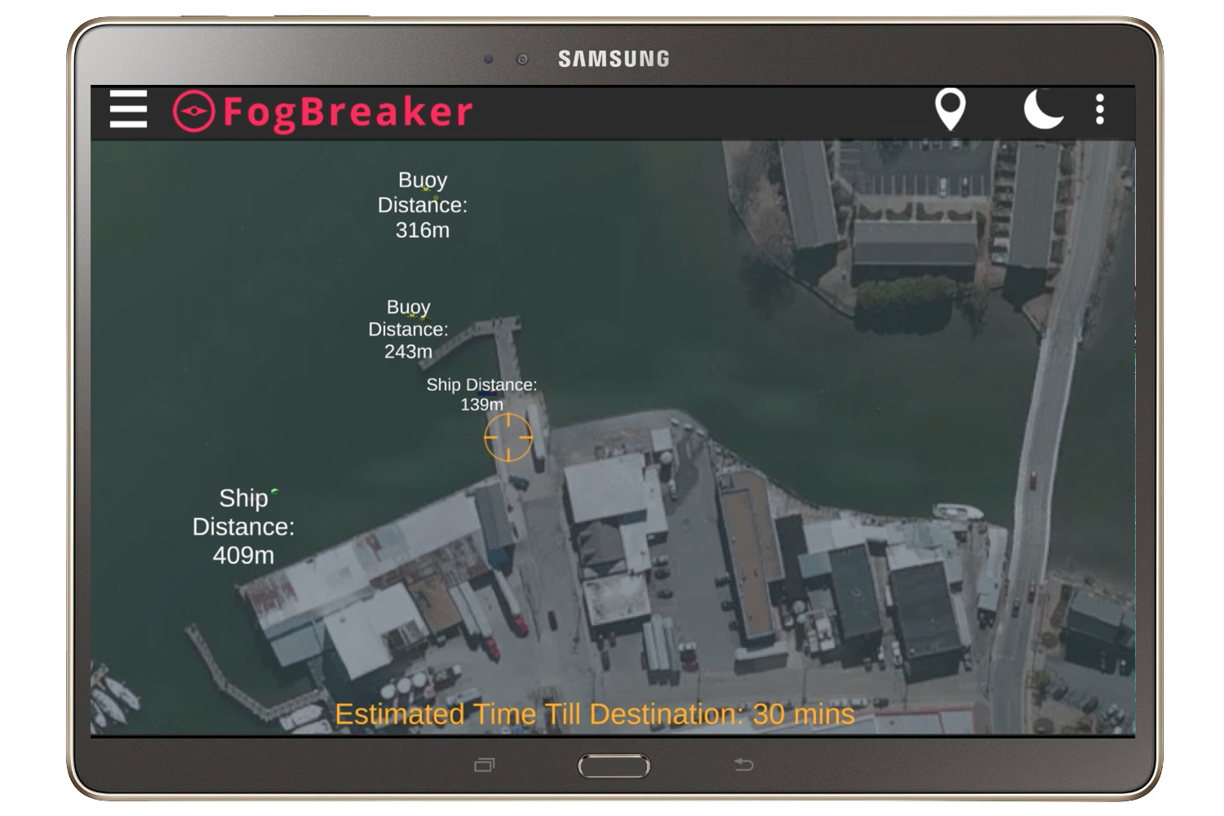
Design
Map View

Slide 7
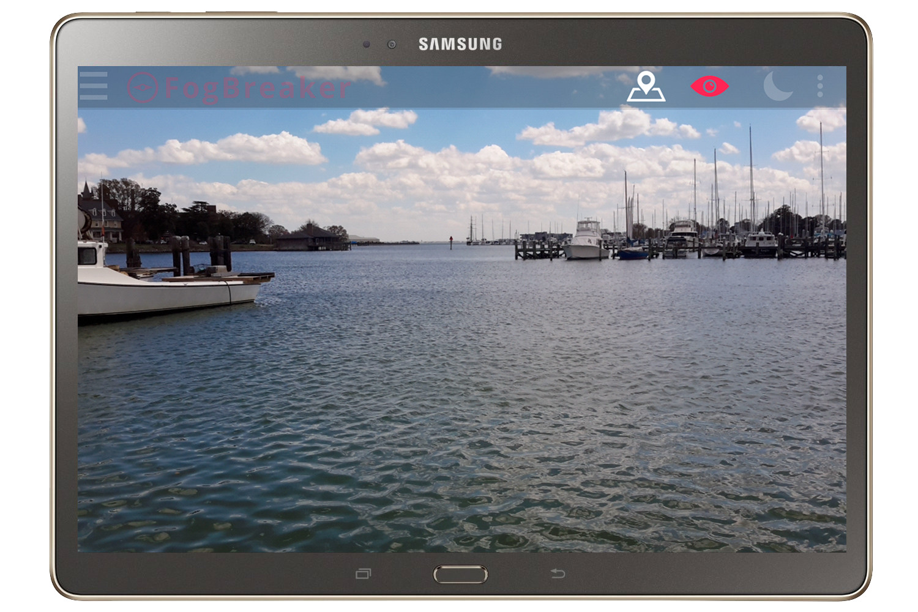
Design
Viz Mute

Slide 8
Demo of In-Device Use
Download Video here: https://vimeo.com/211557803

Slide 9
GitHub
https://github.com/ario-llc/Fogbreaker

