Slide 1

Traffic Lights Decider
Denis Shapira
Igor Krol

Slide 2
Project Goals
Lowering traffic jams by improving traffic lights distribution

Slide 3
Project Description
Traffic lights distribution algorithm based on density for real-time use in any junction.
Algorithm based on scheduling algorithm ‘Simulated Annealing’
Traffic simulation with Unity to visualize the results

Slide 4
Responsibilities
Denis Shapira: Unity part – Simulation and Design
Igor Krol: Algorithm, Calculations and adaptation

Slide 5
Git Repository
https://github.com/aripash/TLD.git

Slide 6
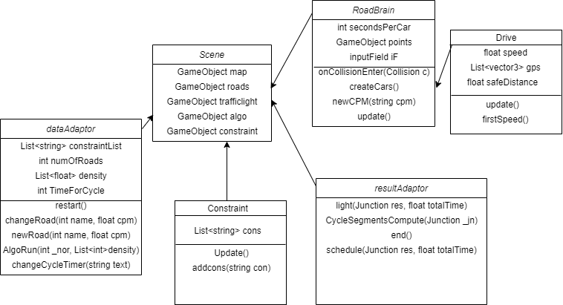
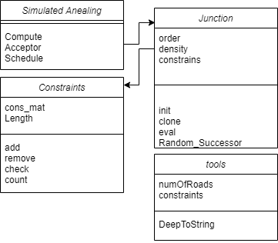
Diagrams
Unity
Algorithm

Slide 7
Insights
Unity Engine has convoluted design that makes a lot of problems.
Theoretical algorithms may have different results in practical use based on environment.
Time management: 30% creating code, 70% bug fixing.

Slide 8
Summary: What we learned
Working with Unity
New language: c#
Graphical design
Agile
Teamwork
Hybrid Algorithms
Object Oriented Programming

Slide 9
Summary: The future
Improvement to the algorithm: more aggressive changes, improve results adaption.
Bigger simulation: more junctions in a single map, more complexity.
Solving entire road systems

