Slide 1
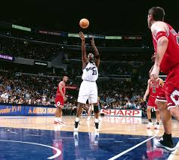
NBA Proposal: One Point, One Shot
Sports Analytics Group at Berkeley
Aaron Pickar, Derek Topper, Cong Chen, Jason Shan

Slide 2
Proposed rule changes
Can the process of shooting free throws be improved?
Replacing two free throws on a shooting foul with one automatic point and one free throw.
A three point shooting foul would become two points and one free throw.
In the last two minutes of the game, the intentional off-ball foul would remain one shot and possession for the fouled team.
Precedent for giving a team points is already established with Goaltending rule.
2
2

Slide 3
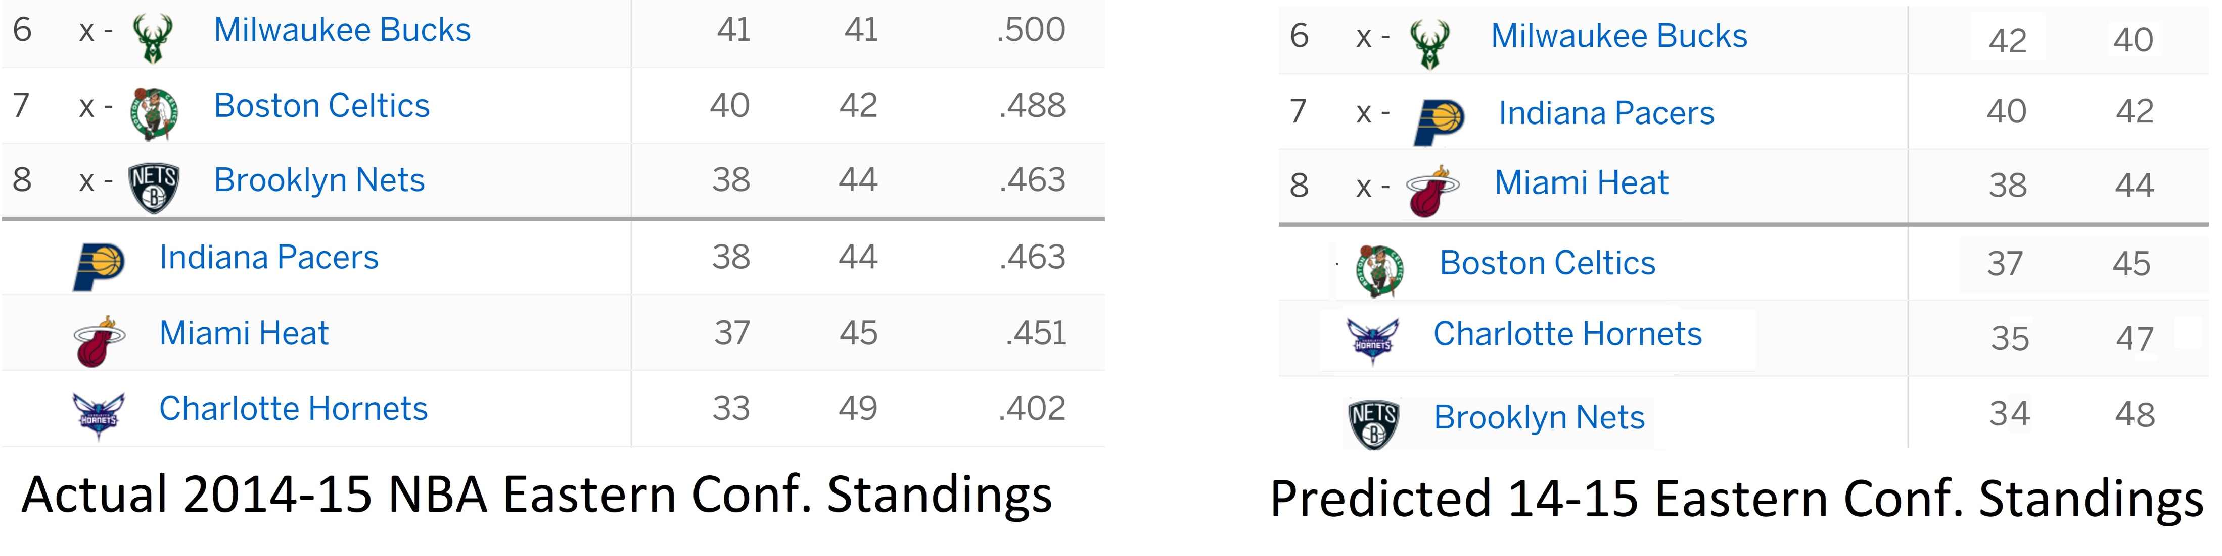
Effect On Scoring of Past Games
Changes in individual game scoring led to changes in playoff teams
If we replaced the current foul rules with our proposal for the last 10 seasons, the average team would have had a difference in wins of 1.31 games per season, with a variance of 1.68 wins per season.
For instance, we can see the change in the 2014-2015 Eastern Conference Standings:
3
3

Slide 4
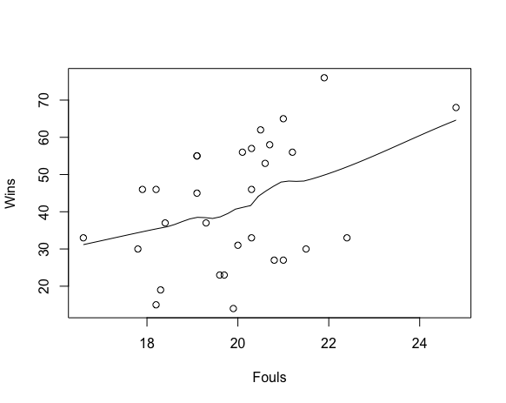
Game Theory Model
Defensive Tendencies: A Value Minimization Game
Assuming the defense has perfect knowledge of the game situation and player positioning, if the offense was approaching a shot, what would the defense do about it?
Given the prior knowledge of the expected points for both fouling and not, teams will minimize the opponent’s score, which means that each play can be simulated as a decision tree.
As a result of this simulation, teams will be heavily incentivized to not foul, the analysis demonstrates the fact that there exists a moderately strong correlation between fouls committed per game and wins.
4
4

Slide 5
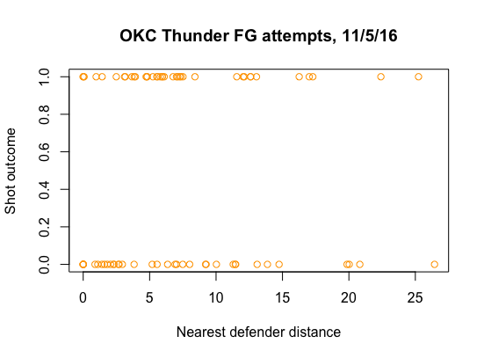
Effect on Defensive Positioning
Disincentivizing fouling leads to an increase in scoring.
We observed that the average distance to nearest defender is higher on made field goals than misses.
The new foul rules would force the defender to play further away from a shooter who is, for example, pulling up for a mid-range jumper or three-pointer, and increase the expected value of the shot.
As teams take fewer free throws and more 3-pointers of higher percentage, we can expect scoring to continue to go up.
5
5

Slide 6
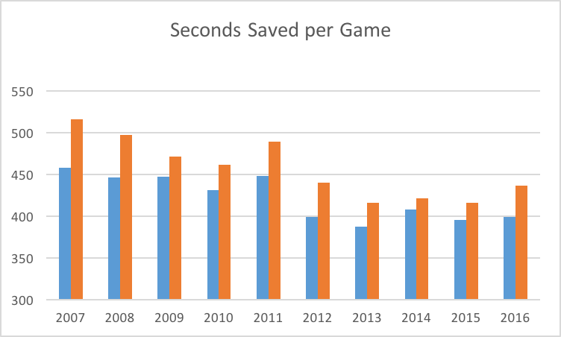
Unexpected Consequences
Will lead to shorter games, fewer injuries
Average Game time would shorten by 422 seconds (7 minutes and 2 seconds), and average playoff game will shorten by 452 seconds (7 minutes and 32 seconds) just from less time spent on free throws.
Based on “Preventing in-game injuries for NBA players” by Takulder et al., as well as recent injuries to NBA stars Kawhi Leonard and Kevin Love, it is apparent that increased fouling has an effect on injuries and our method would cut the number of fouls by disincentivising them.
6
6

