Slide 1

Time-series analysis using RStudio
Arip S. Nur
L20583502

Slide 2


Datasets
Daily high level historical data of Edward Aquifer-J17 can be downloaded in : https://www.edwardsaquifer.org/science-maps/aquifer-data/historical-data/
Spring flow at 08168710 Comal Springs at New Braunfels, TX (https://waterdata.usgs.gov/nwis/dv?referred_module=sw&site_no=08168710)
Spring flow at 08170000 San Marcos Springs at San Marcos, TX (https://waterdata.usgs.gov/nwis/dv/?site_no=08170000)

Slide 3
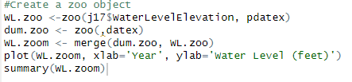
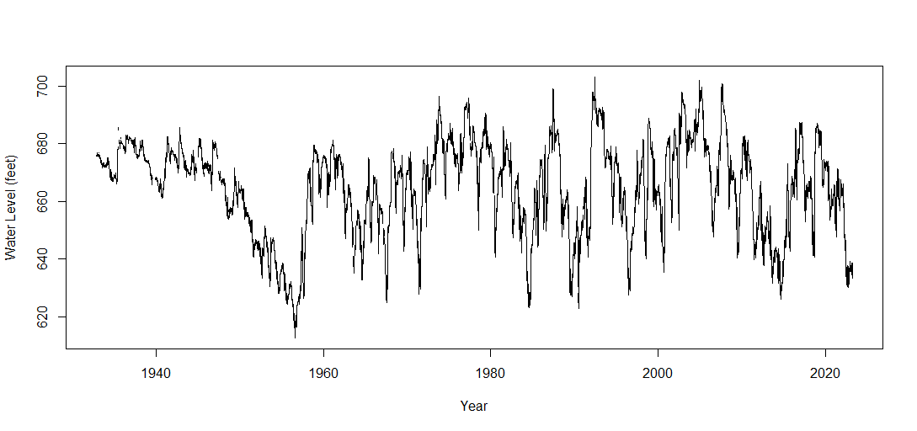
J17 San Antonio
Index WL.zoom
Min. :1932-11-12 Min. : 612.5
1st Qu. :1955-06-20 1st Qu. : 653.7
Median :1978-01-25 Median : 667.5
Mean :1978-01-25 Mean : 664.7
3rd Qu.:2000-09-01 3rd Qu. : 676.5
Max. :2023-04-09 Max. : 703.3
NA's : 801

Slide 4
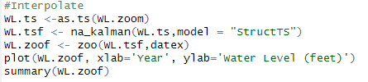

J17 San Antonio
Index WL.zoof
Min. :1932-11-12 Min. : 612.5
1st Qu. :1955-06-20 1st Qu. : 654.0
Median :1978-01-25 Median : 667.6
Mean :1978-01-25 Mean : 664.8
3rd Qu. :2000-09-01 3rd Qu. : 676.5
Max. :2023-04-09 Max. : 703.3

Slide 5

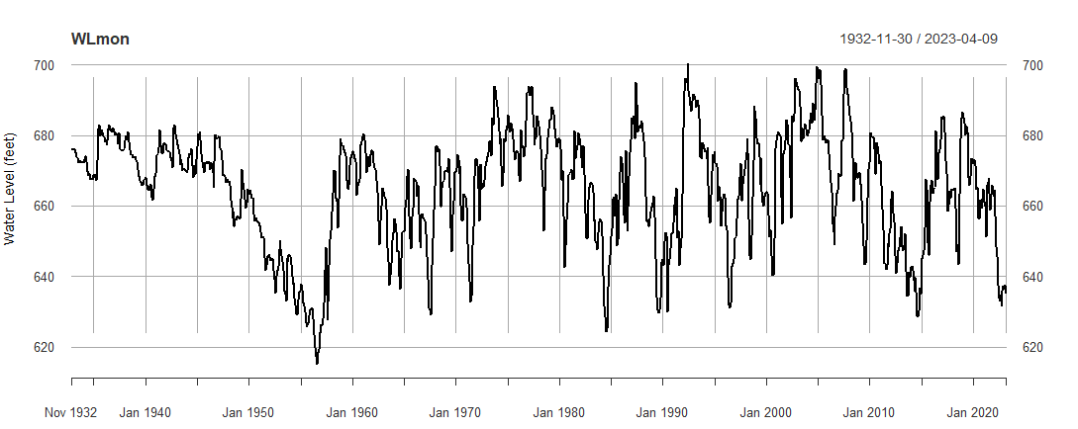

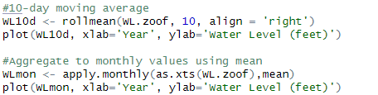
J17 Data Aggregate
Monthly average data
Daily data
10-day moving average

Slide 6
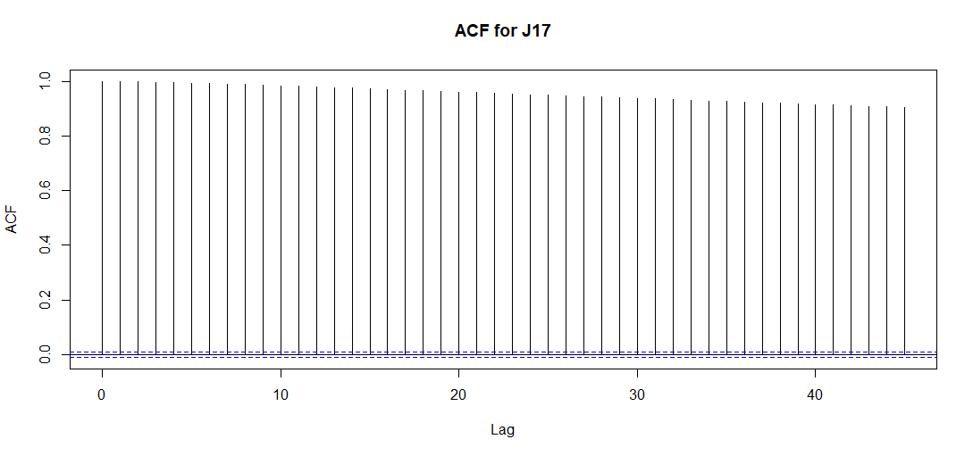
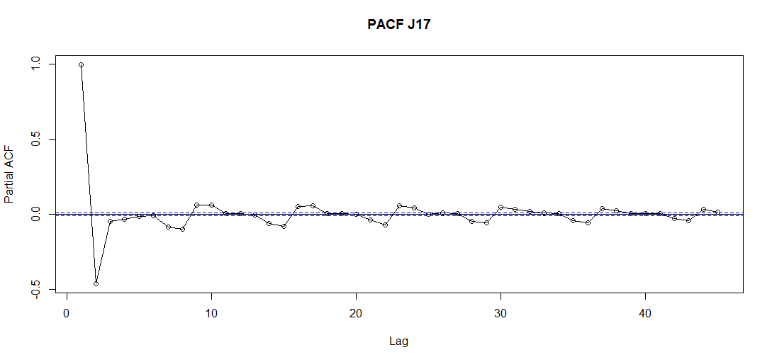
ACF and PACF for J17 data

Slide 7

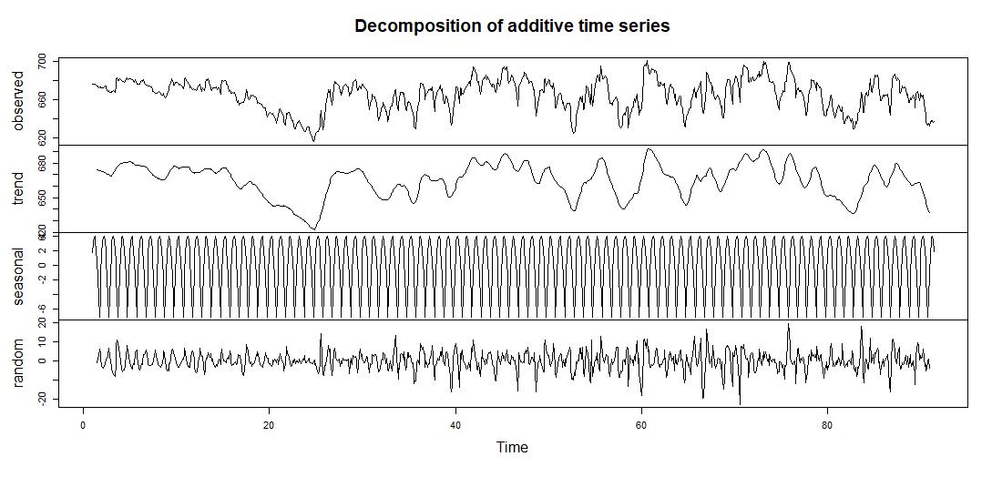
Decompose J17 data

Slide 8
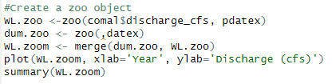
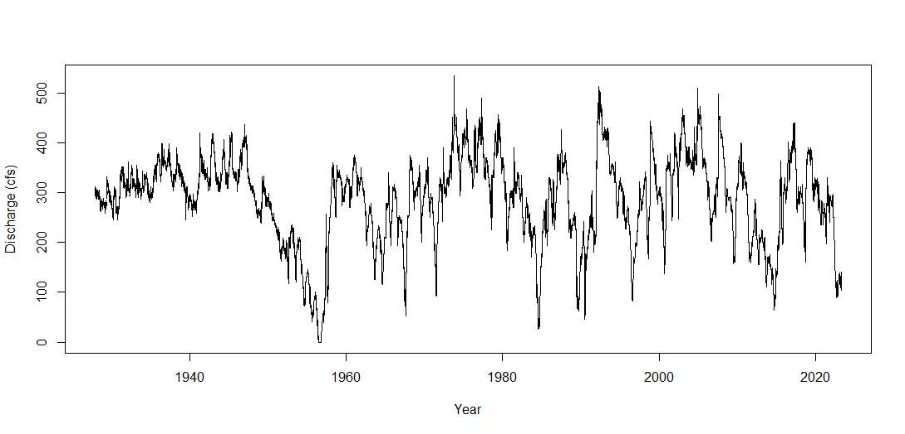
Comal
Index WL.zoom
Min. :1927-12-19 Min. : 0.0
1st Qu. :1951-10-17 1st Qu.:238.0
Median :1975-08-15 Median :299.0
Mean :1975-08-15 Mean :286.1
3rd Qu. :1999-06-13 3rd Qu.:343.0
Max. :2023-04-11 Max. :534.0
NA's :49

Slide 9
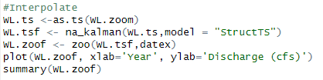
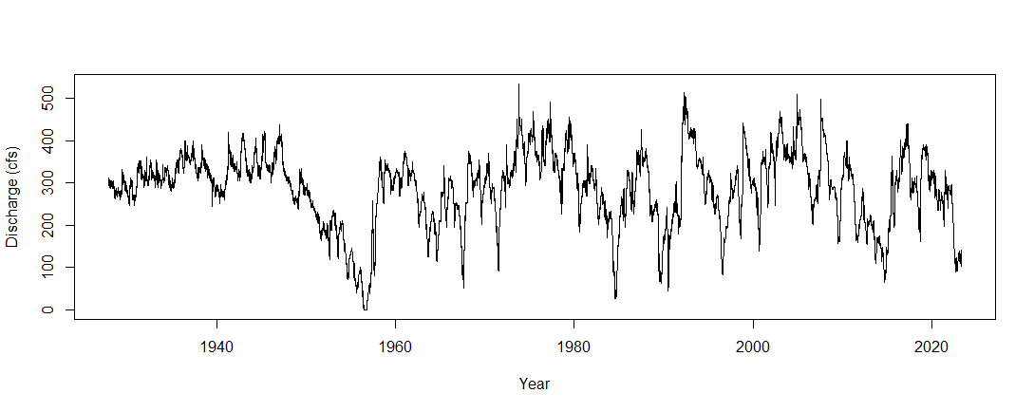
Comal
Index WL.zoof
Min. :1927-12-19 Min. : 0.0
1st Qu. :1951-10-17 1st Qu.:238.0
Median :1975-08-15 Median :299.0
Mean :1975-08-15 Mean :286.2
3rd Qu. :1999-06-13 3rd Qu.:343.0
Max. :2023-04-11 Max. :534.0

Slide 10
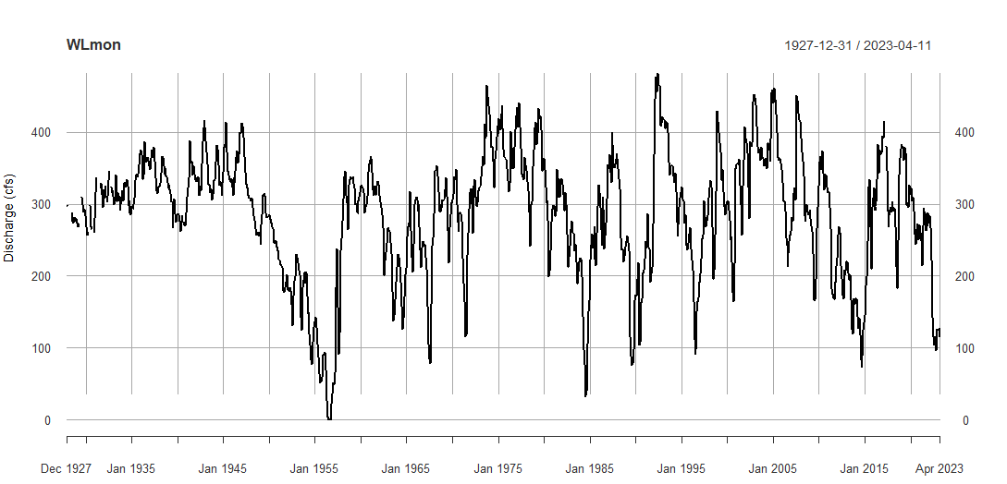
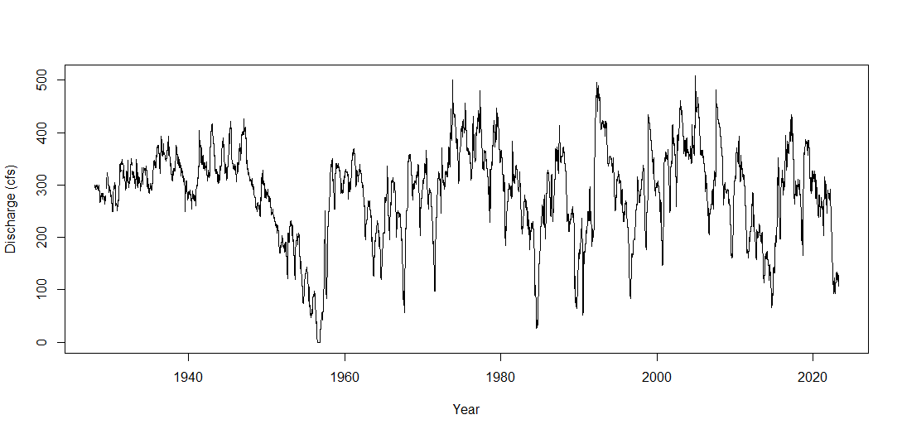
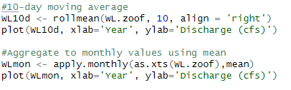
Comal Data Aggregate
Monthly average data
Daily data
10-day moving average

Slide 11
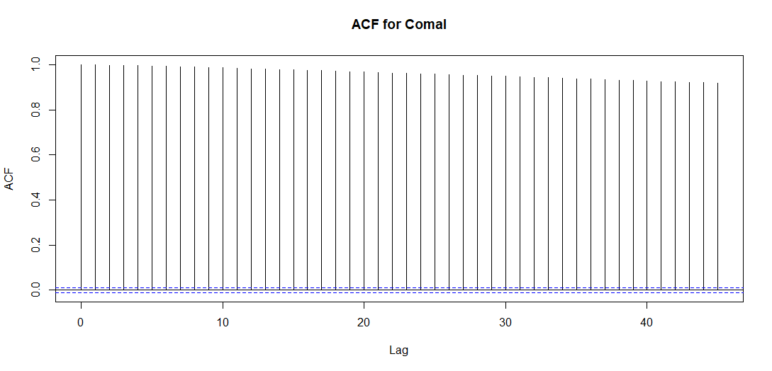

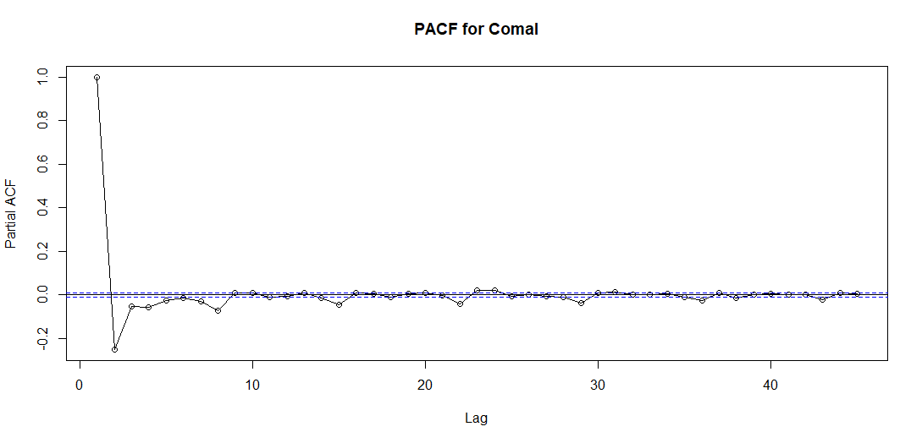
ACF and PACF for Comal data

Slide 12
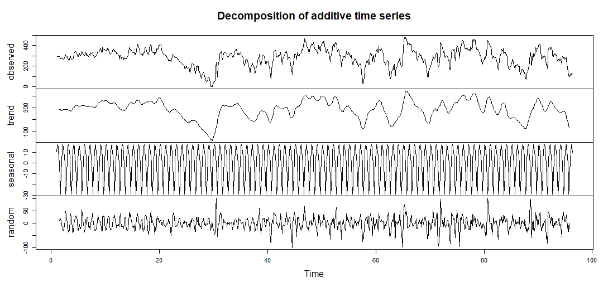
Decompose Comal data

Slide 13
San Marcos
Index WL.zoom
Min. : 1956-05-26 Min. : 46.0
1st Qu. : 1973-02-12 1st Qu. :124.0
Median : 1989-11-01 Median :162.0
Mean : 1989-11-01 Mean :173.7
3rd Qu. : 2006-07-21 3rd Qu. :211.0
Max. : 2023-04-09 Max. :451.0

Slide 14
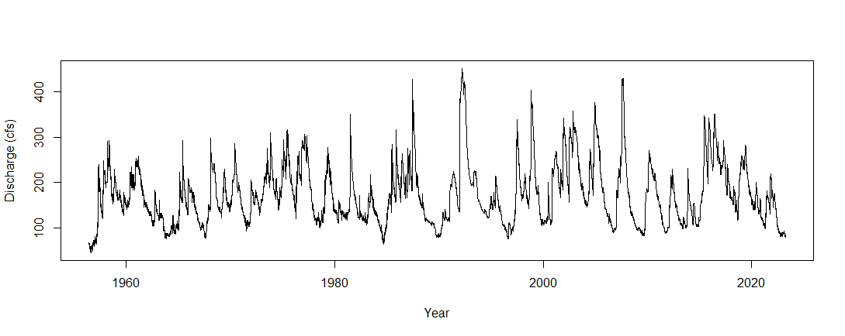
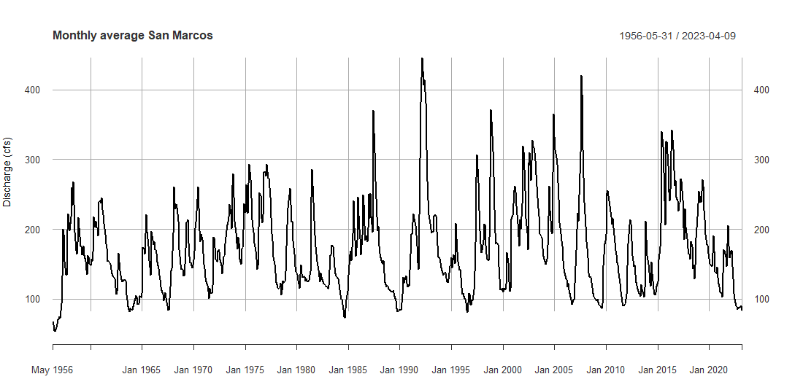
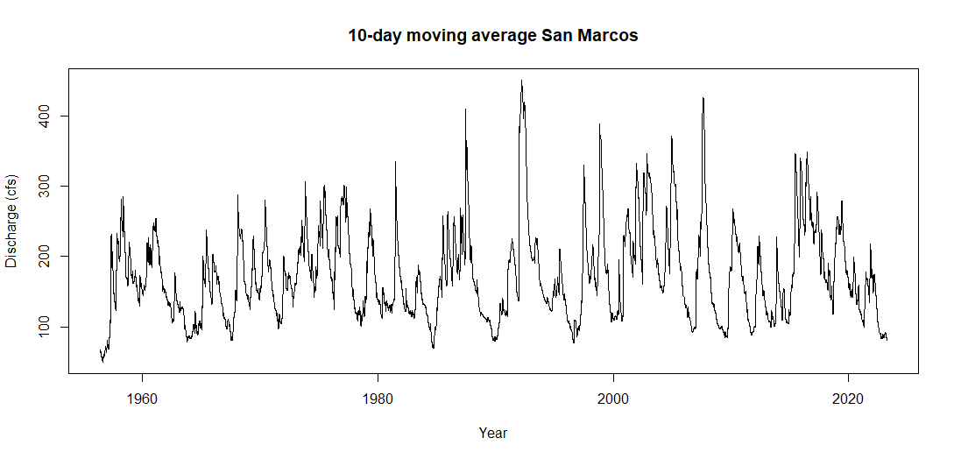
San Marcos Data Aggregate
Monthly average data
Daily data

Slide 15
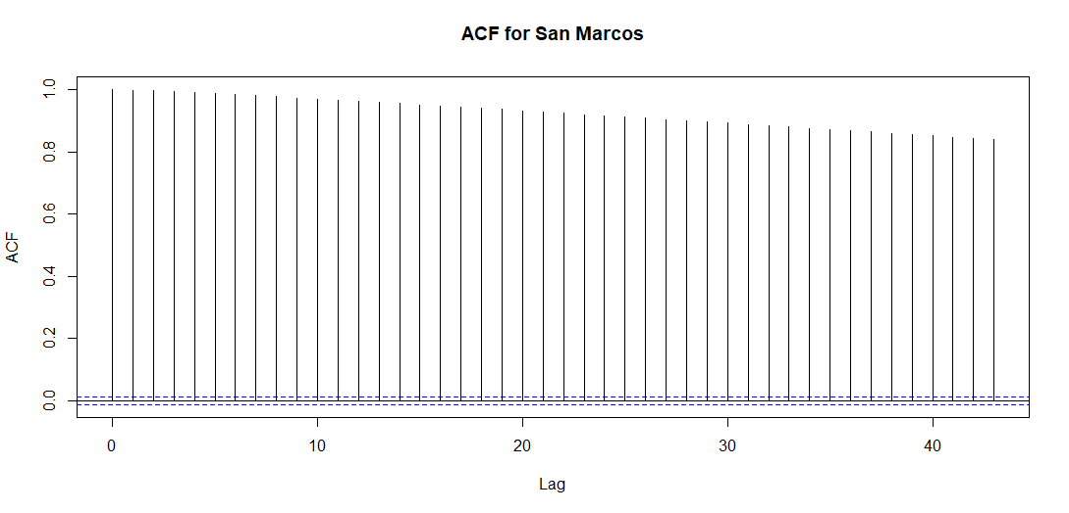

ACF and PACF for San Marcos Data

Slide 16
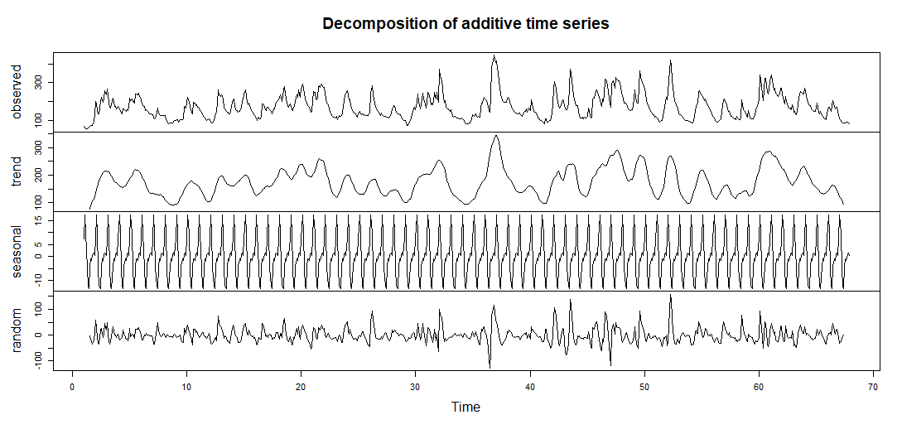
Decompose San Marcos data

Slide 17
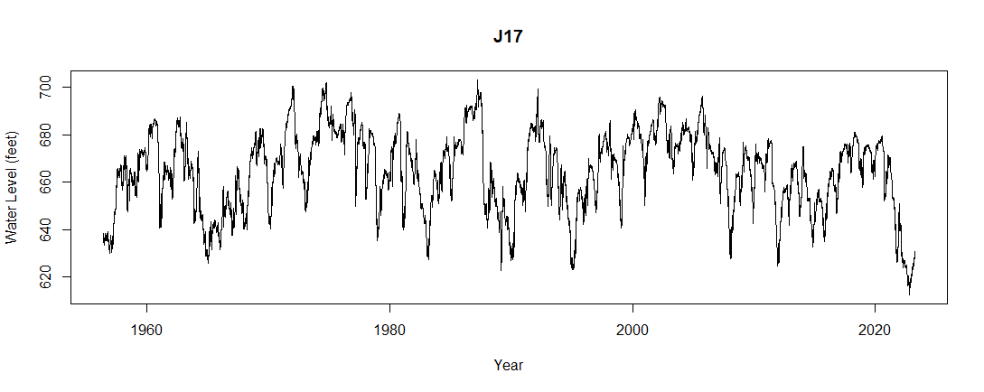
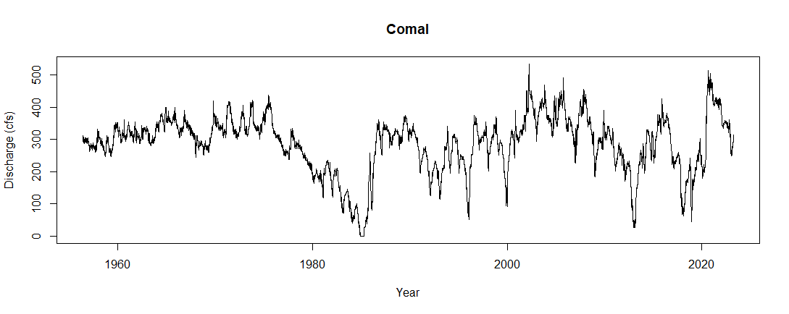
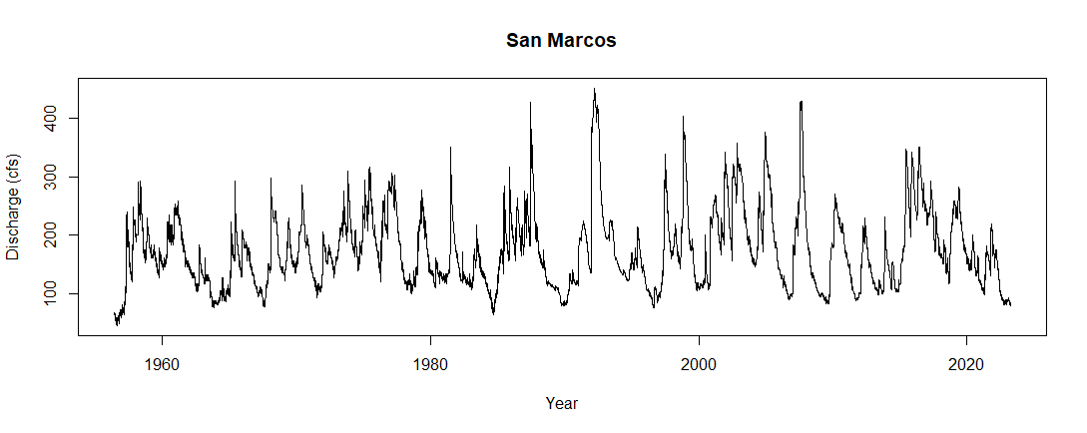
Cross Correlation Function

Slide 18
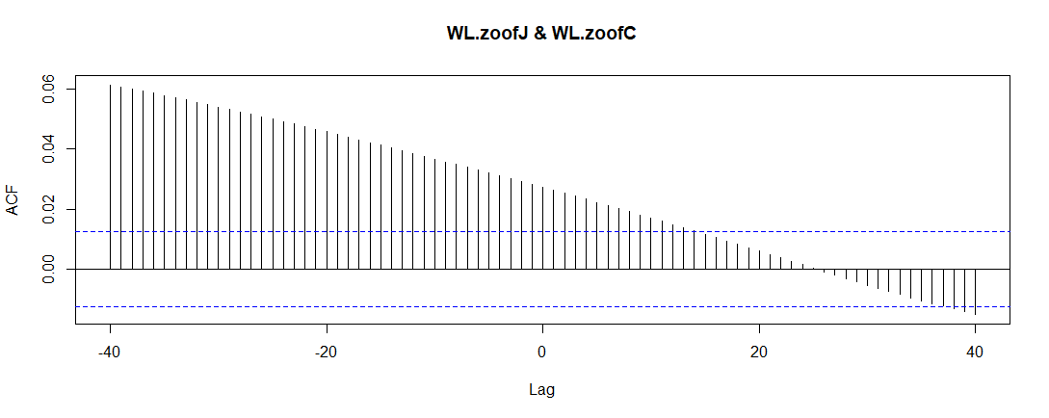

Cross Correlation Function

Slide 19
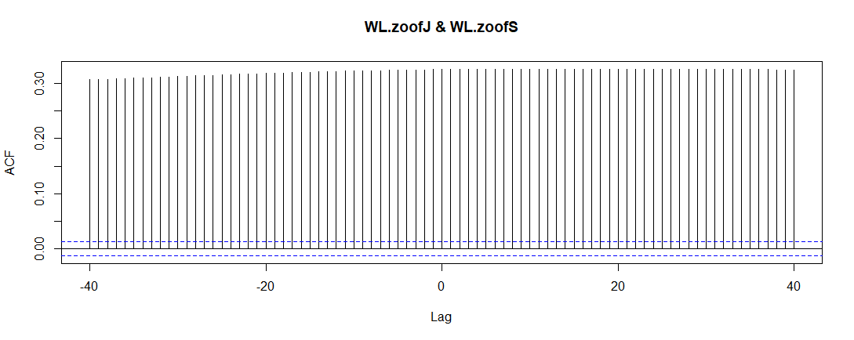
Cross Correlation Function

Slide 20
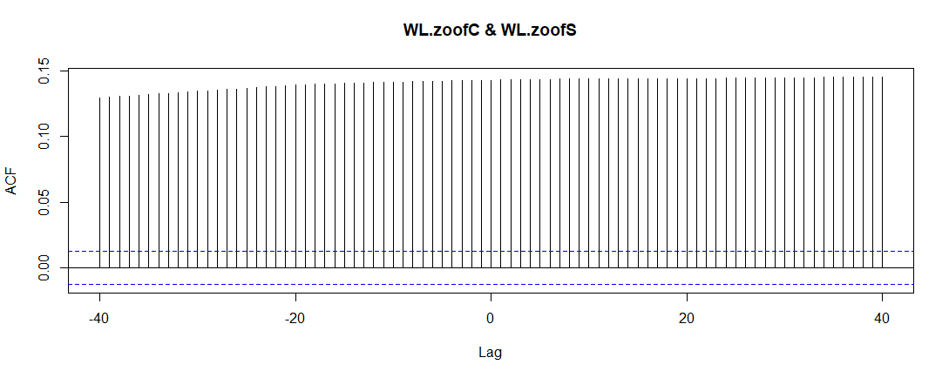
Cross Correlation Function

Slide 21
Thank you
Arip S Nur
Email address: anur@lamar.edu

